Slide 1

ChatBot to Recommend Movies
Vu Pham
Brian E Campbell

Slide 2

Agenda
Project Description
Goals
Data, cleanup, exploration
Approach
Results and Conclusion
Summary
Problems Encountered
Future Considerations

Slide 3
Project Description
Create a chatbot like application that uses OpenAI, spaCy, and Whisper to allow a user to request a recommendation for a movie based on their interests and specific movie attributes such as release year, rating, etc.

Slide 4
Goals
Question to be answered:
Given movie review datasets that includes names, length, rating, etc., can we create a chatbot that processes user requests for movie recommendations based on user requirements such as certain years (can be a range), length (can be a range), rating (can be a range), genre, etc.?
"Suggest an action movie made between 2018-2019 that has a rating of 8.0 or greater."
Using OpenAI, spaCy, and Whisper

Slide 5
Data, cleanup, exploration
Originally considered Movie Review Dataset from Kaggle.
Data was limited – rejected
Considered real-time query of IMDB
Query data and interface was limited – rejected
Settled:
Direct ChatGPT interface
Real-time query of TMDB instead of IMDB

Slide 6
Approach
Create simple but reusable code to query TMDB based on a limited set of attributes:
Genre
Minimum release date
Maximum release date
Average rating
Minimum runtime length
Maximum runtime length
Keep it simple at first
Interface with ChatGPT directly (let ChatGPT/OpenAI do ALL the work)
Replace ChatGPT with spaCy NLP to parse data and request data from TMDB
Translate audio to text and process using spaCy NLP and TMDB query.

Slide 7
Results and Conclusion
ChatGPT
Plain
Easy to do
With ConversationChain
Semi-easy but issues (more later)
spaCy NLP
Easy to parse data
Parsed data has some limitations
Querying TMDB was easy but some limitations
Whisper
Easy to use but with limitations

Slide 8
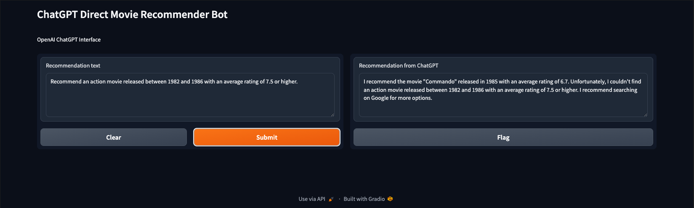
ChatGPT Direct

Slide 9
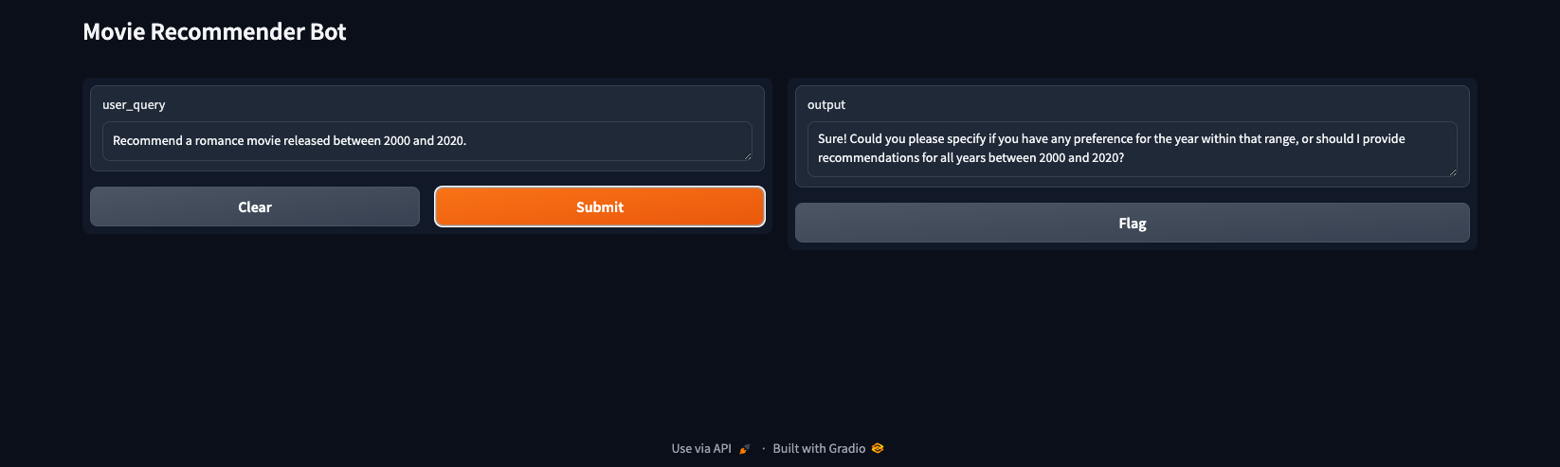
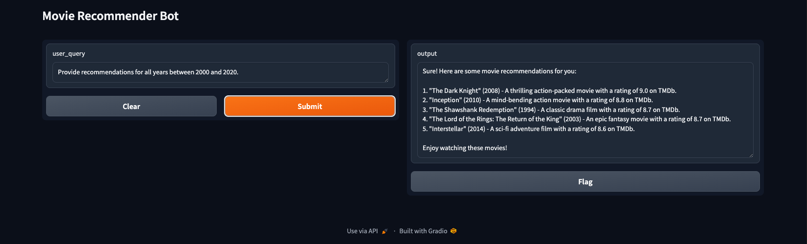
ChatGPT w/Conversation

Slide 10
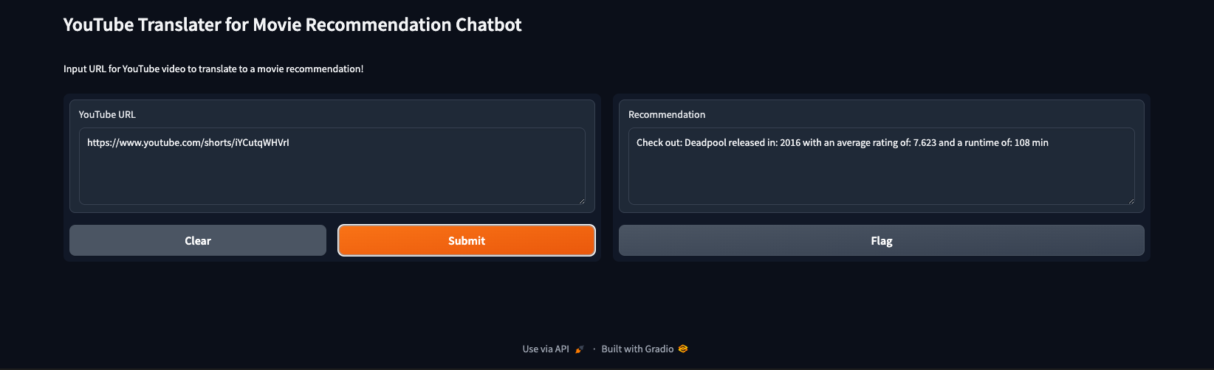
spaCy and Whisper

Slide 11
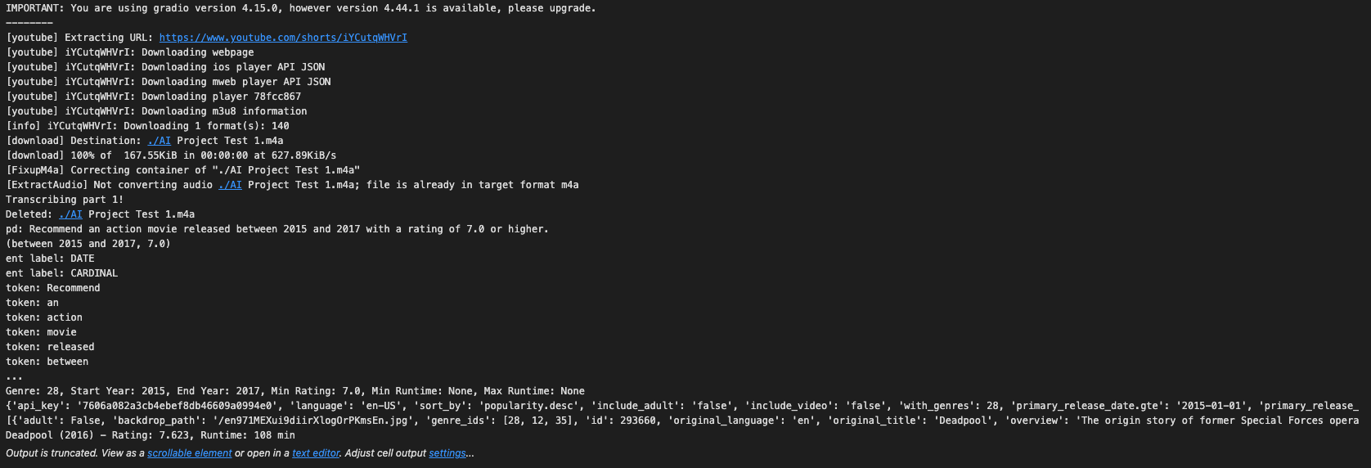
spaCy and Whisper

Slide 12
Summary
Easy to do something very basic but becomes very hard very fast once you want to get sophisticated.

Slide 13
Problems Encountered
ChatGPT
Depending upon interface used, data returned was not what we expected.
TMDB
Interface wasn’t random and too strict.
spaCy NLP
Tokens returned were too too pedantic: “sci-fi”
Required custom Tokenizer for spaCy
Entries not fully captured and returned as hoped
Required manual parsing
Whisper
Local storage of translated files caused caching problems

Slide 14
Future Considerations
Filter out bad results from ChatGPT
Possible code a “fail safe” that queries Google directly
Create custom code to generate spaCy entries that match our data requirements (e.g., movie genre)
Create interface for direct capture of audio to process with Whisper

Slide 15
Questions?

