Slide 1
Improving Users’ Experiences with Security and Privacy Tasks on Mobile Devices
Brian Mellinger
Notes:
Improving Users’ Experiences with Security and Privacy Tasks on Mobile Devices. $647.7 million lost in Q1 2024 (FTC, SmishViz)

Slide 2
About me

Slide 3
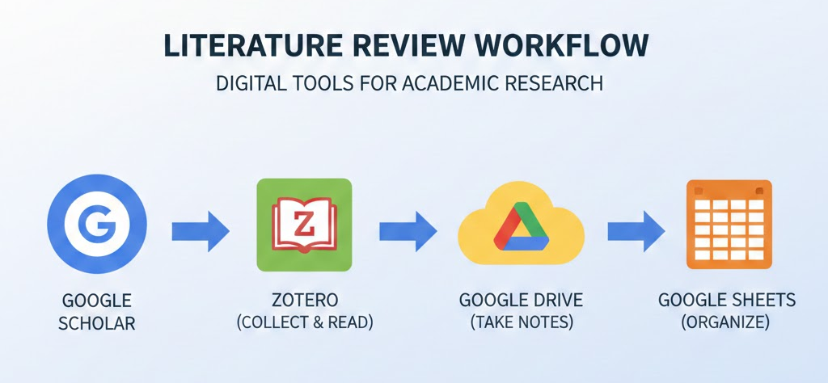
Smishing is a Usability and Security Challenge
The study
Smishing overview
Solutions
Courtesy of Gemini - “Create a graphic of google scholar, then zotero, then drive, the sheets

Slide 4
Smishing is not Random, its Coordinated and Structured
Coordinated ecosystem Threat
URLs and Shorteners (sanjari et al., 2025)
Brand impersonation (sanjari et al., 2025)
Cross channel coordination (social media, calls, emails, text) (tabassum et al.)
Japan study (saeki et al., 2022)
Circadian rhythms
Updates twice a day
Common domain registers used (godaddy)

Slide 5
Human Psychology Drives Smishing Success
Psychological manipulation
Authority impersonation (Tabassum et al.)
IRS, DHS, housing, immigration
Fear, urgency, greed used (zimba et al., 2025) (Rahman et al., 2025)
Cultural and contextual Vulnerabilities
Education migrants (Tabassum et al.)
Race (black, mexican-american) (Rahman et al., 2023)
Gender (men) (Yeboah -Boateng & amanor, 2014)
Users without cybersecurity training (Tabassum et al., 2024)
Zambia study (63% unaware) (Zimba et al., 2025)

Slide 6
Detection Alone Cannot Keep up with Evolving Smishing Campaigns
Machine learning approaches
S-Detector - Naive Bayes classifier (Joo et al., 2017)
SmiDCA - Statistical correlator and noun classifier (Sonowal & Kuppusamy, 2018)
Limitations
URL changes rapidly (Joo et al., 2017)
Mobile carrier ineffectiveness (25-35% blocked) (Commercial Anti-Smishing Tools, 2023)
Lack of reporting of smishing messages (Tabassum et al., 2024) (Faklaris, 2024)
Can be described as a cat and mouse issue.
Educational problem.

Slide 7
Effective Defense Requires Education
Focus on Education (Yeboah-Boateng & Amanor, 2014) (Njunga et al., 2022)
Issues with …
TCPA
CAN-SPAM act
TRACED act
Tradition methods are not working (Sonowal & Kuppusamy, 2018)
Blacklist
Whitelist
Carrier level blocking
Machine learning (Sanjari et al, 2025) (Seo et al., 2024)
Needs full-time professional paid help with governmental support

Slide 8
Questions?

