Slide 1



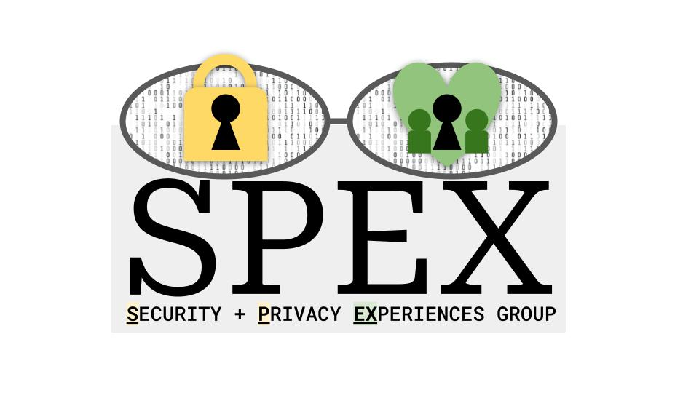
UNC Charlotte
SMiShing: A Systematic Literature Review with Suggestions for Future Research
Brian Mellinger
Notes:
Intro: Today I am going to talk to you about smishing …. spex lab + HCCRG + CCI… name is Brian Mellinger, conducted an extended systematic literature review on the topic of smishing
Does anyone know what smishing is?

Slide 2
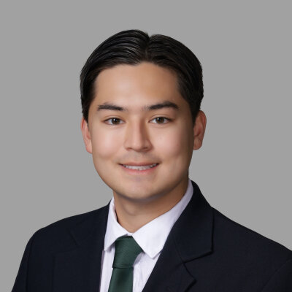
Who am I?
Undergraduate Researcher under Dr. Cori Faklaris
Education
B.S. Computer Science (2027)
M.S. Cybersecurity (2028)
US Army - Cyber Warfare Officer (2029)
My experience with cybercrime
bmelling@charlotte.edu
Introduction
Notes:
Undergraduate researcher under Dr. Cori Faklaris in the Security and Privacy Experiences Lab
Junior studying Computer Science: Cybersecurity Concentration and starting my Masters in Cybersecurity next semester (early entry program)
The time my military family was hit by a cybercrime

Slide 3
Outline
Introduction
Research
Conclusion
Notes:
Introduction: Define what smishing is, the key components of this review
Research: What researchers are saying about smishing
Conclusion: What clearly needs to happen to solve this global issue

Slide 4
What is smishing?
“… a type of social engineering attack … fake text messages are created … to obtain user credentials, install malware … click on a URL that redirects them to a phishing website, or call the provided number …”
Md Lutfor Rahman, Daniel Timko, Hamid Wali, and Ajaya Neupane. 2023. Users Really Do Respond To Smishing. In Proceedings of the Thirteenth ACM Conference on Data and Application Security and Privacy (CODASPY ’23), April 24, 2023. Association for Computing Machinery, New York, NY, USA, 49–60. https://doi.org/10.1145/3577923.3583640
Introduction

Slide 5
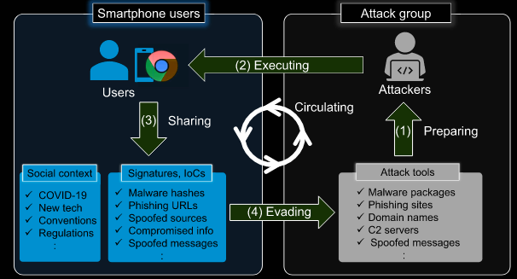
What is smishing?
Image retrieved from: Ryu Saeki, Leo Kitayama, Jun Koga, Makoto Shimizu, and Kazumasa Oida. 2022. Smishing Strategy Dynamics and Evolving Botnet Activities in Japan. IEEE Access 10, (2022), 114869–114884. https://doi.org/10.1109/ACCESS.2022.3217795
Introduction

Slide 6
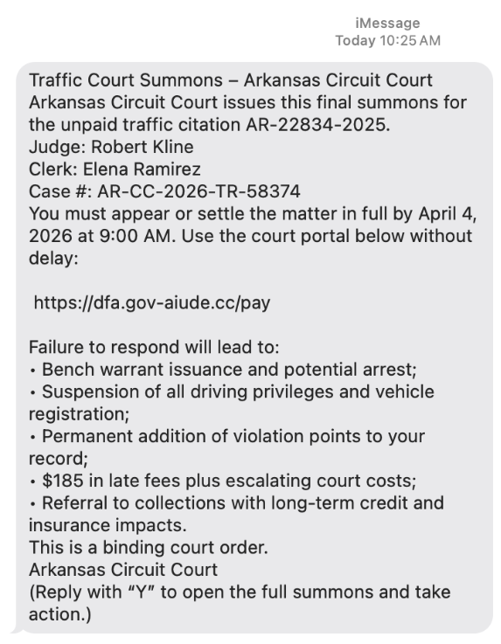
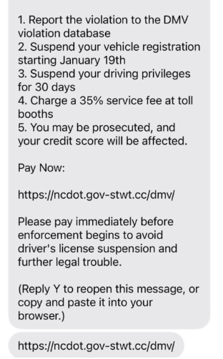
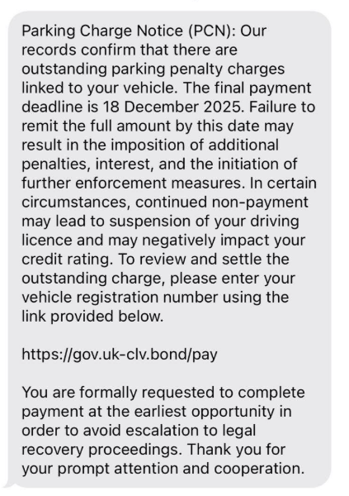
Would you click it?
@article{timko2024smishing,
title={Smishing Dataset I: Phishing SMS Dataset from Smishtank.com},
author={Timko, Daniel and Rahman, Muhammad Lutfor},
booktitle={Proceedings of the Fourteenth ACM Conference on Data and Application Security and Privacy},
pages={289--294},
year={2024}
}
Introduction
Notes:
https://smishtank.com/smish/4794 They are all listed as potential smishing messages listed by smishtank.
https://smishtank.com/smish/4723
https://smishtank.com/smish/4753

Slide 7
Key Takeaways
Major issue
$470 million lost in 2024 (FTC)
Smishing is not random, its coordinated and structured
Professional-like in practice
Human Psychology drives smishing success
Authority
Emotion
2025. New FTC Data Show Top Text Message Scams of 2024; Overall Losses to Text Scams Hit $470 Million. Federal Trade Commission. Retrieved March 24, 2026 from https://www.ftc.gov/news-events/news/press-releases/2025/04/new-ftc-data-show-top-text-message-scams-2024-overall-losses-text-scams-hit-470-million
Introduction
Notes:
FTC estimated in 2024 alone, 470 million lost to smishing

Slide 8
Research Questions
RQ1: What are the psychological and demographic factors that influence a user’s susceptibility to smishing attacks?
RQ2: How effective are technical solutions in mitigating smishing?
RQ3: What gaps exist in current smishing defenses? What interdisciplinary strategies are needed to address the smishing issue?
Research

Slide 9
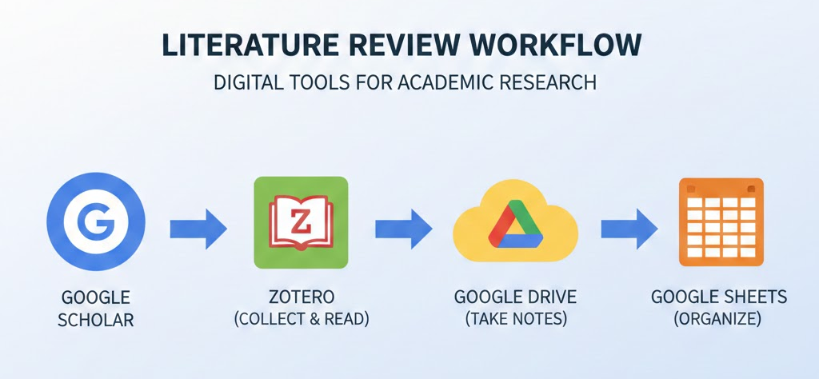
Methodology
Systematic approach
Google scholar + “SMiShing”
Zotero
Google Drive
Sheets (22 total sources)
Research
Courtesy of Gemini AI “Create a diagram of google scholar, then zotero, then google drive, and finally google sheets.”

Slide 10
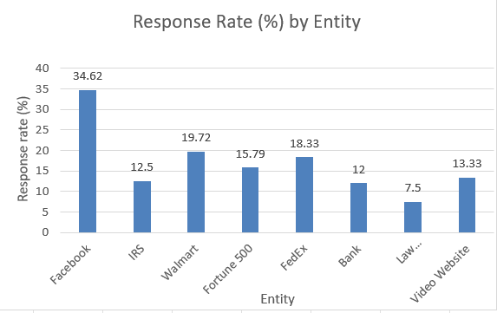
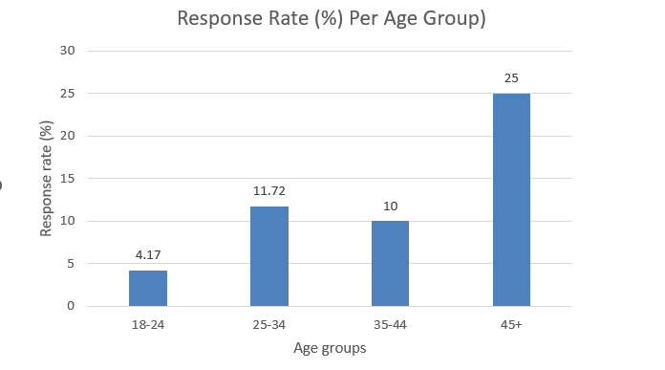
RQ1: psychological and demographic factors that influence susceptibility to smishing attacks
Charts were created by the author (Brian Mellinger)
Data from: Md Lutfor Rahman, Daniel Timko, Hamid Wali, and Ajaya Neupane. 2023. Users Really Do Respond To Smishing. In Proceedings of the Thirteenth ACM Conference on Data and Application Security and Privacy (CODASPY ’23), April 24, 2023. Association for Computing Machinery, New York, NY, USA, 49–60. https://doi.org/10.1145/3577923.3583640
Research
Notes:
265 participants

Slide 11
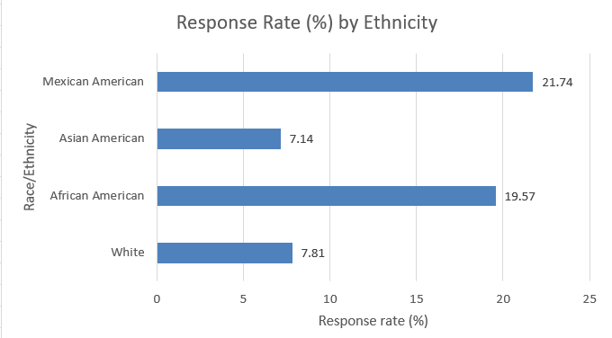
RQ1: psychological and demographic factors that influence susceptibility to smishing attacks
Authority Impersonation¹
Fear, urgency, greed²
African-American, Mexican-American³
Men⁴
Users without cybersecurity training¹
n = 23
[1]
Sarah Tabassum, Cori Faklaris, and Heather Richter Lipford. What Drives SMiShing Susceptibility? A U.S. Interview Study of How and Why Mobile Phone Users Judge Text Messages to be Real or Fake.
[2]
Md Lutfor Rahman, Daniel Timko, Hamid Wali, and Ajaya Neupane. 2023. Users Really Do Respond To Smishing. In Proceedings of the Thirteenth ACM Conference on Data and Application Security and Privacy (CODASPY ’23), April 24, 2023. Association for Computing Machinery, New York, NY, USA, 49–60. https://doi.org/10.1145/3577923.3583640
[3]
Aaron Zimba, Katongo Phiri, Chimanga Kashale, and Mwiza Phiri. 2025. Unveiling deception: a socio-economic analysis of smishing attacks on mobile money transaction users. Humanit Soc Sci Commun 12, 1 (December 2025), 1880. https://doi.org/10.1057/s41599-025-06141-8
[4]
Ezer Osei Yeboah-Boateng and Priscilla Mateko Amanor. 2014. Phishing, SMiShing & Vishing: An Assessment of Threats against Mobile Devices. 5, 4 (2014).
n = 28
n = 46
n = 128
Chart created by the author (Brian Mellinger)
Data from: Md Lutfor Rahman, Daniel Timko, Hamid Wali, and Ajaya Neupane. 2023. Users Really Do Respond To Smishing. In Proceedings of the Thirteenth ACM Conference on Data and Application Security and Privacy (CODASPY ’23), April 24, 2023. Association for Computing Machinery, New York, NY, USA, 49–60. https://doi.org/10.1145/3577923.3583640
Research

Slide 12
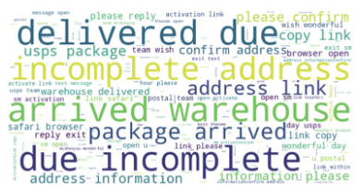
RQ2: How effective is smishing mitigation?
Machine Learning?
Cybersmish (multi-analysis)¹ → 95.5%
SmiDCA (noun classifier)² → 96.4%
Laws? (U.S.)
TCPA
CAN-SPAM
TRACED act
[1]
W. L. T. T. N. Kumarasiri, M. K. J. C. Siriwardhana, S. A. D. S. L. Suraweera, A. N. Senarathne, and S. M. B. Harshanath. 2023. Cybersmish: A Proactive Approach for Smishing Detection and Prevention using Machine Learning. In 2023 7th International Conference on I-SMAC (IoT in Social, Mobile, Analytics and Cloud) (I-SMAC), October 2023. 210–217. https://doi.org/10.1109/I-SMAC58438.2023.10290228
[2]
Gunikhan Sonowal and K S Kuppusamy. 2018. SmiDCA: An Anti-Smishing Model with Machine Learning Approach. Comput J 61, 8 (August 2018), 1143–1157. https://doi.org/10.1093/comjnl/bxy039
Image retrieved via: Seyed Mohammad Sanjari, Ashfak Md Shibli, Maraz Mia, Maanak Gupta, and Mir Mehedi Ahsan Pritom. 2025. SmishViz: Towards A Graph-based Visualization System for Monitoring and Characterizing Ongoing Smishing Threats. In Proceedings of the Fifteenth ACM Conference on Data and Application Security and Privacy (CODASPY ’25), June 04, 2025. Association for Computing Machinery, New York, NY, USA, 257–268. https://doi.org/10.1145/3714393.3726499
Research
Notes:
Cybersmish - scans Messages, URL, and website code: 95.5% accuracy
smiDCA - 96.40% accuracy
(TCPA) Telephone consumer protection act - advertisers must gain explicit consent before texting customers
CAN-SPAM - targets emails … only legitimate businesses
TRACED - helps reduce robo calls not sms texts

Slide 13
RQ3: What gaps exist in current smishing defenses?
Lack of laws specific to smishing
The machine learning issue
Lack of psychological research
Ecosystem level phishing defenses
Reporting and user support failures
Synthesized by the author’s (Brian Mellinger) working literature review “The Evolution of SMiShing: A Literature Review of Coordinated THreats, Psychological Triggers, and Multi-Domain Defense Strategies
Research
Notes:
Laws don’t relate to smishing
Machine learning requires constant support and data collection for retraining
Smishing is a psychological issue, they use strong emotion to invoke a response
Modern smishing implements multiple forms of phishing, it doesn’t always stay in text
Who even knows how to report smishing messages

Slide 14
RQ3: What gaps exist in current smishing defenses?
7726
Lack of laws specific to smishing
The machine learning issue
Lack of psychological research
Ecosystem level phishing defenses
Reporting and user support failures
Synthesized by the author’s (Brian Mellinger) working literature review “The Evolution of SMiShing: A Literature Review of Coordinated THreats, Psychological Triggers, and Multi-Domain Defense Strategies
Research
Notes:
Laws don’t relate to smishing
Machine learning requires constant support and data collection for retraining
Smishing is a psychological issue, they use strong emotion to invoke a response
Modern smishing implements multiple forms of phishing, it doesn’t always stay in text
Who even knows how to report smishing messages

Slide 15
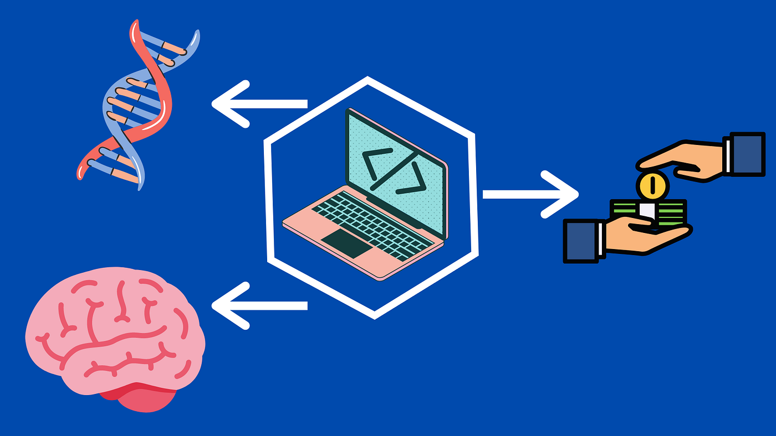
Discussion/Key Takeaways
Smishing campaigns
organized/professional
Not opportunistic or rudimentary
Current understanding
Human behavior is the weapon
Reframing the issue
The new approach
Machine learning success
Limitations and environment testing
Image via: https://afwh12.medium.com/are-computer-science-and-psychology-substantially-connected-8a7814477bea
Conclusion
Notes:
important to remember that smishing isnt rudimentary, its an organized cybercrime network that uses human behavior as its primary weapon and we have to reshape how we think about this issue. Machine learning approaches show promise but need fulltime support and have only been tested in enclosed environments

Slide 16
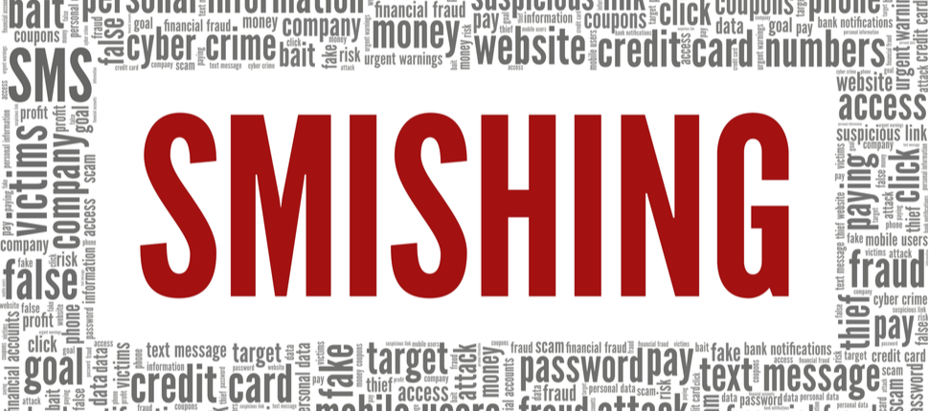
Future Research
Reformed understanding of smishing
Psychological issue
mass cybercrime enterprise
Interdisciplinary research
Psychology/education researchers
Combined research
long standing studies
collection of smishing messages
lasting machine learning solution
Image via: https://home.sophos.com/en-us/security-news/2021/smishing
Conclusion

Slide 17
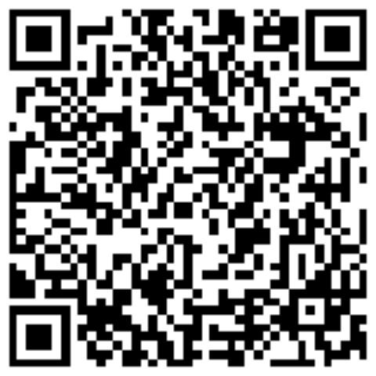
Conclusion
Smishing is a $470 million dollar issue
Smishing is a professional business
Smishing cannot be solved with stand-alone research
Brian Mellinger
bmelling@charlotte.edu
Conclusion

