Slide 1
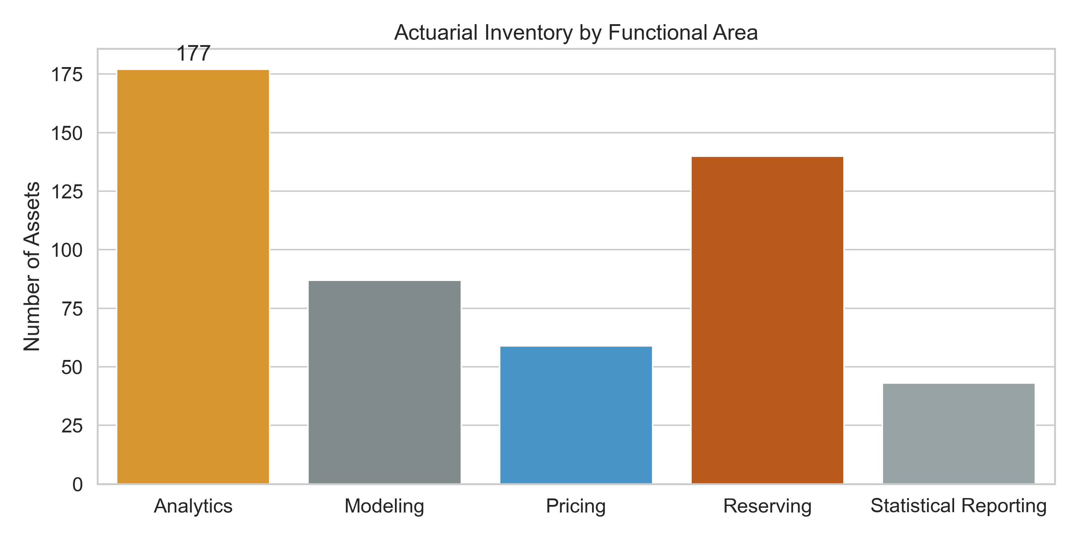

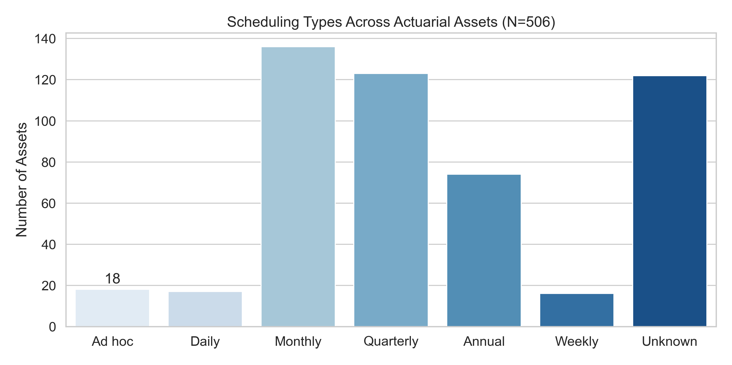
Actuarial Inventory Overview
Note: 'Unknown' cadence (122) indicates metadata gaps to close via catalog/governance.

