Slide 1

COS 301
Group 15 (Merlot Team) Mock demonstration for the
One Time Pin (OTP) Subsystem
Basic formatting has been done, would consult to make sure contents is agreed on by everyone
presentation by Group 15 – OTP (Merlot Team)

Slide 2
Meet the Team
As part of phase 3 of the COS 301 Mini-Project involving the design of a new generation ATM, these will be your members of group 15, part of the Merlot team. We were tasked with designing the OTP subsystem that would be interacting with the authentication, notification and ATM subsystems.
Meet the team
Project Management
Git Structure
Testing Functions
presentation by Group 15 – OTP (Merlot Team)

Slide 3

Brian Ndung’u (15322913)
Integration Lead
Theoveshen Naidu (16148861)
Project Manager
Tlou Lebelo (15209190)
Software Testing Lead
Dylan Schiwikkard (16120206)
Software Testing and Documentation
Alessio Rossi (14137934)
Documentation Lead
Meet the team
Project Management
Git Structure
Testing Functions
presentation by Group 15 – OTP (Merlot Team)

Slide 4
Our Vision & Mission
Our vision is to create a working One Time Pin (OTP) subsystem
that Users will be able to use as a second measure of security
within the new generation ATM. The system we have in place
should be able to securely generate a OTP for a specific client,
verify the input of the OTP matches input from the user, and
return the status back to the Authentication subsystem.
Meet the team
Project Management
Git Structure
Testing Functions
presentation by Group 15 – OTP (Merlot Team)

Slide 5


Project Management
We have decided to use the management tool Zenhub
in order to maintain a sense of organization through our project.
Zenhub - Links to our ZenHub home workspace.
The reason we have chosen this specific tool is because:
More accurate metrics in terms of tracking changes and updates
Using a centralized approach to help focus on the product rather
than the process
Assists in keeping up with schedules and helps allocate tasks amongst
the team members
Due to ZenHub being a sub-program of GitHub, we felt it would beneficial
to keep the collaboration in house
Meet the team
Project Management
Git Structure
Testing Functions
presentation by Group 15 – OTP (Merlot Team)

Slide 6

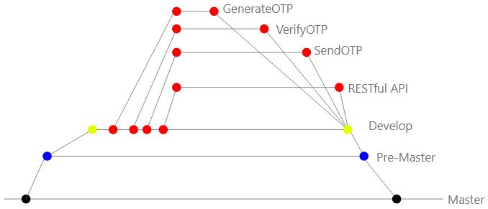
Git Structure
We had decided that there would be a total of 5 mock functions to implement. We had divided these equally to be able to set up the relevant
Git Hub
The following link will take you to our Git repository to show the layout in terms of branches we have assigned as well as the functions we have developed for the OTP generation.
Meet the team
Project Management
Git Structure
Testing Functions

Slide 7
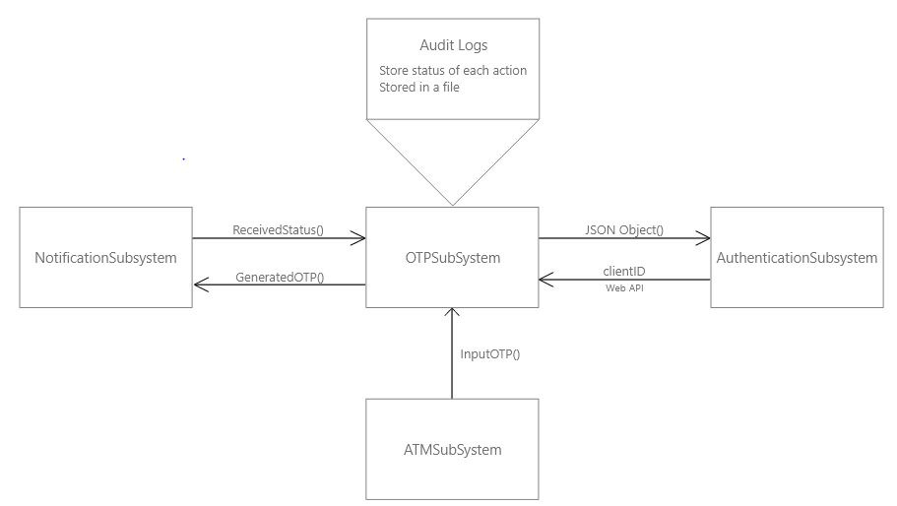
Use cases
We used the following cases to test our implementation and flow
Of the mock functions we had developed.
We identify the following use cases to play a role within our subsystem:
Ideal simulation
Notification exceptions (OTP submission time out, server side issues)
ATM timeouts (where the OTP has not been filled in within the allocated timeframe)
Incorrect OTP entered
Meet the team
Project Management
Git Structure
Testing Functions

Slide 8
Use cases – Ideal Simulation
Ideal Simulation case
Receive a ClientID from the Authentication Subsystem for generation of an OTP
Generate OTP for the specific clientID
Send the generated OTP to the Notification module and receive a successful status message back
Wait on input from the ATM subsystem
Verify the input from the ATM subsystem matches the generated OTP
On a successful verification, prepare a JSON object containing the clientID, status (successful) and a statusMessage (successful)
Meet the team
Project Management
Git Structure
Testing Functions
presentation by Group 15 – OTP (Merlot Team)

Slide 9
Use cases – Incorrect OTP Input
Incorrect input case
Receive a ClientID from the Authentication Subsystem for generation of an OTP
Generate OTP for the specific clientID
Send the generated OTP to the Notification module and receive a successful status message back
Wait on input from the ATM subsystem
During verification of the input against the generated OTP, if there is a mismatch between the two pins, an exception is thrown
The user will have three attempts in total to input the correct OTP
The OTP subsystem will wait on a reissue on the same ClientID from the Authentication subsystem
Meet the team
Project Management
Git Structure
Testing Functions
presentation by Group 15 – OTP (Merlot Team)

Slide 10
Use cases – Notification Exceptions
Notification Exception cases
Receive a ClientID from the Authentication Subsystem for generation of an OTP
Generate OTP for the specific clientID
Send generated OTP to the Notification subsystem to allow them to distribute it to the relevant client
Notification subsystem makes an exception returning an error message and an unsuccessful response to the OTP subsystem
OTP subsystem will regenerate a new OTP for the failed clientID and attempt to send the OTP to the Notification subsystem
Meet the team
Project Management
Git Structure
Testing Functions
presentation by Group 15 – OTP (Merlot Team)

Slide 11
Use cases – ATM Exception
ATM Exception cases
Receive a ClientID from the Authentication Subsystem for generation of an OTP
Generate OTP for the specific clientID
Send the generated OTP to the Notification module and receive a successful status message back
Wait on input from the ATM subsystem
While waiting on the input from the ATM, the OTP code expires as a time limit has been exceeded since the generation of the code
The user will be prompted if they would like a new OTP generated and the generation begins again
Meet the team
Project Management
Git Structure
Testing Functions
presentation by Group 15 – OTP (Merlot Team)

Slide 12
References
User by Wilson Joseph from the Noun Project (Home page Icon)
Team by AFY Studio from the Noun Project (Team icon)
Team members by Vectors Market from the Noun Project (Team member Icon)
Help.zenhub.com. (2019). Using Epics in ZenHub for projects and user stories. [online] Available at: https://help.zenhub.com/support/solutions/articles/43000010341-an-intro-to-zenhub-epics [Accessed 14 Mar. 2019].
Coursera. (2019). 4.3.2 – Designing a REST Service - REST Architecture for SOA | Coursera. [online] Available at: https://www.coursera.org/lecture/service-oriented-architecture/4-3-2-designing-a-rest-service-BoW2Y [Accessed 15 Mar. 2019].
Meet the team
Project Management
Git Structure
Testing Functions
presentation by Group 15 – OTP (Merlot Team)

