Slide 1

Study Buddy
INFO 6150 FINAL PROJECT
Brian Patrao
Vishal Desai
Shruthi Venkatesh
Divya Prajapati

Slide 2
PURPOSE
Doubts is the most important part when student is studying, Study Buddy helps to connect with other students from same course.
Students can discuss doubts with teachers, other students and also helps in keeping notes.

Slide 3
Techstack
Api
Node
Fetch
Axios
Database
MongoDB
Others
React
JWT Tokens
Dotenv
Particles
md5 sha1 (for encryption)

Slide 4
Contribution
Brian Patrao : Sign-in/Registration, User Authentication, Tying components
Vishal Desai : Home Page, Notes
Shruthi Venkatesh : Discussion, Courses
Divya Prajapati : Domain Model, EmptyState, modal styles

Slide 5
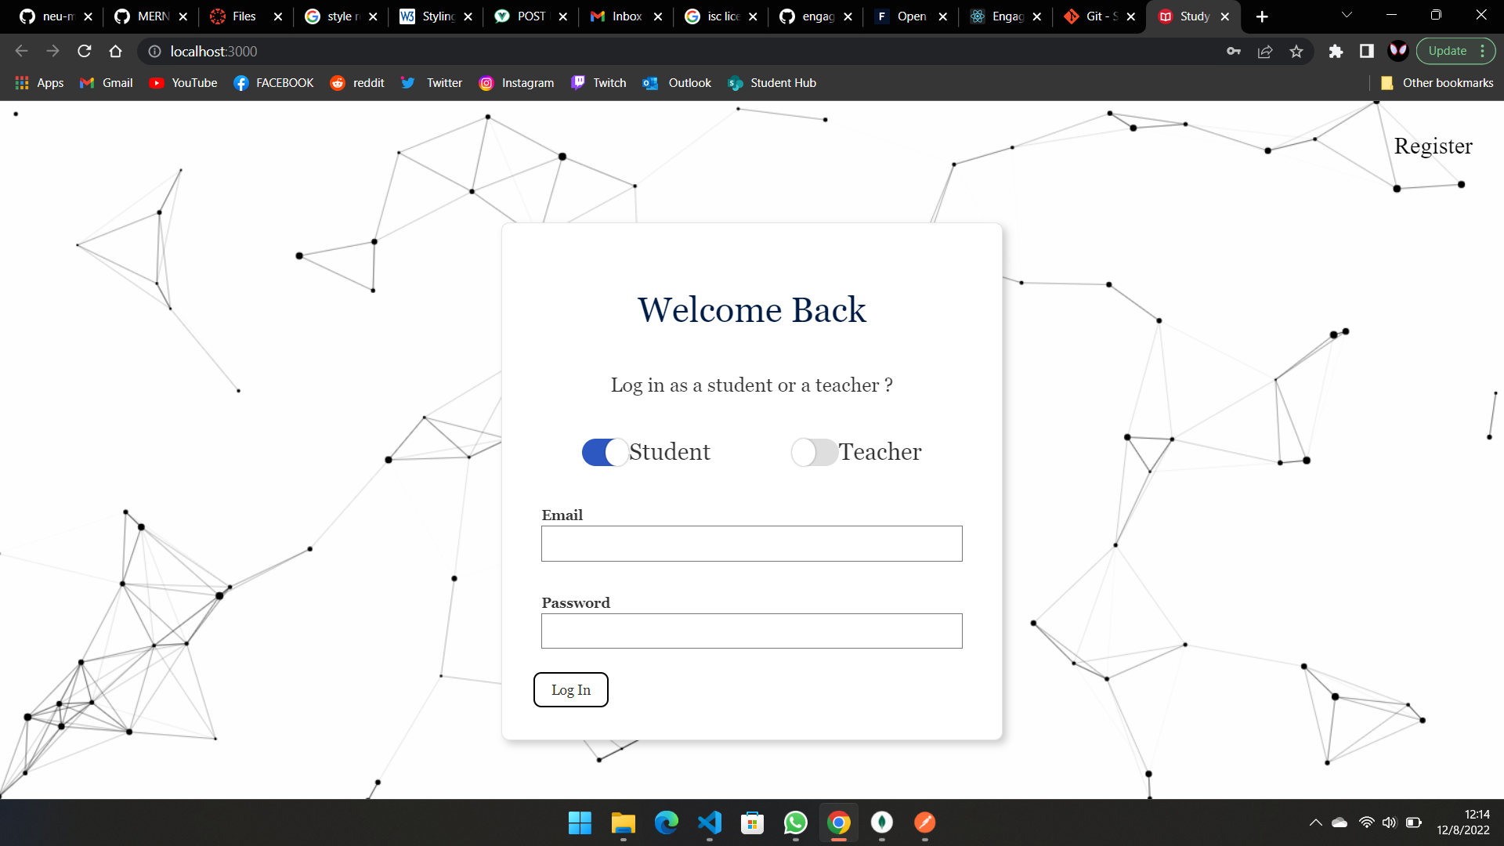

Slide 6
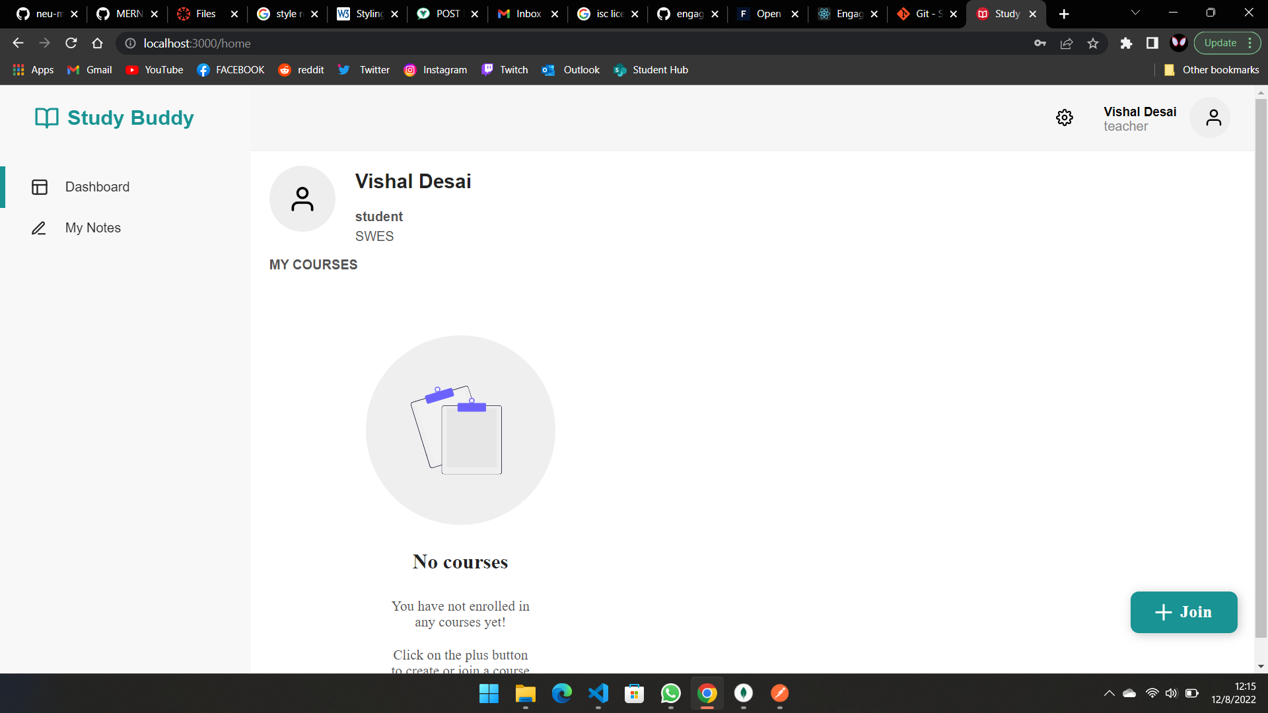

Slide 7
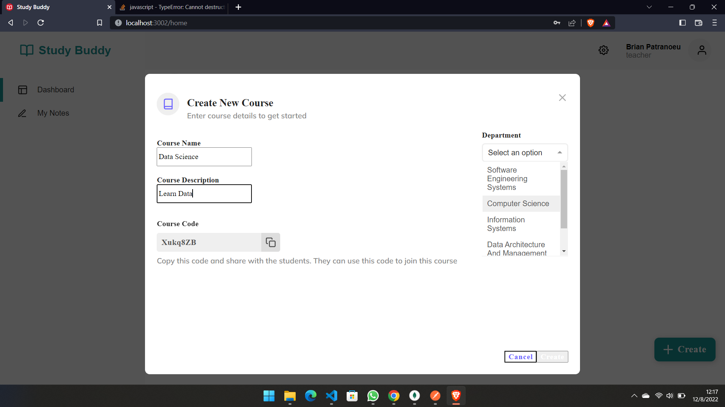

Slide 8
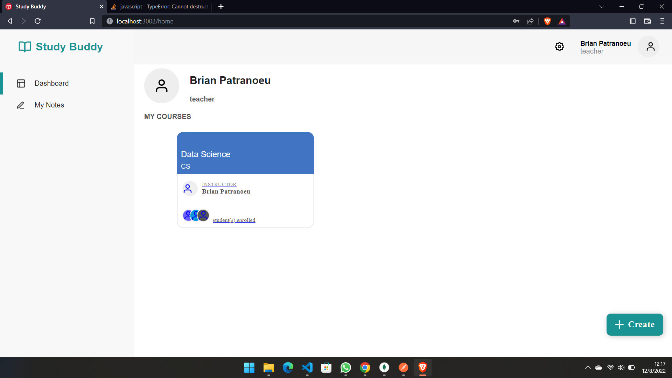

Slide 9
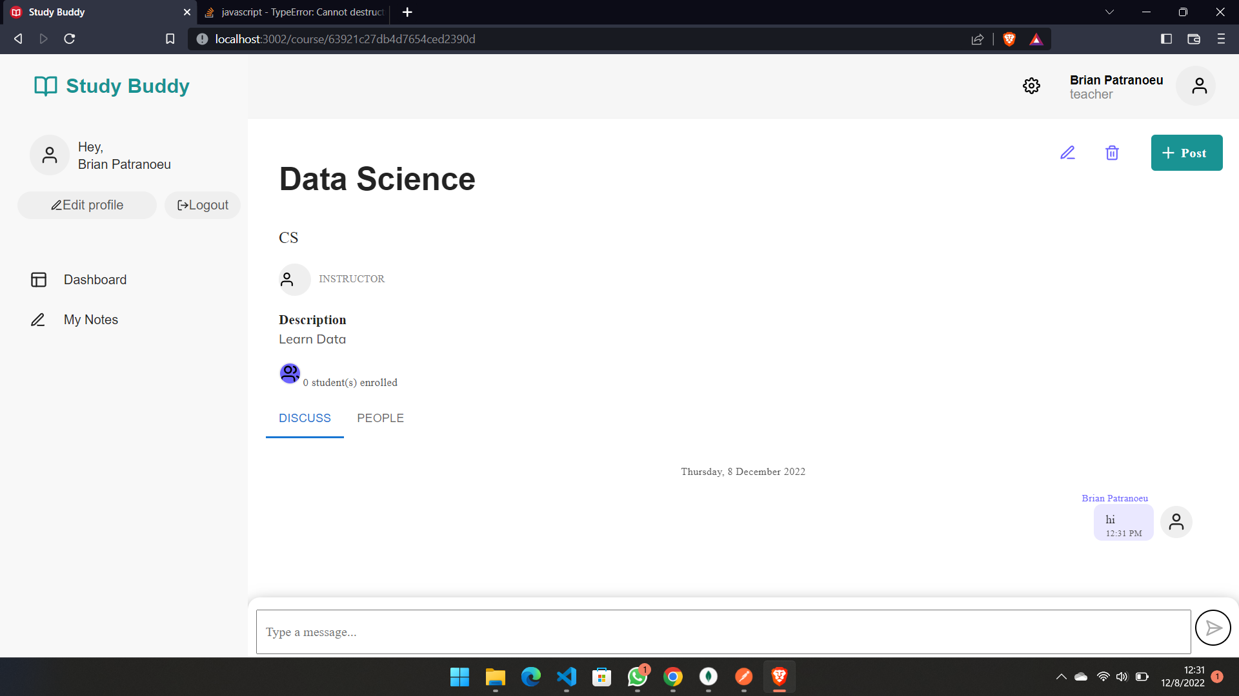

Slide 10
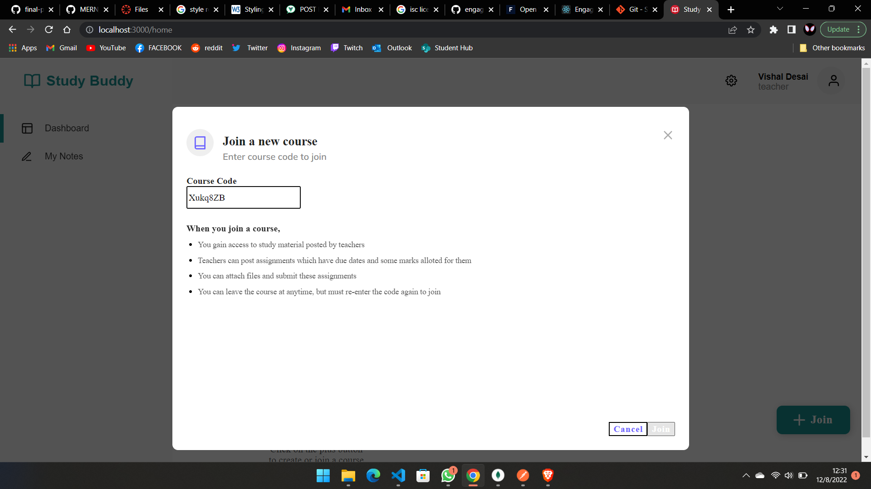

Slide 11
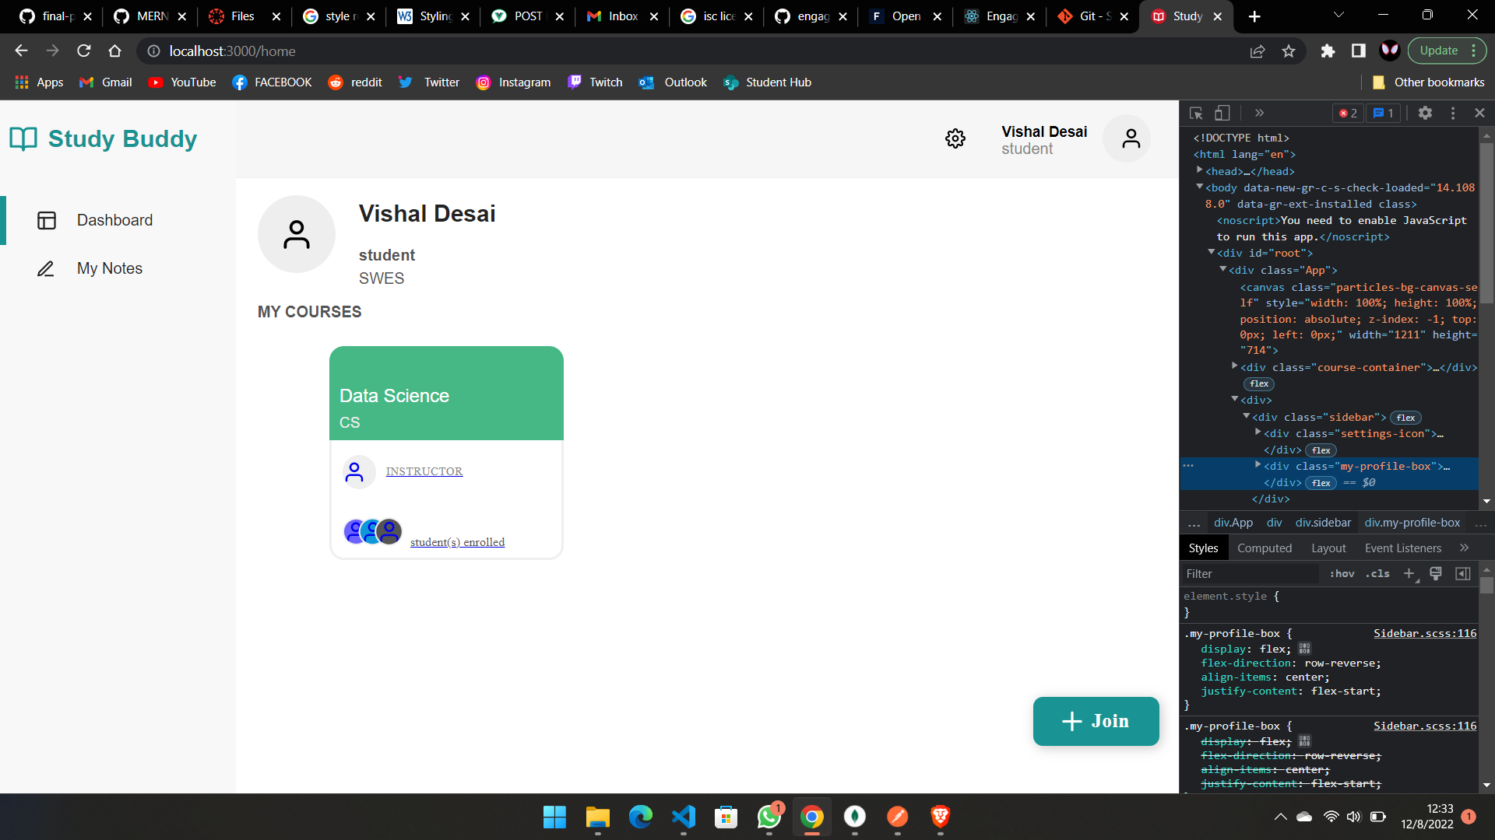

Slide 12
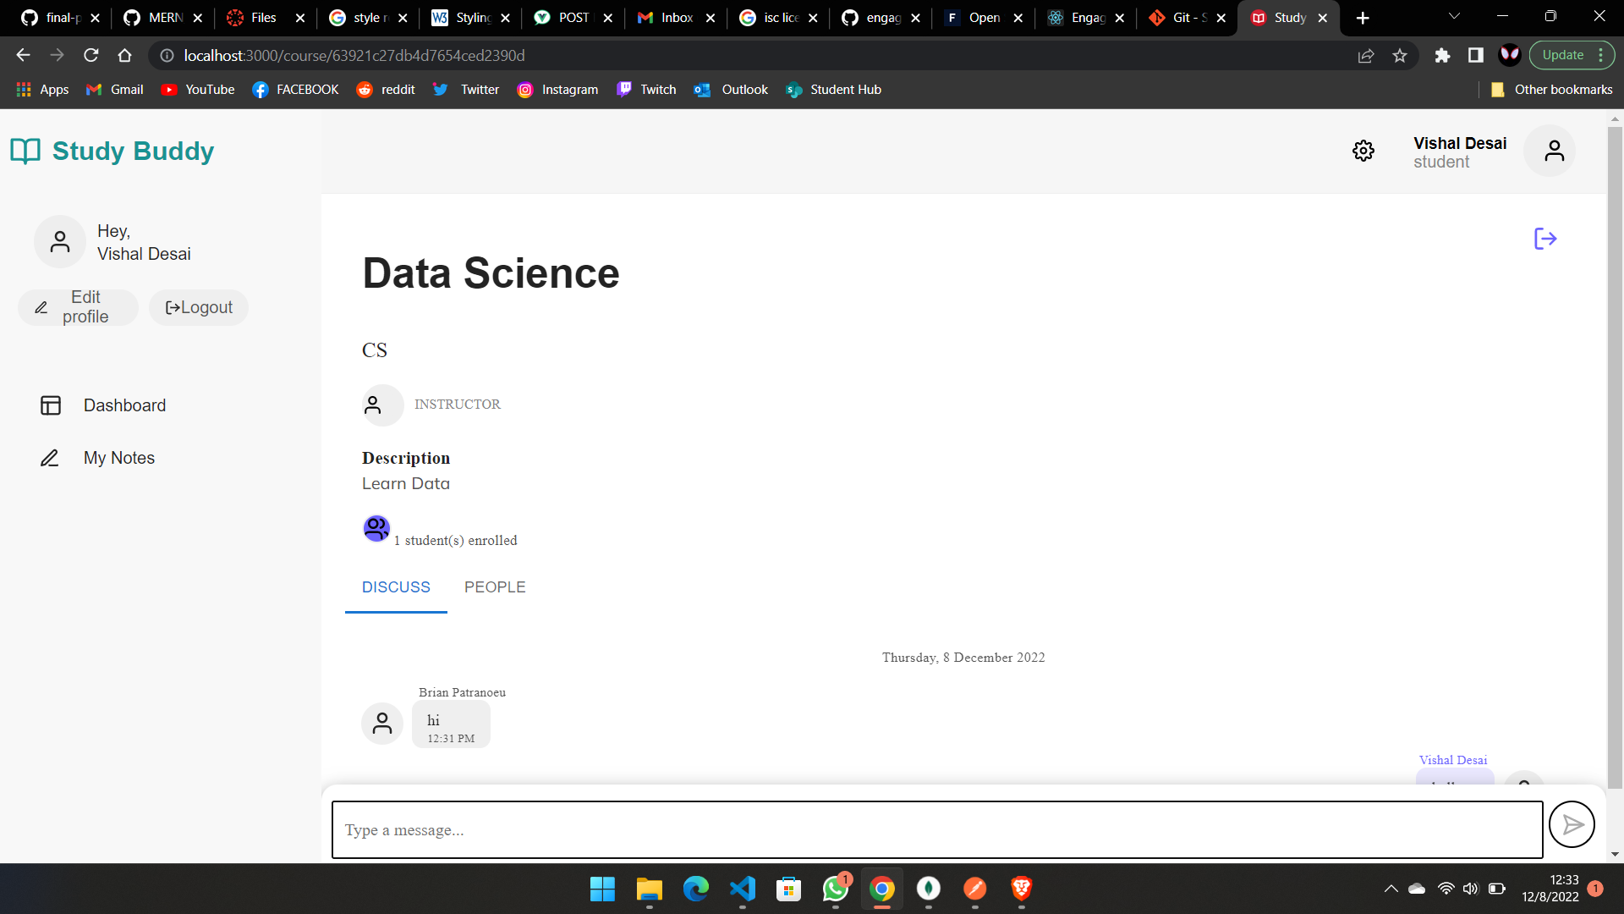

Slide 13
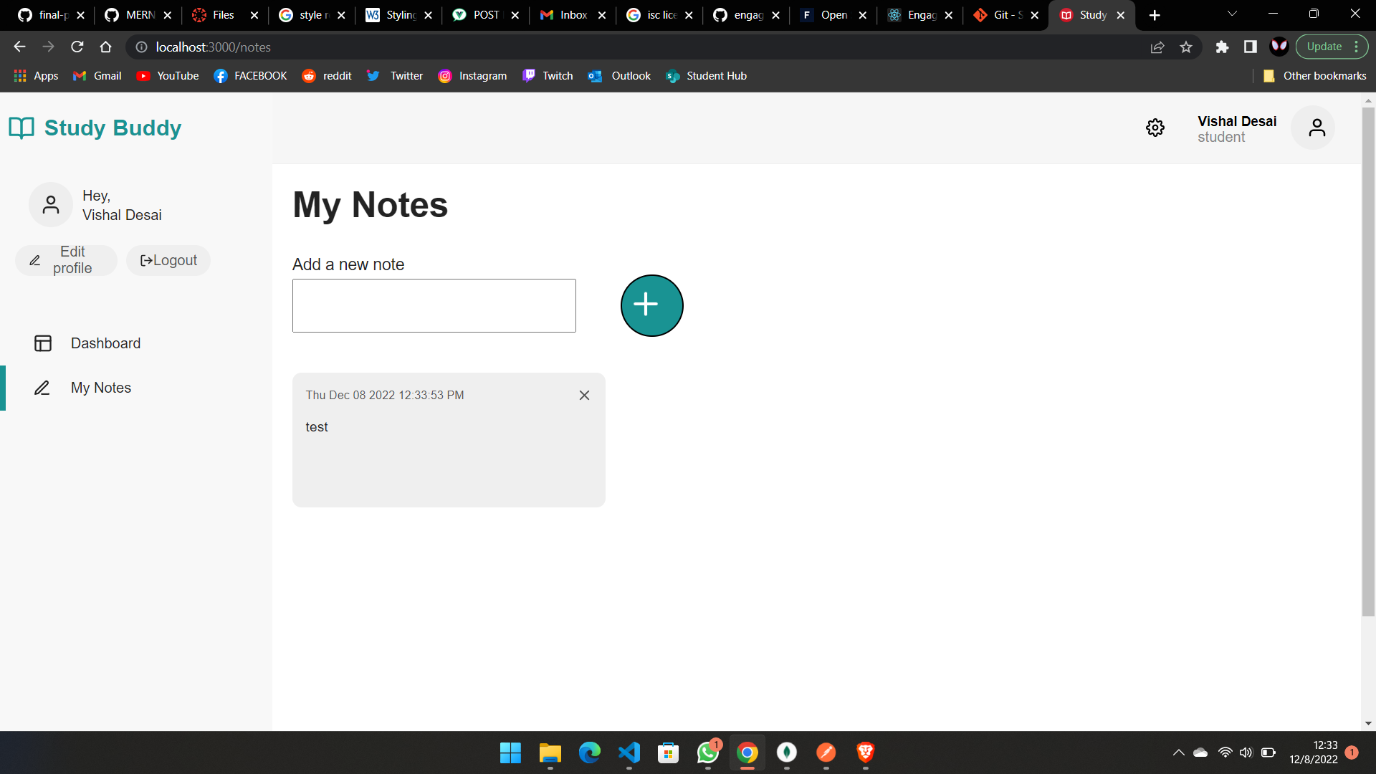

Slide 14
Reference
https://itnext.io/authentication-in-mern-stack-using-jwt-25c966027f77
https://rapidapi.com/guides/fetch-api
https://quizlet.com/latest
https://tachyons.io/
https://zerotomastery.io/courses/coding-bootcamp/
https://www.youtube.com/

Slide 15
Thank You

