Slide 1
Jumanji: The Case for Dynamic NUCA in the Datacenter
Brian C. Schwedock, Nathan Beckmann
MICRO 2020

Slide 2


Datacenters care about security and tail latency
Security: data and performance protection among untrusted users (e.g., VMs)
Tail latency: execution time of slowest application requests
Computer systems must be redesigned to efficiently enforce these goals!
Meltdown
Spectre
Tail latency
Back-end requests
Front-end query

Slide 3
Prior D-NUCAs do not work for datacenter applications!
Core
Core
LLC bank
LLC bank
Thread
Thread
D-NUCAs improve energy efficiency > 50%!
Problem: After 20 years of research, all D-NUCAs care only about data movement, making them unreliable for datacenter apps
8-core chip multiprocessor (CMP)
Dynamic NUCA (D-NUCA)
Static NUCA (S-NUCA)
Jumanji is a new D-NUCA that improves security, tail latency, and energy efficiency!

Slide 4

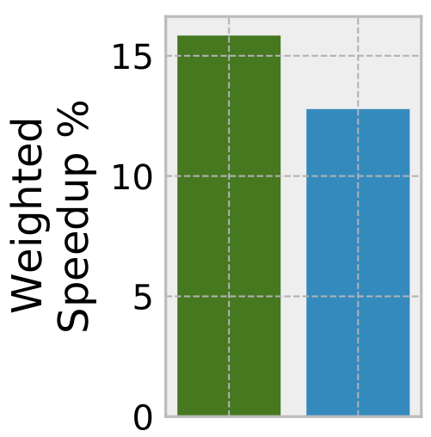
High-level overview of Jumanji
Batch
Lat-crit
Lat-crit
Lat-crit
Jumanji: places apps’ data in the LLC to meet apps’ high-level goals
VM 1
VM 2
Reserves space to meet tail-latency deadlines
VM 3
1
VM 4
Isolates VMs across banks to defend against LLC attacks
2
Lat-crit
Lat-crit
20-core CMP
Optimizes batch data placement within each VM
3

Slide 5
Agenda
Motivation
Security
Tail latency
Prior D-NUCAs
Jumanji’s design
Evaluation
Conclusion

Slide 6
LLC has a big impact on security and tail latency
Data movement within the LLC exposes side-channel attacks and determines tail latencies
Many recently discovered side channels occur at the LLC [1]
Larger LLC allocations greatly reduce tail latency [2,3,4]
These works ignore NUCA, and by doing so, miss additional security vulnerabilities and harm efficiency
Network-on-chip
(NoC) latency
LLC banks
Thread
LLC banks
20-core CMP
w/ NUCA
20-core CMP
w/ NUCA
[1] Liu et al., LLC Side-Channel Attacks, S&P 2015
[2] Chen et al., PARTIES, ASPLOS 2019
[3] Kasture et al., Ubik, ASPLOS 2014
[4] Lo et al., Heracles, ISCA 2015

Slide 7
Prior work
Security: sharing LLC banks is unsafe
Security: sharing LLC banks is unsafe
Tail latency: ignoring NUCA wastes cache space
D-NUCA: ignoring application goals is harmful

Slide 8
Prior LLC designs are insecure and inefficient
Prior LLC designs focus on defending conflict attacks (e.g., prime + probe); way-partitioning is the most common defense
Insecure: Limited LLC associativity prevents defending all processes
Insecure: We demonstrate new port and replacement-policy attacks on prior designs
Wasteful: Ignoring NUCA ➔ lots of unnecessary data movement
Cache controller
Imperfect performance
isolation
Shared cache ports
3
2
Shared cache
contents
1
20-core CMP

Slide 9
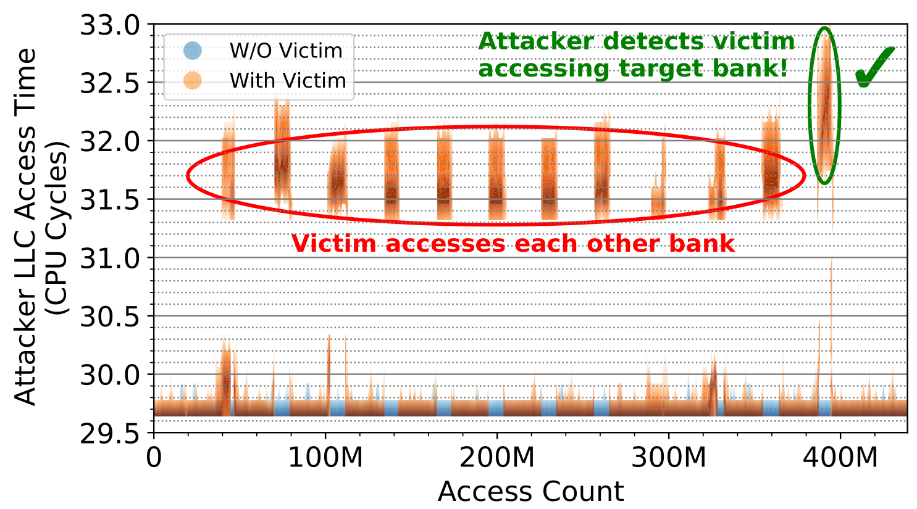
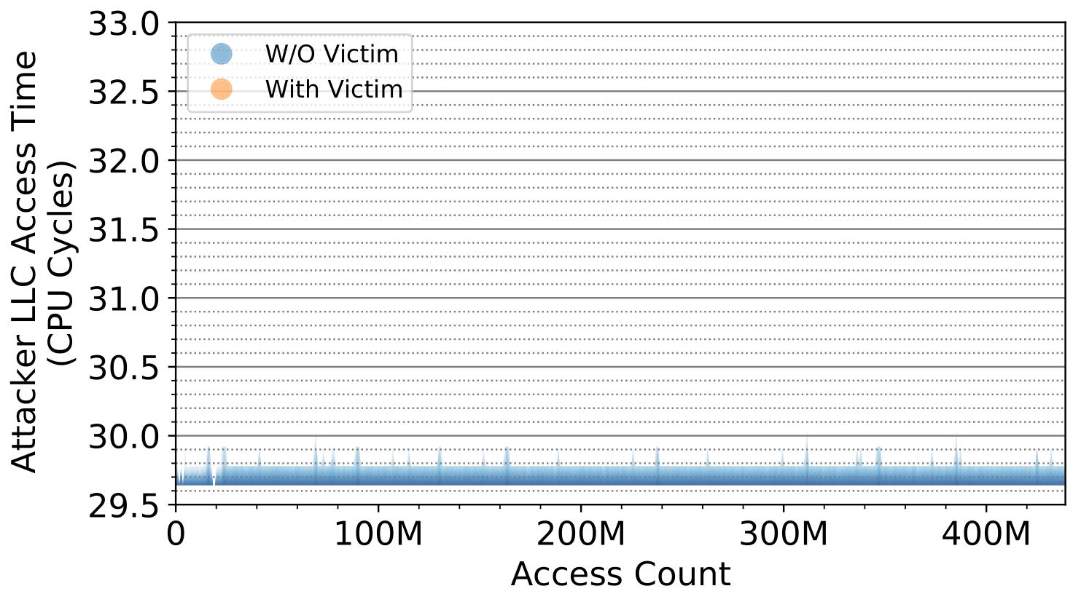
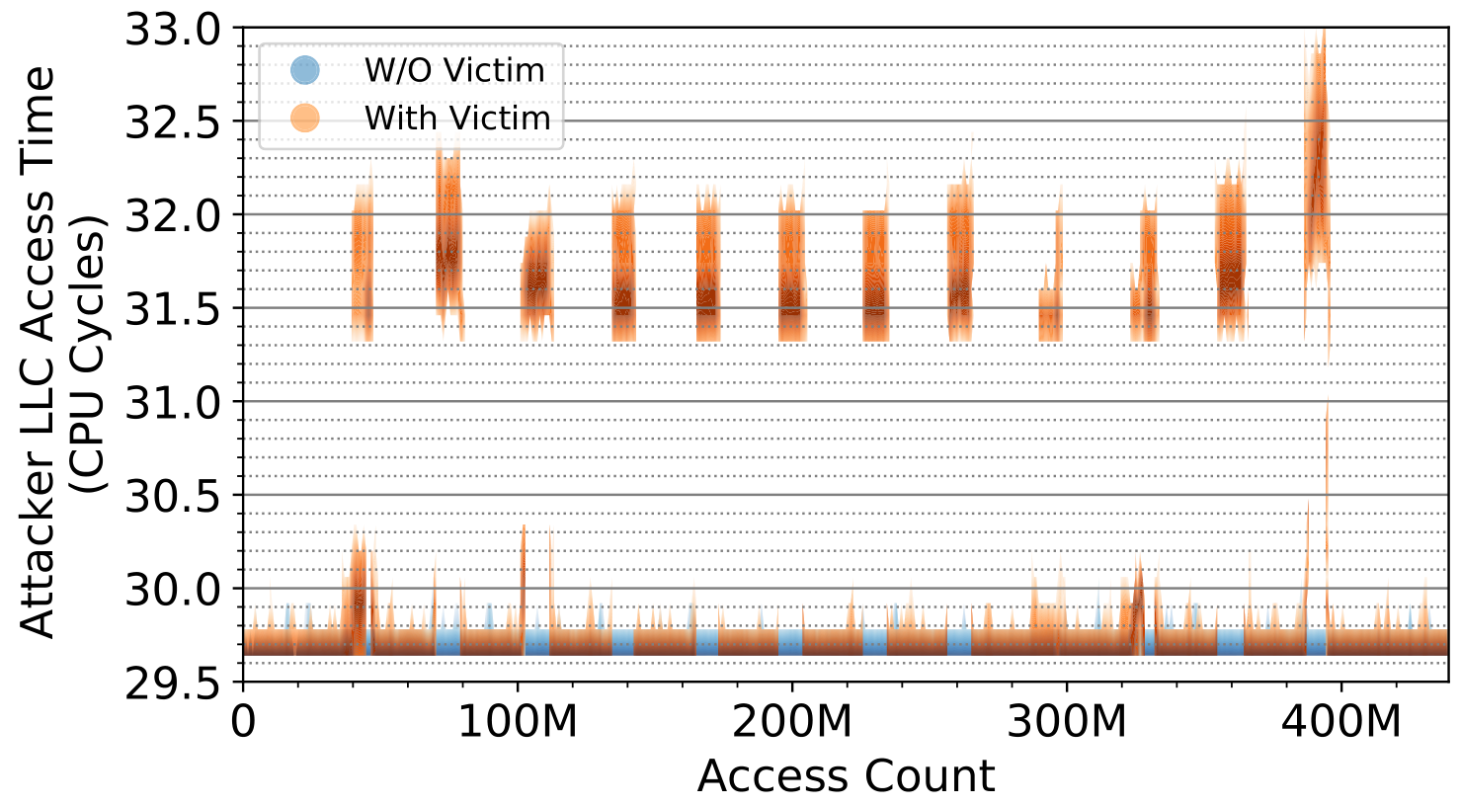
Demonstration: Sharing LLC banks is unsafe
Cache controller
Imperfect performance
isolation
Shared cache ports
3
2
Shared cache
contents
1
Port attack on Xeon processor LLC

Slide 10
Only prior LLC defense: IRONHIDE
IRONHIDE is the only prior solution which defends all LLC attacks
It isolates applications across LLC banks, creating two regions: secure and insecure
Although it also defends non-LLC attacks, it only supports one secure region at a time
Additionally, IRONHIDE does not address tail latency and does not minimize data movement as well as D-NUCAs
Secure
Insecure
20-core CMP
Omar et al., IRONHIDE, HPCA 2020

Slide 11
Prior work
Security: sharing LLC banks is unsafe
Tail latency: ignoring NUCA wastes cache space
Tail latency: ignoring NUCA wastes cache space
D-NUCA: ignoring application goals is harmful

Slide 12
Prior LLC designs for tail latency are inefficient
Prior LLC designs for tail latency dynamically allocate cache space, but ignore NUCA
Wasteful: Ignoring NUCA ➔ lots of unnecessary data movement for latency-critical applications
Wasteful: Latency-critical applications thus need more cache space to meet deadlines, harming co-running batch applications
(And are still insecure)
Latency-critical
application
Batch
application
20-core CMP

Slide 13
Prior LLC designs for tail latency are inefficient
With S-NUCA, LLC accesses have high latency!
Latency-critical
application
Batch
application
Placing data closer lowers avg access latency…
Which leaves more space for co-running batch applications to improve throughput
… so less space is needed to maintain tail latency
D-NUCA meets tail-latency deadlines much more efficiently!
20-core CMP

Slide 14
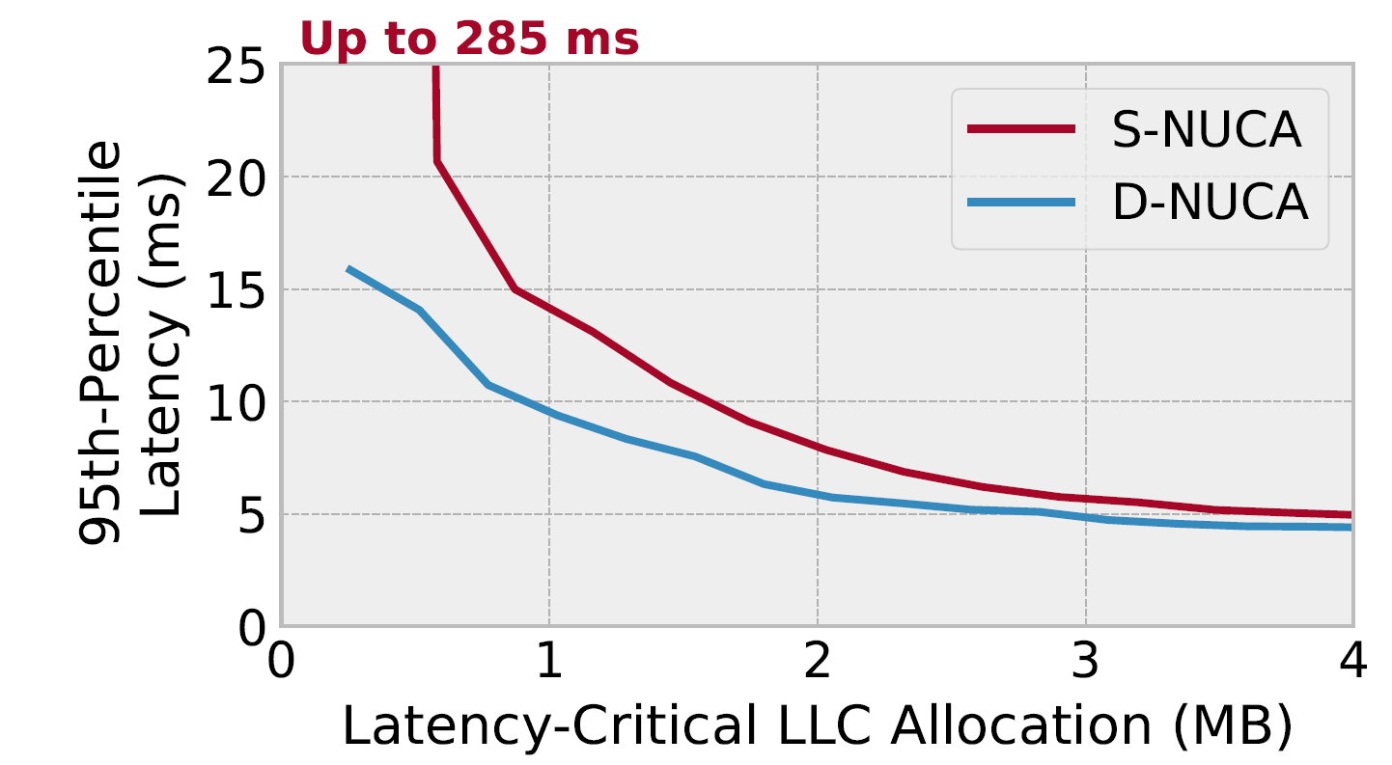
D-NUCA meets deadlines with less LLC space
Simulated 20-core CMP
Running latency-critical application Xapian in isolation
Measured tail latency with different allocation sizes using way-partitioning (S-NUCA) and nearby data placement (D-NUCA)
S-NUCA requires 75% more space!

Slide 15
Prior work
Security: sharing LLC banks is unsafe
Tail latency: ignoring NUCA wastes cache space
D-NUCA: ignoring application goals is harmful
D-NUCA: ignoring application goals is harmful

Slide 16
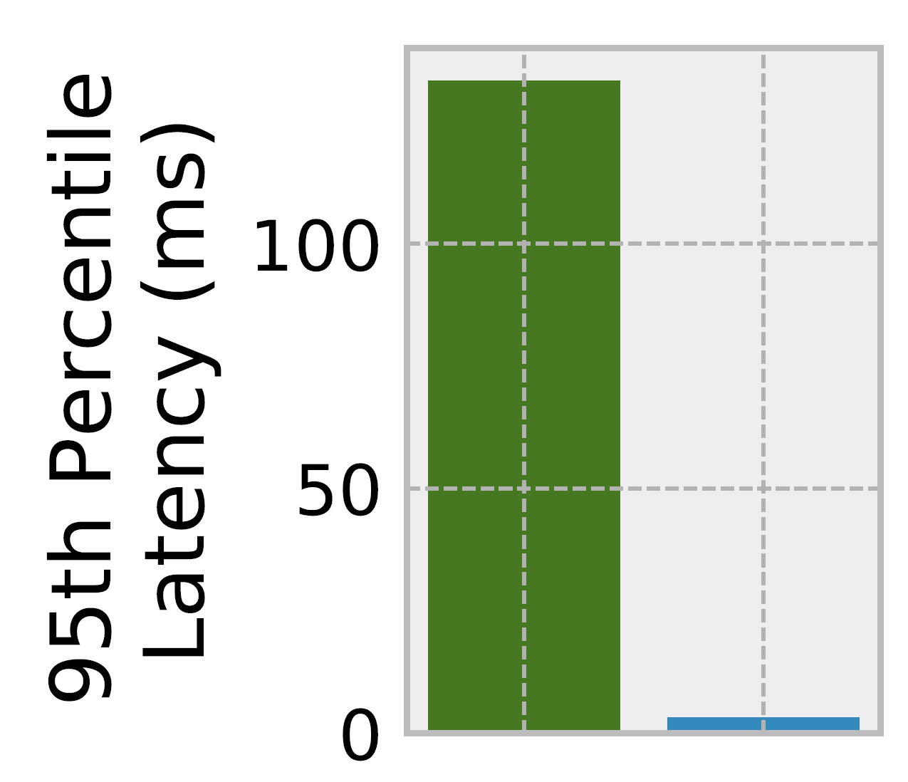
Unfortunately, prior D-NUCAs fail in the datacenter
Dynamic non-uniform cache access (D-NUCA) architectures place data in LLC banks to minimize data movement
… but data movement != security and tail latency
➔ Jigsaw performs well on throughput-oriented batch applications, but poorly for all other goals
Latency-critical
application
Batch
application
Beckmann et al., Jigsaw, PACT 2013
Jigsaw: State-of-the-art D-NUCA
Tail latency for Jigsaw vs Jumanji

Slide 17
Jumanji is the solution!
Defends all applications against more LLC attacks
Meets tail-latency deadlines with minimal data movement
Maximizes throughput of co-running batch applications
Simple design and small software changes to Jigsaw

Slide 18
Agenda
Motivation
Security
Tail latency
Prior D-NUCAs
Jumanji’s design
Evaluation
Conclusion

Slide 19

Jumanji Software
100 ms
Periodically trigger reconfiguration
Batch
Lat-crit
Jumanji OS Runtime
Feedback controller
1
Reserve lat-crit allocation
2
Partition banks among VMs
3
Optimize batch within each VM
VM 1
Request
completes
USER SPACE
VM 2
…
Jumanji Hardware
Miss curve monitors
VTB (update data placement)

Slide 20


Step 1: Meeting tail-latency deadlines
100 ms
Decrease by 10%
Periodically trigger reconfiguration
Previous allocation
Greedily place data near thread(s)
Tail < 85% * deadline
No change
Tail latency of recent requests
Tail < 95% * deadline
Feedback controller
Increase by 10%
Tail < 105% * deadline
User-defined deadline
Tail >= 105% * deadline
Boost to “safe” size

Slide 21
Step 2: Defending LLC attacks
Merged from each VM’s batch-app curves
Batch
Lat-crit
Lat-crit
Lat-crit
VM 1
Per-VM miss curves
VM 2
Lookahead Algo.
VM 3
VM 4
Lat-crit
Lat-crit
Modified to allocate at bank granularity to prevent VMs from sharing banks. This is how Jumanji defends LLC bank attacks.
Qureshi et al., UCP, MICRO 2009
Mukkara et al., Whirlpool, ASPLOS 2016

Slide 22
Step 3: Optimizing for batch performance
Lat-crit
Lat-crit
Lat-crit
Lat-crit
Execute Jigsaw on batch apps within each VM
Lat-crit
Lat-crit
Lat-crit
Lat-crit
Beckmann et al., Jigsaw, PACT 2013

Slide 23
Jumanji Hardware (borrowed from Jigsaw)
Out-of-order core
LLC banks
L1d
L1i
TLB
Modified: TLB
Added: VTB, UMON
VC id
L2
VTB
LLC bank
UMON
20-core CMP
VC id: 42
Addr: 0xBEEF
VTB
bank id
VC ids
Placement descriptors
Hash
…
7
2
1
2
0
0
1
1
…
Beckmann et al., Jigsaw, PACT 2013
Beckmann et al., CDCS, HPCA 2015
42
0
1
0
0
2
0
2
0xBEEF ➔ LLC bank 1

Slide 24
Agenda
Motivation
Security
Tail latency
Prior D-NUCAs
Jumanji’s design
Evaluation
Conclusion

Slide 25
Evaluation Methodology
Simulate 20-core CMP based on Nehalem using ZSim
20 single-threaded applications split into 4 VMs
Each VM has
1 latency-critical app (from Tailbench)
4 batch apps (from SPEC CPU2006)
Latency-critical workloads
4 copies of the same latency-critical app
Random mixes of latency-critical apps
Batch workloads
40 random mixes of batch apps for each latency-critical workload

Slide 26
Evaluation Methodology – LLC Designs
Adaptive:
Meets deadlines using way-partitioning and feedback controller
VM-Part:
Also way-partitions across VMs to defend conflict attacks (but not our new attacks)
Jigsaw
Jumanji

Slide 27
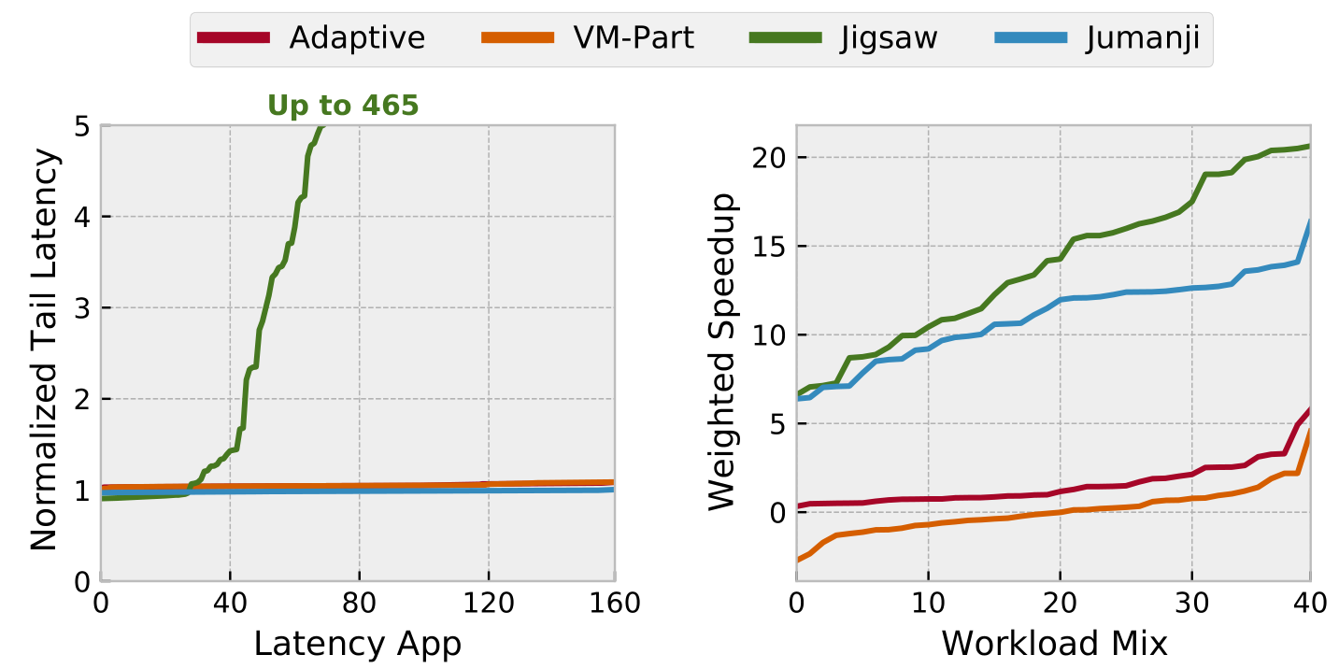
Jumanji meets deadlines and speeds up batch apps
%
Latency-critical apps: Xapian x 4

Slide 28
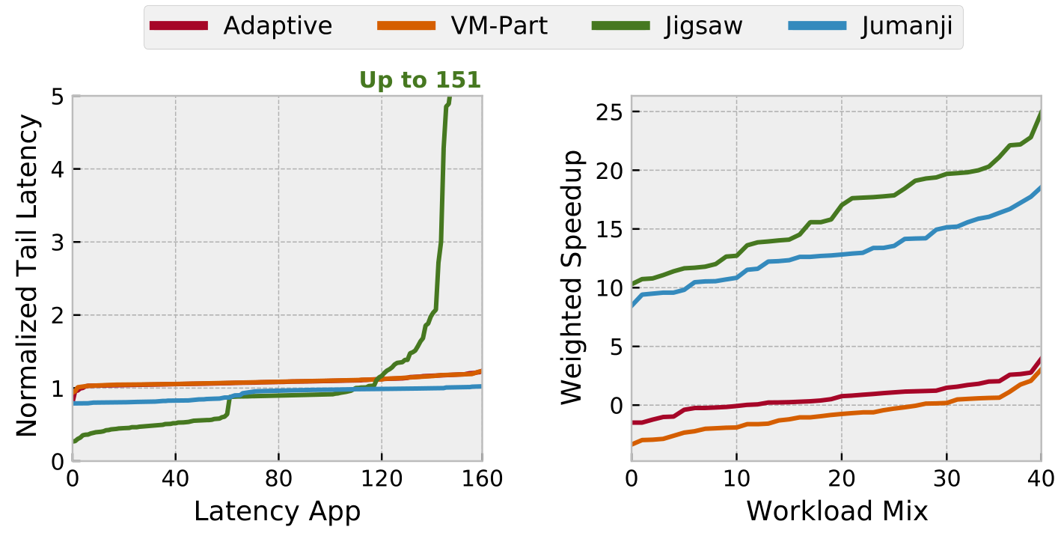
Jumanji meets deadlines and speeds up batch apps
%
Latency-critical apps: random mixes from Tailbench

Slide 29
See the paper for more results!
Jumanji’s data placement is nearly ideal
Jumanji scales well with VM size
Also…
Energy savings
Security analysis
System sensitivity study

Slide 30
Agenda
Motivation
Security
Tail latency
Prior D-NUCAs
Jumanji’s design
Evaluation
Conclusion

Slide 31
Jumanji makes D-NUCA viable in the datacenter
Jumanji recognizes the advantages D-NUCA provides for security and tail latency
Isolating untrusted VMs across LLC banks provides stronger security than prior designs
Placing latency-critical data near cores saves cache space for co-running batch applications
The overall design makes D-NUCA work for modern application goals
Lat-crit
Lat-crit
Lat-crit
Lat-crit
Brian Schwedock bschwedo@andrew.cmu.edu
Nathan Beckmann beckmann@cs.cmu.edu
This presentation and recording belong to the authors. No distribution is allowed without the authors’ permission.

