Slide 1
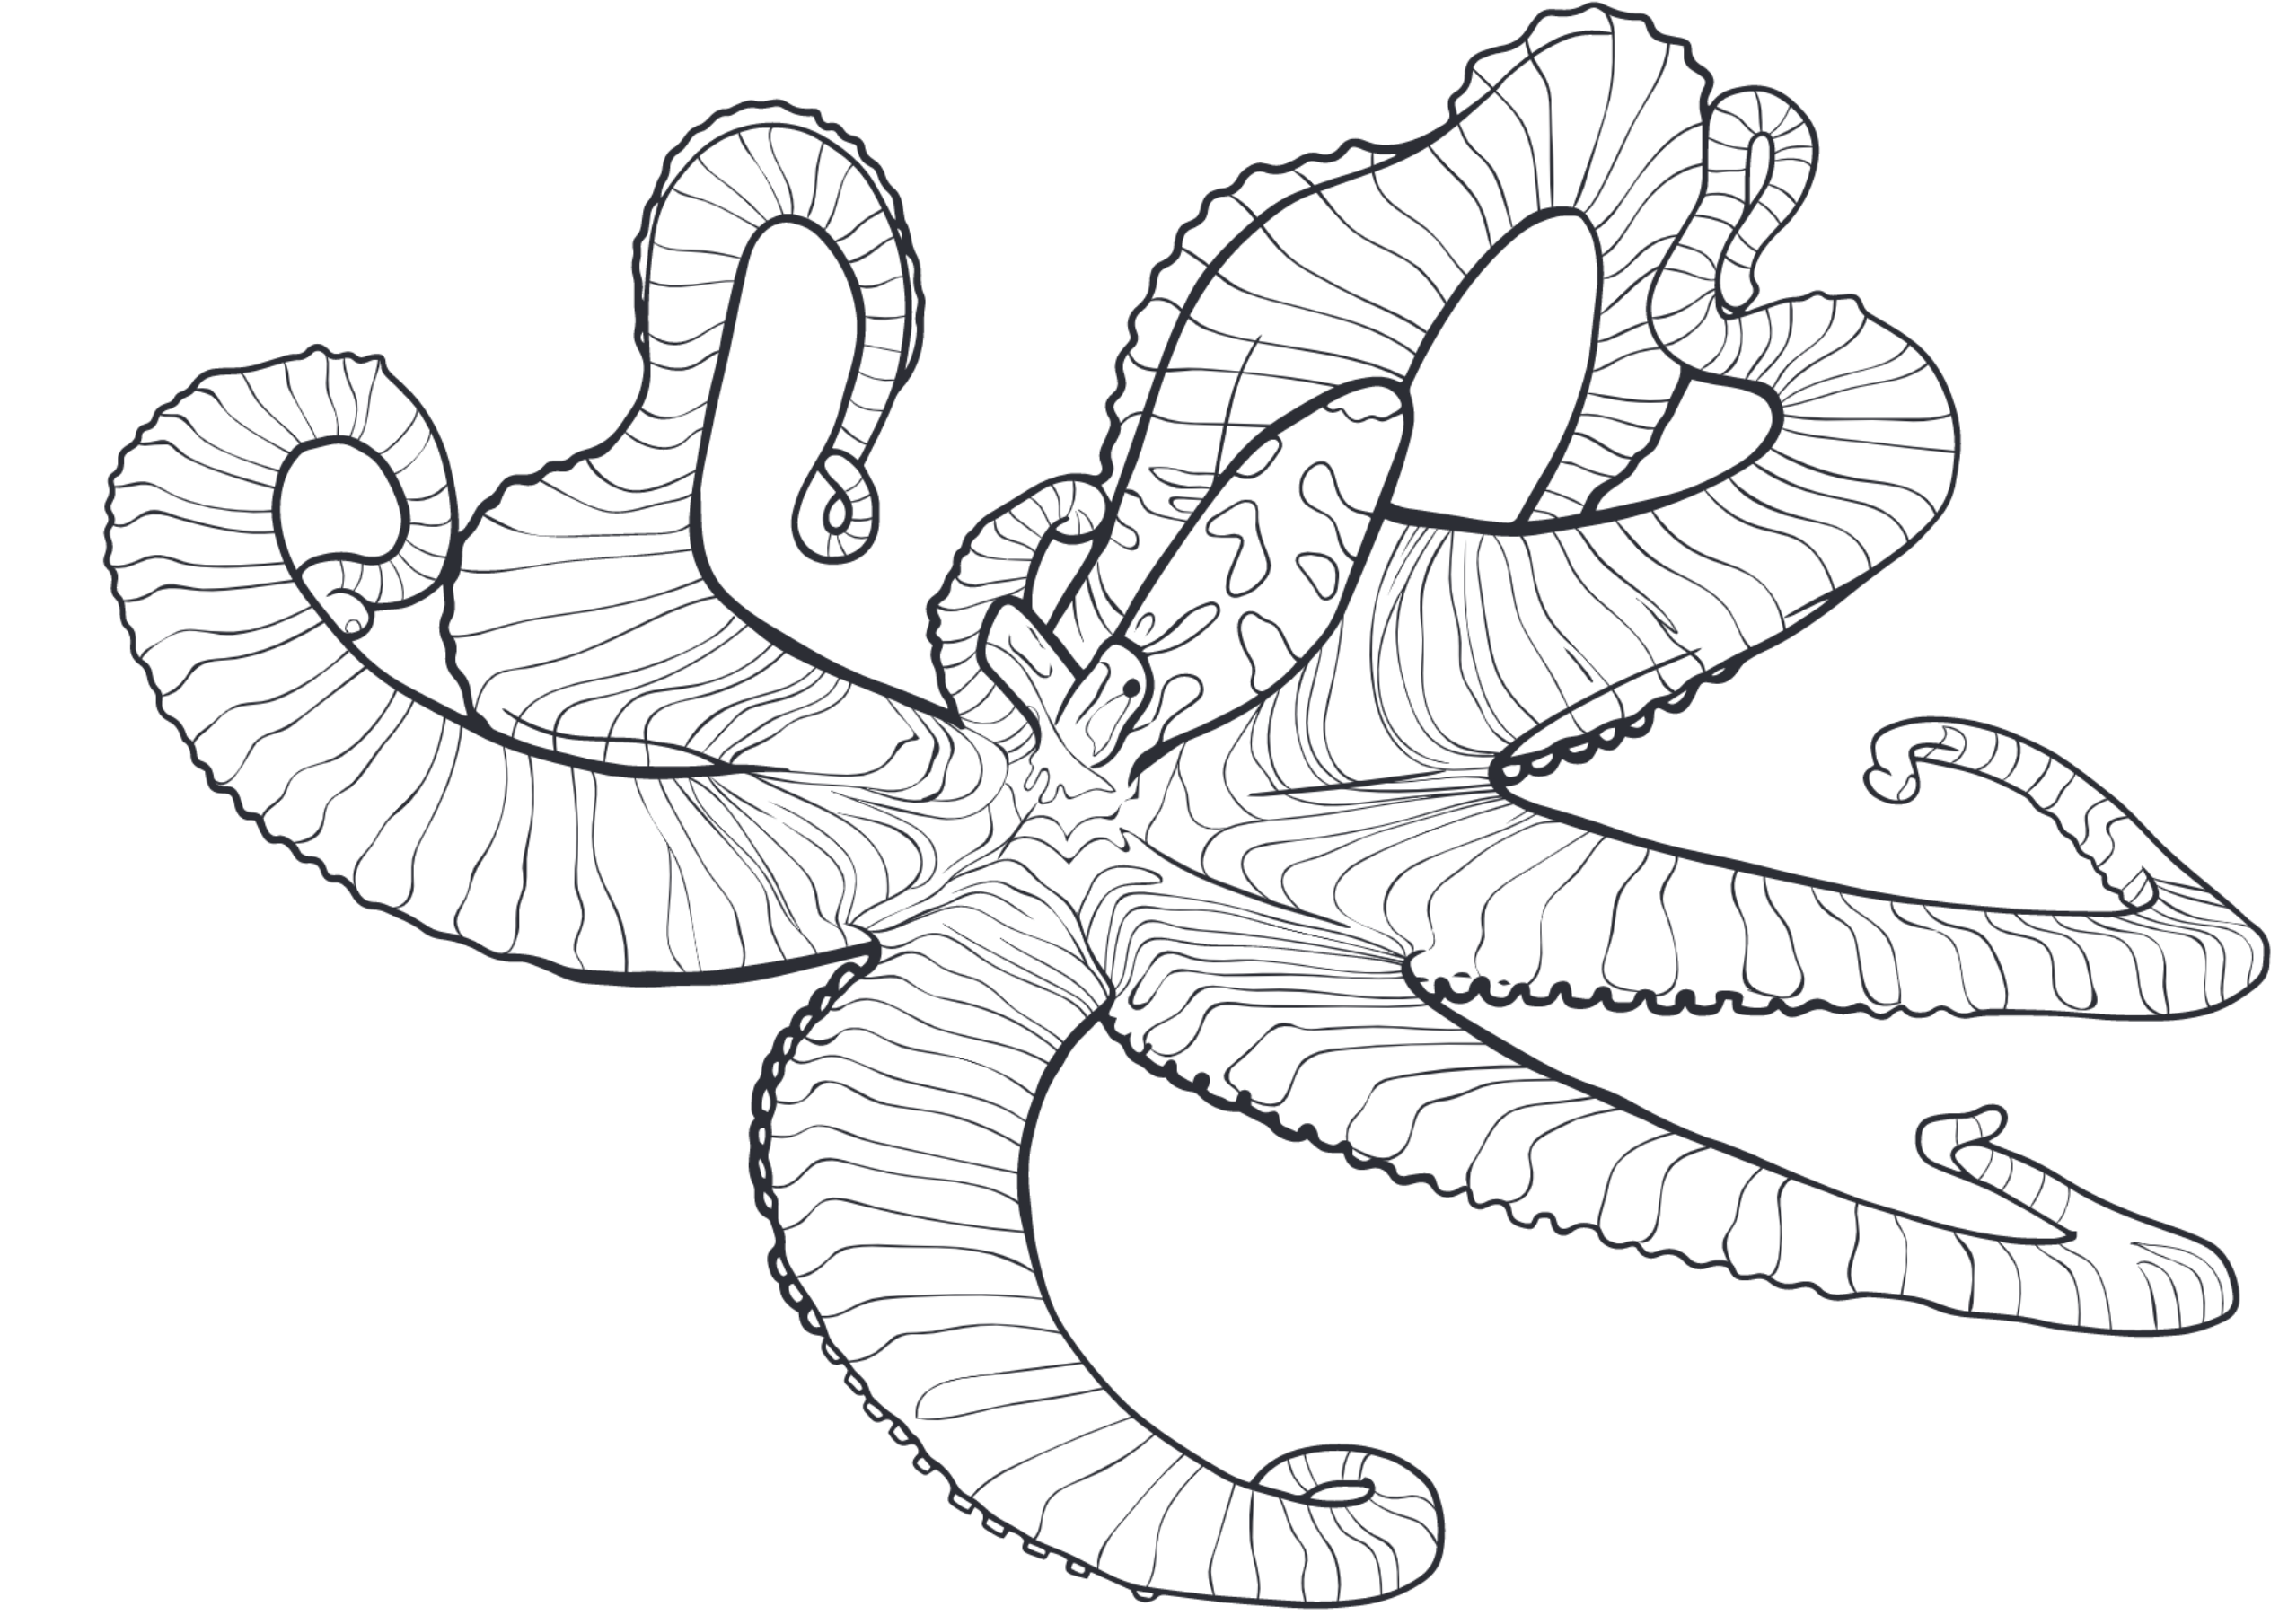
täkō: A Polymorphic Cache Hierarchy for General-Purpose Optimization of Data Movement
Brian C. Schwedock, Piratach Yoovidhya, Jennifer Seibert, Nathan Beckmann
ISCA 2022
Session 1: Best Paper Nominees

Slide 2
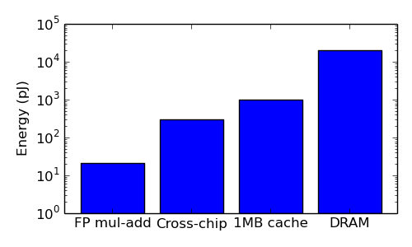
Data movement costs keep getting worse
Core & L1
Core
L2
LLC slice
1000x
Loads & stores
50 years
Memory
Memory
Memory

Slide 3
Specialized memory hierarchies give big gains!
Graph optimizations
Data placement
System software (e.g., file system)
Sparse linear algebra / machine learning
Approximation / compression
Data marshalling / layout
Pointer chasing
Memoization
Prefetching
Relaxed coherence / consistency
Memory management
…
- Big opportunity -
Often >2x end-to-end speedup!
Core & L1
L2
LLC slice
Specialized hardware ➔ Not going to happen!!!
Memory
Memory

Slide 4
How can we specialize the memory hierarchy without specialized hardware?

Slide 5




The interface is the problem!
Core
Core
Core
Core
Software-controlled
Loads & stores
Hardware-controlled
Private Cache
Private Cache
Private Cache
Shared Cache
Shared Cache
Shared Cache
ASICs
Engine
Memory
Memory
Memory
Memory
Software’s view
Current systems
Specialized hierarchies
täkō

Slide 6
täkō: A Polymorphic Cache Hierarchy for General-Purpose Optimization of Data Movement
Memory
Memory

Slide 7
täkō: A Polymorphic Cache Hierarchy for General-Purpose Optimization of Data Movement
täkō makes memory-hierarchy specialization practical
Memory
Memory

Slide 8
täkō exposes data movement to software
Solution: Tell software when data moves! (& let it do something)
Baseline loads &
stores work normally
“Phantom” data lives
only in caches! [Carter, HPCA’99]
Software serves
misses to phantom
data (& evictions)
Core
Cache
Memory
Load
Normal Data
Miss
Data
App Code
Load
Phantom Data
täkō Engine
onMiss()
onEviction()
onWriteback()
App Code

Slide 9
Prior near-data computing is insufficient
Prior NDC
täkō
Core
Cache
Memory
Core
Cache
Memory
Data
Data
App Code
App Code
Engine
Engine
Engines triggered by cores
Engines triggered by data movement
täkō inspired by programmable memory hierarchies from the ‘90s
But enables new memory semantics, vs. optimizing loads & stores
[Kuskin, ISCA’94] [Reinhardt, ISCA’94] [Agarwal, ISCA’95] [Horowitz, ISCA‘96] [Carter, HPCA’99] [Shacham, DAC’09]

Slide 10
Outline
Introduction
Motivation
Design
Evaluation

Slide 11
Motivating Example: Lossy Compression

Slide 12
Base+delta (B+Δ) lossy compression
…
Compressed
Base
Δ
Δ
Δ
Δ
Base
Δ
Δ
+
+
+
+
≈
≈
≈
≈
…
Decompressed

Slide 13
B+Δ decompression: in the core
Core
B
Δ
+
≈
Load
Pros: Reduced memory and cache usage
Cons: Decompress on every access
Private Cache
B
Δ
Shared Cache
B
Δ
Memory
Δ
B
Δ
B

Slide 14
B+Δ decompression: compressed caches?
Core
Load
Pros:
Reduced memory and cache usage
Reuse decomp. data in private cache
Cons:
Compression scheme fixed in hardware
Cannot support lossy compression
Private Cache
B
Δ
+
≈
Shared Cache
Memory
Δ
[Miguel, MICRO’15]
Δ
B
Δ
B
B

Slide 15
B+Δ decompression: täkō
Core
Pros:
Reduced memory and cache usage
Reuse decomp. data in private cache
SW can implement any compression scheme!
… without needing new hardware for each!
Load
phantom
Private Cache
täkō Engine
B
Δ
+
≈
✅
Shared Cache
onMiss()
Memory
Δ
B
Δ
B

Slide 16
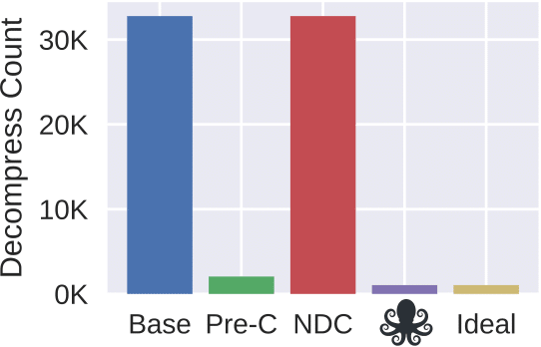
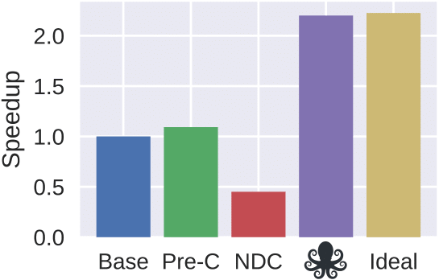
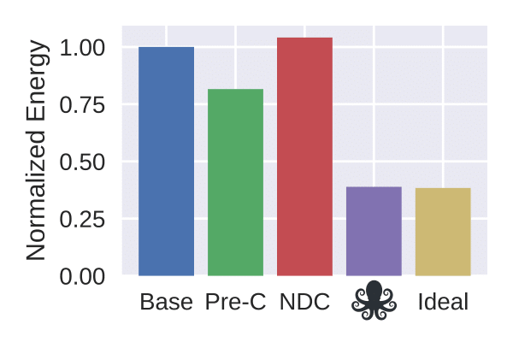
Evaluation: täkō leverages cache to capture reuse
16K objects, 32K accesses, Zipfian distribution (full experimental methodology shown later)
Data-movement triggers decompression on cache miss!
täkō with an ideal engine
Decompress on each access
Offload each decompression to L2

Slide 17
The interface is the problem
täkō is the solution
Core
Core
Software-controlled
Loads & stores
Hardware-controlled
Private Cache
Shared Cache
Engine
Memory
Memory
Software’s view
täkō

Slide 18
täkō Design: Programming Interface

Slide 19
täkō programming interface
Callback
Description
onMiss(void* addr)
Generate & fill in cache line at addr.
onEviction(void* addr)
Handle eviction of clean data.
onWriteback(void* addr)
Handle eviction of dirty data.

Slide 20
Registering callbacks
Address range
MorphA
0xFFFF
register(MorphA, L2, 4 MB)
onMiss()
onEviction()
onWriteback()
Normal data
register(MorphA, LLC, 8 MB)
MorphB
onMiss()
onEviction()
onWriteback()
register(MorphB, L2, 6 MB)
0x0000

Slide 21
täkō Design: Architecture

Slide 22
täkō architecture
Tile
Core
Hardware Scheduler
Callback Buffer
L1d
L1i
L2
Engine
L1d
TLB
rTLB
L3 Cache Bank
Dataflow Fabric
Data Array
Tag Array

Slide 23
onMiss callback
3
Scheduled
1
GET A
Core
Hardware Scheduler
∞
L1 hit
Callback Buffer
L1d
L1i
L2
Engine
L1d
TLB
rTLB
6
Response
L3 Cache Bank
5
Fill A
Data Array
2
L3 miss
4
Tags
onMiss(A)

Slide 24
onWriteback callback
3
Scheduled
Core
Hardware Scheduler
2
Callback Buffer
Invalidate A
L1d
L1i
L2
Engine
L1d
TLB
rTLB
L3 Cache Bank
Data Array
1
A evicted
(✔ = registered)
A ✔
4
onWriteback(A)
Tags

Slide 25
Additional cache and engine state
Core
2 bits per TLB entry
1 bit per tag
Callback buffer
Engine L1d
Engine TLB
Engine reverse TLB
< 3% overhead vs. L3 cache
Callback Buffer
Hardware Scheduler
L1d
L1i
TLB
L2
L1d
TLB
rTLB
Engine
L3 Cache Bank
Dataflow Fabric
Data Array
Tag Array

Slide 26
Engine microarchitecture
Engine Dataflow Fabric
Fabric Network
Processing Element
op1
op2
pred
tid
op
imm
etc
Token store
Instr memory
≈3% state overhead (vs L3 cache)
Engine L1d
ALUs
Fabric Network
Similar to triggered instructions
[Parashar, ISCA’13]

Slide 27
Why dataflow?
Engine Dataflow Fabric
Callbacks need memory-level parallelism
Callbacks are typically short
Callbacks are executed repeatedly
Multiple callbacks execute in parallel
Engine L1d

Slide 28
Evaluation: Case Studies

Slide 29
Evaluation methodology
Cycle-level simulation of 16-tile CMP
Tile contains: OoO main core and täkō engine
täkō dataflow fabric: 5x5 array, 1-cycle PE latency
Ideal fabric: infinite PEs, 0-cycle PE latency
Core
Callback Buffer
Hardware Scheduler
L1d
L1i
TLB
L2
Engine
L1d
TLB
rTLB
L3 Cache Bank
Dataflow Fabric
Data Array
Tag Array

Slide 30
Case studies
In-cache data transformation
Commutative scatter-updates
Decoupled graph traversals
Transactions on NVM
Detect cache side-channel attacks

Slide 31
Case Study: Commutative Scatter-updates

Slide 32
Commutative scatter-updates in graphs
Scatter-updates are common in graph algorithms:
But current cache hierarchies are bad at scatter-updates
Conflict between pull vs. push semantics
➔ Excess bandwidth & synchronization
2
for src in vertices:
for dst in outNeighbors(src):
vertex(dst) += vertex(src)
0
3
1
4
PHI: Architectural Support for Synchronization- and Bandwidth-Efficient Commutative Scatter Updates. [Mukkara+, MICRO’19]

Slide 33
Commutative scatter-updates in graphs
PHI changes the memory hierarchy to have push-based semantics
1. Updates are buffered in-cache without accessing memory
2. Updates applied on eviction:
2a) Immediately in-place, or
2b) Logged & deferred [Beamer, IPDPS’17]
Updates moved off critical path
Bandwidth optimized by 2a) vs 2b)
Core
UPDATE 0xFOO, +4
UPDATE 0xFOO, +2
Cache
0xFOO
4
6
2a) +6 in-place
2b) Log & defer
Memory
0xFOO
16
0xFOO: +6
10
PHI: Architectural Support for Synchronization- and Bandwidth-Efficient Commutative Scatter Updates. [Mukkara+, MICRO’19]

Slide 34
Example: PHI on täkō
Morph registered at L3 cache
Vertex updates buffered in phantom data
onWriteback selectively applies updates in-place or logs updates
Core
Memory
1
Update Vertex
A
F
B
E
L2
Engine
C
D
2
onMiss zeroes lines
L3
Bins
{B,0}
3a
{B,1} {E,2}
{B,1}
{F,1}
Impossible in software without täkō’s callbacks!
{C,3} {D,1}
3b
{F,1}
onWriteback can a) update in-place b) log update
{E,2}

Slide 35
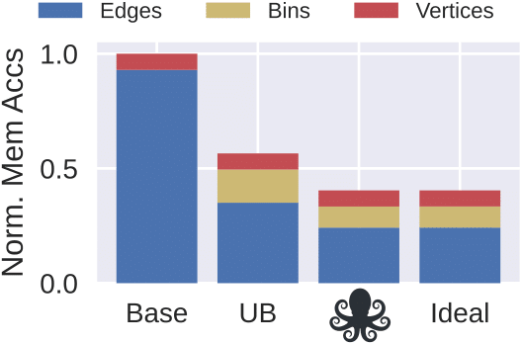
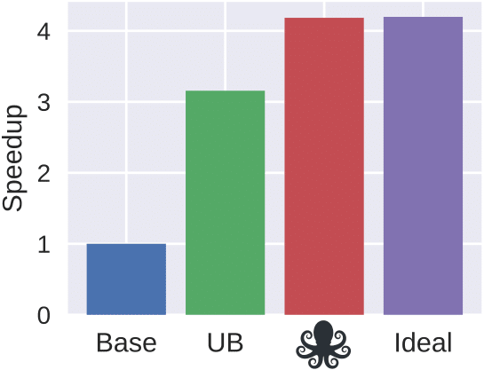
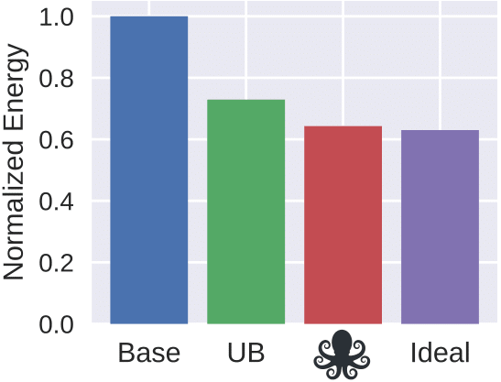
täkō’s benefits implementing PHI
PageRank, 16 threads, graph: 16M vertices & 160M edges
In-place
Log
In-place
Log
In-place
Log
täkō with an ideal engine
täkō implementation of PHI
Push-based PageRank
Software update-batching (always log)
[Beamer, IPDPS’17]

Slide 36
Case Study: Detecting Side-channel Attacks

Slide 37
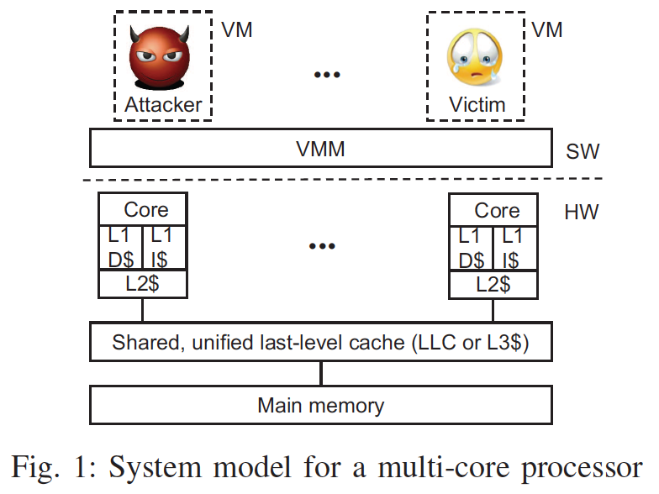
Prime + probe cache attack
Core
Core
1a. Attacker primes
target set
1b. Sensitive data
is evicted
2. Victim evicts
attacker data
3. Attacker probes
target set
Long-latency load
➔ attack successful!
Shared LLC
➔ onEviction interrupts core before any info leaks!!
Target set

Slide 38
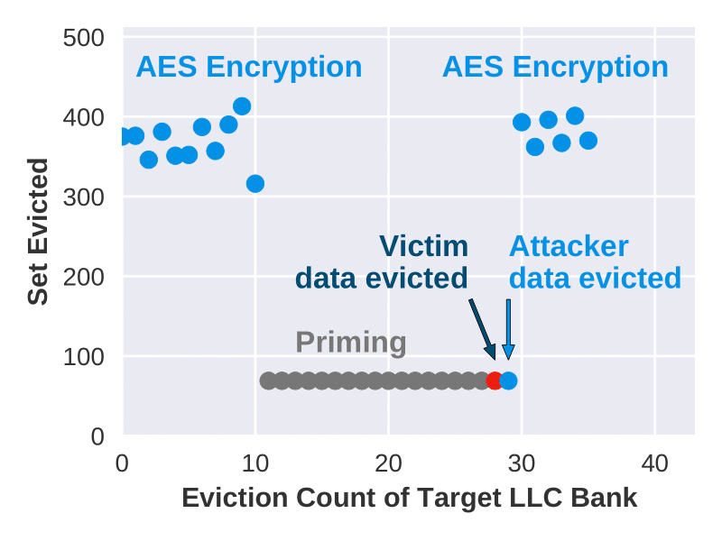
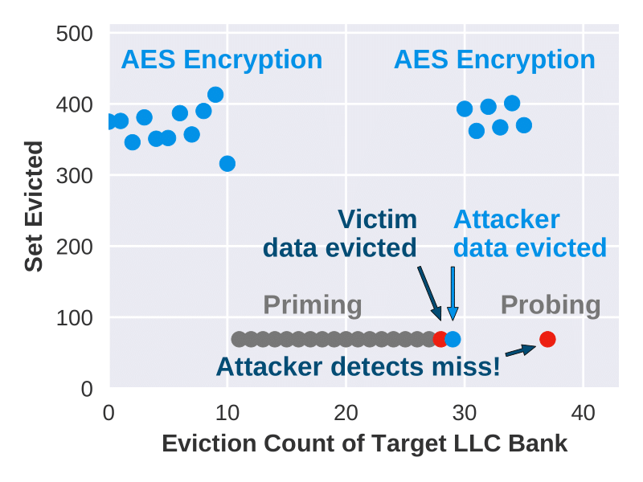
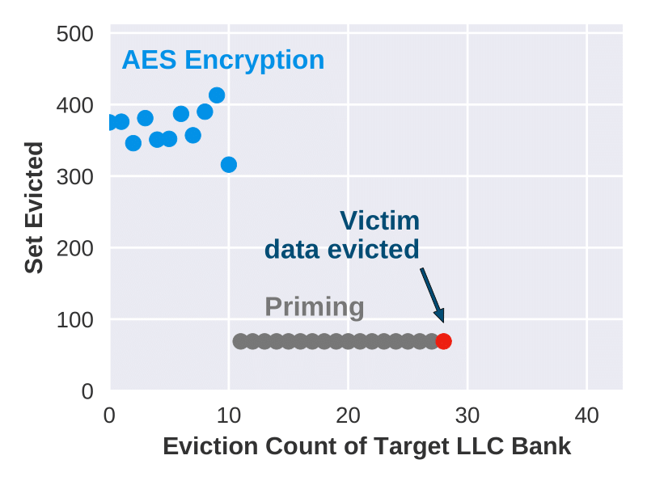
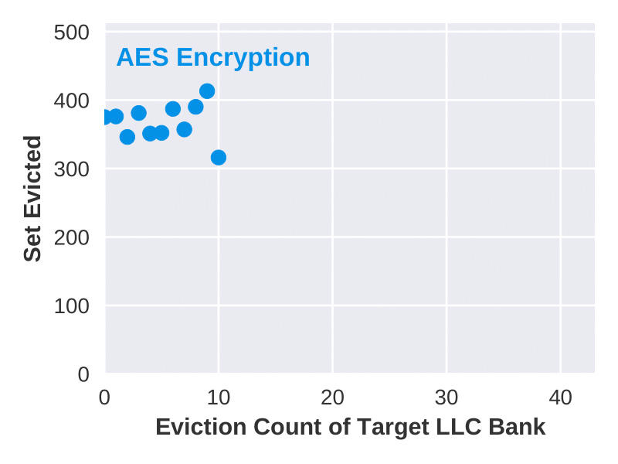
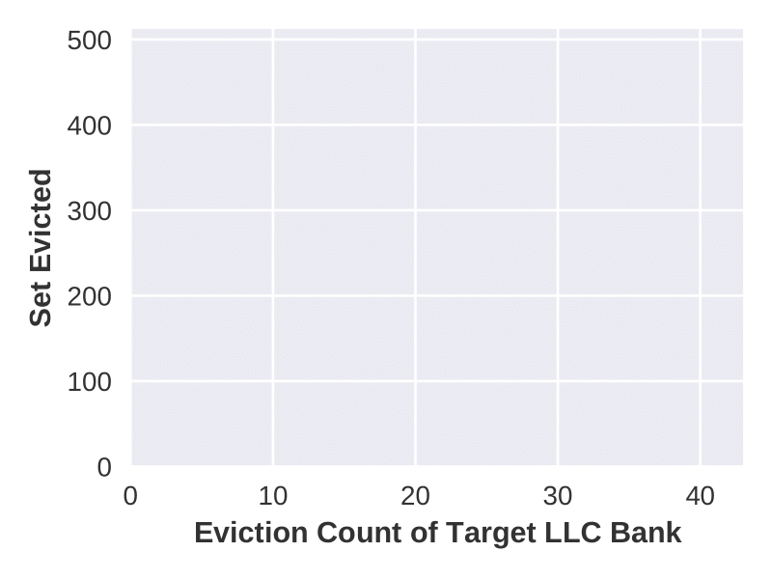
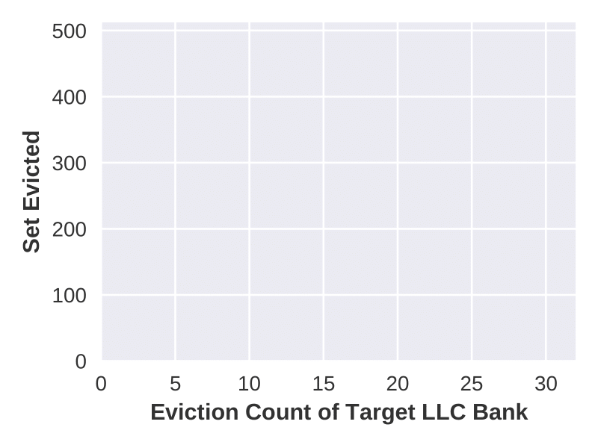
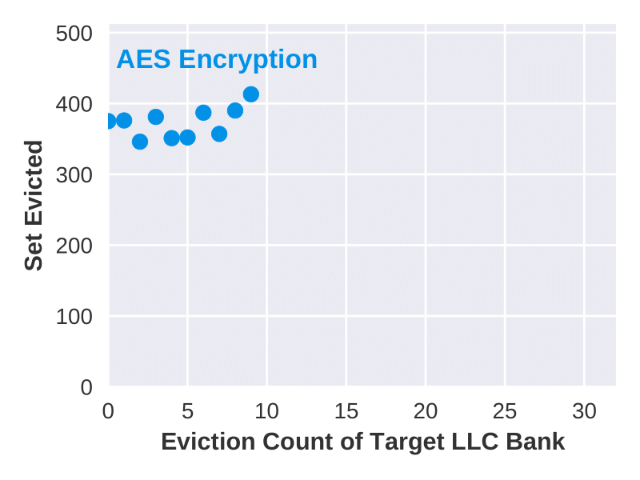
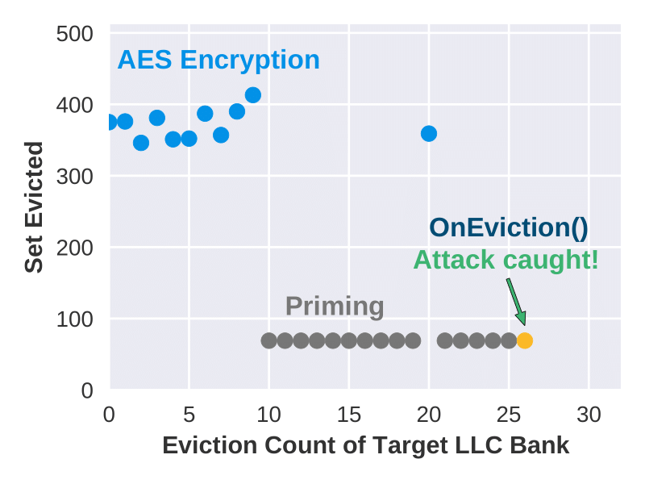
Prime + probe: cache eviction trace
✘
✅
Without täkō
With täkō
Target set

Slide 39
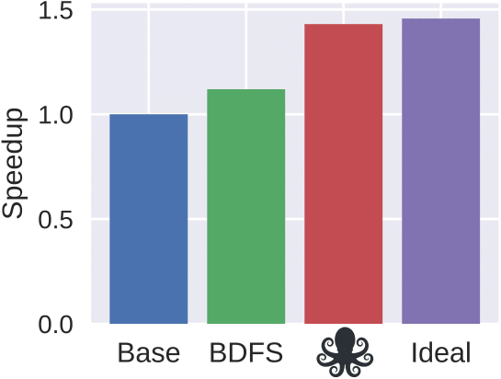
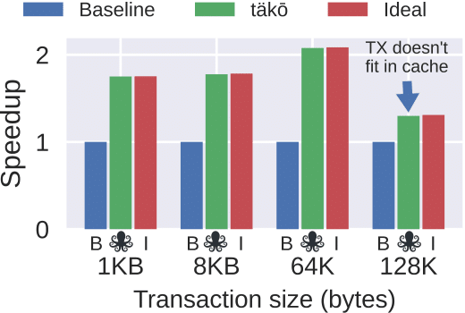
See the paper for full results
In-cache data transformation: 2.2x speedup, 61% energy savings
Commutative scatter-updates: 4.2x speedup, 36% energy savings
Decoupled graph traversals: 43% speedup, 17% energy savings
Transactions on NVM: 2.1x speedup, 47% energy savings
Detect cache side-channel attacks
Insensitive to system configuration and data sizes

Slide 40
täkō: polymorphic cache hierarchy
The memory interface limits software capabilities
Specialized hierarchies are beneficial but impractical
täkō provides a general-purpose architecture to enable software optimization of the cache hierarchy
Core
Callback Buffer
Hardware Scheduler
L1d
L1i
TLB
L2
Engine
L1d
TLB
rTLB
L3 Cache Bank
Dataflow Fabric
Data Array
Tag Array

