Slide 1

Marcel Stimberg, ENS Paris
marcel.stimberg@ens.fr

Slide 2
Motivation for Brian²
Learn from the experiences made in Brian 1 and incorporate them in the design from the beginning
Core principles:
  Explicit model descriptions with strings
  Code generation
  Modularity
Allow for some backward incompatibility

Slide 3
New targets for Brian
Separating preparatory work (applying numerical integration methods to model equations …) from computational work
(state update step, setting variable values, …)
Will allow “standalone” Brian code, e.g. completely Brian-independent C++ code
and then…

Slide 4
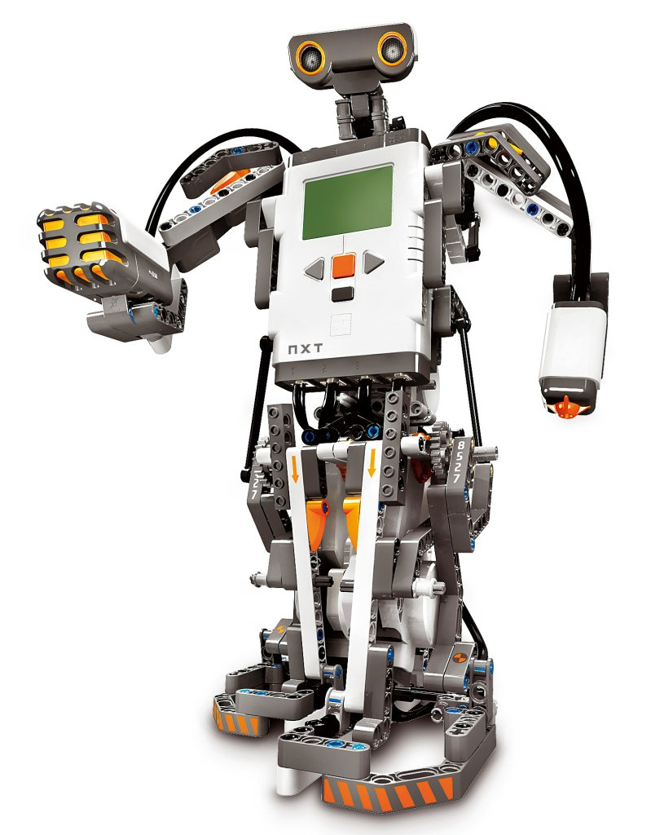
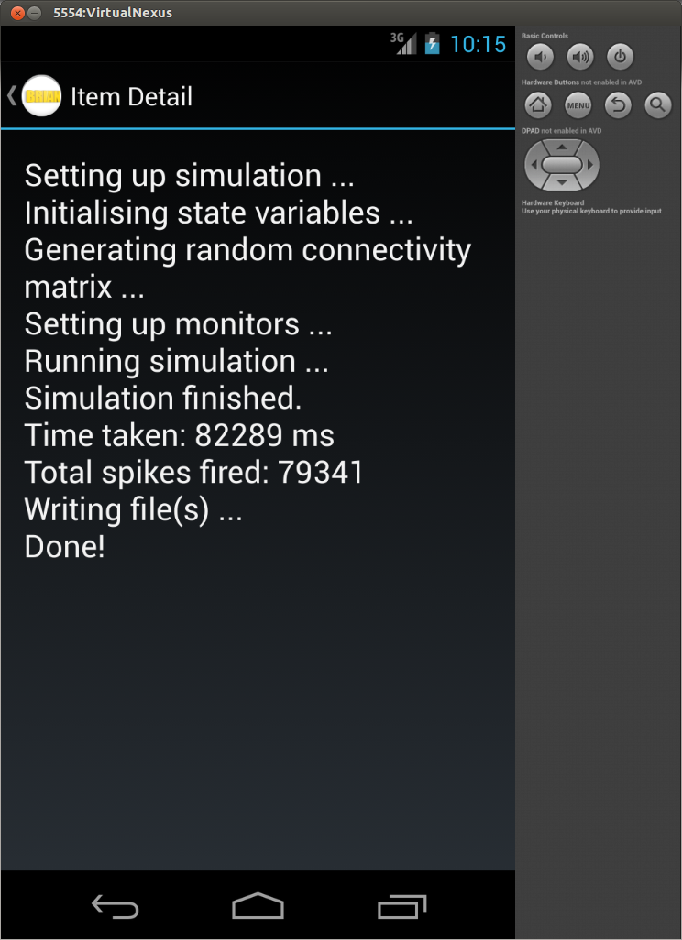

Robots and phones!
Achilles Koutsou,
University of Cyprus

Slide 5
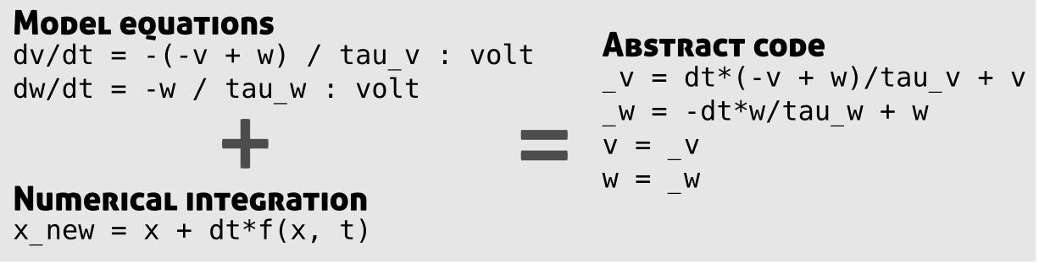
Code generation step 1

Slide 6
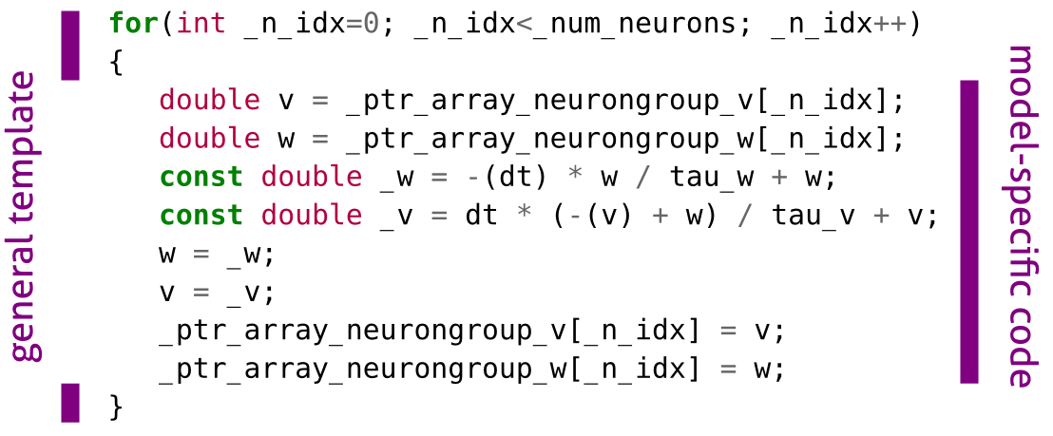
Code generation step 2 (C++)

