Slide 1
Contributing to Brian²
Marcel Stimberg, ENS Paris
marcel.stimberg@ens.fr

Slide 2
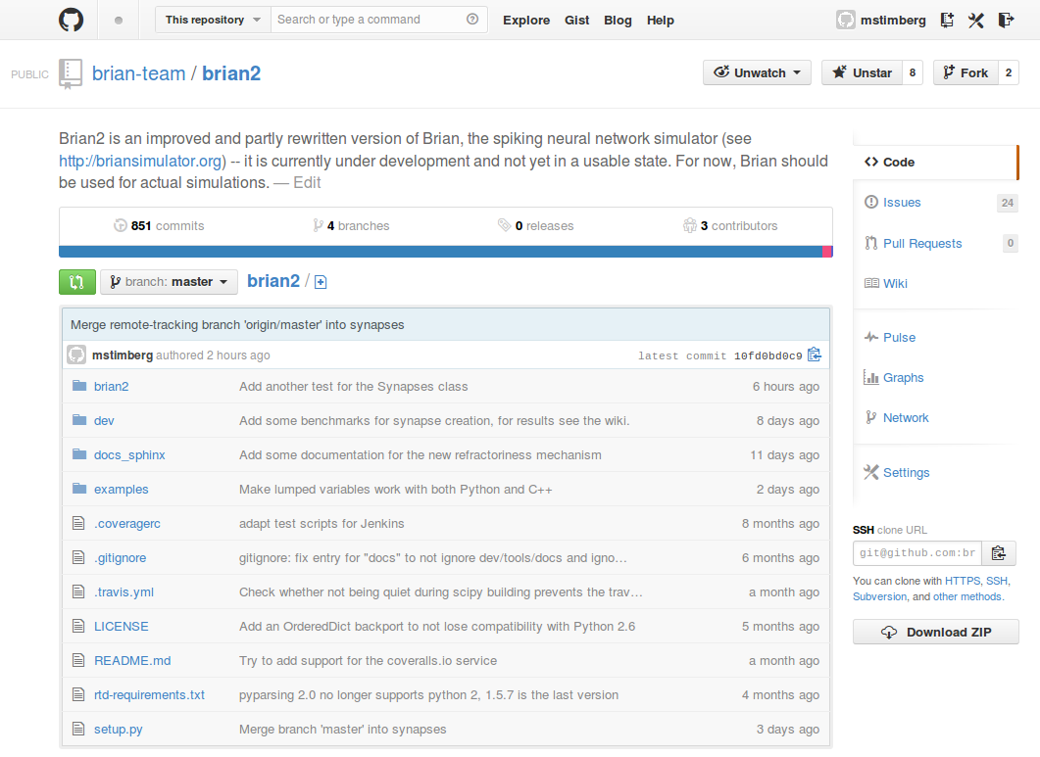
Github repository
https://github.com/brian-team/brian2

Slide 3
Github repository
https://github.com/brian-team/brian2

Slide 4
Development workflow
File an issue
Fork the project
Create a branch (recommended)
Create a pull request
Refine the code until the reviewer is happy
The reviewer merges the change into Brian
Enjoy the eternal gratitude of the Brian community
https://brian2.readthedocs.org/en/latest/developer/guidelines/workflow.html

Slide 5
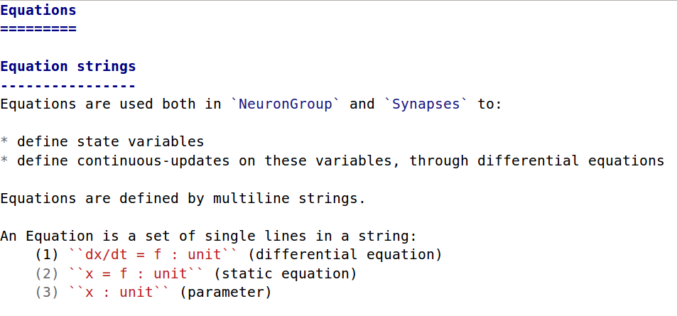
Brian documentation
Restructured text:

Slide 6
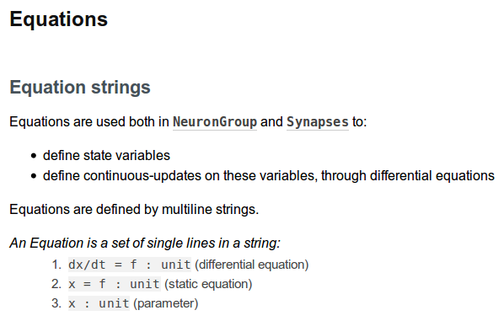
Brian documentation
Rendered Restructured text:

Slide 7
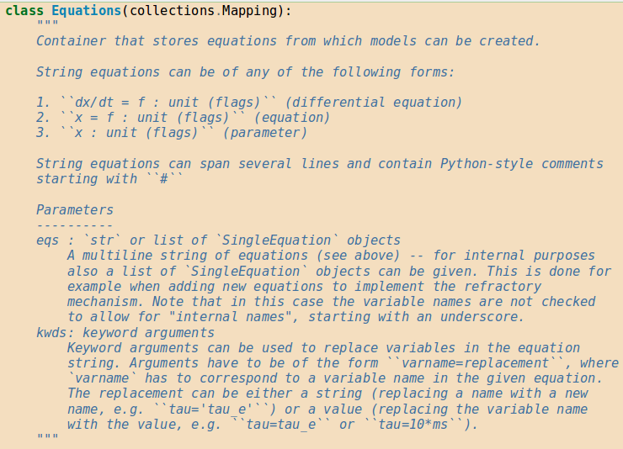
Brian documentation
Docstrings using numpydoc style

Slide 8
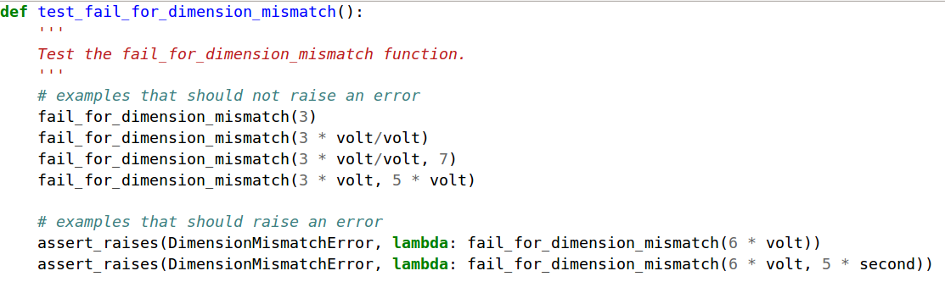
Writing tests
Tests are automatically collected from brian2.test (filenames starting with test, functions starting with test)
Tests should cover a single function/feature, use assert statements

Slide 9



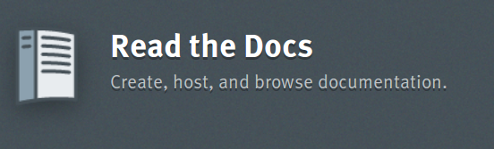
Tools we use
github.com (source code repository, issues, wiki)
travis-ci.org (continuous integration testing)
coveralls.io (test coverage)
readthedocs.org (documentation hosting/building)

Slide 10
Where to contribute
Extending Brian: State updaters, new code generation languages, …
Fixing bugs (including “easy fixes”: mistakes in documentation, better error messages)
Writing tests to increase test coverage
Writing and submitting examples
Reporting bugs

