Slide 1
Advanced modelling of spiking neural networks with Brian
Tutorial at CNS 2013
Time | Topic (Presenter)
9.00 – 9.15 | Overview
9.15 – 9.50 | Synapses class (Romain Brette)
9.55 – 10.30 | Model fitting toolbox (Cyrille Rossant)
Break
10.45 – 11.20 | Multicompartmental modeling (Romain Brette)
11.25 – 12.00 | Brian hears toolbox (Bertrand Fontaine)
Lunch break
13.30 – 14.25 | “Best practice” for complex simulations and general advanced features (Dan Goodman)
Break
14.40 – 15.05 | Brian 2 (Marcel Stimberg)
15.10 – 15.35 | How to contribute to Brian (Marcel Stimberg)
15.40 – 16.30 | Question/answer session, “bring your code”, ask individual questions

Slide 2

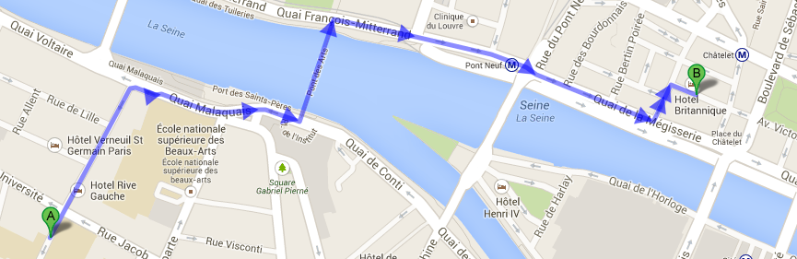
Meet Brian (and us) for a drink!
After today's “Welcome Reception” (should end around 8pm)
19 avenue Victoria, 75001 Paris
Métro 1, 4, 7, 11, 14. RER A, D: Châtelet – Les Halles
Exit: Place du Châtelet – Théâtre du Châtelet.

