Slide 1
HW1
Yu-Hung Lin Master std.
Ping-Xu Lin Master std.
Rhaditya Viansyah A. Master std.
2026.03.16

Slide 2
Table of Content
Software
Section properties
Analysis parameters

Slide 3


HW1
Software
Notes:
Report about the software we are going to use, and the reason why we choose ETABS and OpenSees.

Slide 4
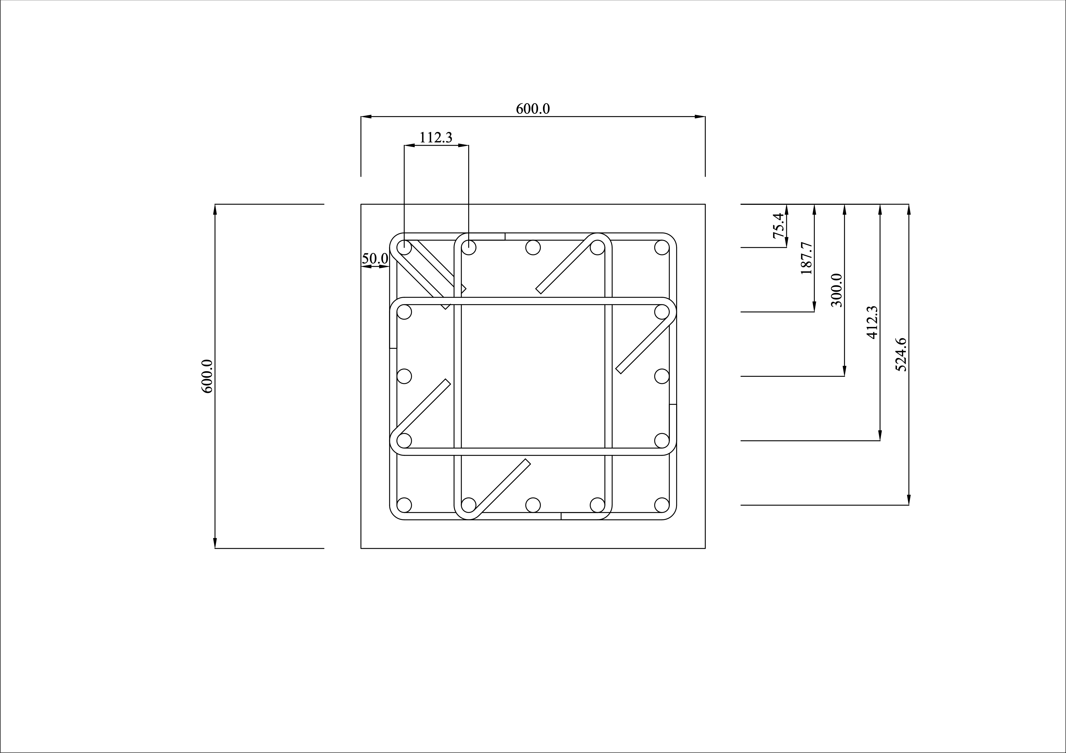
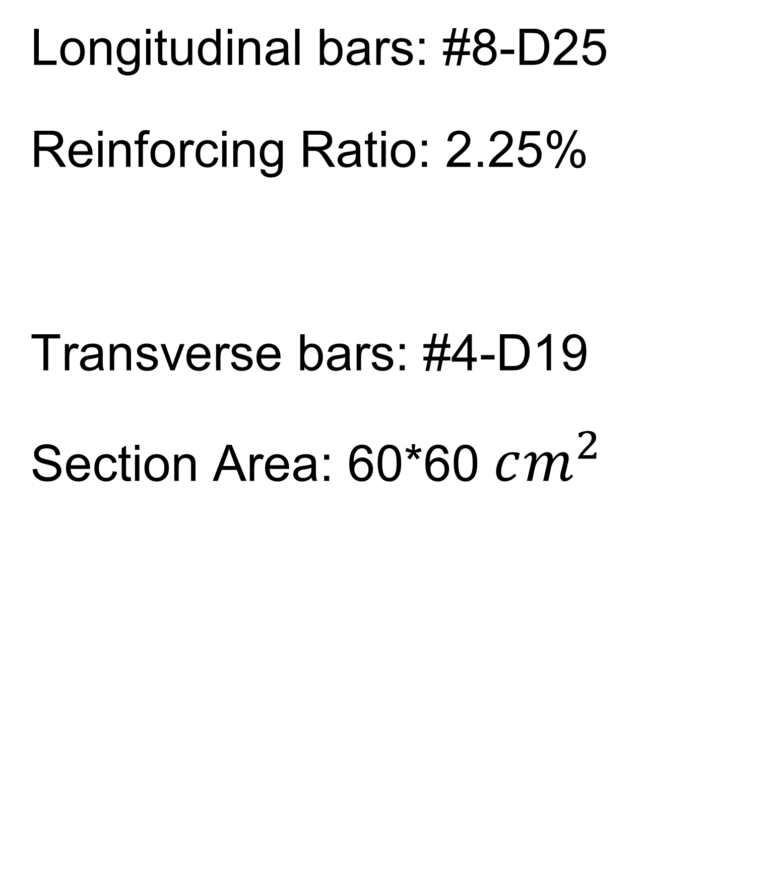
HW1
Section, parameters
Longitudinal bars: #8-D25
Reinforcing Ratio: 2.25%
Transverse bars: #4-D19
Section Area: 60*60 $cm^{2}$
Notes:
We choose this section because … 1. 30*30 minimum size requirement of ACI-318
2. Slenderness effect need to be neglect.
3. Height should be enough for a floor (3.2~3.5 m/floor)
4. Ties is according to the regulation of ACI-318.
5. Clear cover is also according to the ACI-318 regulation.

Slide 5
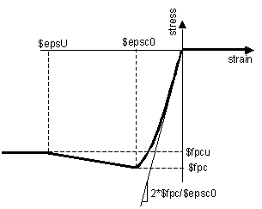
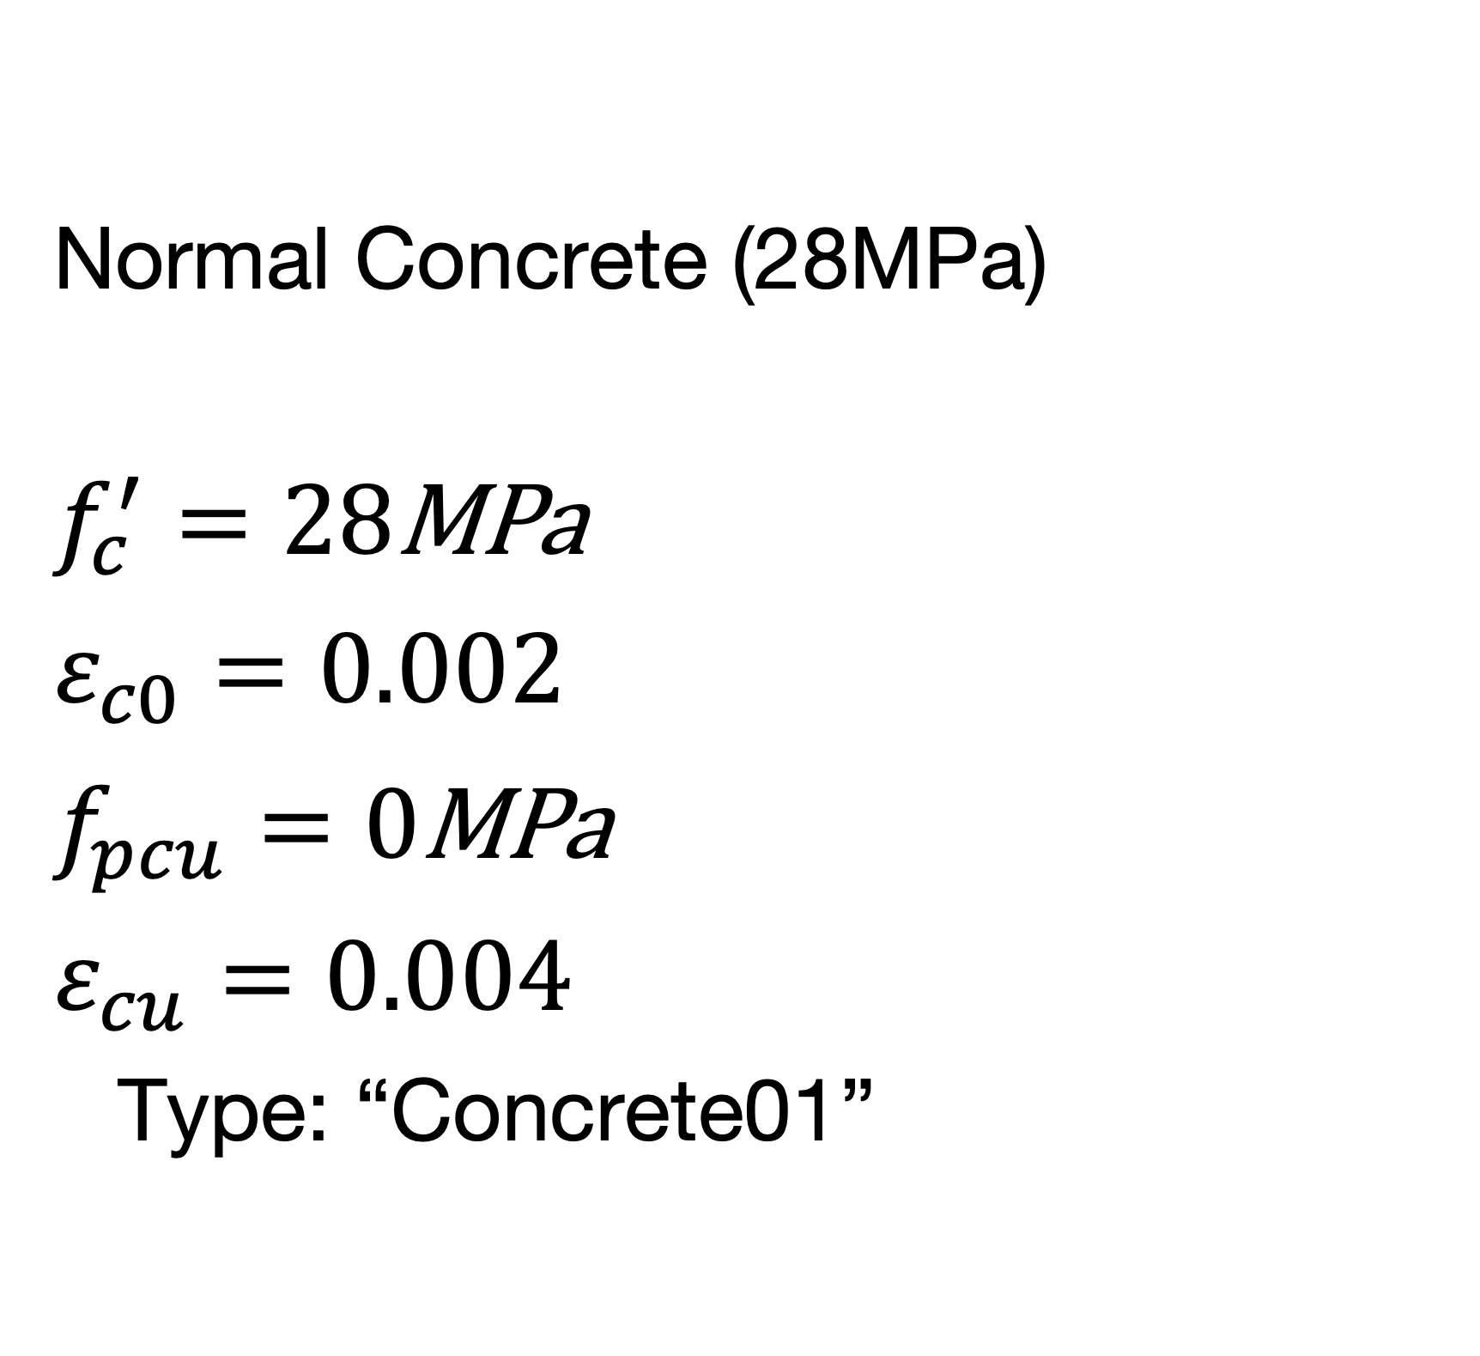
HW1
Material Properties
Normal Concrete (28MPa)
$$f_{c}^{′}=28\text{MPa}$$
$$ε_{c0}=0.002$$
$$f_{pcu}=0\text{MPa}$$
$$ε_{cu}=0.004$$
Type: “Concrete01”
Notes:
First concrete properties is the most common used concrete as our base line.

Slide 6
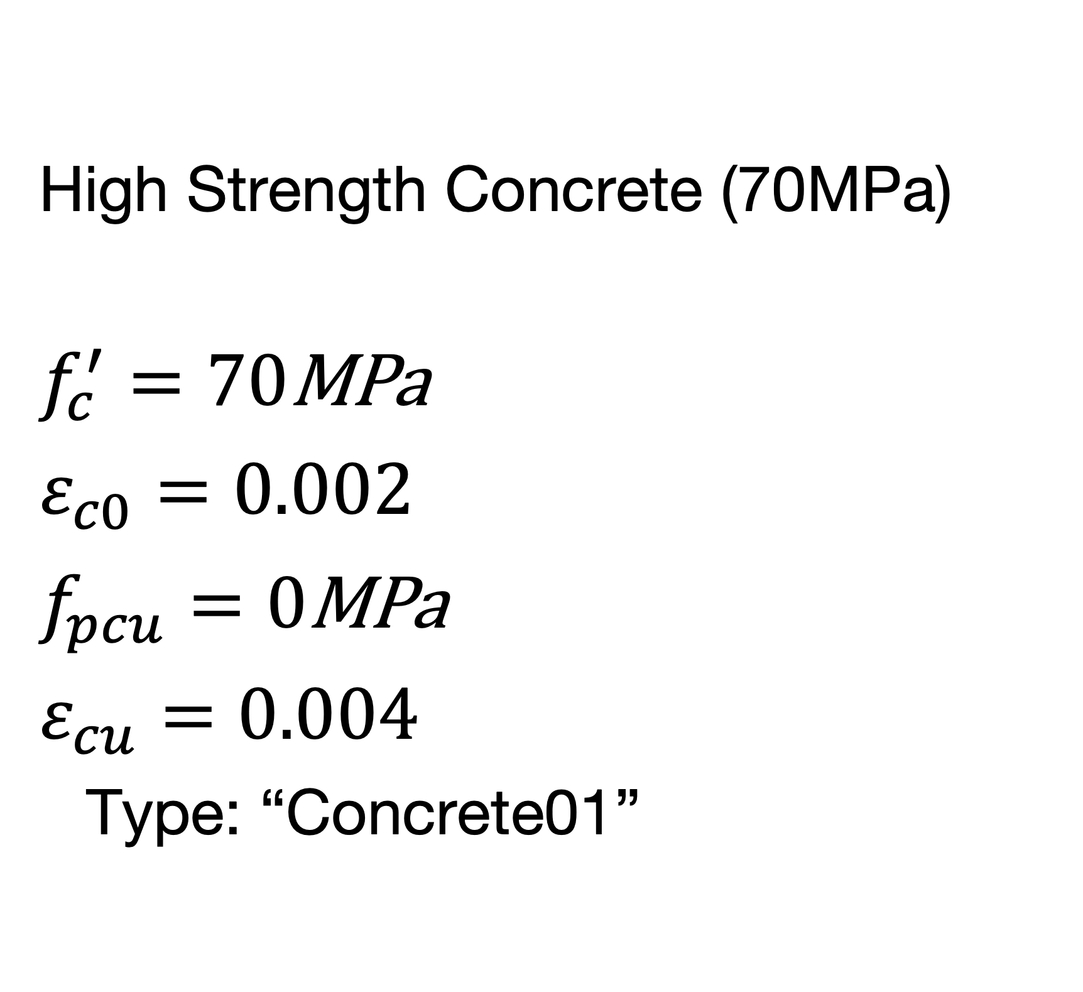
HW1
Material Properties
High Strength Concrete (70MPa)
$$f_{c}^{′}=70\text{MPa}$$
$$ε_{c0}=0.002$$
$$f_{pcu}=0\text{MPa}$$
$$ε_{cu}=0.004$$
Type: “Concrete01”

Slide 7
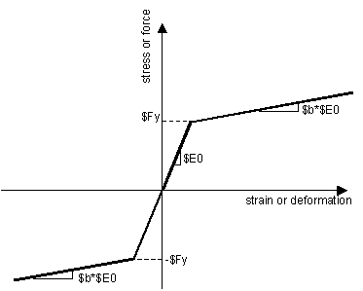
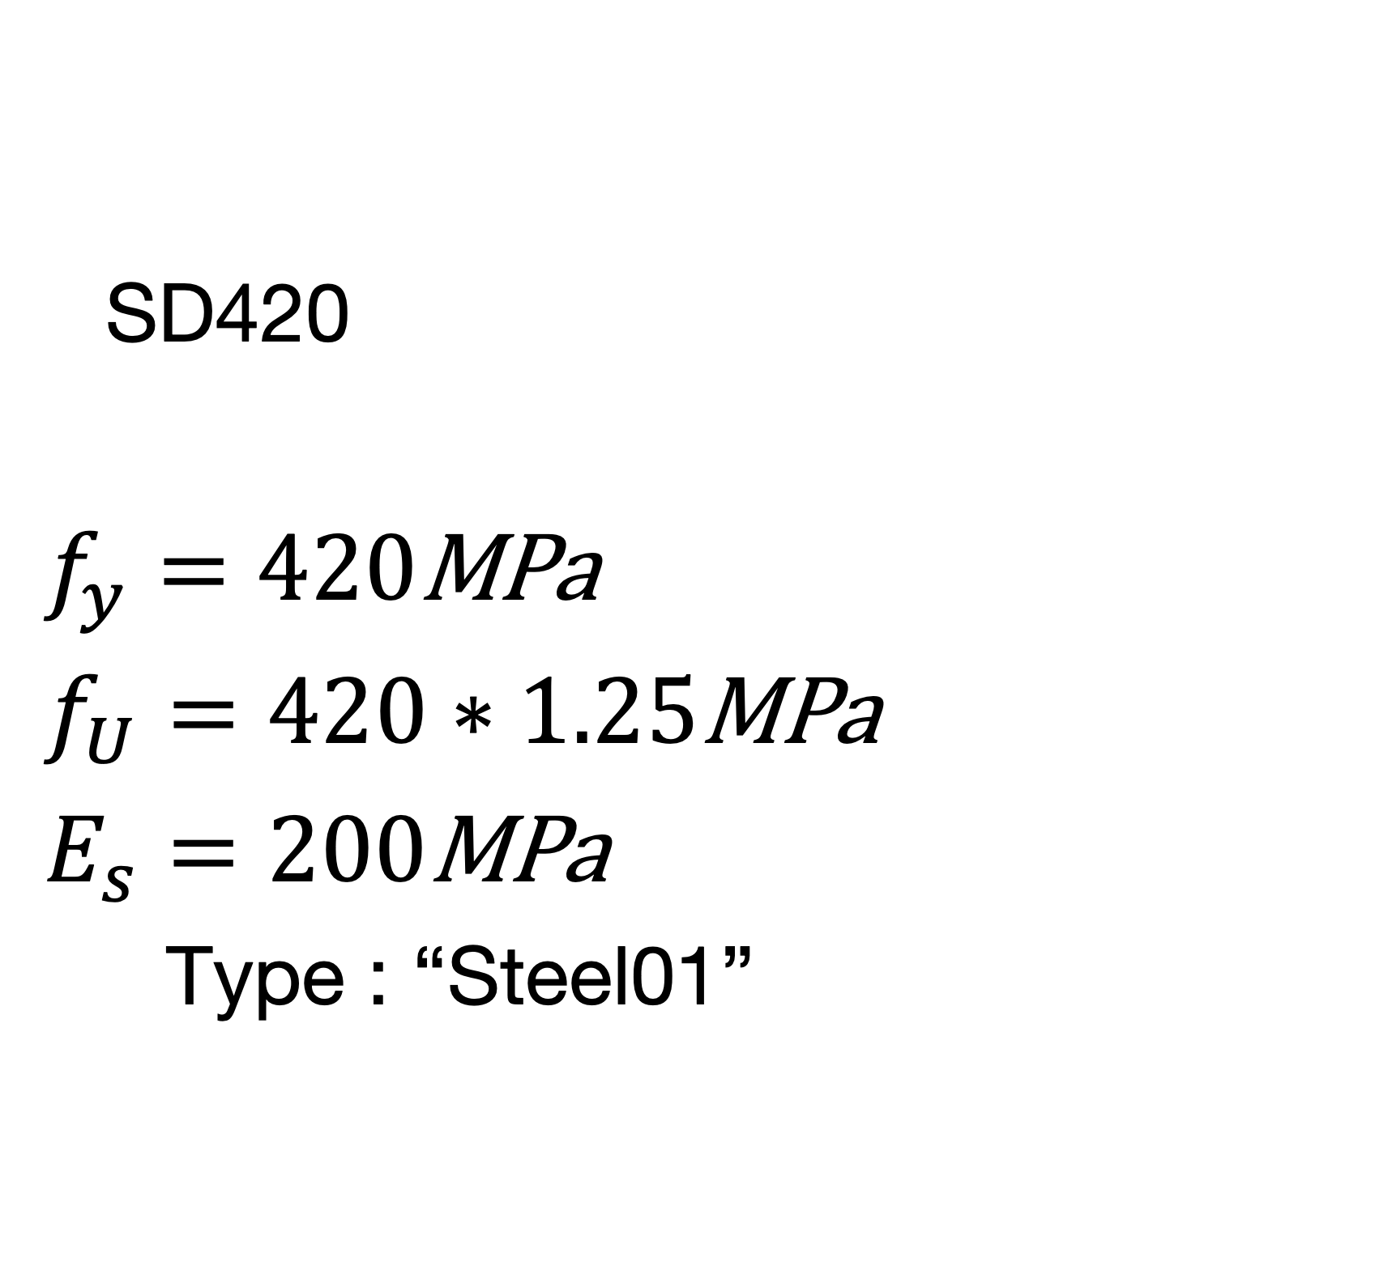
HW1
Material Properties
SD420
$$f_{y}=420\text{MPa}$$
$$f_{U}=420∗1.25\text{MPa}$$
$$E_{s}=200\text{MPa}$$
Type : “Steel01”

Slide 8
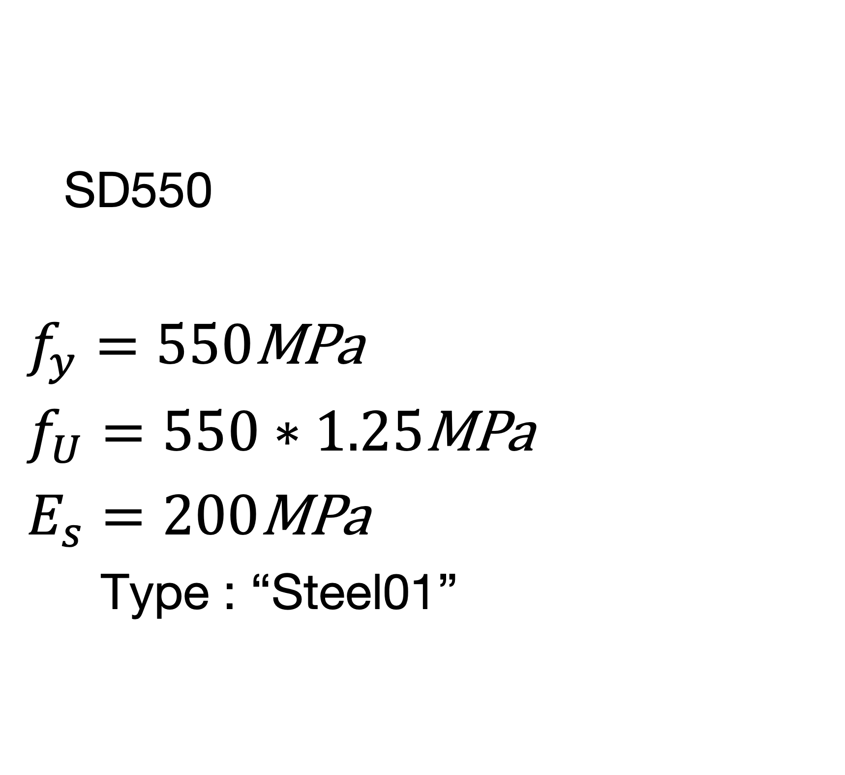
HW1
Material Properties
SD550
$$f_{y}=550\text{MPa}$$
$$f_{U}=550∗1.25\text{MPa}$$
$$E_{s}=200\text{MPa}$$
Type : “Steel01”

Slide 9
HW1
Case1: NC-SD420
Case2: NC-SD550
Case1: HSC-SD420
Case1: HSC-SD420
Analysis case

