Slide 1
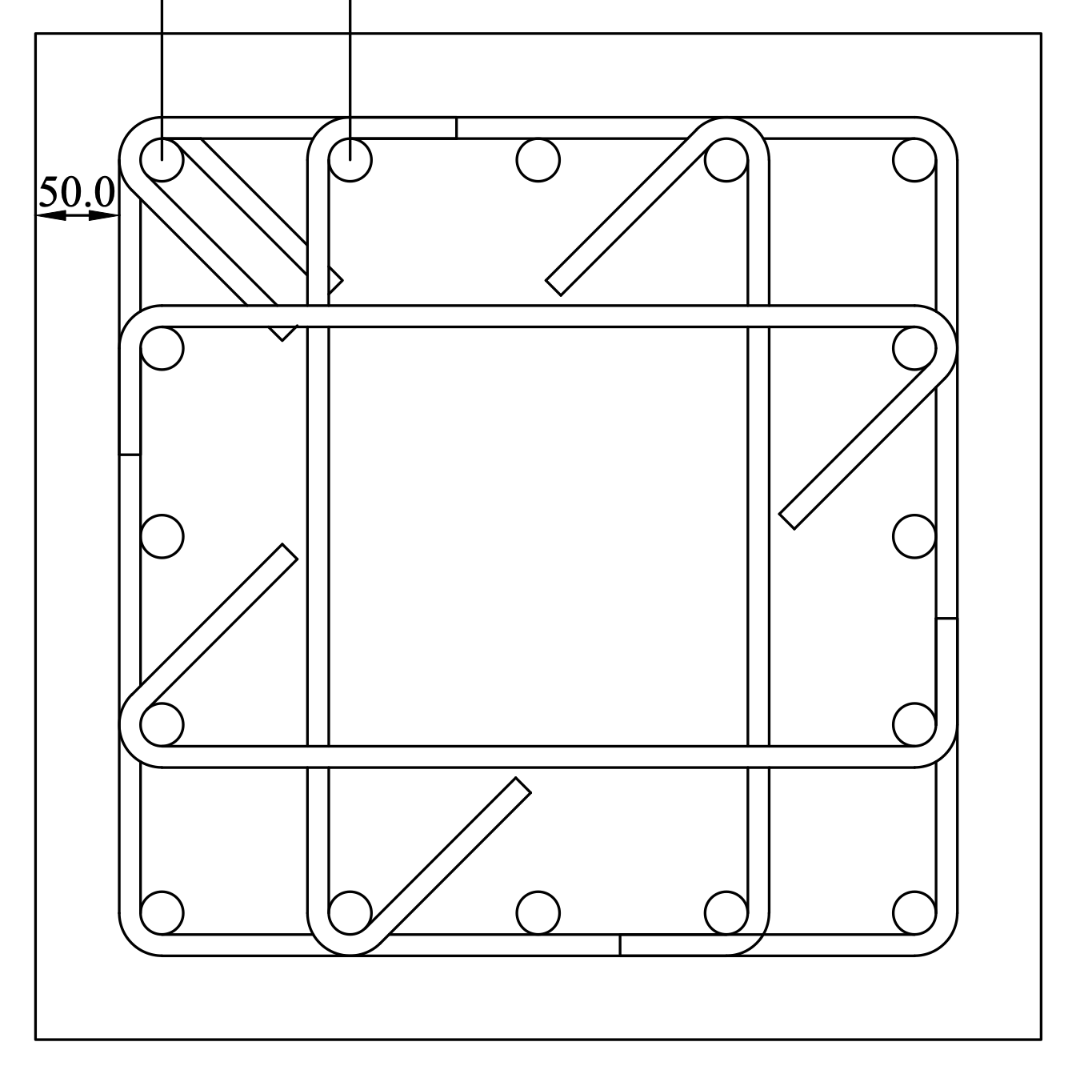
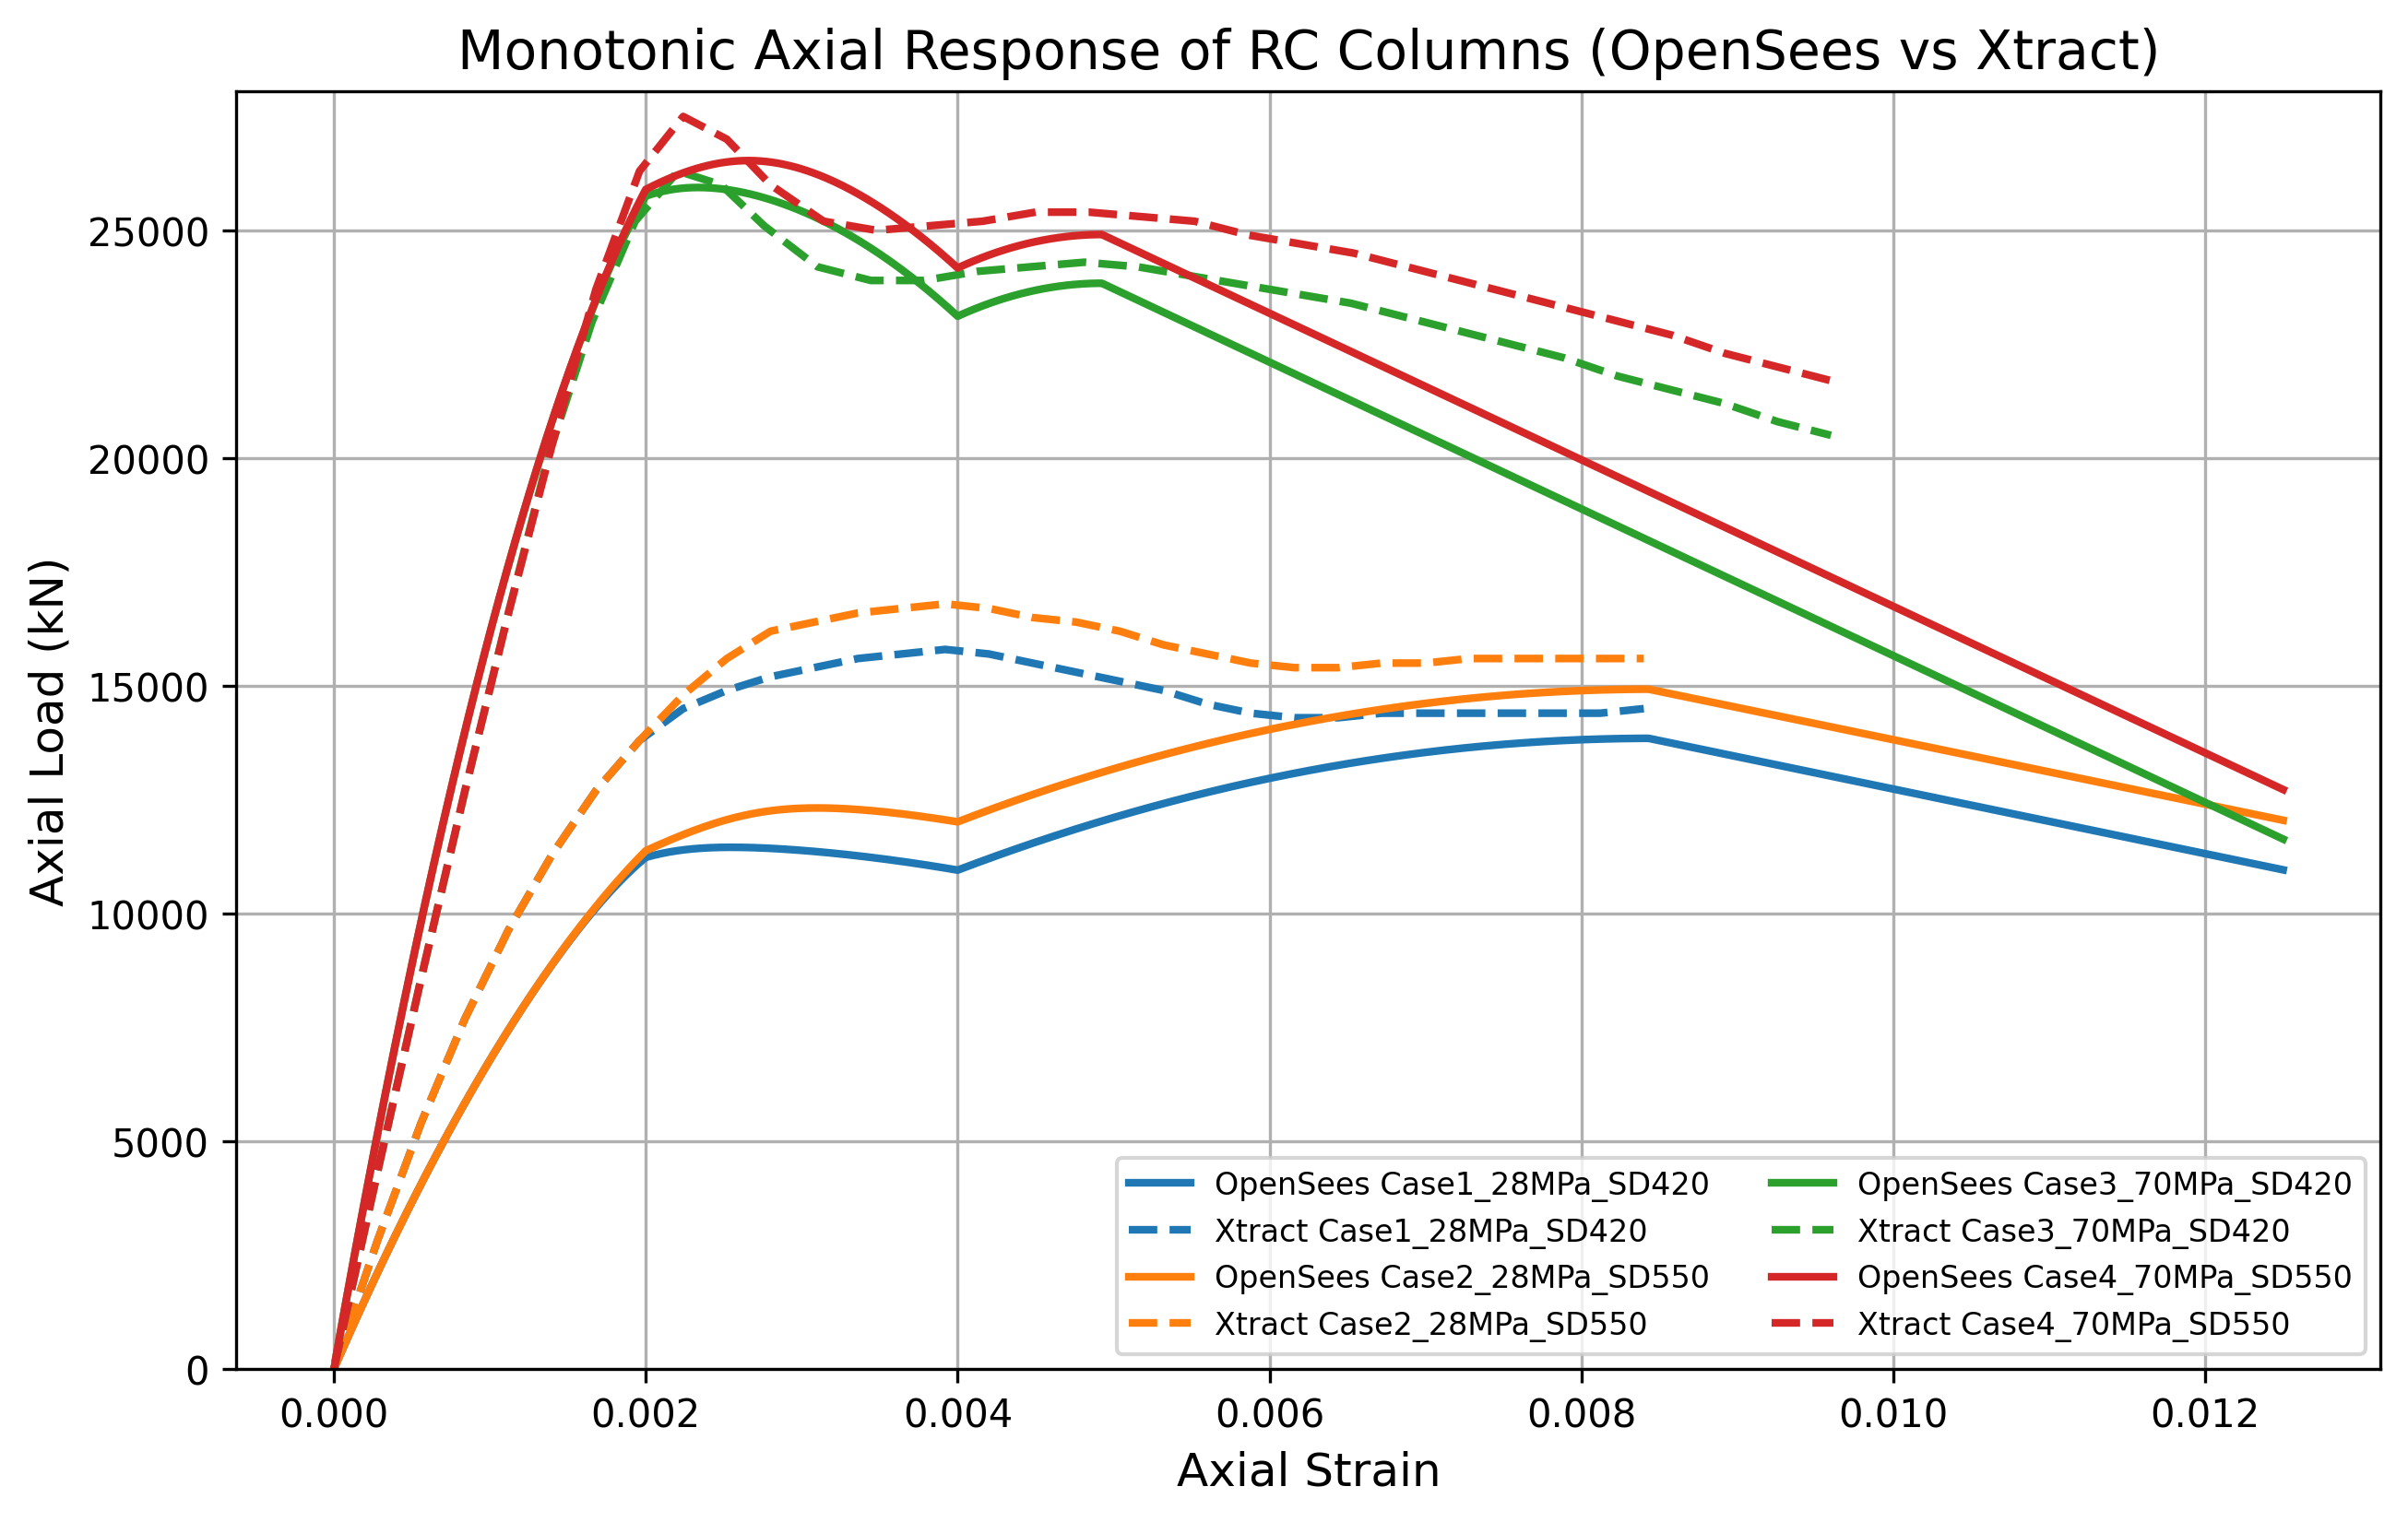


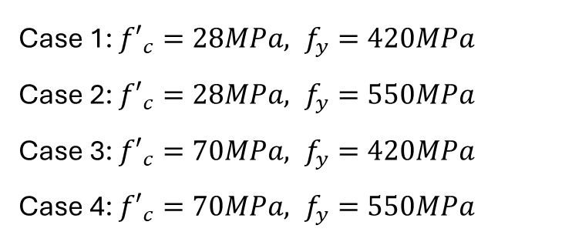
Summary
Case 1: ${{f′}_{c}=28MPa, f}_{y}=420MPa$
Case 2: ${{f′}_{c}=28MPa, f}_{y}=550MPa$
Case 3: ${{f′}_{c}=70MPa, f}_{y}=420MPa$
Case 4: ${{f′}_{c}=70MPa, f}_{y}=550MPa$
Vs.

