Slide 1
Moment-Curvature Behavior
Yu-Hung, Lin
Ping-Xu, Lin
Rhaditya Viansyah A.
N66144220
N66141125
E64148458

Slide 2


Table of content
Section properties
Parameter selection
OpenSees analysis
Xtract analysis
Comparison & Justification
Conclusions

Slide 3
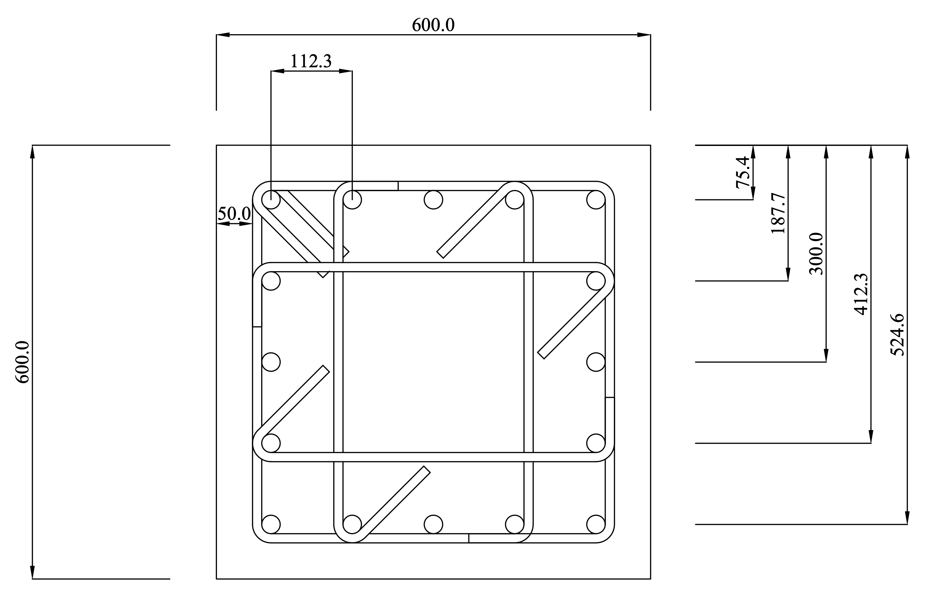
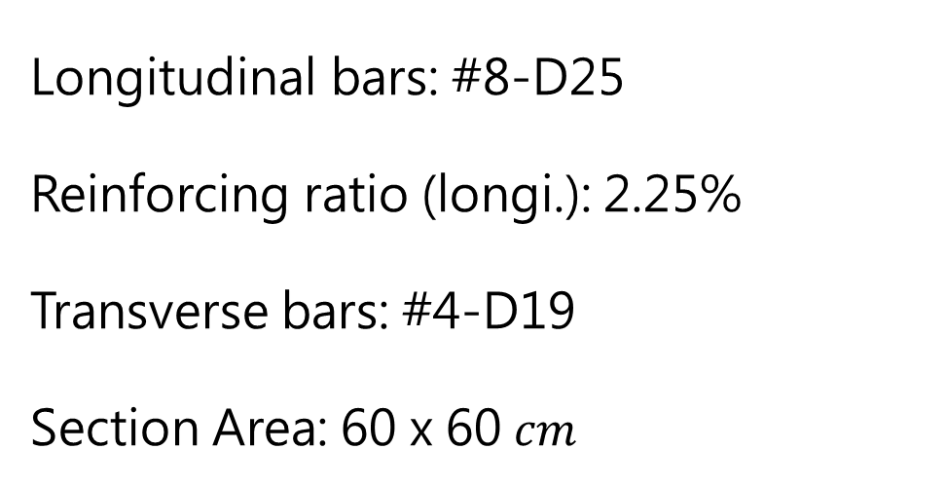
Section properties
Longitudinal bars: #8-D25
Reinforcing ratio (longi.): 2.25%
Transverse bars: #4-D19
Section Area: 60 x 60 $cm$
unit: mm

Slide 4
Parameter selection
Concrete strength (MPa) | Steel grade (MPa)
28 | 420 | 550
35
42
4 combinations were discussed in this report.
case1: (28, 420), case2: (28, 550)
case3: (35, 420), case4: (35, 550)
case5: (42, 420), case6: (42, 550)
1
2
1
2
Notes:
To investigate the effects of different concrete strengths and steel yield strengths on the moment-curvature behavior of a column, a total of 6 cases are discussed in this report.

Slide 5
OpenSees analysis

Slide 6
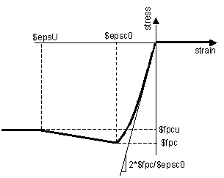

OpenSees analysis
Material properties
Concrete (28、35、42MPa)
$$f_{c}^{′}=28、35、42 \text{MPa}$$
$$ε_{c0}=0.002$$
$$f_{pcu}=0 \text{MPa}$$
$$ε_{cu}=0.004$$
Type: Concrete01
Reference: OpenSees Wiki
Notes:
For the concrete material model, we adopted the Hognestad model and set the peak compressive strain to 0.002.
And to accurately capture the physical phenomenon of cover spalling at the ultimate state, we defined the unconfined concrete to fail completely when the compressive strain reaches 0.004, meaning the residual strength is set to zero.

Slide 7
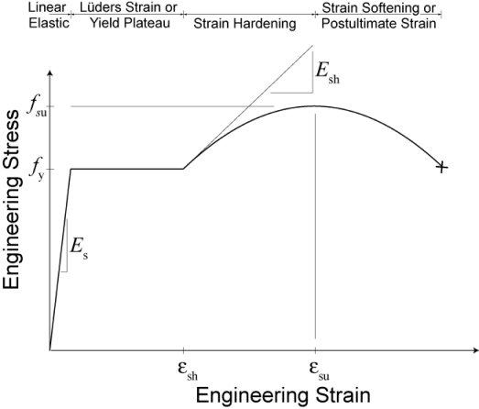

OpenSees analysis
Material properties
Reinforcement (420、550MPa)
$$f_{y}=420、550\text{MPa}$$
Type: Reinforcingsteel
Chang and Mander(1994) uniaxial steel model
Reference: OpenSees Wiki
Notes:
In many cases, people use steel01 and steel02 model to simulate rebars in the analysis,
But they are oversimplified and fail to capture the yielding plateau and non-linear strain hardening of steel reinforcement.
Therefore, in this study, we implement the ReinforcingSteel model to fully simulate the true behavior of the rebar up to its ultimate strength

Slide 8
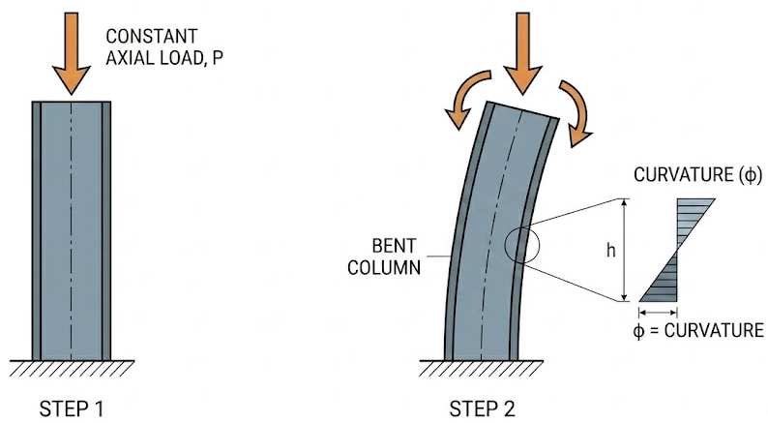
OpenSees analysis
Loading pattern
Phase 1: Apply a constant axial load (20% axial load ratio)
Phase 2: Increment the curvature (Displacement control, DOF 3)
Notes:
First, we apply an axial load to the section, setting the axial load ratio at 20%, and keep it constant throughout the analysis.
After the axial load is fully applied, we start to increase the curvature.
We do this by using a displacement-control method, specifically controlling the third degree of freedom—DOF 3—to achieve true curvature control.

Slide 9
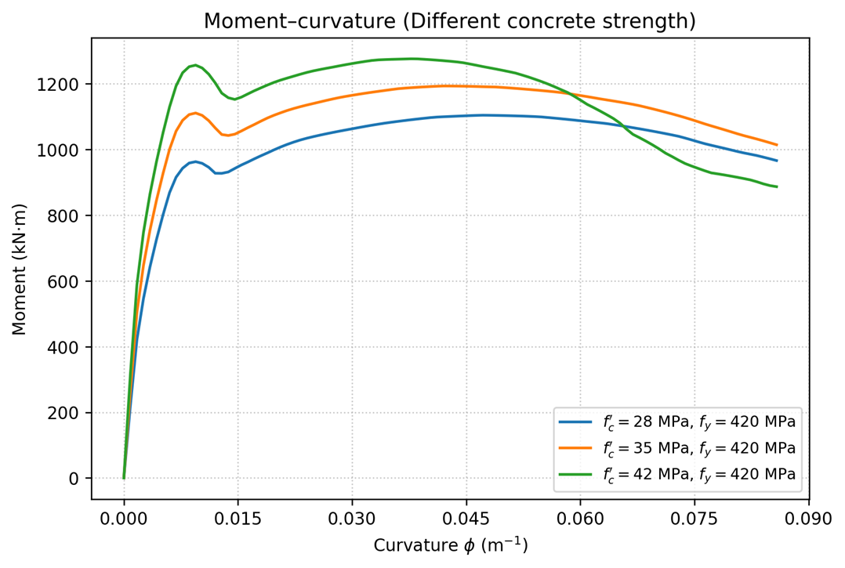
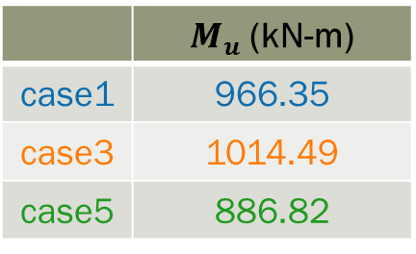
OpenSees analysis
Results
Different concrete strength
W / SD420
 | $M_{u}$ (kN-m)
case1 | 966.35
case3 | 1014.49
case5 | 886.82
*$M_{max}$ is the moment corresponding to the maximum curvature
Notes:
On this slide, we are examining the effect of different concrete strength—from 28, to 35, to 42 MPa—on the moment-curvature behavior of the section, while keeping the longitudinal reinforcement constant using SD420 steel.
We specifically extracted the ultimate moment (M_{u}) at the end of the curve and marked it with horizontal dashed lines.
Here, you might notice a phenomenon: Case 5, which uses the 42 MPa concrete, actually drops to the lowest residual ultimate moment at 886.82 among the three.
This behavior is primarily due to the brittleness of 42 MPa concrete compared to 28 and 35. It provides a much higher peak strength, but it suffers from the serious cover spalling when subjected to large deformations. After the cover concrete spalls, the core confined concrete crushes and degrades at a much faster rate compared to the lower-strength concrete.
0.08575

Slide 10
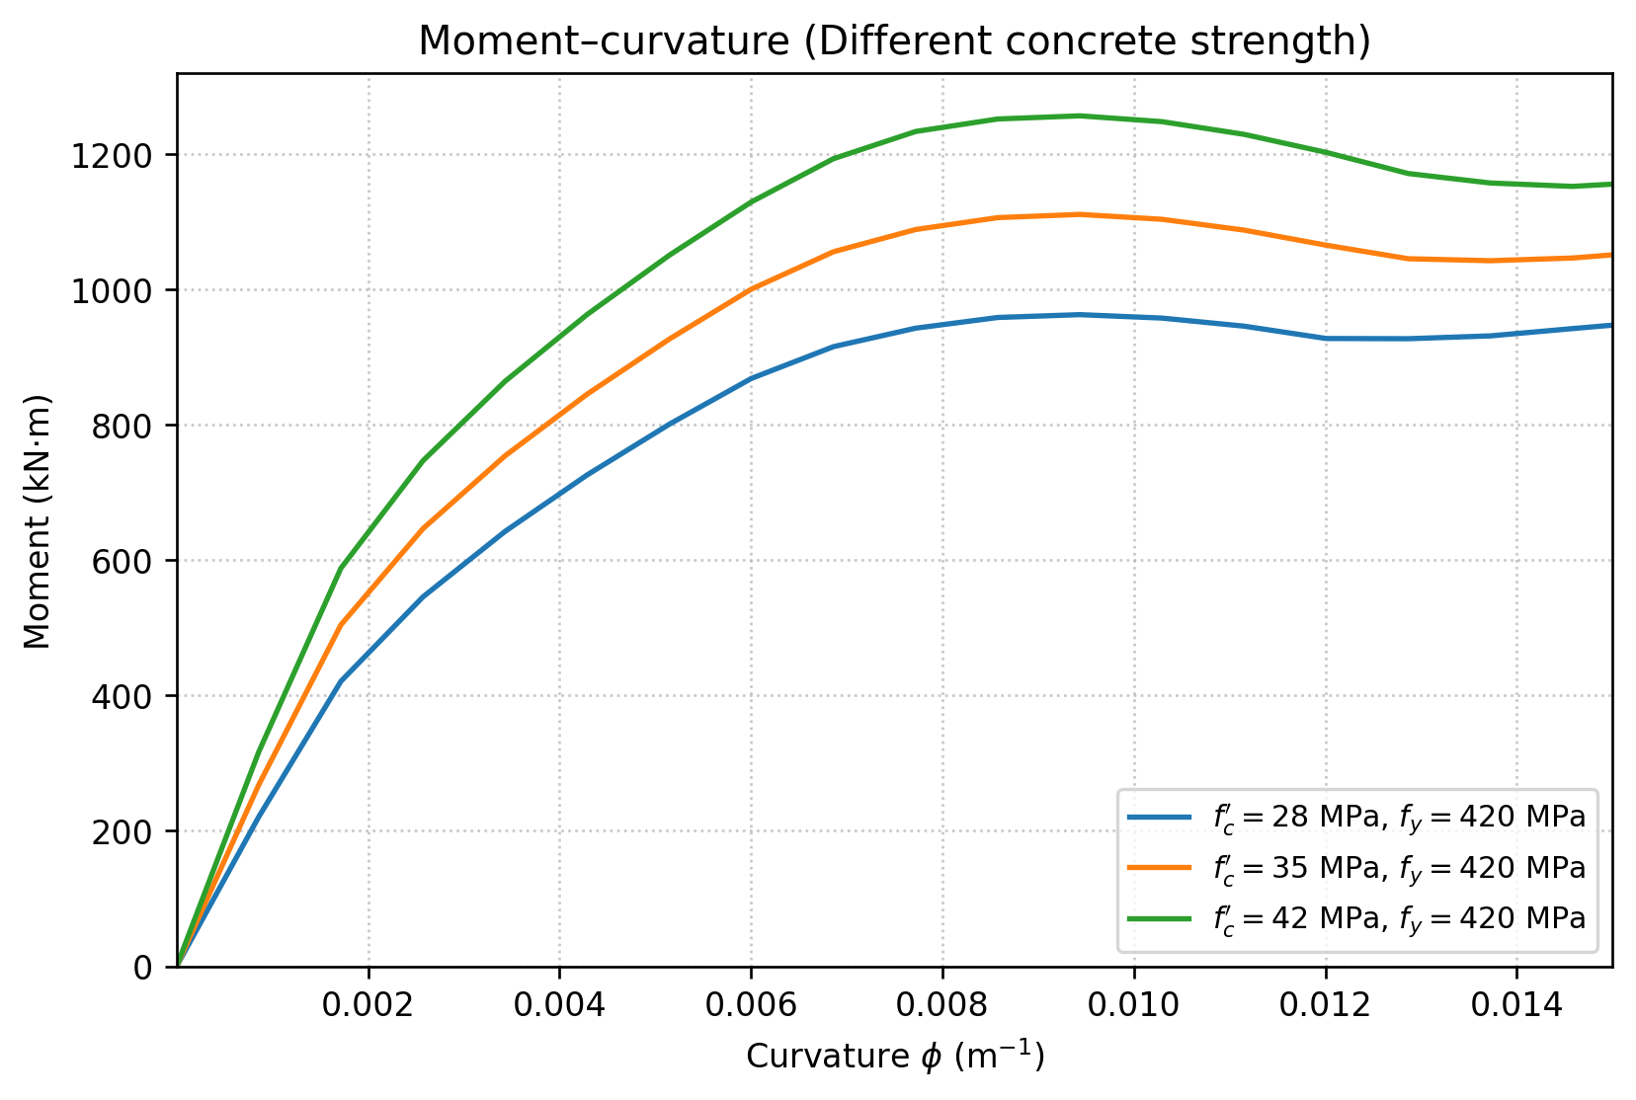
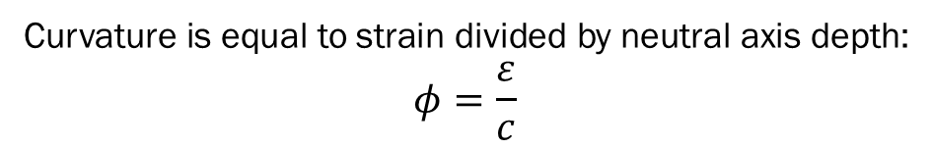

OpenSees analysis
$f^{′}c$ ↑, $φ$ ↑
Curvature is equal to strain divided by neutral axis depth:
$$φ=\frac{ε}{c}$$
Notes:
This is a magnified moment-curvature plot. To provide a clear view of the section’s failure progress,
we have zoomed in on the curves and marked the onset of concrete cover spalling for each case with vertical dashed lines.
First, as expected, the green curve 42 MPa concrete with SD420 rebar demonstrates the highest flexural stiffness and peak strength.
When the ultimate strain is reached and the concrete cover spalls off, losing its load-bearing capacity, all three curves accurately reflect the moment drop after the peak.
3條虛線(spall的曲率差異)
On the right side, there are 3 dashed lines
We can see that, as the concrete strength increases, the curvature corresponding to the cover spalling actually becomes larger,
which means the dashed lines shift further to the right.
This occurs because higher-strength concrete can withstand greater compressive stress.
As a result, to maintain internal force equilibrium of the section, the required neutral axis depth decreases.
Assuming the cover spalls at a compressive strain of 0.004, a smaller neutral axis depth naturally calculates to a larger curvature.

Slide 11
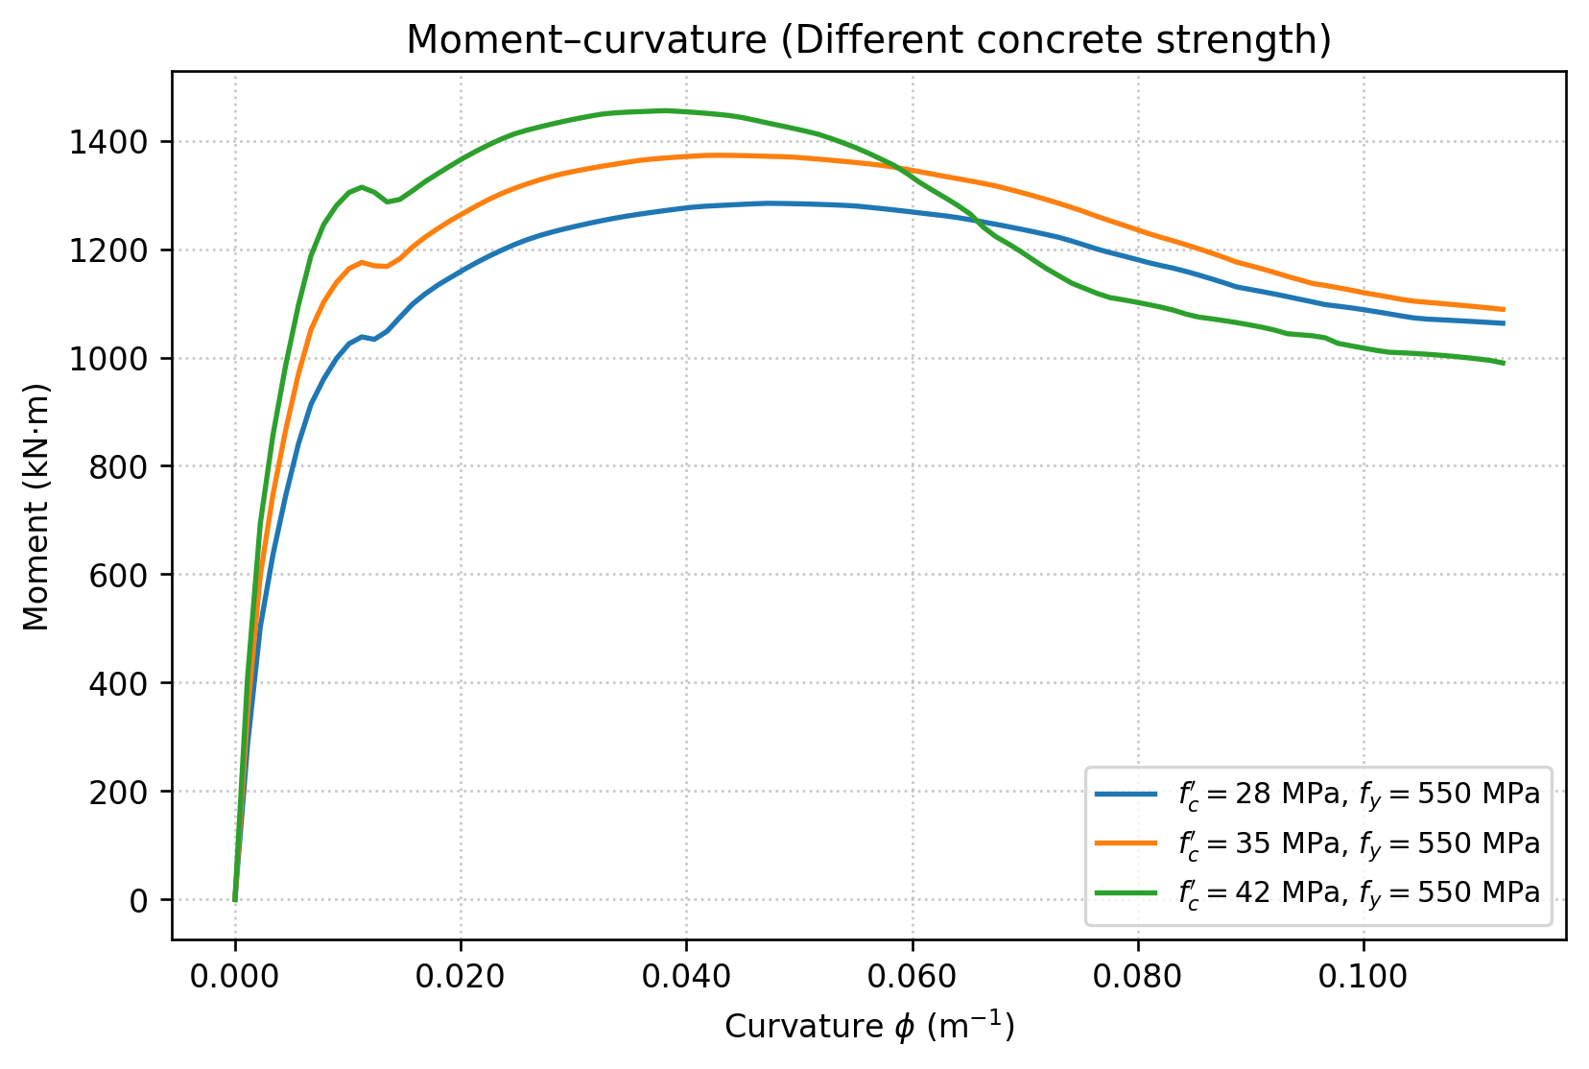
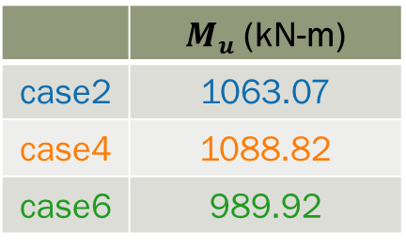
OpenSees analysis
Results
Different concrete strength
W / SD550
Spalling
 | $M_{u}$ (kN-m)
case2 | 1063.07
case4 | 1088.82
case6 | 989.92
Notes:
In this part, we upgraded the reinforcement to SD550, expecting the higher-strength steel to carry the strength loss as the concrete cover spalling.
As you can see from the curves, unlike the previous SD420 cases, although a sudden moment drop still occurs after spalling, the magnitude of this drop is significantly reduced.
Furthermore, the higher-strength steel accelerates the moment recovery, creating a second peak to these 3 cases.
However, as the curvature is pushed to the ultimate limit, the green curve which is case6 still experiences a Steep decline,
and its residual strength of 989.92 remains the lowest among the three.
This indicates that the strain hardening of the high-strength steel SD550 ultimately cannot fully offset the core crushing and brittle degradation of the 42 MPa concrete at extreme deformations.
In contrast, look at the orange curve, Case 4, which uses the 35 MPa concrete. It benefits from the secondary peak gain provided by the SD550, perfectly sustaining a high ultimate moment of 1088.82
This clearly verifies that, 35 MPa concrete with SD550 steel is the optimal combination of these 6 cases
0.1123

Slide 12
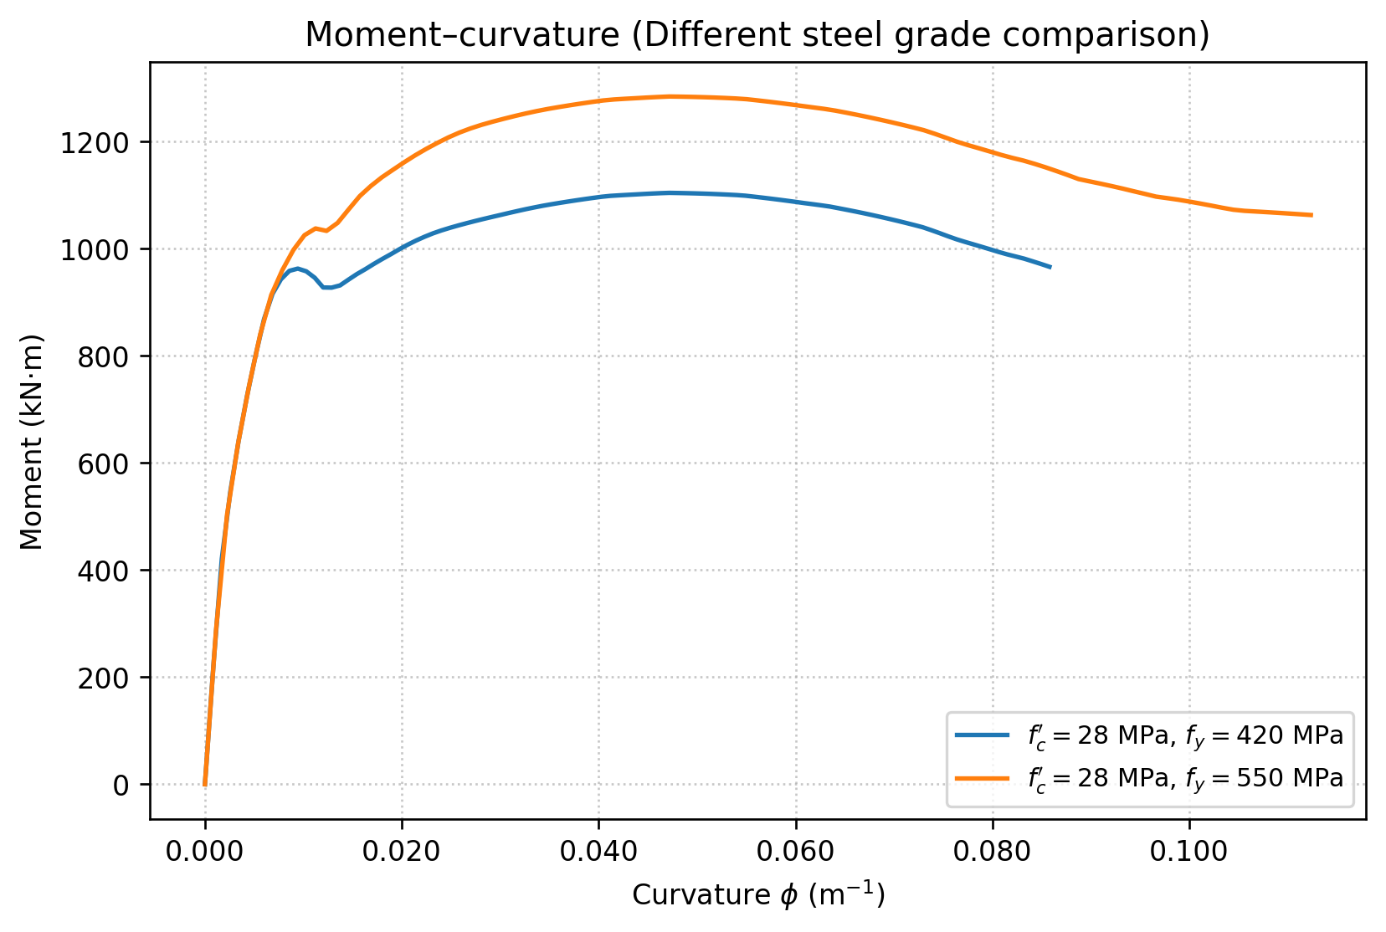
OpenSees analysis
Results
Different steel grade
W / 28MPa concrete
Notes:
In the previous slides, we discussed the effect of concrete strength. Now, we keep the constant concrete strength constant,
we will evaluate the specific benefits of upgrading the longitudinal reinforcement from SD420 to SD550.
First, for the 28 MPa baseline group. As you can see, during the elastic stage—before a curvature of 0.01—the blue and orange curves overlap completely,
because the stiffness here is dominated by the concrete. The real difference occurs after the cover concrete spalling.
After reaching its peak, the blue line (SD420 steel) begins to gradually decline. In contrast, the orange line (SD550 steel), because it yields later and hardens significantly, successfully reverses the downward trend and pushes upward to a second peak. This clearly establishes the fundamental mechanism of how high-strength steel rescues the load-carrying capacity after cover spalling.

Slide 13
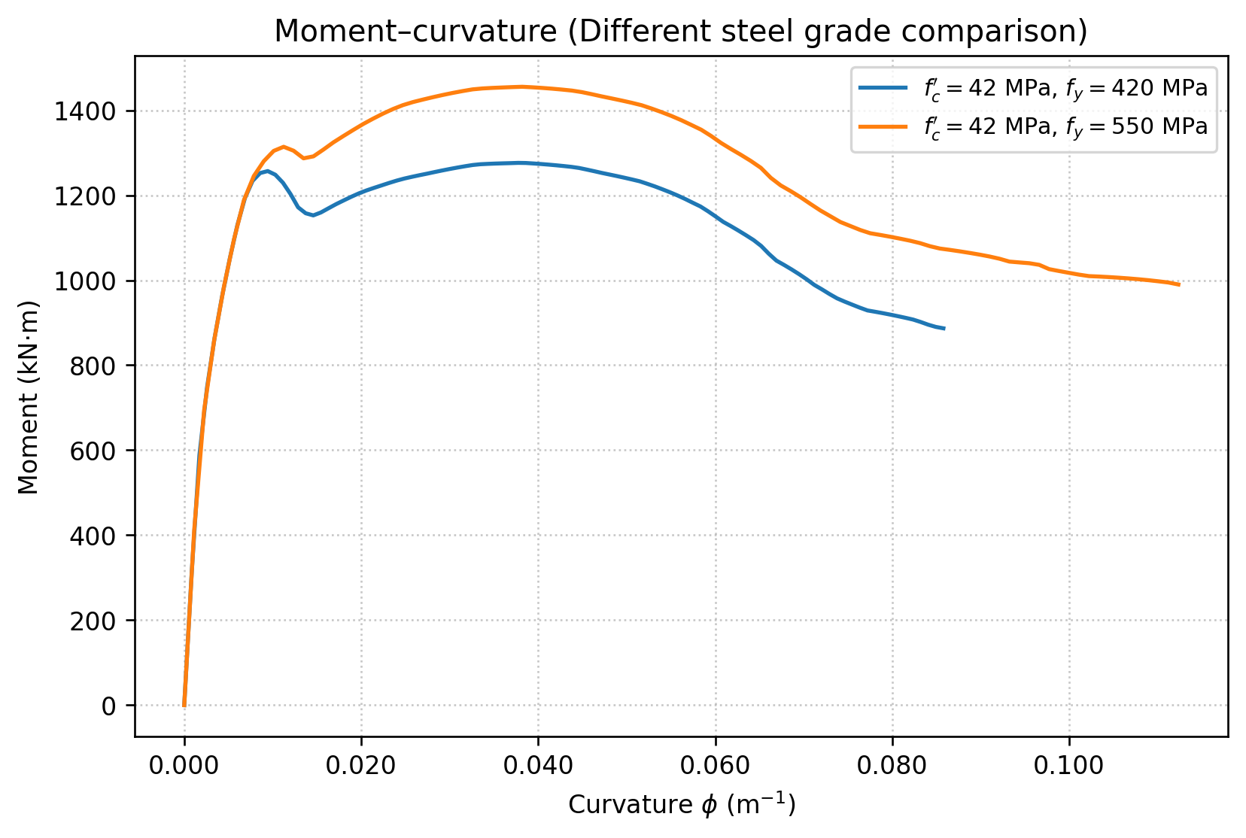
OpenSees analysis
Results
Different steel grade
W / 42MPa concrete
Notes:
Finally, let's examine the extreme case of 42 MPa. On the surface, the SD550 steel aggressively pushes the maximum moment of this section well beyond the 1400 kN-m mark. However, look at the steep drop of the orange line (SD550) after a curvature of 0.06. This graph provides us with a crucial mechanical warning: no matter how strong the strain hardening of the steel is, it cannot prevent the brittle collapse of a high-strength concrete core. When the 42 MPa core crushes prematurely, causing a rapid shortening of the internal moment arm, even SD550 steel cannot save the section from degrading.
To summarize the comparison of these 2 graphs, we can draw a clear conclusion: while upgrading to SD550 steel indeed comprehensively increases the ultimate load-carrying capacity, if we want to ensure the ultimate ductility of the member during a major earthquake, we must very carefully control the issue of brittle degradation in high-strength concrete.

