Slide 1
Monotonic Lateral (Pushover) Behavior of Columns
Yu-Hung, Lin
Ping-Xu, Lin
Rhaditya Viansyah A.
N66144220
N66141125
E64148458

Slide 2


Table of content
Section properties
Parameter selection
OpenSees analysis
Xtract analysis
Comparison & Justification
Conclusions

Slide 3
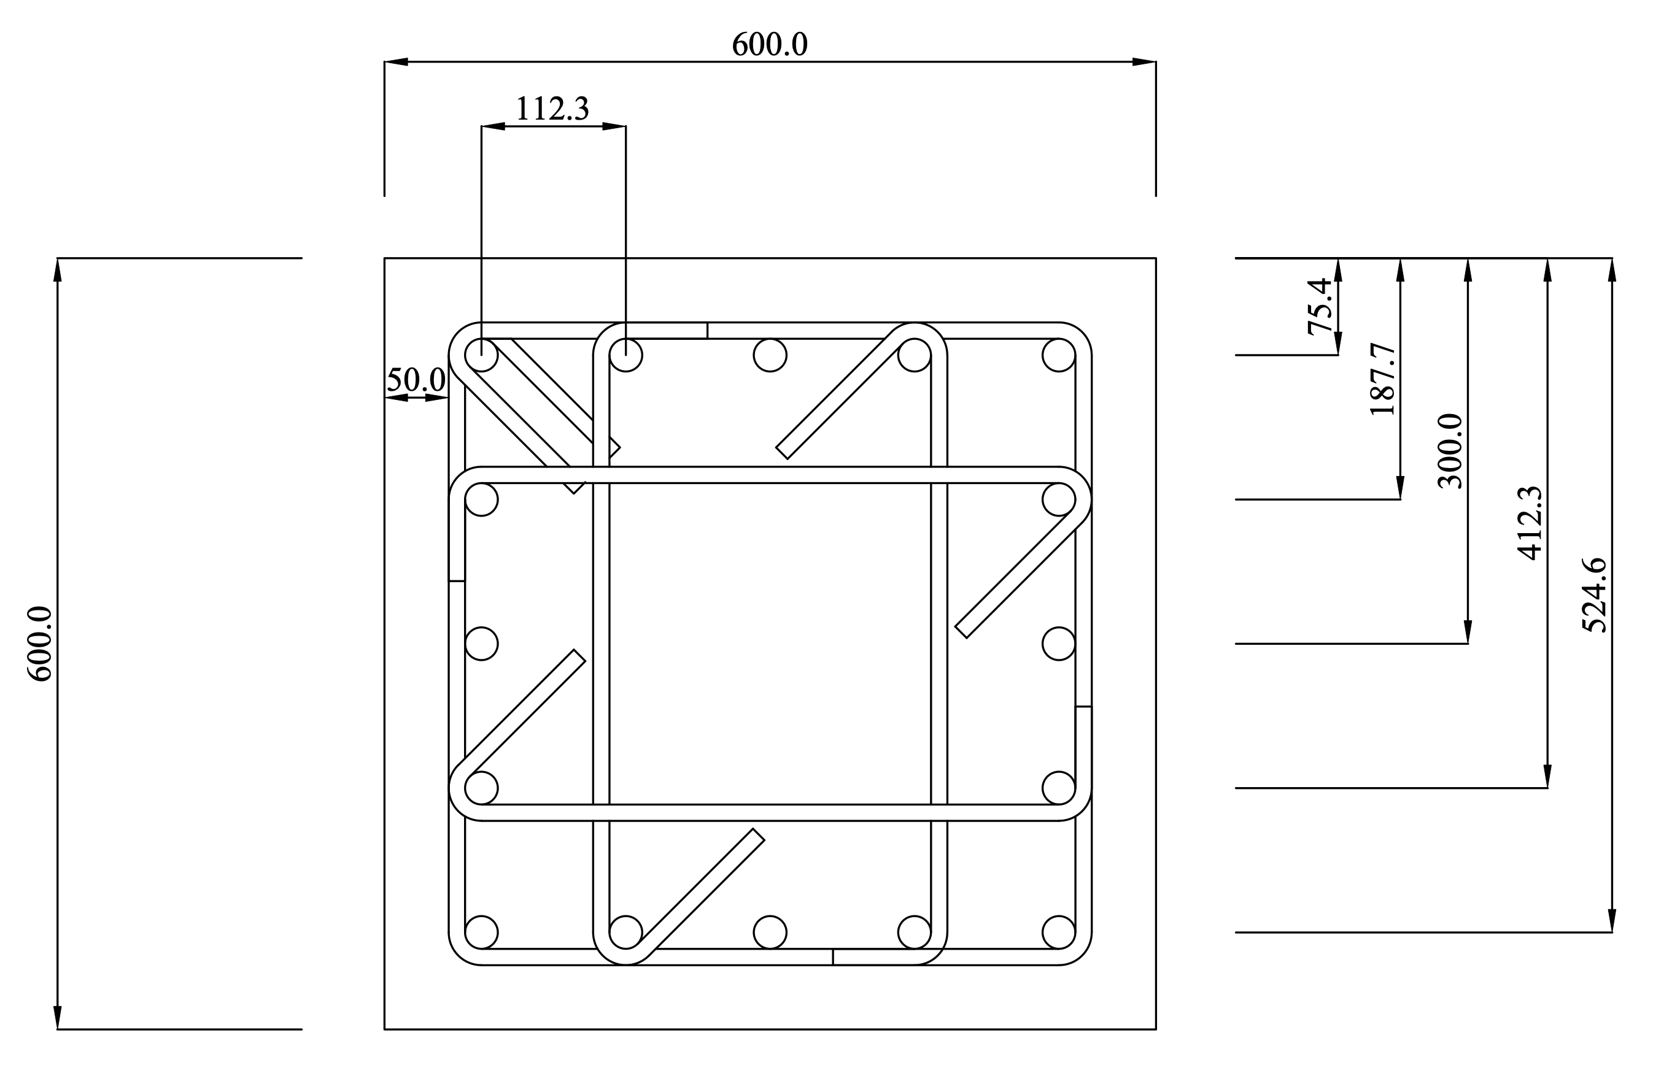
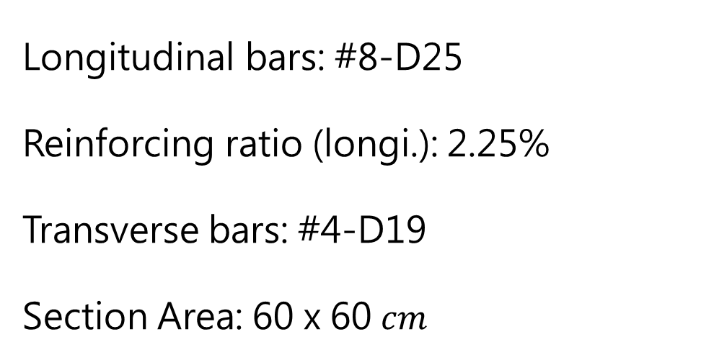
Section properties
Longitudinal bars: #8-D25
Reinforcing ratio (longi.): 2.25%
Transverse bars: #4-D19
Section Area: 60 x 60 $cm$
unit: mm

Slide 4
OpenSees analysis

Slide 5
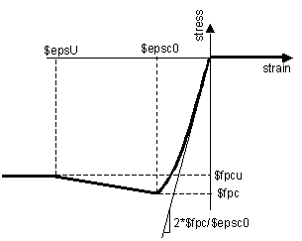

OpenSees analysis
Material properties
Concrete (28、35、42MPa)
$$f_{c}^{′}=28、35、42 \text{MPa}$$
$$ε_{c0}=0.002$$
$$f_{pcu}=0 \text{MPa}$$
$$ε_{cu}=0.004$$
Type: Concrete01
Reference: OpenSees Wiki

Slide 6
Xtract analysis

Slide 7
Comparison & Justification

Slide 8
Conclusion

