Slide 1
Assembly Language for x86 Processors 7th Edition, Global Edition
Kip Irvine
Chapter 2: x86 Processor Architecture
Slides prepared by the author
Revision date: 1/15/2014 Modified by: Liang, 2016 Spring
(c) Pearson Education, 2015. All rights reserved. You may modify and copy this slide show for your personal use, or for use in the classroom, as long as this copyright statement, the author's name, and the title are not changed.

Slide 2
Chapter Overview
General Concepts
IA-32 Processor Architecture
Modes of operation
Basic execution environment
IA-32 Memory Management
Protected Mode
64-bit Processors
Components of an IA-32 Microcomputer
Input-Output System

Slide 3
General Concepts
Basic microcomputer design
Instruction execution cycle
Reading from memory
How program runs

Slide 4
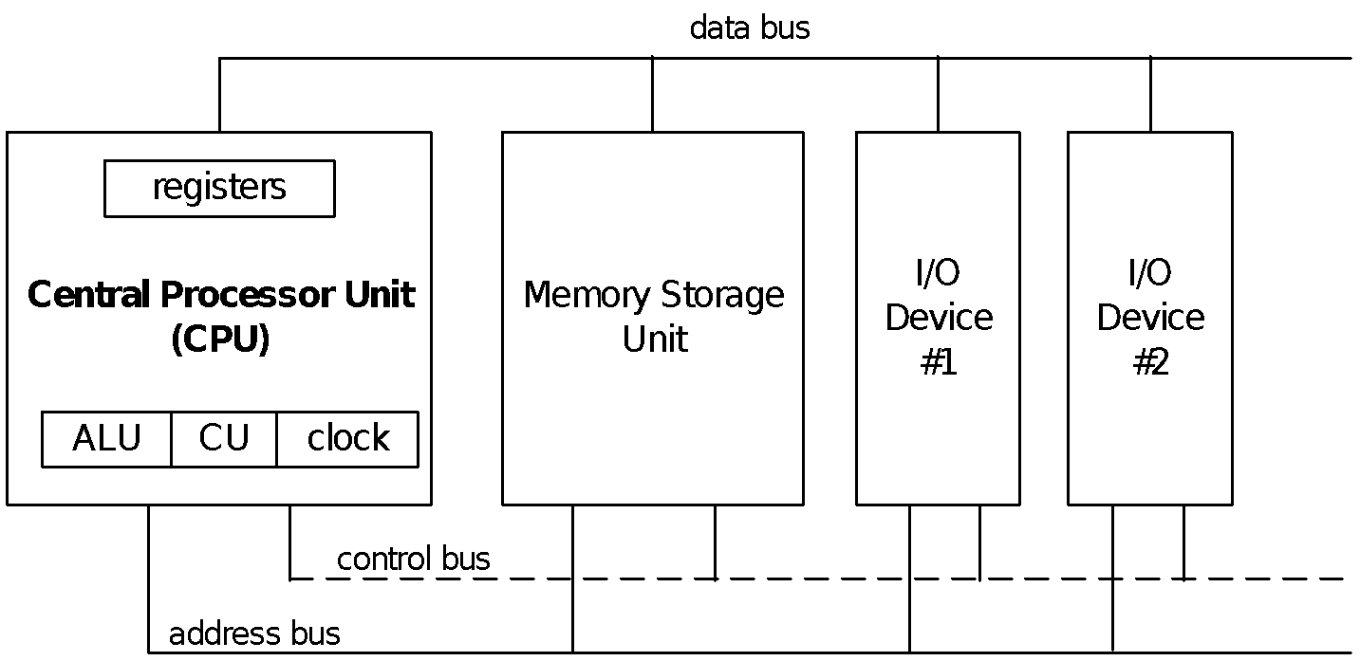
Basic Microcomputer Design
clock synchronizes CPU operations
control unit (CU) coordinates sequence of execution steps
ALU performs arithmetic and bitwise processing

Slide 5
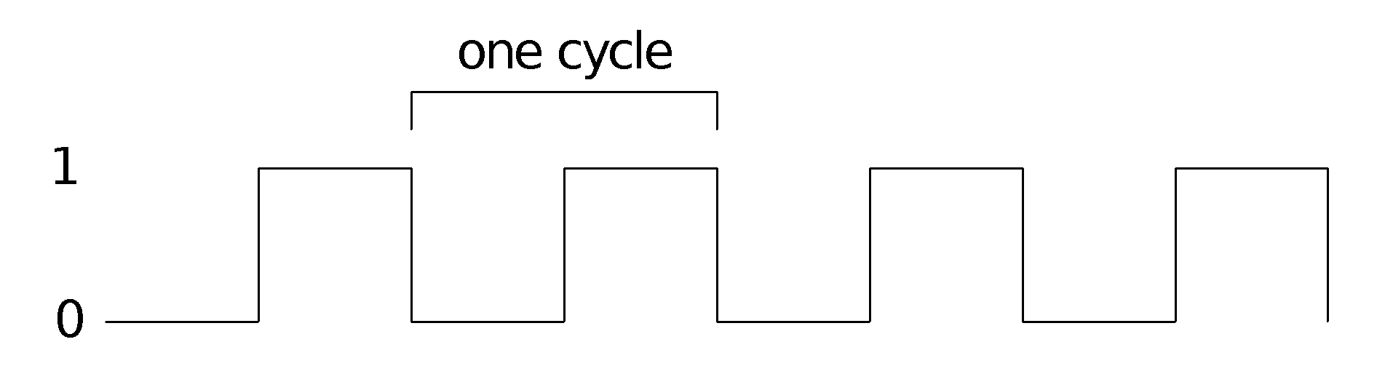
Clock
synchronizes all CPU and BUS operations
machine (clock) cycle measures time of a single operation
clock is used to trigger events

Slide 6
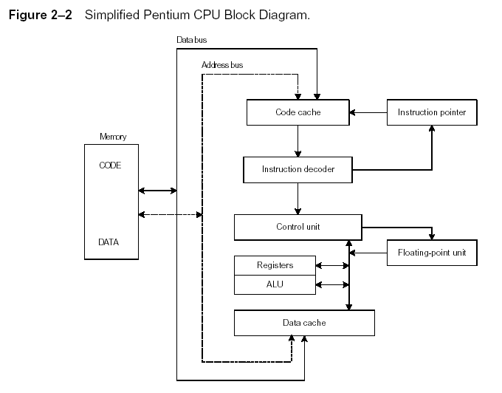
Instruction Execution Cycle
Instruction Execution Cycle
Fetch
Decode
Fetch operands
Execute
Store output

Slide 7
Reading from Memory
Multiple machine cycles are required when reading from memory, because it responds much more slowly than the CPU. The steps are:
Place the address of the value you want to read on the address bus.
Assert (changing the value of) the processor’s RD (read) pin.
Wait one clock cycle for the memory chips to respond.
Copy the data from the data bus into the destination operand

Slide 8
Cache Memory
High-speed expensive static RAM both inside and outside the CPU.
Level-1 cache: inside the CPU
Level-2 cache: outside the CPU
Cache hit: when data to be read is already in cache memory
Cache miss: when data to be read is not in cache memory.

Slide 9
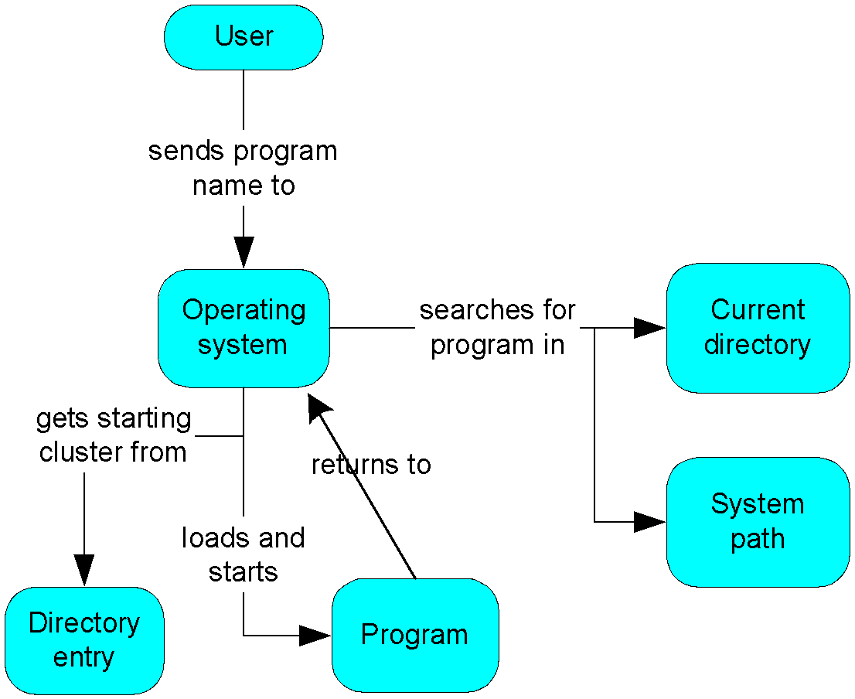
How a Program Runs

Slide 10
What's Next
General Concepts
IA-32 Processor Architecture
IA-32 Memory Management
64-Bit Processors
Components of an IA-32 Microcomputer
Input-Output System

Slide 11
IA-32 Processor Architecture
Modes of operation
Basic execution environment

Slide 12
Modes of Operation
Protected mode
native mode (Windows, Linux)
Real-address mode
native MS-DOS
System management mode
power management, system security, diagnostics
Virtual-8086 mode
hybrid of Protected
each program has its own 8086 computer

Slide 13
Basic Execution Environment
Addressable Memory
General-purpose registers
Index and base registers
Specialized register uses
Status flags
Floating-point, MMX, XMM registers

Slide 14
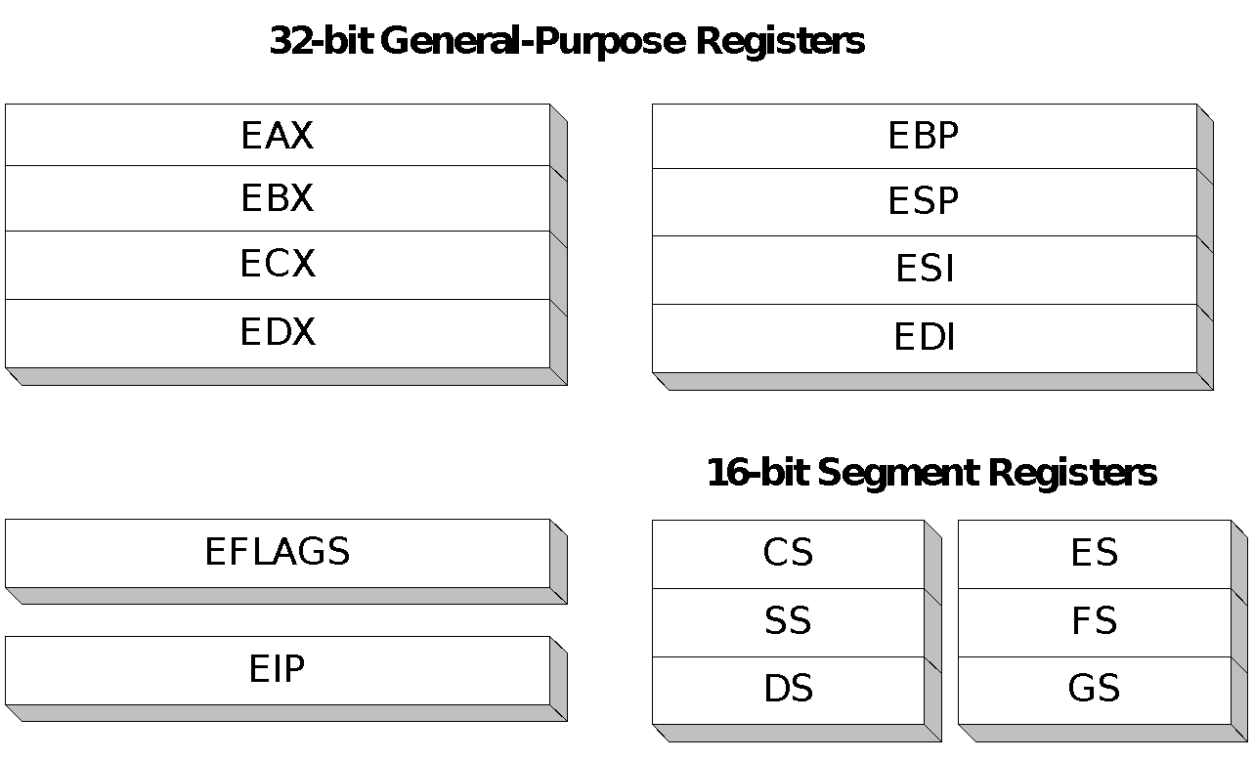
General-Purpose Registers
Named storage locations inside the CPU, optimized for speed.
CPU
控制單元 (Control Unit)
Memory
System bus
暫存器Register
16-bit Segment
Registers
32-bit General-Propose Registers
EAX | EBP
EBX | ESP
ECX | ESI
EDX | EDI
CS
SS
DS
ES
SS
GS
算術邏輯單元 (ALU)
EIP
EFLAGS

Slide 15
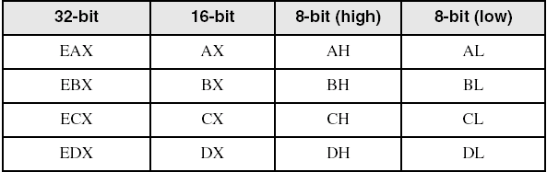
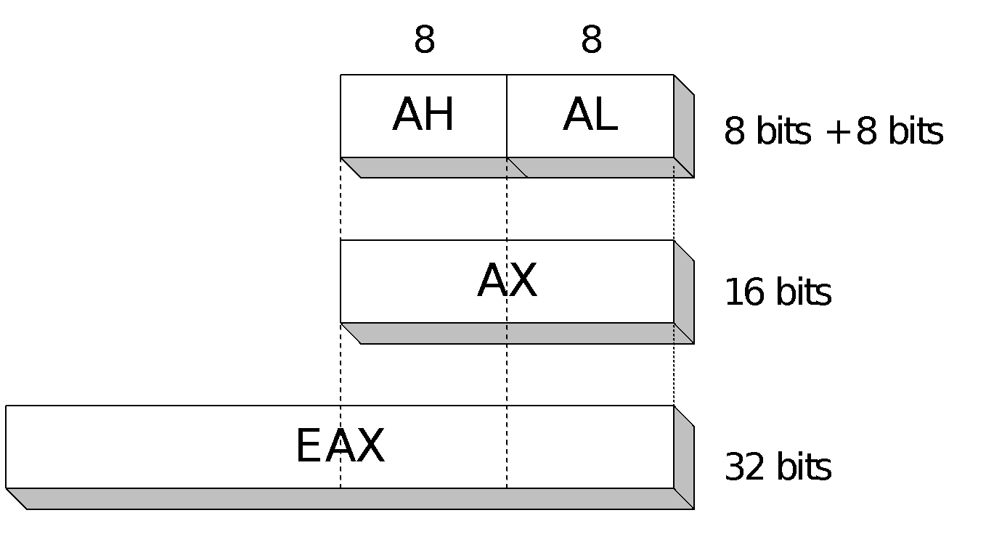
Accessing Parts of Registers
Use 8-bit name, 16-bit name, or 32-bit name
Applies to EAX, EBX, ECX, and EDX

Slide 16
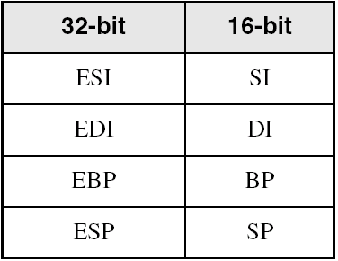
Index and Base Registers
Some registers have only a 16-bit name for their lower half:

Slide 17
Some Specialized Register Uses (1 of 2)
General-Purpose
EAX – accumulator
ECX – loop counter
ESP – stack pointer
ESI, EDI – index registers
EBP – extended frame pointer (stack)
Segment
CS – code segment
DS – data segment
SS – stack segment
ES, FS, GS - additional segments

Slide 18
Some Specialized Register Uses (2 of 2)
EIP – instruction pointer
EFLAGS
status and control flags
each flag is a single binary bit

Slide 19
Status Flags
Carry (bit 0)
unsigned arithmetic out of range
Overflow (bit 11)
signed arithmetic out of range
Sign (bit 7)
result is negative
Zero (bit 6)
result is zero
Auxiliary Carry (bit 4)
carry from bit 3 to bit 4
Parity (bit 2)
sum of 1 bits is an even number
 |  | OF |  | SF | ZF |  | AF |  | PF |  | CF | EFLAGS
31 | … | 11 | … | 7 | 6 | … | 4 | … | 2 | … | 0

Slide 20
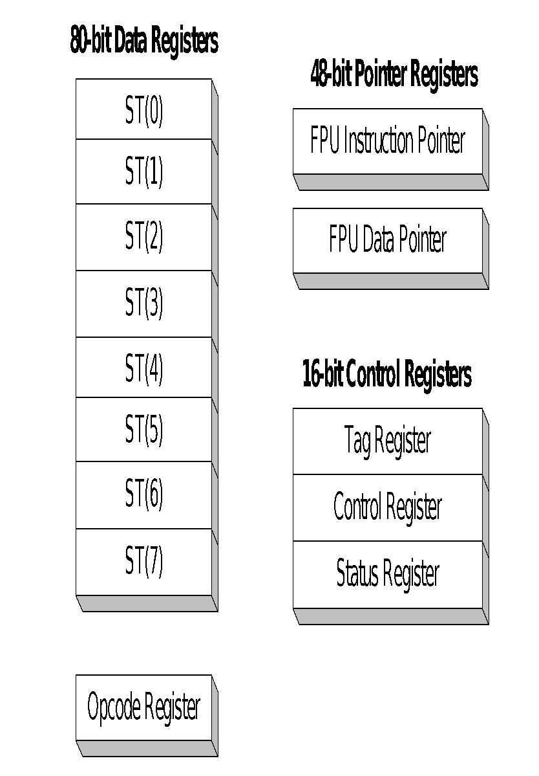
Floating-Point, MMX, XMM Registers
Eight 80-bit floating-point data registers
ST(0), ST(1), . . . , ST(7)
arranged in a stack
used for all floating-point arithmetic
Eight 64-bit MMX registers
Eight 128-bit XMM registers for single-instruction multiple-data (SIMD) operations

Slide 21
What's Next
General Concepts
IA-32 Processor Architecture
IA-32 Memory Management
64-Bit Processors
Components of an IA-32 Microcomputer
Input-Output System

Slide 22
IA-32 Memory Management
Real-Address mode
Protected mode

Slide 23
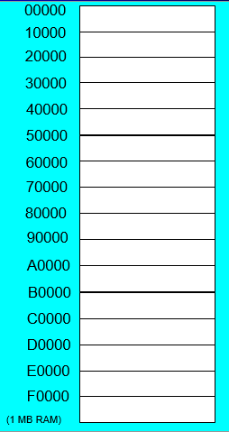
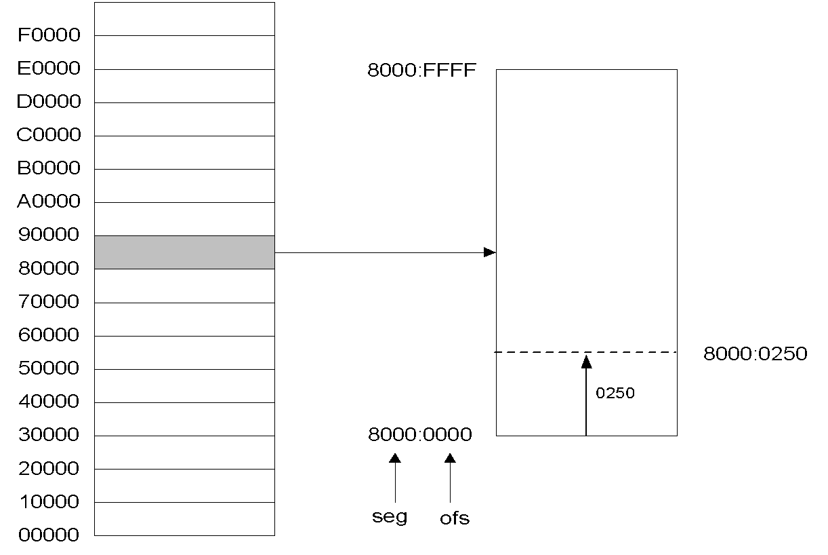
Real-address mode
Real-address and Virtual-8086 modes
1 MB space
20-bit address
Single tasking
Programs can access any area of memory
linear addresses
Notes:
16-bit real mode segment can be overlapped.

Slide 24
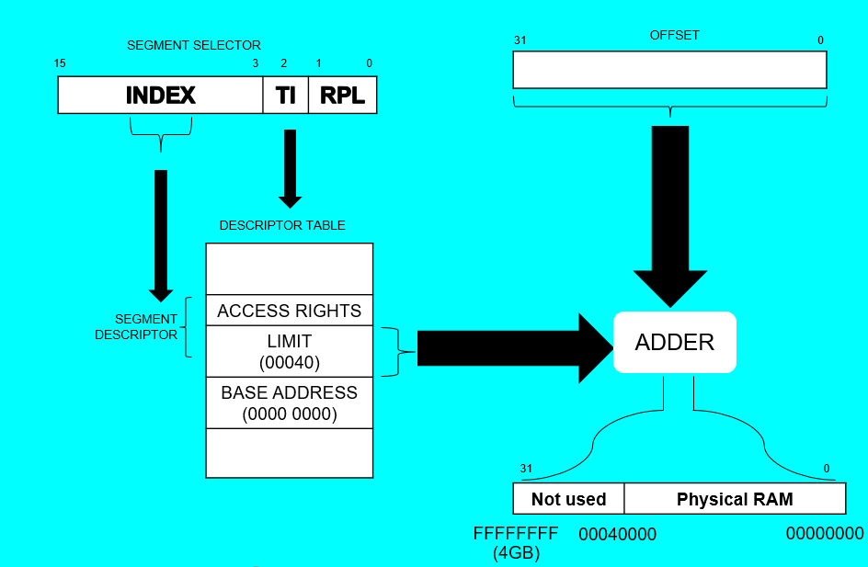
Protected Mode
Designed for multitasking
Each program assigned a memory partition which is protected from other programs
Protected Mode use segment selector’s
1. INDEX is used to get segment descriptor
2. TI is used to decide which kind descriptor table
3. RPL is access right.
Descriptor Table transforms
Logical address into linear address.
And it include base address、
limit and access right.
This access right is used to prevent
program to assign other program’s
Memory address.
Notes:
http://godleon.blogspot.tw/2008/02/ia-32-protected-mode-segmentation.html

Slide 25
OFFSET
SEGMENT SELECTOR
31 0
15 3 2 1 0
INDEX | TI | RPL
DESCRIPTOR TABLE
ACCESS RIGHTS
LIMIT (00040)
BASE ADDRESS (0000 0000)
SEGMENT
DESCRIPTOR
ADDER
31 0
Not used | Physical RAM
FFFFFFFF
00040000
00000000
(4GB)

Slide 26
What's Next
General Concepts
IA-32 Processor Architecture
IA-32 Memory Management
64-Bit Processors
Components of an IA-32 Microcomputer
Input-Output System

Slide 27
64-Bit Processors
64-Bit Operation Modes
Compatibility mode – can run existing 16-bit and 32-bit applications (Windows supports only 32-bit apps in this mode)
64-bit mode – Windows 64 uses this
Basic Execution Environment
addresses can be 64 bits (48 bits, in practice)
16 64-bit general purpose registers
64-bit instruction pointer named RIP

Slide 28
64-Bit General Purpose Registers
32-bit general purpose registers:
EAX, EBX, ECX, EDX, EDI, ESI, EBP, ESP, R8D, R9D, R10D, R11D, R12D, R13D, R14D, R15D
64-bit general purpose registers:
RAX, RBX, RCX, RDX, RDI, RSI, RBP, RSP, R8, R9, R10, R11, R12, R13, R14, R15

Slide 29
What's Next
General Concepts
IA-32 Processor Architecture
IA-32 Memory Management
64-Bit Processors
Components of an IA-32 Microcomputer
Input-Output System

Slide 30
Components of an IA-32 Microcomputer
Motherboard
Video output
Memory
Input-output ports

Slide 31
Motherboard
CPU socket
External cache memory slots
Main memory slots
BIOS chips
Sound synthesizer chip (optional)
Video controller chip (optional)
IDE, parallel, serial, USB, video, keyboard, joystick, network, and mouse connectors
PCI bus connectors (expansion cards)

Slide 32
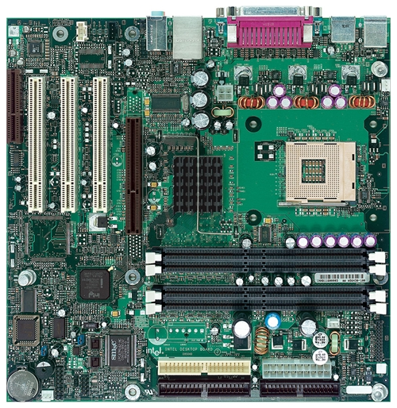
Intel D850MD Motherboard
mouse, keyboard, parallel, serial, and USB connectors
Video
Audio chip
PCI slots
memory controller hub
Pentium 4 socket
AGP slot
dynamic RAM
Firmware hub
I/O Controller
Speaker
Power connector
Battery
Diskette connector
Source: Intel® Desktop Board D850MD/D850MV Technical Product Specification
IDE drive connectors

Slide 33
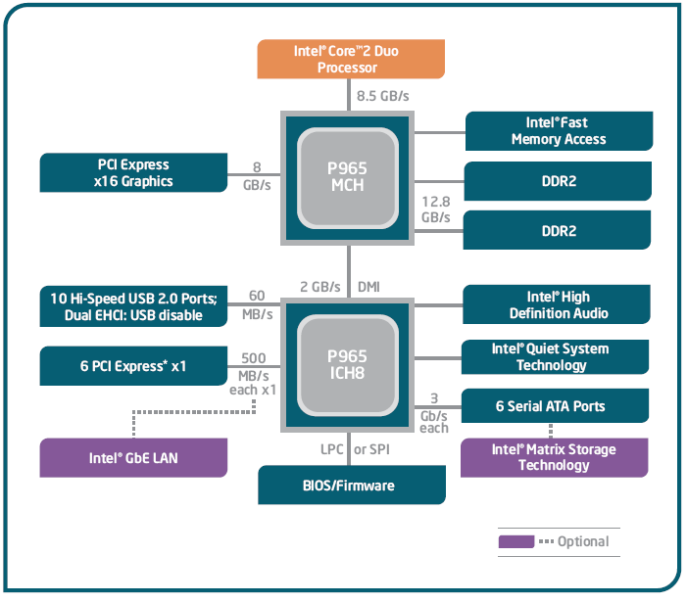
Intel 965 Express Chipset

Slide 34
Video Output
Video controller
on motherboard, or on expansion card
AGP (accelerated graphics port technology)*
Video memory (VRAM)
Video CRT Display
uses raster scanning
horizontal retrace
vertical retrace
Direct digital LCD monitors
no raster scanning required
* This link may change over time.

Slide 35
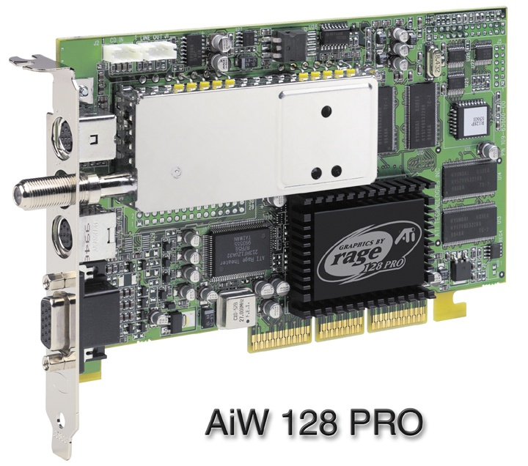
Sample Video Controller (ATI Corp.)
128-bit 3D graphics performance powered by RAGE™ 128 PRO
3D graphics performance
Intelligent TV-Tuner with Digital VCR
TV-ON-DEMAND™
Interactive Program Guide
Still image and MPEG-2 motion video capture
Video editing
Hardware DVD video playback
Video output to TV or VCR

Slide 36
Memory
ROM
read-only memory
EPROM
erasable programmable read-only memory
Dynamic RAM (DRAM)
inexpensive; must be refreshed constantly
Static RAM (SRAM)
expensive; used for cache memory; no refresh required
Video RAM (VRAM)
dual ported; optimized for constant video refresh
CMOS RAM
complimentary metal-oxide semiconductor
system setup information
See: Intel platform memory (Intel technology brief: link address may change)

Slide 37
Input-Output Ports
USB (universal serial bus)
intelligent high-speed connection to devices
up to 12 megabits/second
USB hub connects multiple devices
enumeration: computer queries devices
supports hot connections
Parallel
short cable, high speed
common for printers
bidirectional, parallel data transfer
Intel 8255 controller chip

Slide 38
Input-Output Ports (cont)
Serial
RS-232 serial port
one bit at a time
uses long cables and modems
16550 UART (universal asynchronous receiver transmitter)
programmable in assembly language

Slide 39
Device Interfaces
ATA host adapters
intelligent drive electronics (hard drive, CDROM)
SATA (Serial ATA)
inexpensive, fast, bidirectional
FireWire
high speed (800 MB/sec), many devices at once
Bluetooth
small amounts of data, short distances, low power usage
Wi-Fi (wireless Ethernet)
IEEE 802.11 standard, faster than Bluetooth

Slide 40
What's Next
General Concepts
IA-32 Processor Architecture
IA-32 Memory Management
Components of an IA-32 Microcomputer
Input-Output System

Slide 41
Levels of Input-Output
Level 3: High-level language function
examples: C++, Java
portable, convenient, not always the fastest
Level 2: Operating system
Application Programming Interface (API)
extended capabilities, lots of details to master
Level 1: BIOS
drivers that communicate directly with devices
OS security may prevent application-level code from working at this level

Slide 42
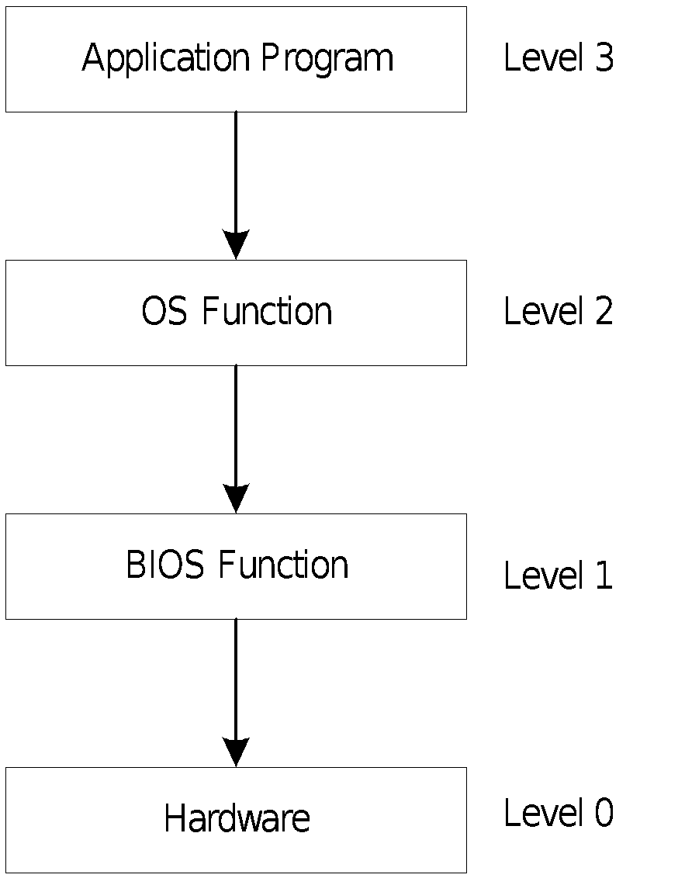
Displaying a String of Characters
When a HLL program displays a string of characters, the following steps take place:

Slide 43
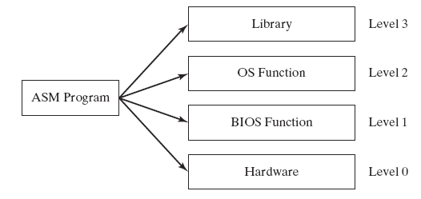
Programming levels
Assembly language programs can perform input-output at each of the following levels:

Slide 44
Summary
Central Processing Unit (CPU)
Arithmetic Logic Unit (ALU)
Instruction execution cycle
Multitasking
Floating Point Unit (FPU)
Complex Instruction Set
Real mode and Protected mode
Motherboard components
Memory types
Input/Output and access levels

Slide 45

42 69 6E 61 72 79
What does this say?

