Slide 1
Assembly Language for x86 Processors 7th Edition , Global Edition
Kip Irvine
Chapter 3: Assembly Language Fundamentals
Slides prepared by the author
Revision date: 1/15/2014 Modified by: Liang, 2016 Spring
(c) Pearson Education, 2015. All rights reserved. You may modify and copy this slide show for your personal use, or for use in the classroom, as long as this copyright statement, the author's name, and the title are not changed.

Slide 2
Chapter Overview
Basic Elements of Assembly Language
Example: Adding and Subtracting Integers
Suggested Coding Standards
64-Bit Programming
Assembling, Linking, and Running Programs
Defining Data
Symbolic Constants

Slide 3
Basic Elements of Assembly Language
Example
Integer constants
Character and string constants
Reserved words and identifiers
Directives and instructions
Labels
Mnemonics and Operands
Comments
Instruction Format Examples

Slide 4
Add and Subtract
TITLE Add and Subtract, Version 2 (AddSub2r.asm)
INCLUDE Irvine32.inc
.data
val1 DWORD 10000h
val2 DWORD 40000h
val3 DWORD 20000h
myStr BYTE "Hello!"
finalVal DWORD ?
.code
Main PROC
.
.
L1: mov eax,val1 ; get first value
add eax,val2 ; add second value
sub eax,val3 ; subtract third value
mov finalVal,eax
.
.
jmp L1
.
Main ENDP
END main
Directives
Integer constants
Character and String Constants
Reserved words and Identifiers
Label
Comment
Instructions
Mnemonics and Operands

Slide 5
Integer Constants
Optional leading + or – sign
binary, decimal, hexadecimal, or octal digits
Common radix characters:
h – hexadecimal
d – decimal
b – binary
r – encoded real
Examples: 30d, 6Ah, 42, 1101b
Hexadecimal beginning with letter: 0A5h

Slide 6
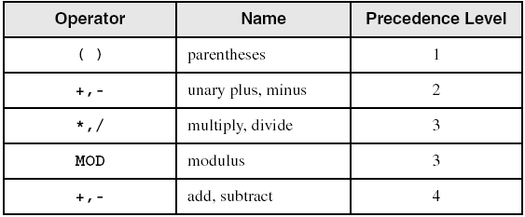
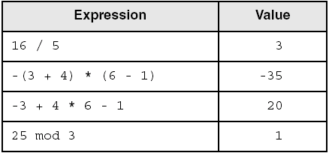
Integer Expressions
Operators and precedence levels:
Examples:

Slide 7
Character and String Constants
Enclose character in single or double quotes
'A', "x"
ASCII character = 1 byte
Enclose strings in single or double quotes
"ABC"
'xyz'
Each character occupies a single byte
Embedded quotes:
'Say "Goodnight," Gracie'

Slide 8
Reserved Words and Identifiers
Reserved words cannot be used as identifiers
Instruction mnemonics, directives, type attributes, operators, predefined symbols
See MASM reference in Appendix A
Examples: DATA, PROC, ADD, SUB
Identifiers
1-247 characters, including digits
not case sensitive
first character must be a letter, _, @, ?, or $
Examples: val1, finalVal, DumpRegs

Slide 9
Directives
Commands that are recognized and acted upon by the assembler
Not part of the Intel instruction set
Used to declare code, data areas, select memory model, declare procedures, etc.
not case sensitive
Examples:
.data
main PROC
main ENDP
Different assemblers have different directives
NASM not the same as MASM

Slide 10
Instructions
Assembled into machine code by assembler
Executed at runtime by the CPU
We use the Intel IA-32 instruction set
An instruction contains:
Label (optional)
Mnemonic (required)
Operand (depends on the instruction)
Comment (optional)
Examples:
mov eax,val1
add eax,val2
mov finalVal,eax

Slide 11
Instruction Format Examples
No operands
stc ; set Carry flag
One operand
inc eax ; register
inc myByte ; memory
Two operands
add ebx,ecx ; register, register
sub myByte,25 ; memory, constant
add eax,36 * 25 ; register, constant-expression

Slide 12
Labels
Act as place markers
marks the address (offset) of code and data
Follow identifer rules
Data label
must be unique
example: myArray (not followed by colon)
Code label
target of jump and loop instructions
example: L1: (followed by colon)

Slide 13
Mnemonics and Operands
Instruction Mnemonics
memory aid
examples: MOV, ADD, SUB, MUL, INC, DEC
Operands
constant
constant expression
register
memory (data label)
Constants and constant expressions are often called immediate values

Slide 14
Comments
Comments are good!
explain the program's purpose
when it was written, and by whom
revision information
tricky coding techniques
application-specific explanations
Single-line comments
begin with semicolon (;)
Multi-line comments
begin with COMMENT directive and a programmer-chosen character
end with the same programmer-chosen character

Slide 15
What's Next
Basic Elements of Assembly Language
Example: Adding and Subtracting Integers
Assembling, Linking, and Running Programs
Defining Data
Symbolic Constants
64-Bit Programming

Slide 16
Example: Adding and Subtracting Integers
TITLE Add and Subtract (AddSub.asm)
; This program adds and subtracts 32-bit integers.
INCLUDE Irvine32.inc
.code
main PROC
mov eax,10000h ; EAX = 10000h
add eax,40000h ; EAX = 50000h
sub eax,20000h ; EAX = 30000h
call DumpRegs ; display registers
exit
main ENDP
END main

Slide 17
Example: Adding and Subtracting Integers
……
.code
main PROC
mov eax,10000h
add eax,40000h
sub eax,20000h
call DumpRegs
exit
main ENDP
END main
CPU
控制單元 (Control Unit)
System bus
算術邏輯單元
(ALU)
暫存器Register
40000h
20000h
10000h
50000h
EAX
10000h
50000h
30000h
50000h
30000h

Slide 18
Example Output
Showing registers and flags in the debugger:
EAX=00030000 EBX=7FFDF000 ECX=00000101 EDX=FFFFFFFF
ESI=00000000 EDI=00000000 EBP=0012FFF0 ESP=0012FFC4
EIP=00401024 EFL=00000206 CF=0 SF=0 ZF=0 OF=0

Slide 19
Suggested Coding Standards (1 of 3)
Some approaches to capitalization
capitalize nothing
capitalize everything
capitalize all reserved words, including instruction mnemonics and register names
capitalize only directives and operators
Other suggestions
descriptive identifier names
spaces surrounding arithmetic operators
blank lines between procedures

Slide 20
Suggested Coding Standards (2 of 3)
Indentation and spacing
code and data labels – no indentation
executable instructions – indent 4-5 spaces
comments: right side of page, aligned vertically
1-3 spaces between instruction and its operands
ex: mov ax,bx
1-2 blank lines between procedures

Slide 21
Suggested Coding Standards (3 of 3)
Capitalize
TITLE Add and Subtract, Version 2 (a.asm)
INCLUDE Irvine32.inc
.data
value1 DWORD 10000h
value2 DWORD 40000h
value3 DWORD 20000h
myStr BYTE "Hello!"
FinalValue DWORD ?
.code
Main PROC
.
.
L1: mov eax,value1 ; get first value
add eax,value2 ; add second value
sub eax,value3 ;subtract third value
mov FinalValue,eax
.
.
jmp L1
.
Main ENDP
END main
No
Indentation
Descriptive Identifier Names
*avoid undescriptive like i,j, and k
and don’t be too long*
Capitalize
the size
Comments are good
(instruction and command align with tab)
Label : No Indentation
Instructions
Indent 4 space
Space between instruction and its operand(s)

Slide 22
What's Next
Basic Elements of Assembly Language
Example: Adding and Subtracting Integers
64-Bit Programming
Assembling, Linking, and Running Programs
Defining Data
Symbolic Constants

Slide 23
64-Bit Programming
MASM supports 64-bit programming, although the following directives are not permitted:
INVOKE, ADDR, .model, .386, .stack
(Other non-permitted directives will be introduced in later chapters)

Slide 24
64-Bit Version of AddTwoSum
64-Bit Version
32-Bit Version
ExitProcess PROTO
.data
sum DWORD 0
.code
main PROC
mov eax,5
add eax,6
mov sum,eax
mov ecx,0
call ExitProcess
main ENDP
END
.386
.model flat,stdcall
.stack 4096
ExitProcess PROTO,
dwExitCode:DWORD
.data
sum DWORD 0
.code
main PROC
mov eax,5
add eax,6
mov sum,eax
INVOKE ExitProcess,0
main ENDP
END
INCLUDE
Irvine32.inc

Slide 25
Things to Notice About the Previous Slide
The following lines are not needed:
.386
.model flat,stdcall
.stack 4096
INVOKE is not supported.
CALL instruction cannot receive arguments
Use 64-bit registers when possible

Slide 26
What's Next
Basic Elements of Assembly Language
Example: Adding and Subtracting Integers
64-Bit Programming
Assembling, Linking, and Running Programs
Defining Data
Symbolic Constants

Slide 27
Assembling, Linking, and Running Programs
Assemble-Link-Execute Cycle

Slide 28
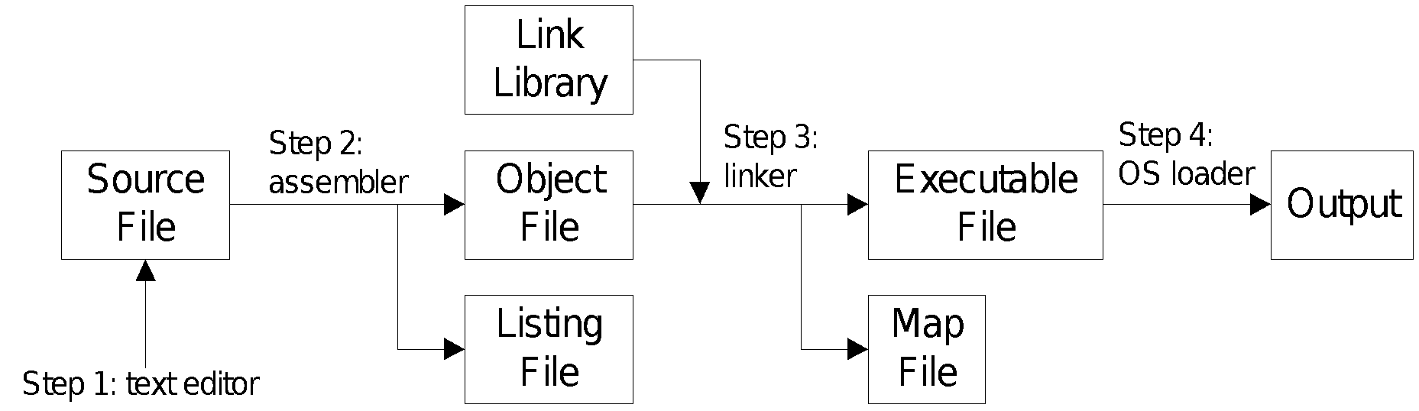
Assemble-Link Execute Cycle
The following diagram describes the steps from creating a source program through executing the compiled program.
If the source code is modified, Steps 2 through 4 must be repeated.

Slide 29
What's Next
Basic Elements of Assembly Language
Example: Adding and Subtracting Integers
64-Bit Programming
Assembling, Linking, and Running Programs
Defining Data
Symbolic Constants

Slide 30
Defining Data
Intrinsic Data Types
Data Definition Statement
Defining BYTE and SBYTE Data
Defining WORD and SWORD Data
Defining DWORD and SDWORD Data
Defining QWORD, TBYTE, Real Number Data
Little Endian Order
Adding Variables to the AddSub Program
Declaring Uninitialized Data

Slide 31
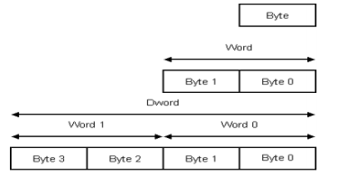
Intrinsic Data Types (1 of 2)
BYTE, SBYTE
8-bit unsigned integer; 8-bit signed integer
WORD, SWORD
16-bit unsigned & signed integer
DWORD, SDWORD
32-bit unsigned & signed integer
QWORD
64-bit integer
TBYTE
80-bit integer
8-bit

Slide 32
Intrinsic Data Types (2 of 2)
REAL4
4-byte IEEE short real
REAL8
8-byte IEEE long real
REAL10
10-byte IEEE extended real

Slide 33
Data Definition Statement
A data definition statement sets aside storage in memory for a variable.
May optionally assign a name (label) to the data
Syntax:
[name] directive initializer [,initializer] . . .
value1 BYTE 10
All initializers become binary data in memory

Slide 34
Defining BYTE and SBYTE Data
Each of the following defines a single byte of storage:
value1 BYTE 'A‘ ; character constant
value2 BYTE 0 ; smallest unsigned byte
value3 BYTE 255 ; largest unsigned byte
value4 SBYTE -128 ; smallest signed byte
value5 SBYTE +127 ; largest signed byte
value6 BYTE ? ; uninitialized byte
BYTE |  | SBYTE
255 | 11111111 | -1
128 | 10000000 | -128
127 | 01111111 | 127
0 | 00000000 | 0
MASM does not prevent you from initializing a BYTE with a negative value, but it's considered poor style.
If you declare a SBYTE variable, the Microsoft debugger will automatically display its value in decimal with a leading sign.

Slide 35
Defining Byte Arrays
Examples that use multiple initializers:
list1 BYTE 10,20,30,40
list2 BYTE 10,20,30,40
BYTE 50,60,70,80
BYTE 81,82,83,84
list3 BYTE ?,32,41h,00100010b
list4 BYTE 0Ah,20h,‘A’,22h

Slide 36
Defining Strings (1 of 3)
A string is implemented as an array of characters
For convenience, it is usually enclosed in quotation marks
It often will be null-terminated
Examples:
str1 BYTE "Enter your name",0
str2 BYTE 'Error: halting program',0
str3 BYTE 'A','E','I','O','U'
greeting BYTE "Welcome to the Encryption Demo program "
BYTE "created by Kip Irvine.",0

Slide 37
Defining Strings (2 of 3)
To continue a single string across multiple lines, end each line with a comma:
menu BYTE "Checking Account",0dh,0ah,0dh,0ah,
"1. Create a new account",0dh,0ah,
"2. Open an existing account",0dh,0ah,
"3. Credit the account",0dh,0ah,
"4. Debit the account",0dh,0ah,
"5. Exit",0ah,0ah,
"Choice> ",0

Slide 38
Defining Strings (3 of 3)
End-of-line character sequence:
0Dh = carriage return
0Ah = line feed
str1 BYTE "Enter your name: ",0Dh,0Ah
BYTE "Enter your address: ",0
newLine BYTE 0Dh,0Ah,0
Idea: Define all strings used by your program in the same area of the data segment.

Slide 39
Using the DUP Operator
Use DUP to allocate (create space for) an array or string. Syntax: counter DUP ( argument )
Counter and argument must be constants or constant expressions
var1 BYTE 20 DUP(0) ; 20 bytes, all equal to zero
var2 BYTE 20 DUP(?) ; 20 bytes, uninitialized
var3 BYTE 4 DUP("STACK") ; 20 bytes: "STACKSTACKSTACKSTACK"
var4 BYTE 10,3 DUP(0),20 ; 5 bytes

Slide 40
Defining WORD and SWORD Data
Define storage for 16-bit integers
or double characters
single value or multiple values
word1 WORD 65535 ; largest unsigned value
word2 SWORD –32768 ; smallest signed value
word3 WORD ? ; uninitialized, unsigned
word4 WORD "AB" ; double characters
myList WORD 1,2,3,4,5 ; array of words
array WORD 5 DUP(?) ; uninitialized array

Slide 41
Defining DWORD and SDWORD Data
Storage definitions for signed and unsigned 32-bit integers:
val1 DWORD 12345678h ; unsigned
val2 SDWORD –2147483648 ; signed
val3 DWORD 20 DUP(?) ; unsigned array
val4 SDWORD –3,–2,–1,0,1 ; signed array

Slide 42
Defining QWORD, TBYTE, Real Data
Storage definitions for quadwords, tenbyte values, and real numbers:
quad1 QWORD 1234567812345678h
val1 TBYTE 1000000000123456789Ah
rVal1 REAL4 -2.1
rVal2 REAL8 3.2E-260
rVal3 REAL10 4.6E+4096
ShortArray REAL4 20 DUP(0.0)

Slide 43
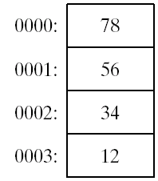
Little Endian Order
All data types larger than a byte store their individual bytes in reverse order. The least significant byte occurs at the first (lowest) memory address.
Example:
val1 DWORD 12345678h

Slide 44
Adding Variables to AddSub
TITLE Add and Subtract, Version 2 (AddSub2.asm)
; This program adds and subtracts 32-bit unsigned
; integers and stores the sum in a variable.
INCLUDE Irvine32.inc
.data
val1 DWORD 10000h
val2 DWORD 40000h
val3 DWORD 20000h
finalVal DWORD ?
.code
main PROC
mov eax,val1 ; start with 10000h
add eax,val2 ; add 40000h
sub eax,val3 ; subtract 20000h
mov finalVal,eax ; store the result (30000h)
call DumpRegs ; display the registers
exit
main ENDP
END main

Slide 45
Declaring Unitialized Data
Use the .data? directive to declare an unintialized data segment:
.data?
Within the segment, declare variables with "?" initializers:
smallArray DWORD 10 DUP(?)
Advantage: the program's EXE file size is reduced.

Slide 46
What's Next
Basic Elements of Assembly Language
Example: Adding and Subtracting Integers
64-Bit Programming
Assembling, Linking, and Running Programs
Defining Data
Symbolic Constants

Slide 47
Symbolic Constants
Equal-Sign Directive
Calculating the Sizes of Arrays and Strings
EQU Directive
TEXTEQU Directive

Slide 48
Equal-Sign Directive
name = expression
expression is a 32-bit integer (expression or constant)
may be redefined
name is called a symbolic constant
good programming style to use symbols
COUNT = 500
.
.
mov ax,COUNT

Slide 49
Calculating the Size of a Byte Array
current location counter: $
subtract address of list
difference is the number of bytes
list BYTE 10,20,30,40
ListSize = ($ - list)
list →
0000 | 10
0001 | 20
0002 | 30
0003 | 40
0004 | ?
$ →

Slide 50
Calculating the Size of a Word Array
Divide total number of bytes by 2 (the size of a word)
list →
0000 | 00
0001 | 10
0002 | 00
0003 | 20
0004 | 00
0005 | 30
0006 | 00
0007 | 40
0008 | ?
list WORD 1000h,2000h,3000h,4000h
ListSize = ($ - list) / 2
$ →

Slide 51
Calculating the Size of a Doubleword Array
Divide total number of bytes by 4 (the size of a doubleword)
list →
0000 | 01
0001 | 00
0002 | 00
0003 | 00
0004 | 02
0005 | 00
0006 | 00
0007 | 00
… | …
000F | 00
0010 | ?
list DWORD 1,2,3,4
ListSize = ($ - list) / 4
$ →

Slide 52
EQU Directive
Define a symbol as either an integer or text expression.
Cannot be redefined
PI EQU <3.1416>
pressKey EQU <"Press any key to continue...",0>
.data
prompt BYTE pressKey

Slide 53
TEXTEQU Directive
Define a symbol as either an integer or text expression.
Called a text macro
Can be redefined
continueMsg TEXTEQU <"Do you wish to continue (Y/N)?">
rowSize = 5
.data
prompt1 BYTE continueMsg
count TEXTEQU %(rowSize * 2) ; evaluates the expression
setupAL TEXTEQU <mov al,count>
.code
setupAL ; generates: "mov al,10"

Slide 54
Summary
Integer expression, character constant
directive – interpreted by the assembler
instruction – executes at runtime
code, data, and stack segments
source, listing, object, map, executable files
Data definition directives:
BYTE, SBYTE, WORD, SWORD, DWORD, SDWORD, QWORD, TBYTE, REAL4, REAL8, and REAL10
DUP operator, location counter ($)
Symbolic constant
EQU and TEXTEQU

Slide 55

4C 61 46 69 6E

