Slide 1
Assembly Language for x86 Processors 7th Edition, Global Edition
Kip Irvine
Chapter 4: Data Transfers, Addressing, and Arithmetic
Slides prepared by the author
Revision date: 1/15/2014
(c) Pearson Education, 2015. All rights reserved. You may modify and copy this slide show for your personal use, or for use in the classroom, as long as this copyright statement, the author's name, and the title are not changed.

Slide 2
Chapter Overview
Data Transfer Instructions
Addition and Subtraction
Data-Related Operators and Directives
Indirect Addressing
JMP and LOOP Instructions
64-Bit Programming

Slide 3
Summary
Data Transfer
MOV – data transfer from source to destination
MOVSX, MOVZX, XCHG
Operand types
direct, direct-offset, indirect, indexed
Arithmetic
INC, DEC, ADD, SUB, NEG
Sign, Carry, Zero, Overflow flags
Operators
OFFSET, PTR, TYPE, LENGTHOF, SIZEOF, TYPEDEF
JMP and LOOP – branching instructions

Slide 4

46 69 6E 61 6C

Slide 5
Data Transfer Instructions
Operand Types
Instruction Operand Notation
Direct Memory Operands
MOV Instruction
Zero & Sign Extension
XCHG Instruction
Direct-Offset Instructions

Slide 6
Operand Types
Immediate – a constant integer (8, 16, or 32 bits)
value is encoded within the instruction
Register – the name of a register
register name is converted to a number and encoded within the instruction
Memory – reference to a location in memory
memory address is encoded within the instruction, or a register holds the address of a memory location

Slide 7
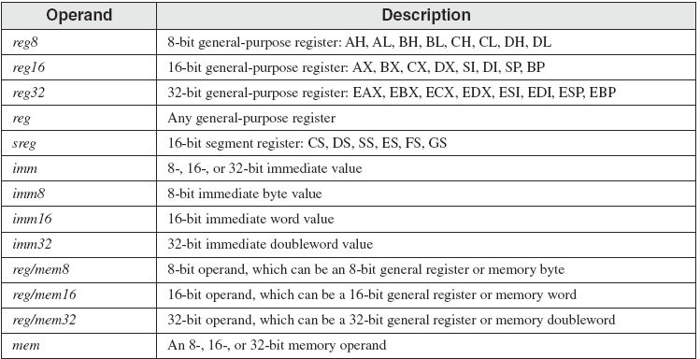
Instruction Operand Notation

Slide 8
Direct Memory Operands
A direct memory operand is a named reference to storage in memory
The named reference (label) is automatically dereferenced by the assembler
.data
var1 BYTE 10h
.code
mov al,var1 ; AL = 10h
mov al,[var1] ; AL = 10h
alternate format

Slide 9
MOV Instruction
Move from source to destination. Syntax:
MOV destination,source
No more than one memory operand permitted
Size matched
CS,DS , EIP,IP ,and immediate value cannot be the destination
.data
count BYTE 100
wVal WORD 2
.code
mov bl,count
mov ax,wVal
mov count,al
mov al,wVal ; error
mov ax,count ; error
mov eax,count ; error

Slide 10
Your turn . . .
Explain why each of the following MOV statements are invalid:
.data
bVal BYTE 100
bVal2 BYTE ?
wVal WORD 2
dVal DWORD 5
.code
mov ds,45
mov esi,wVal
mov eip,dVal
mov 25,bVal
mov bVal2,bVal
immediate move to DS not permitted
size mismatch
EIP cannot be the destination
immediate value cannot be destination
memory-to-memory move not permitted

Slide 11
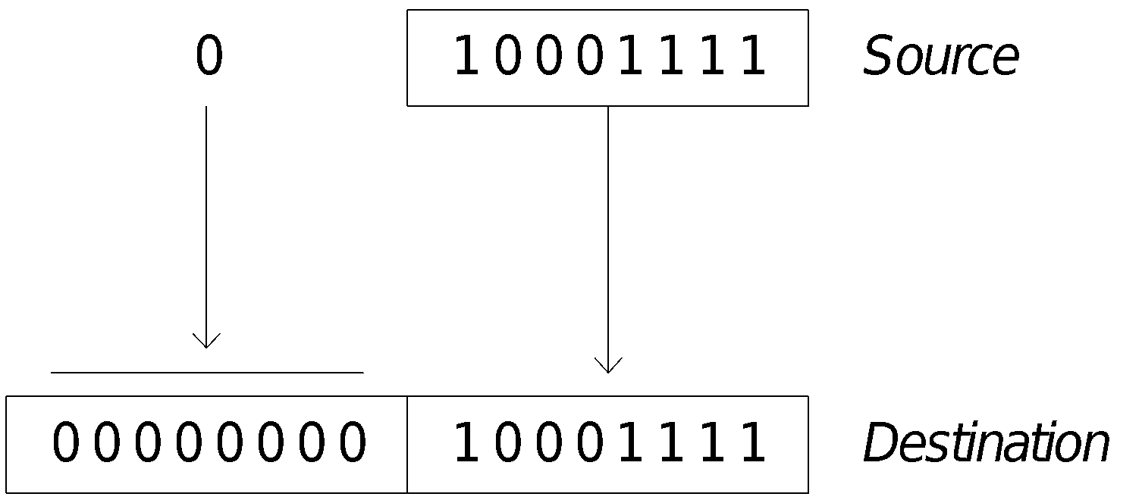
Zero Extension
When you copy a smaller value into a larger destination, the MOVZX instruction fills (extends) the upper half of the destination with zeros.
mov bl,10001111b
movzx ax,bl ; zero-extension
The destination must be a register.

Slide 12

Sign Extension
The MOVSX instruction fills the upper half of the destination with a copy of the source operand's sign bit.
mov bl,10001111b
movsx ax,bl ; sign extension
The destination must be a register.

Slide 13
XCHG Instruction
XCHG exchanges the values of two operands. At least one operand must be a register. No immediate operands are permitted.
.data
var1 WORD 1000h
var2 WORD 2000h
.code
xchg ax,bx ; exchange 16-bit regs
xchg ah,al ; exchange 8-bit regs
xchg var1,bx ; exchange mem, reg
xchg eax,ebx ; exchange 32-bit regs
xchg var1,var2 ; error: two memory operands

Slide 14
Direct-Offset Operands
A constant offset is added to a data label to produce an effective address (EA). The address is dereferenced to get the value inside its memory location.
address | value
0x1000h | 10h
0x1001h | 20h
0x1002h | 30h
0x1003h | 40h
.data
arrayB BYTE 10h,20h,30h,40h
.code
mov al,arrayB+1 ; AL = 20h
mov al,[arrayB+1] ; alternative notation
Q: Why doesn't arrayB+1 produce 11h?

Slide 15
Direct-Offset Operands (cont)
A constant offset is added to a data label to produce an effective address (EA). The address is dereferenced to get the value inside its memory location.
address | value
0x1034h | 00h
0x1035h | 10h
0x1036h | 00h
0x1037h | 20h
address | value
0x1134h | 01h
0x1135h | 00h
0x1136h | 00h
0x1137h | 00h
0x1138h | 02h
0x1139h | 00h
0x113ah | 00h
0x113bh | 00h
.data
arrayW WORD 1000h,2000h,3000h
arrayD DWORD 1,2,3,4
.code
mov ax,[arrayW+2] ; AX = 2000h
mov ax,[arrayW+4] ; AX = 3000h
mov eax,[arrayD+4] ; EAX = 00000002h
; Will the following statements assemble?
mov ax,[arrayW-2] ; ??
mov eax,[arrayD+16] ; ??
What will happen when they run?

Slide 16
Your turn. . .
Write a program that rearranges the values of three doubleword values in the following array as: 3, 1, 2.
.data
arrayD DWORD 1,2,3
Step1: copy the first value into EAX and exchange it with the value in the second position.
mov eax,arrayD
xchg eax,[arrayD+4]
Step 2: Exchange EAX with the third array value and copy the value in EAX to the first array position.
xchg eax,[arrayD+8]
mov arrayD,eax

Slide 17
Evaluate this . . .
We want to write a program that adds the following three bytes:
.data
myBytes BYTE 80h,66h,0A5h
What is your evaluation of the following code?
mov al,myBytes
add al,[myBytes+1]
add al,[myBytes+2]
What is your evaluation of the following code?
mov ax,myBytes
add ax,[myBytes+1]
add ax,[myBytes+2]
Any other possibilities?

Slide 18
Evaluate this . . . (cont)
.data
myBytes BYTE 80h,66h,0A5h
How about the following code. Is anything missing?
movzx ax,myBytes
mov bl,[myBytes+1]
add ax,bx
mov bl,[myBytes+2]
add ax,bx ; AX = sum
Yes: Move zero to BX before the MOVZX instruction.

Slide 19
What's Next
Data Transfer Instructions
Addition and Subtraction
Data-Related Operators and Directives
Indirect Addressing
JMP and LOOP Instructions
64-Bit Programming

Slide 20
Addition and Subtraction
INC and DEC Instructions
ADD and SUB Instructions
NEG Instruction
Implementing Arithmetic Expressions
Flags Affected by Arithmetic
Zero
Sign
Carry
Overflow
Overflow and Carry Flags A Hardware Viewpoint
Notes:
修改超連結：移除sign中 overflow and carry flag部分，增加獨立超連結

Slide 21
INC and DEC Instructions
Add 1, subtract 1 from destination operand
operand may be register or memory
INC destination
Logic: destination ← destination + 1
DEC destination
Logic: destination ← destination – 1

Slide 22
INC and DEC Examples
.data
myWord WORD 1000h
myDword DWORD 10000000h
.code
inc myWord ; 1001h
dec myWord ; 1000h
inc myDword ; 10000001h
mov ax,00FFh
inc ax ; AX = 0100h
mov ax,00FFh
inc al ; AX = 0000h

Slide 23
Your turn...
Show the value of the destination operand after each of the following instructions executes:
.data
myByte BYTE 0FFh, 0
.code
mov al,myByte ; AL =
mov ah,[myByte+1] ; AH =
dec ah ; AH =
inc al ; AL =
dec ax ; AX =
FFh
00h
FFh
00h
FEFF

Slide 24
ADD and SUB Instructions
ADD destination, source
Logic: destination ← destination + source
SUB destination, source
Logic: destination ← destination – source
Same operand rules as for the MOV instruction (referred to page 9)

Slide 25
ADD and SUB Examples
.data
var1 DWORD 10000h
var2 DWORD 20000h
.code ; ---EAX---
mov eax,var1 ; 00010000h
add eax,var2 ; 00030000h
add ax,0FFFFh ; 0003FFFFh
add eax,1 ; 00040000h
sub ax,1 ; 0004FFFFh

Slide 26
NEG (negate) Instruction
Reverses the sign of an operand. Operand can be a register or memory operand.
.data
valB BYTE -1
valW WORD +32767
.code
mov al,valB ; AL = -1
neg al ; AL = +1
neg valW ; valW = -32767
Suppose AX contains –32,768 and we apply NEG to it. Will the result be valid?

Slide 27
NEG Instruction and the Flags
The processor implements NEG using the following internal operation:
SUB 0,operand
Any nonzero operand causes the Carry flag to be set.
.data
valB BYTE 1,0
valC SBYTE -128
.code
neg valB ; CF = 1, OF = 0
neg [valB + 1] ; CF = 0, OF = 0
neg valC ; CF = 1, OF = 1
Notes:
上面的那一個，是邏輯上的意思

Slide 28
Implementing Arithmetic Expressions
HLL compilers translate mathematical expressions into assembly language. You can do it also. For example:
Rval = -Xval + (Yval – Zval)
Rval DWORD ?
Xval DWORD 26
Yval DWORD 30
Zval DWORD 40
.code
mov eax,Xval
neg eax ; EAX = -Xval
mov ebx,Yval ; EBX = Yval
sub ebx,Zval ; EBX = Yval-Zval
add eax,ebx ; EAX = -Xval+(Yval-Zval)
mov Rval,eax ; Rval= -Xval+(Yval-Zval)

Slide 29
Your turn...
Translate the following expression into assembly language. Do not permit Xval, Yval, or Zval to be modified:
Rval = Xval - (-Yval + Zval)
Assume that all values are signed doublewords.
mov ebx,Yval
neg ebx
add ebx,Zval
mov eax,Xval
sub eax,ebx
mov Rval,eax

Slide 30
Flags Affected by Arithmetic
The ALU has a number of status flags that reflect the outcome of arithmetic (and bitwise) operations
based on the contents of the destination operand
Essential flags:
Zero flag – set when destination equals zero
Sign flag – set when destination is negative
Carry flag – set when unsigned value is out of range
Overflow flag – set when signed value is out of range
The MOV instruction never affects the flags.
Notes:
MOV不影響flag—加上強調閃爍

Slide 31
Concept Map
CPU
part of
executes
executes
ALU
conditional jumps
arithmetic & bitwise operations
attached to
used by
provide
affect
status flags
branching logic
You can use diagrams such as these to express the relationships between assembly language concepts.

Slide 32
Zero Flag (ZF)
The Zero flag is set when the result of an operation produces zero in the destination operand.
mov cx,1
sub cx,1 ; CX = 0, ZF = 1
mov al,0FFh
inc al ; AL = 0, ZF = 1
inc al ; AL = 1, ZF = 0
AL
1 | 1 | 1 | 1 | 1 | 1 | 1 | 1
0 | 0 | 0 | 0 | 0 | 0 | 0 | 0
ZF = 1
0 | 0 | 0 | 0 | 0 | 0 | 0 | 1
ZF = 0
 |  |  |  |  |  | + | 1
Remember...
A flag is set when it equals 1.
A flag is clear when it equals 0.

Slide 33
Sign Flag (SF)
The Sign flag is set when the destination operand is negative. The flag is clear when the destination is positive.
The sign flag is a copy of the destination's highest bit:
mov al,0
sub al,1 ;SF = 1
add al,2 ;SF = 0
AL
1
1 | 1 | 1 | 1 | 1 | 1 | 1
AL
0 | 0 | 0 | 0 | 0 | 0 | 1
0
First bit is equal to Sign Flag

Slide 34
Signed and Unsigned Integers A Hardware Viewpoint
All CPU instructions operate exactly the same on signed and unsigned integers
The CPU cannot distinguish between signed and unsigned integers
YOU, the programmer, are solely responsible for using the correct data type with each instruction
Added Slide. Gerald Cahill, Antelope Valley College

Slide 35
Overflow and Carry Flags A Hardware Viewpoint
How the ADD instruction affects OF and CF:
CF = (carry out of the MSB)
OF = (carry out of the MSB) XOR (carry into the MSB)
How the SUB instruction affects OF and CF:
CF = INVERT (carry out of the MSB)
negate the source and add it to the destination
OF = (carry out of the MSB) XOR (carry into the MSB)
0 | 1 | 1 | 1
7
MSB = Most Significant Bit (high-order bit)
XOR = eXclusive-OR operation
NEG = Negate (same as SUB 0,operand )
0 | 0 | 0 | 0
0
1 | 0 | 0 | 0
-8

Slide 36
Carry Flag (CF)
The Carry flag is set when the result of an operation generates an unsigned value that is out of range (too big or too small for the destination operand).
mov al,0FFh
add al,1 ; CF = 1, AL = 00
; Try to go below zero:
mov al,0
sub al,1 ; CF = 1, AL = FF
0
CF
AL
1 | 1 | 1 | 1 | 1 | 1 | 1 | 1
 |  |  |  |  |  | + | 1
CF
AL
0 | 0 | 0 | 0 | 0 | 0 | 0 | 0
1
0
CF
AL
0 | 0 | 0 | 0 | 0 | 0 | 0 | 0
 |  |  |  |  |  | - | 1
CF
AL
1 | 1 | 1 | 1 | 1 | 1 | 1 | 1
1

Slide 37
Your turn . . .
For each of the following marked entries, show the values of the destination operand and the Sign, Zero, and Carry flags:
mov ax,00FFh
add ax,1 ; AX= SF= ZF= CF=
sub ax,1 ; AX= SF= ZF= CF=
add al,1 ; AL= SF= ZF= CF=
mov bh,6Ch
add bh,95h ; BH= SF= ZF= CF=
mov al,2
sub al,3 ; AL= SF= ZF= CF=
0100h 0 0 0
00FFh 0 0 0
00h 0 1 1
01h 0 0 1
FFh 1 0 1

Slide 38
Overflow Flag (OF)
The Overflow flag is set when the signed result of an operation is invalid or out of range.
; Example 1
mov al,+127
add al,1 ; OF = 1, AL = ??
; Example 2
mov al,7Fh ; OF = 1, AL = 80h
add al,1
The two examples are identical at the binary level because 7Fh equals +127. To determine the value of the destination operand, it is often easier to calculate in hexadecimal.

Slide 39
A Rule of Thumb
When adding two integers, remember that the Overflow flag is only set when . . .
Two positive operands are added and their sum is negative
Two negative operands are added and their sum is positive
What will be the values of the Overflow flag?
mov al,80h
add al,92h ; OF =
mov al,-2
add al,+127 ; OF =
1
0

Slide 40
Overflow Flag – Hardware View (1/2)
OF = (carry out of the MSB) XOR (carry into the MSB)
A₁
B₁
A₀
B₀
1-bit
Full Adder1
C₁
1-bit
Full Adder1
C₂
C₀
S₁
S₀
C₁ | C₂ | C₁ XOR C₂
1 | 1 | 0
1 | 0 | 1
0 | 1 | 1
0 | 0 | 0
Notes:
Carry Out / Carry Into

Slide 41
Overflow Flag – Hardware View (2/2)
OF = (carry out of the MSB) XOR (carry into the MSB)
(Carry out, Carry in) = (0, 1) CF = 0 OF = 1 | (1, 1) CF = 1 OF = 0
(0, 0) CF = 0 OF = 0 | (1, 0) CF = 1 OF = 1
01
0101 (5)
0110 (6)
01011
11
1101 (-3)
0111 (7)
10100
00
1100 (-4)
0011 (3)
01111
10
1001 (-7)
1011 (-5)
10100

Slide 42
Your turn . . .
What will be the values of the given flags after each operation?
mov al,-128
neg al ; CF = OF =
mov ax,8000h
add ax,2 ; CF = OF =
mov ax,0
sub ax,2 ; CF = OF =
mov al,-5
sub al,+125 ; OF =
1 1
0 0
1 0
1

Slide 43
What's Next
Data Transfer Instructions
Addition and Subtraction
Data-Related Operators and Directives
Indirect Addressing
JMP and LOOP Instructions
64-Bit Programming

Slide 44
Data-Related Operators and Directives
OFFSET Operator
PTR Operator
TYPE Operator
LENGTHOF Operator
SIZEOF Operator
LABEL Directive

Slide 45
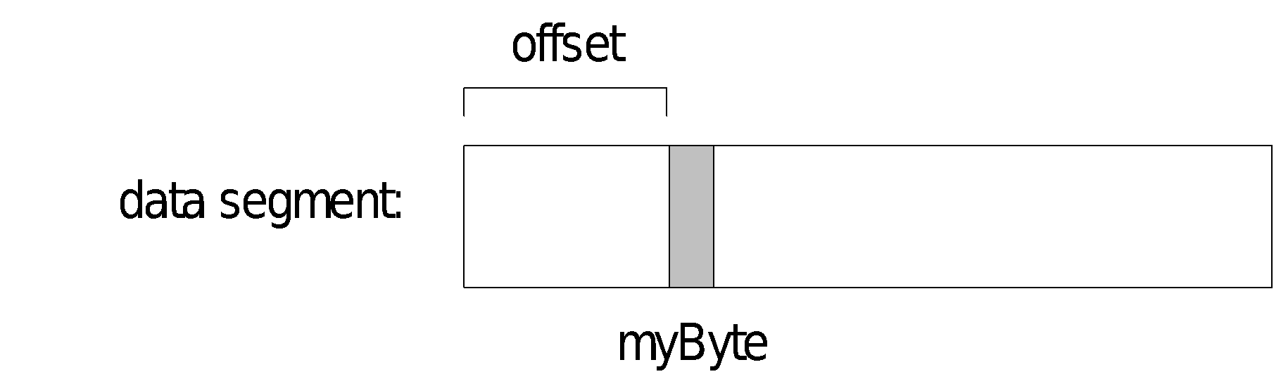
OFFSET Operator
OFFSET returns the distance in bytes, of a label from the beginning of its enclosing segment
Protected mode: 32 bits
Real mode: 16 bits
The Protected-mode programs we write use only a single segment (flat memory model).
Notes:
因為32 bit的定旨模式是protect mode
Returns the offset into the relevant segment of expression
MASM expression Debugger expression’
OFFSET Var &Var
An address constant is a special type of immediate operand that consists of an offset or segment value.
The OFFSET operator returns the offset of a memory location relative to the beginning of the segment to which the location belongs:
mov bx, OFFSET var ; Load offset address
Since data in different modules may belong to a single segment, the assembler cannot know for each module the true offsets within a segment.
Thus, the offset for var, although an immediate value, is not determined until link time.

Slide 46
OFFSET Examples
Let's assume that the data segment begins at 00404000h:
.data
bVal BYTE ? ;1
wVal WORD ? ;2
dVal DWORD ? ;4
dVal2 DWORD ? ;4
.code
mov esi,OFFSET bVal ; ESI = 00404000
mov esi,OFFSET wVal ; ESI = 00404001
mov esi,OFFSET dVal ; ESI = 00404003
mov esi,OFFSET dVal2 ; ESI = 00404007
0040400h
bVal
0040401h
wVal
0040403h
dVal
0040407h
dVal2

Slide 47
Relating to C/C++
The value returned by OFFSET is a pointer. Compare the following code written for both C++ and assembly language:
// C++ version:
char array[1000];
char * p = array;
; Assembly language:
.data
array BYTE 1000 DUP(?)
.code
mov esi,OFFSET array

Slide 48
PTR Operator
Overrides the default type of a label (variable). Provides the flexibility to access part of a variable.
.data
myDouble DWORD 12345678h
.code
mov ax,myDouble ; error – why?
mov ax,WORD PTR myDouble ; loads 5678h
mov WORD PTR myDouble,4321h ; saves 4321h
Little endian order is used when storing data in memory (see Section 3.4.9).
Notes:
Mov ax, mydouble 因為大小不一致，會在組譯皆段就產生error
第二行ok
第三行，如果沒有指定位置，且大小不對等（等三行旨令），assembler會將常數擴充至相同大小（00004321h）
括胡在此沒有影響
+常數以byte為單位

Slide 49
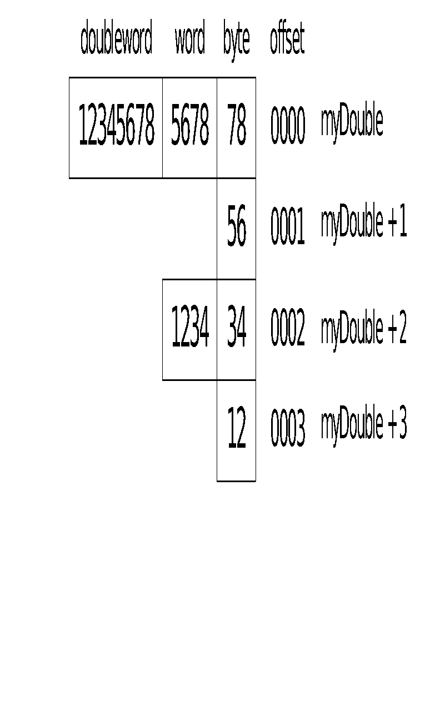
Little Endian Order
Little endian order refers to the way Intel stores integers in memory.
Multi-byte integers are stored in reverse order, with the least significant byte stored at the lowest address
For example, the doubleword 12345678h would be stored as:
When integers are loaded from memory into registers, the bytes are automatically re-reversed into their correct positions.

Slide 50

PTR Operator Examples
.data
myDouble DWORD 12345678h
mov al,BYTE PTR myDouble ; AL = 78h
mov al,BYTE PTR [myDouble+1] ; AL = 56h
mov al,BYTE PTR [myDouble+2] ; AL = 34h
mov ax,WORD PTR myDouble ; AX = 5678h
mov ax,WORD PTR [myDouble+2] ; AX = 1234h
Notes:
如果不加 word ptr，會在組譯時就產生error

Slide 51
PTR Operator (cont)
PTR can also be used to combine elements of a smaller data type and move them into a larger operand. The CPU will automatically reverse the bytes.
.data
myBytes BYTE 12h,34h,56h,78h
.code
mov ax,WORD PTR [myBytes] ; AX = 3412h
mov ax,WORD PTR [myBytes+2] ; AX = 7856h
mov eax,DWORD PTR myBytes ; EAX = 78563412h

Slide 52
Your turn . . .
Write down the value of each destination operand:
.data
varB BYTE 65h,31h,02h,05h
varW WORD 6543h,1202h
varD DWORD 12345678h
.code
mov ax,WORD PTR [varB+2] ; a.
mov bl,BYTE PTR varD ; b.
mov bl,BYTE PTR [varW+2] ; c.
mov ax,WORD PTR [varD+2] ; d.
mov eax,DWORD PTR varW ; e.
0502h
78h
02h
1234h
12026543h

Slide 53
TYPE Operator
The TYPE operator returns the size, in bytes, of a single element of a data declaration.
.data
var1 BYTE ?
var2 WORD ?
var3 DWORD ?
var4 QWORD ?
.code
mov eax,TYPE var1 ; 1
mov eax,TYPE var2 ; 2
mov eax,TYPE var3 ; 4
mov eax,TYPE var4 ; 8

Slide 54
LENGTHOF Operator
The LENGTHOF operator counts the number of elements in a single data declaration.
.data LENGTHOF
byte1 BYTE 10,20,30 ; 3
array1 WORD 30 DUP(?),0,0 ; 32
array2 WORD 5 DUP(3 DUP(?)) ; 15
array3 DWORD 1,2,3,4 ; 4
digitStr BYTE "12345678",0 ; 9
.code
mov ecx,LENGTHOF array1 ; 32

Slide 55
SIZEOF Operator
The SIZEOF operator returns a value that is equivalent to multiplying LENGTHOF by TYPE.
.data SIZEOF
byte1 BYTE 10,20,30 ; 3
array1 WORD 30 DUP(?),0,0 ; 64
array2 WORD 5 DUP(3 DUP(?)) ; 30
array3 DWORD 1,2,3,4 ; 16
digitStr BYTE "12345678",0 ; 9
.code
mov ecx,SIZEOF array1 ; 64

Slide 56
Spanning Multiple Lines (1 of 2)
A data declaration spans multiple lines if each line (except the last) ends with a comma. The LENGTHOF and SIZEOF operators include all lines belonging to the declaration:
.data
array WORD 10,20,
30,40,
50,60
.code
mov eax,LENGTHOF array ; 6
mov ebx,SIZEOF array ; 12

Slide 57
Spanning Multiple Lines (2 of 2)
In the following example, array identifies only the first WORD declaration. Compare the values returned by LENGTHOF and SIZEOF here to those in the previous slide:
.data
array WORD 10,20
WORD 30,40
WORD 50,60
.code
mov eax,LENGTHOF array ; 2
mov ebx,SIZEOF array ; 4

Slide 58
LABEL Directive
Assigns an alternate label name and type to an existing storage location
LABEL does not allocate any storage of its own
Removes the need for the PTR operator
.data
dwList LABEL DWORD
wordList LABEL WORD
intList BYTE 00h,10h,00h,20h
.code
mov eax,dwList ; 20001000h
mov cx,wordList ; 1000h
mov dl,intList ; 00h

Slide 59
What's Next
Data Transfer Instructions
Addition and Subtraction
Data-Related Operators and Directives
Indirect Addressing
JMP and LOOP Instructions
64-Bit Programming

Slide 60
Indirect Addressing
Indirect Operands
Array Sum Example
Indexed Operands
Pointers

Slide 61
Indirect Operands (1 of 3)
An indirect operand holds the address of a variable, usually an array or string. It can be dereferenced (just like a pointer).
.data
val1 BYTE 10h,20h,30h
.code
mov esi,OFFSET val1
mov al,[esi] ; dereference ESI (AL = 10h)
inc esi
mov al,[esi] ; AL = 20h
inc esi
mov al,[esi] ; AL = 30h
Notes:
Error instruction operands must be the same size
inderect時不會知道型態，但是會根據暫存器的大小去抓值
當mov是 register 到 register時，括弧代表dereference
當mov是 memory 到 register or register到 memory時，memory有沒有括號沒有影響
REGISTER則有影響

Slide 62
Indirect Operands (2 of 3)
Register
Memory
esi | 00400040
Val1 →
00400040 | 10h
00400041 | 20h
00400042 | 30h
mov al, [esi]
mov al, [00400040]
mov al, 10h

Slide 63
Indirect Operands (3 of 3)
Use PTR to clarify the size attribute of a memory operand.
.data
myCount WORD 0
.code
mov esi,OFFSET myCount
inc [esi] ; error: ambiguous
inc WORD PTR [esi] ; ok
Should PTR be used here?
add [esi],20
yes, because [esi] could point to a byte, word, or doubleword

Slide 64
Array Sum Example
Indirect operands are ideal for traversing an array. Note that the register in brackets must be incremented by a value that matches the array type.
.data
arrayW WORD 1000h,2000h,3000h
.code
mov esi,OFFSET arrayW
mov ax,[esi]
add esi,2 ; or: add esi,TYPE arrayW
add ax,[esi]
add esi,2
add ax,[esi] ; AX = sum of the array
ToDo: Modify this example for an array of doublewords.

Slide 65
Indexed Operands
An indexed operand adds a constant to a register to generate an effective address. There are two notational forms:
[label + reg] label[reg]
.data
arrayW WORD 1000h,2000h,3000h
.code
mov esi,0
mov ax,[arrayW + esi] ; AX = 1000h
mov ax,arrayW[esi] ; alternate format
add esi,2
add ax,[arrayW + esi]
etc.
ToDo: Modify this example for an array of doublewords.

Slide 66
Index Scaling
You can scale an indirect or indexed operand to the offset of an array element. This is done by multiplying the index by the array's TYPE:
.data
arrayB BYTE 0,1,2,3,4,5
arrayW WORD 0,1,2,3,4,5
arrayD DWORD 0,1,2,3,4,5
.code
mov esi,4
mov al,arrayB[esi*TYPE arrayB] ; 04
mov bx,arrayW[esi*TYPE arrayW] ; 0004
mov edx,arrayD[esi*TYPE arrayD] ; 00000004

Slide 67
Pointers
You can declare a pointer variable that contains the offset of another variable.
.data
arrayW WORD 1000h,2000h,3000h
ptrW DWORD arrayW
.code
mov esi,ptrW
mov ax,[esi] ; AX = 1000h
Alternate format:
ptrW DWORD OFFSET arrayW

Slide 68
What's Next
Data Transfer Instructions
Addition and Subtraction
Data-Related Operators and Directives
Indirect Addressing
JMP and LOOP Instructions
64-Bit Programming

Slide 69
JMP and LOOP Instructions
JMP Instruction
LOOP Instruction
LOOP Example
Summing an Integer Array
Copying a String

Slide 70
JMP Instruction
JMP is an unconditional jump to a label that is usually within the same procedure.
Syntax: JMP target
Logic: EIP ← target
Example:
top:
.
.
jmp top
A jump outside the current procedure must be to a special type of label called a global label (see Section 5.5.2.3 for details).

Slide 71
LOOP Instruction
The LOOP instruction creates a counting loop
Syntax: LOOP target
Logic:
ECX ← ECX – 1
if ECX != 0, jump to target
Implementation:
The assembler calculates the distance, in bytes, between the offset of the following instruction and the offset of the target label. It is called the relative offset.
The relative offset is added to EIP.

Slide 72
LOOP Example
The following loop calculates the sum of the integers 5 + 4 + 3 +2 + 1:
EIP
0000000E
00000009
offset machine code source code
EIP→
00000000 66 B8 0000 mov ax,0
00000004 B9 00000005 mov ecx,5
00000009 66 03 C1 L1: add ax,cx
0000000C E2 FB loop L1
0000000E
+
CPU
E2 FB
When LOOP is assembled, the current location = 0000000E (offset of the next instruction). –5 (FBh) is added to the the current location, causing a jump to location 00000009:
00000009 ← 0000000E + FB

Slide 73
Your turn . . .
If the relative offset is encoded in a single signed byte,
(a) what is the largest possible backward jump?
(b) what is the largest possible forward jump?
−128
+127

Slide 74
Your turn . . .
mov ax,6
mov ecx,4
L1:
inc ax
loop L1
What will be the final value of AX?
10
How many times will the loop execute?
mov ecx,0
X2:
inc ax
loop X2
4,294,967,296

Slide 75
Nested Loop
If you need to code a loop within a loop, you must save the outer loop counter's ECX value. In the following example, the outer loop executes 100 times, and the inner loop 20 times.
.data
count DWORD ?
.code
mov ecx,100 ; set outer loop count
L1:
mov count,ecx ; save outer loop count
mov ecx,20 ; set inner loop count
L2: .
.
loop L2 ; repeat the inner loop
mov ecx,count ; restore outer loop count
loop L1 ; repeat the outer loop

Slide 76
Summing an Integer Array
The following code calculates the sum of an array of 16-bit integers.
.data
intarray WORD 100h,200h,300h,400h
.code
mov edi,OFFSET intarray ; address of intarray
mov ecx,LENGTHOF intarray ; loop counter
mov ax,0 ; zero the accumulator
L1:
add ax,[edi] ; add an integer
add edi,TYPE intarray ; point to next integer
loop L1 ; repeat until ECX = 0

Slide 77
Your turn . . .
What changes would you make to the program on the previous slide if you were summing a doubleword array?

Slide 78
Copying a String
The following code copies a string from source to target:
.data
source BYTE "This is the source string",0
target BYTE SIZEOF source DUP(0)
.code
mov esi,0 ; index register
mov ecx,SIZEOF source ; loop counter
L1:
mov al,source[esi] ; get char from source
mov target[esi],al ; store it in the target
inc esi ; move to next character
loop L1 ; repeat for entire string
good use of SIZEOF

Slide 79
Your turn . . .
Rewrite the program shown in the previous slide, using indirect addressing rather than indexed addressing.

Slide 80
What's Next
Data Transfer Instructions
Addition and Subtraction
Data-Related Operators and Directives
Indirect Addressing
JMP and LOOP Instructions
64-Bit Programming

Slide 81
64-Bit Programming
MOV instruction in 64-bit mode accepts operands of 8, 16, 32, or 64 bits
When you move a 8, 16, or 32-bit constant to a 64-bit register, the upper bits of the destination are cleared.
When you move a memory operand into a 64-bit register, the results vary:
32-bit move clears high bits in destination
8-bit or 16-bit move does not affect high bits in destination

Slide 82
More 64-Bit Programming
MOVSXD sign extends a 32-bit value into a 64-bit destination register
The OFFSET operator generates a 64-bit address
LOOP uses the 64-bit RCX register as a counter
RSI and RDI are the most common 64-bit index registers for accessing arrays.

Slide 83
Other 64-Bit Notes
ADD and SUB affect the flags in the same way as in 32-bit mode
You can use scale factors with indexed operands.

