Slide 1
Assembly Language for x86 Processors 7th Edition , Global Edition
Kip R. Irvine
Chapter 7: Integer Arithmetic
Slides prepared by the author
Revision date: 1/15/2014
(c) Pearson Education, 2015. All rights reserved. You may modify and copy this slide show for your personal use, or for use in the classroom, as long as this copyright statement, the author's name, and the title are not changed.

Slide 2
Chapter Overview
Shift and Rotate Instructions
Shift and Rotate Applications
  Binary Multiplication
  Displaying Binary Bits
  Isolating a Bit String
  Shifting Multiple Doublewords
Multiplication and Division Instructions
Extended Addition and Subtraction
ASCII and packed Decimal Arithmetic
Notes:
Displaying Binary Bits例子不講，連結拿掉（因為例子不好）
Extended Addition and Subtraction
ASCII and Unpacked Decimal Arithmetic
Packed Decimal Arithmetic
是新的

Slide 3
Summary
Shift and rotate instructions are some of the best tools of assembly language
  finer control than in high-level languages
  SHL, SHR, SAR, ROL, ROR, RCL, RCR
MUL and DIV – integer operations
  close relatives of SHL and SHR
  CBW, CDQ, CWD: preparation for division
32-bit Mode only:
  Extended precision arithmetic: ADC, SBB
  ASCII decimal operations (AAA, AAS, AAM, AAD)
  Packed decimal operations (DAA, DAS)

Slide 4

55 74 67 61 6E 67 65 6E

Slide 5
Shift and Rotate Instructions
Logical vs Arithmetic Shifts
SHL Instruction
SHR Instruction
SAL and SAR Instructions
ROL Instruction
ROR Instruction
RCL and RCR Instructions
SHLD/SHRD Instructions
Notes:
RCL and RCR Instructions
SHLD/SHRD Instructions
舊版沒有

Slide 6
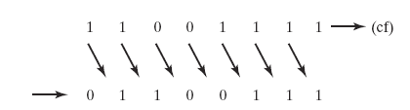
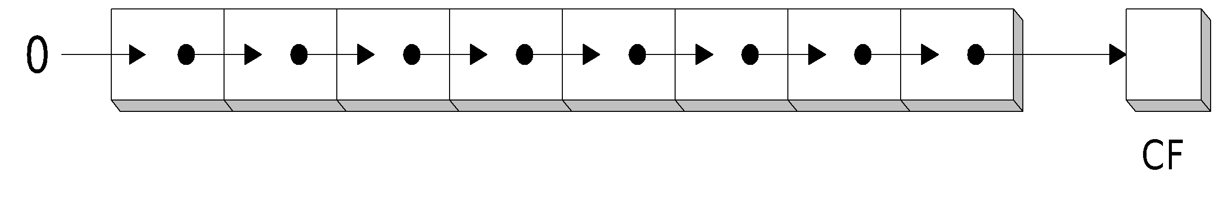
Logical Shift
A logical shift fills the newly created bit position with zero:

Slide 7
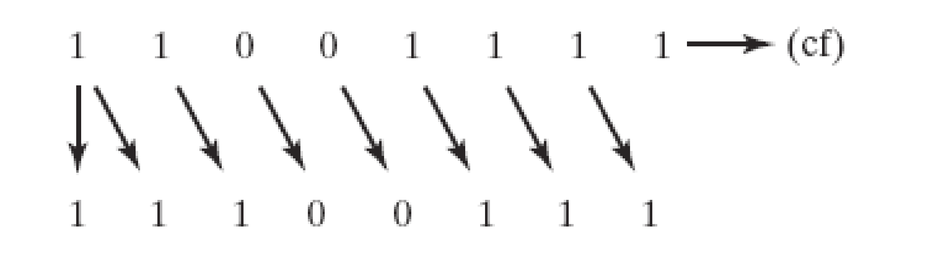
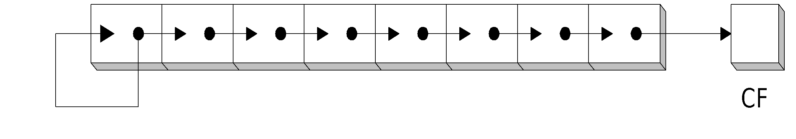
Arithmetic Shift
An arithmetic shift fills the newly created bit position with a copy of the number’s sign bit:

Slide 8
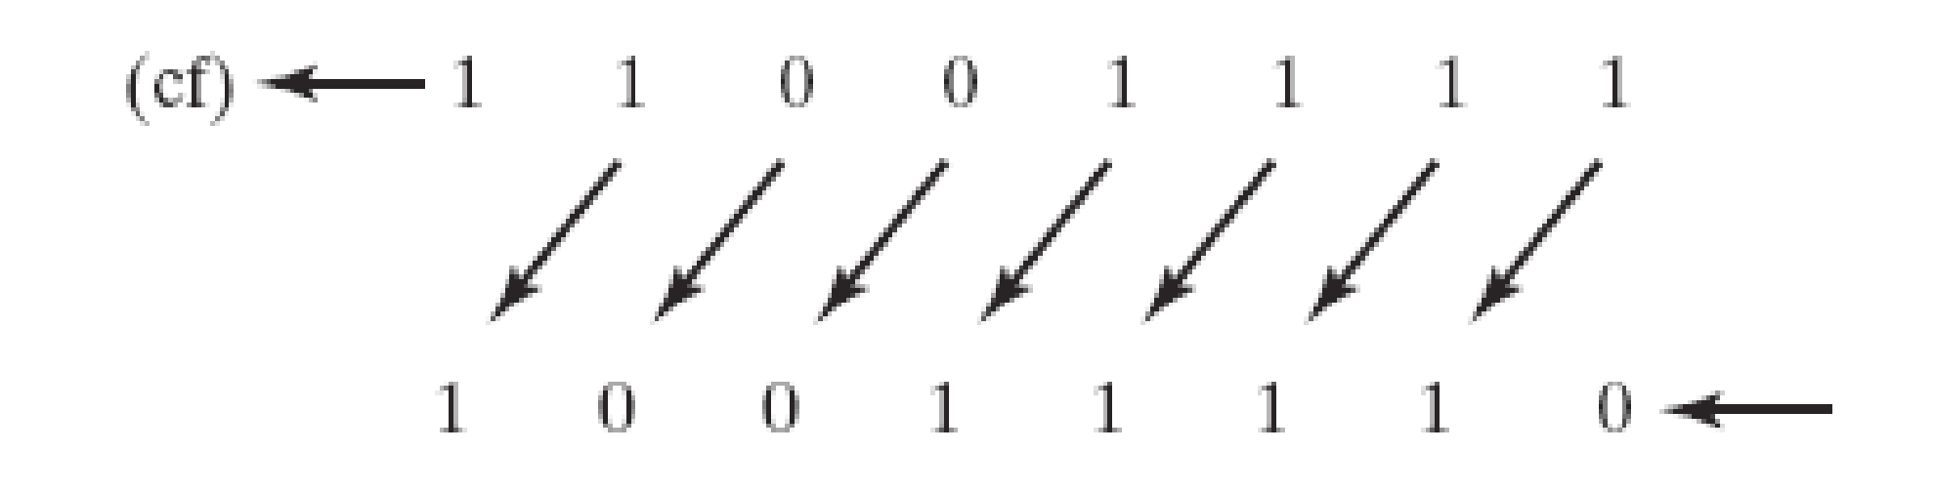
SHL Instruction
The SHL (shift left) instruction performs a logical left shift on the destination operand, filling the lowest bit with 0.
Operand types for SHL:
SHL reg,imm8
SHL mem,imm8
SHL reg,CL
SHL mem,CL
(Same for all shift and rotate instructions)

Slide 9
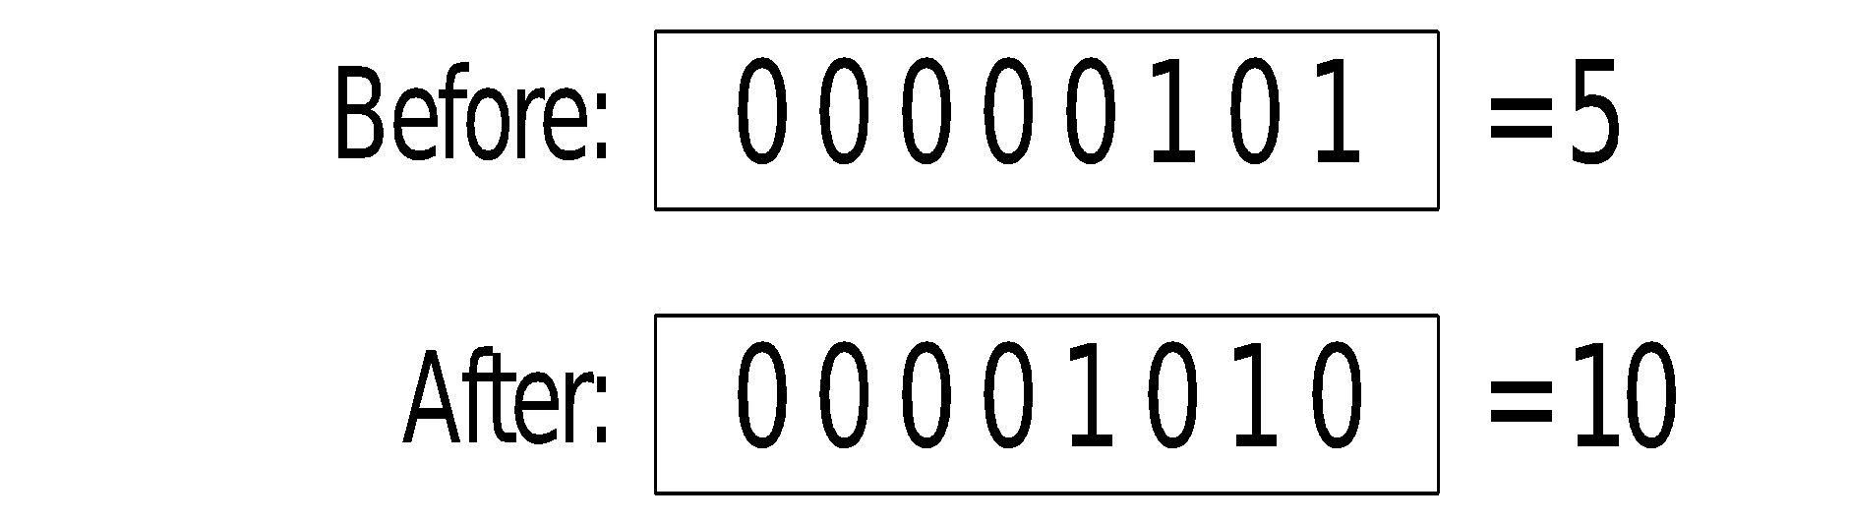
Fast Multiplication
Shifting left 1 bit multiplies a number by 2
mov dl,5
shl dl,1
Shifting left n bits multiplies the operand by 2^{n}
For example, 5 * 2² = 20
mov dl,5
shl dl,2 ; DL = 20

Slide 10

SHR Instruction
The SHR (shift right) instruction performs a logical right shift on the destination operand. The highest bit position is filled with a zero.
Shifting right n bits divides the operand by 2^{n}
DL
0 | 1 | 0 | 1 | 0 | 0 | 0 | 0
mov dl,80
shr dl,1 ; DL = 40
shr dl,2 ; DL = 10
0 | 0 | 1 | 0 | 1 | 0 | 0 | 0
0 | 0 | 0 | 0 | 1 | 0 | 1 | 0

Slide 11

SAL and SAR Instructions
SAL (shift arithmetic left) is identical to SHL.
SAR (shift arithmetic right) performs a right arithmetic shift on the destination operand.
An arithmetic shift preserves the number's sign.
DL
1 | 0 | 1 | 1 | 0 | 0 | 0 | 0
mov dl,-80
sar dl,1 ; DL = -40
sar dl,2 ; DL = -10
1 | 1 | 0 | 1 | 1 | 0 | 0 | 0
1 | 0 | 0 | 1 | 0 | 1 | 1 | 0

Slide 12
Your turn . . .
Indicate the hexadecimal value of AL after each shift:
mov al,6Bh
shr al,1 a.
shl al,3 b.
mov al,8Ch
sar al,1 c.
sar al,3 d.
35h
A8h
C6h
F8h

Slide 13
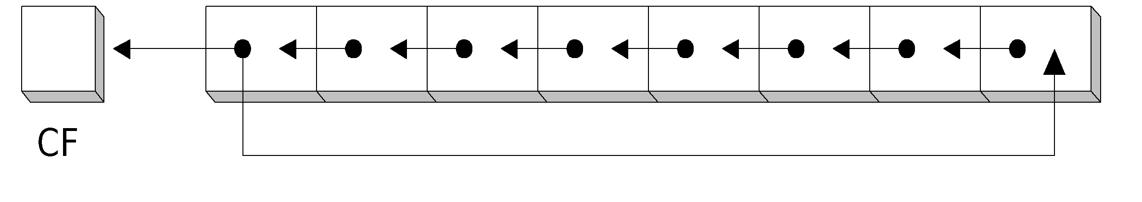
ROL Instruction
ROL (rotate) shifts each bit to the left
The highest bit is copied into both the Carry flag and into the lowest bit
No bits are lost
AL
mov al,11110000b
rol al,1
mov dl,3Fh
rol dl,4 ; DL = F3h
CF
1 | 1 | 1 | 1 | 0 | 0 | 0 | 0
1 | 1 | 1 | 0 | 0 | 0 | 0 | 1
1

Slide 14
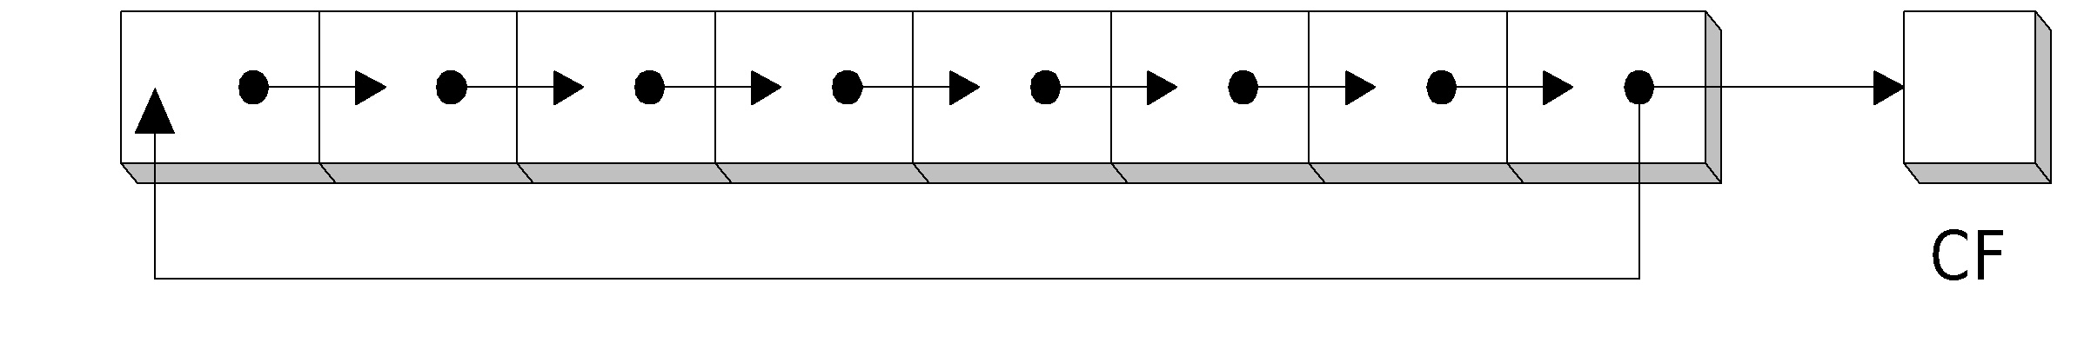
ROR Instruction
ROR (rotate right) shifts each bit to the right
The lowest bit is copied into both the Carry flag and into the highest bit
No bits are lost
AL
mov al,11110000b
ror al,1 ; AL = 01111000b
mov dl,3Fh
ror dl,4 ; DL = F3h
1 | 1 | 1 | 1 | 0 | 0 | 0 | 0
CF
0 | 1 | 1 | 1 | 1 | 0 | 0 | 0
0

Slide 15
Your turn . . .
Indicate the hexadecimal value of AL after each rotation:
mov al,6Bh
ror al,1 a.
rol al,3 b.
B5h
ADh

Slide 16
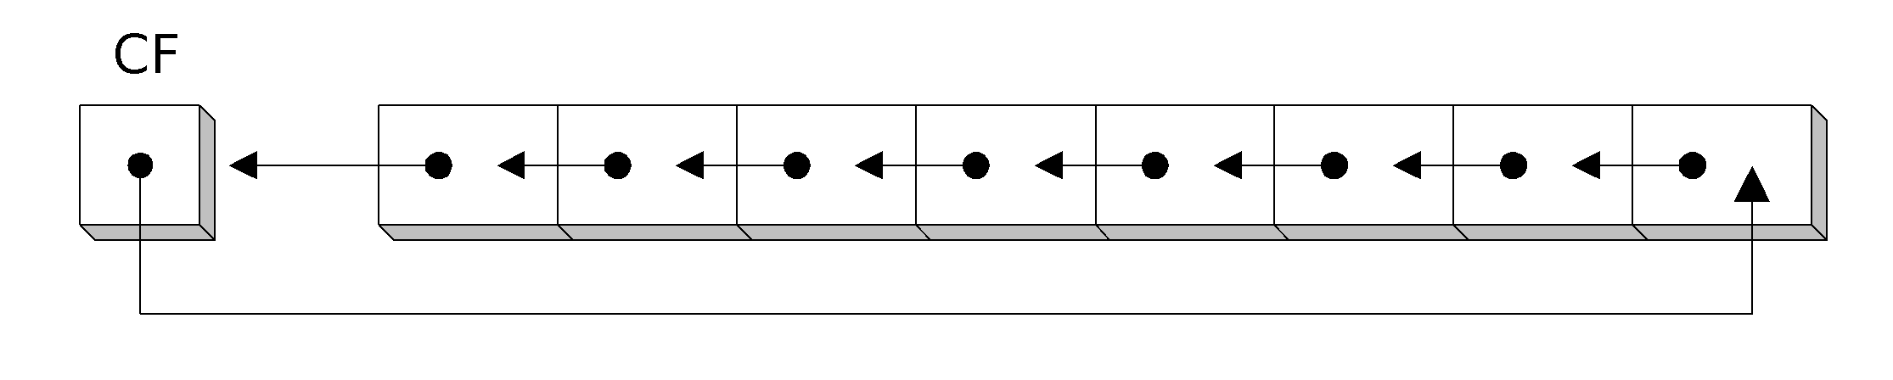
RCL Instruction
RCL (rotate carry left) shifts each bit to the left
Copies the Carry flag to the least significant bit
Copies the most significant bit to the Carry flag
CF
BL
clc ; CF = 0
mov bl,88h
rcl bl,1
rcl bl,1
0
1 | 0 | 0 | 0 | 1 | 0 | 0 | 0
0
0 | 0 | 0 | 1 | 0 | 0 | 0 | 0
1
0 | 0 | 1 | 0 | 0 | 0 | 0 | 1
0

Slide 17
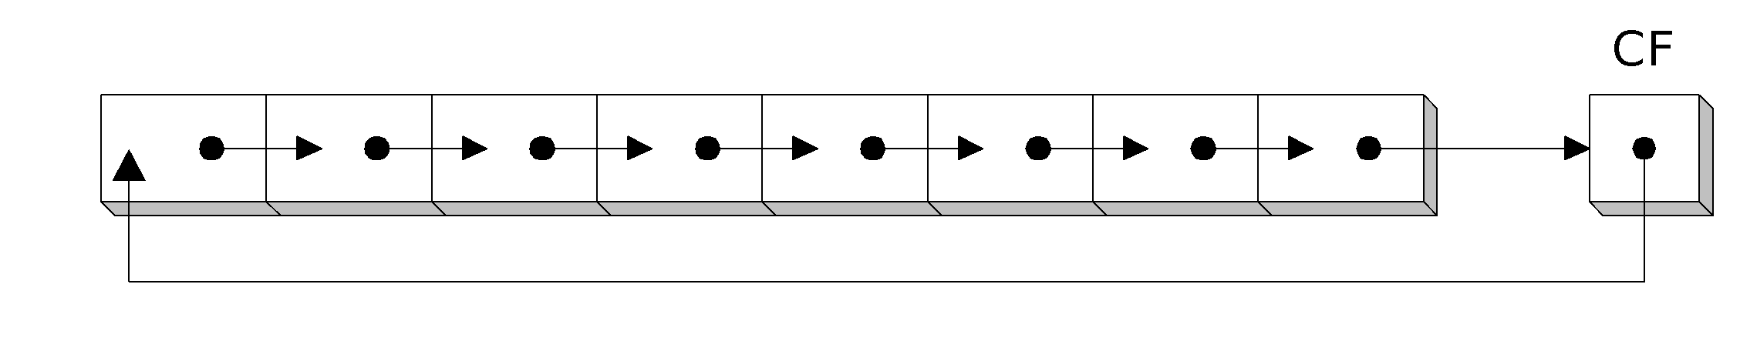
RCR Instruction
RCR (rotate carry right) shifts each bit to the right
Copies the Carry flag to the most significant bit
Copies the least significant bit to the Carry flag
CF
AH
1
stc ; CF = 1
mov ah,10h
rcr ah,1
0 | 0 | 0 | 1 | 0 | 0 | 0 | 0
1
1 | 0 | 0 | 0 | 1 | 0 | 0 | 0
0

Slide 18
Your turn . . .
Indicate the hexadecimal value of AL after each rotation:
stc
mov al,6Bh
rcr al,1 a.
rcl al,3 b.
B5h
AEh

Slide 19
SHLD Instruction
Shifts a destination operand a given number of bits to the left
The bit positions opened up by the shift are filled by the most significant bits of the source operand
The source operand is not affected
Syntax:
  SHLD destination, source, count
Operand types:
SHLD reg16/32, reg16/32, imm8/CL
SHLD mem16/32, reg16/32, imm8/CL

Slide 20
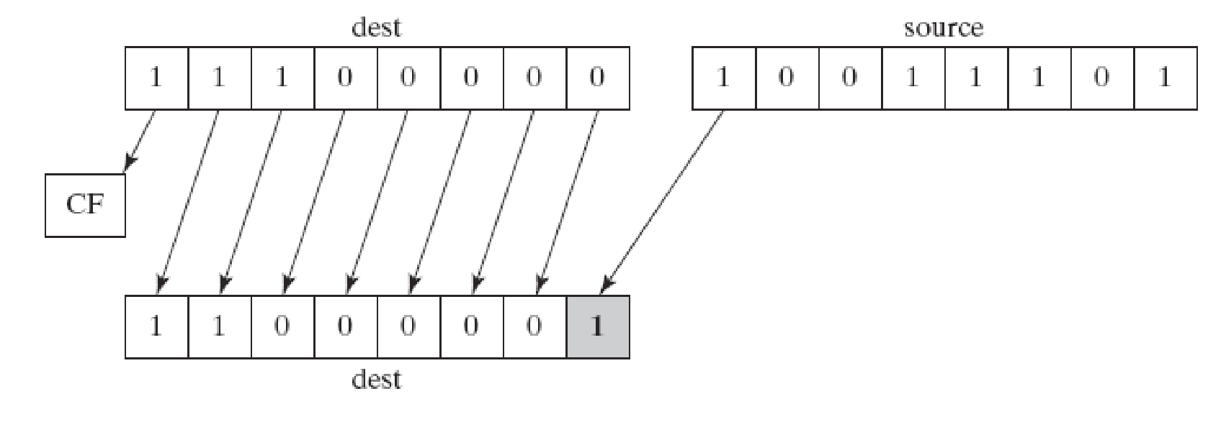
SHLD Example
Shift count of 1:
mov al,11100000b
mov bl,10011101b
shld al,bl,1

Slide 21
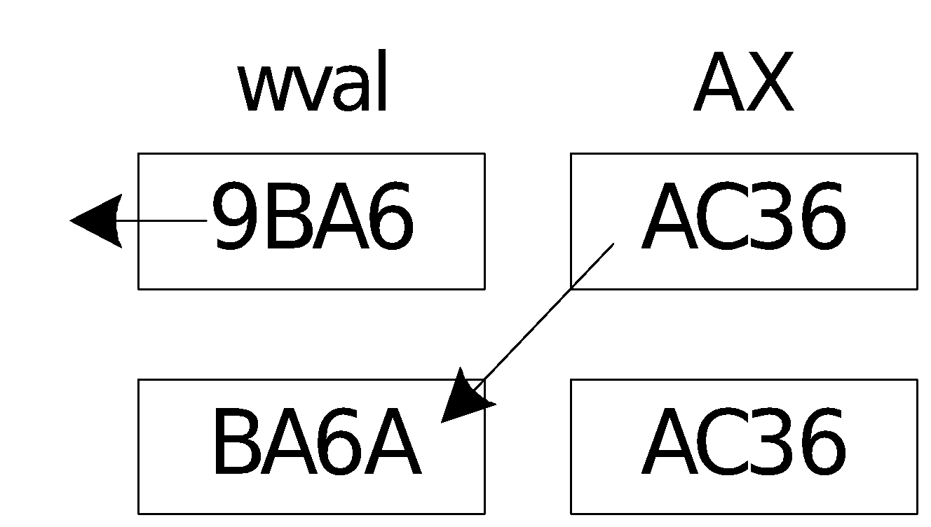
Another SHLD Example
Shift wval 4 bits to the left and replace its lowest 4 bits with the high 4 bits of AX:
.data
wval WORD 9BA6h
.code
mov ax,0AC36h
shld wval,ax,4
Before:
After:

Slide 22
SHRD Instruction
Shifts a destination operand a given number of bits to the right
The bit positions opened up by the shift are filled by the least significant bits of the source operand
The source operand is not affected
Syntax:
  SHRD destination, source, count
Operand types:
SHRD reg16/32, reg16/32, imm8/CL
SHRD mem16/32, reg16/32, imm8/CL

Slide 23
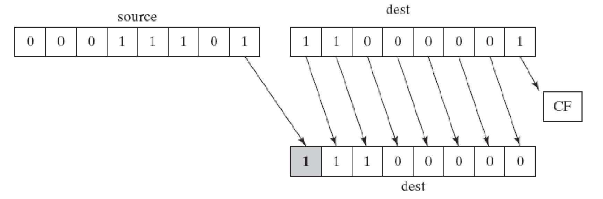
SHRD Example
Shift count of 1:
mov al,11000001b
mov bl,00011101b
shrd al,bl,1

Slide 24
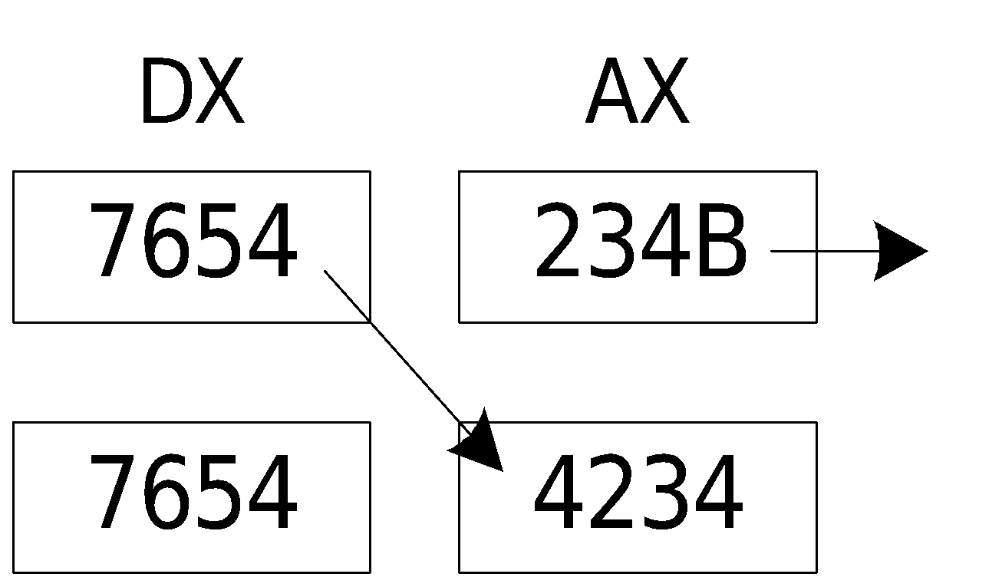
Another SHRD Example
Shift AX 4 bits to the right and replace its highest 4 bits with the low 4 bits of DX:
mov ax,234Bh
mov dx,7654h
shrd ax,dx,4
Before:
After:

Slide 25
Your turn . . .
Indicate the hexadecimal values of each destination operand:
mov ax,7C36h
mov dx,9FA6h
shld dx,ax,4 ; DX =
shrd dx,ax,8 ; DX =
FA67h
36FAh

Slide 26
What's Next
Shift and Rotate Instructions
Shift and Rotate Applications
Multiplication and Division Instructions
Extended Addition and Subtraction
ASCII and Unpacked Decimal Arithmetic
Packed Decimal Arithmetic

Slide 27
Shift and Rotate Applications
Shifting Multiple Doublewords
Binary Multiplication
Displaying Binary Bits
Isolating a Bit String

Slide 28
Shifting Multiple Doublewords (1/2)
Programs sometimes need to shift all bits within an array, as one might when moving a bitmapped graphic image from one screen location to another.
0
0
array [1] |  |  |  |  |  |  |  | array [0]
1 | 0 | 0 | 1 | 1 | 0 | 0 | 1 | 1 | 0 | 0 | 1 | 1 | 0 | 0 | 1

Slide 29
Shifting Multiple Doublewords (2/2)
The following shifts an array of 3 doublewords 1 bit to the right (view complete source code):
1001 10 … 01 1001 | 1001 10 … 01 1001 | 1001 10 … 01 1001
array [8] | array [4] | array [0]
1100 11 … 00 1100
array [0]
0100 11 … 00 1100
array [8]
1100 11 … 00 1100
array [4]
CF | -
CF | 1
.data
ArraySize = 3
array DWORD ArraySize DUP(99999999h) ; 1001 1001...
.code
mov esi,0
shr array[esi + 8],1 ; high dword
rcr array[esi + 4],1 ; middle dword, include Carry
rcr array[esi],1 ; low dword, include Carry

Slide 30
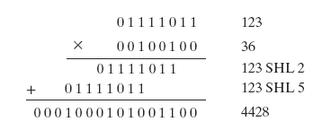
Binary Multiplication
mutiply 123 * 36

Slide 31
Binary Multiplication
We already know that SHL performs unsigned multiplication efficiently when the multiplier is a power of 2.
You can factor any binary number into powers of 2.
  For example, to multiply EAX * 36, factor 36 into 32 + 4 and use the distributive property of multiplication to carry out the operation:
EAX * 36
= EAX * (32 + 4)
= (EAX * 32)+(EAX * 4)
mov eax,123
mov ebx,eax
shl eax,5 ; mult by 2⁵
shl ebx,2 ; mult by 2²
add eax,ebx

Slide 32
Your turn . . .
Multiply AX by 26, using shifting and addition instructions. Hint: 26 = 16 + 8 + 2.
mov ax,2 ; test value
mov dx,ax
shl dx,4 ; AX * 16
push edx ; save for later
mov dx,ax
shl dx,3 ; AX * 8
shl ax,1 ; AX * 2
add ax,dx ; AX * 10
pop edx ; recall AX * 16
add ax,dx ; AX * 26

Slide 33
Displaying Binary Bits
Algorithm: Shift MSB into the Carry flag; If CF = 1, append a "1" character to a string; otherwise, append a "0" character. Repeat in a loop, 32 times.
.data
buffer BYTE 32 DUP(0),0
.code
mov ecx,32
mov esi,OFFSET buffer
L1: shl eax,1
mov BYTE PTR [esi],'0'
jnc L2
mov BYTE PTR [esi],'1'
L2: inc esi
loop L1

Slide 34
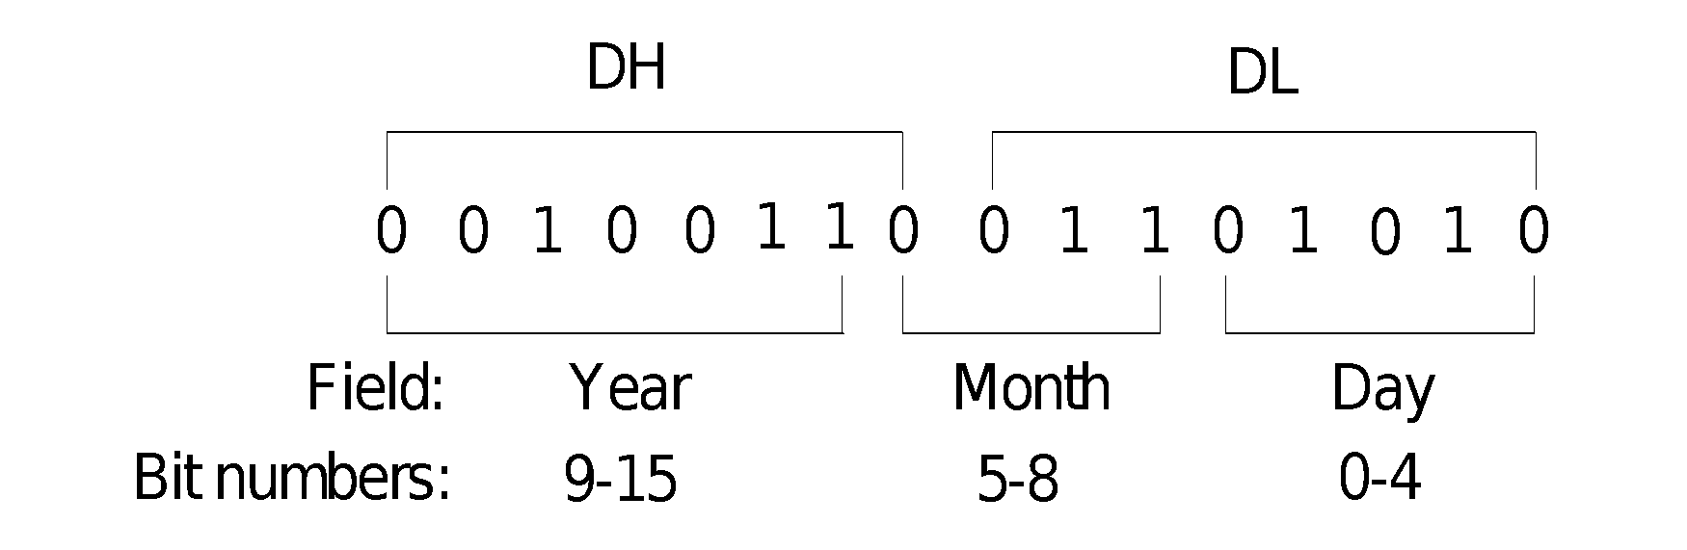
Isolating a Bit String
The MS-DOS file date field packs the year, month, and day into 16 bits:
Isolate the Month field:
mov ax,dx ; make a copy of DX
shr ax,5 ; shift right 5 bits
and al,00001111b ; clear bits 4-7
mov month,al ; save in month variable

Slide 35
What's Next
Shift and Rotate Instructions
Shift and Rotate Applications
Multiplication and Division Instructions
Extended Addition and Subtraction
ASCII and Unpacked Decimal Arithmetic
Packed Decimal Arithmetic

Slide 36
Multiplication and Division Instructions
MUL Instruction
IMUL Instruction
DIV Instruction
Signed Integer Division
CBW, CWD, CDQ Instructions
IDIV Instruction
Implementing Arithmetic Expressions

Slide 37
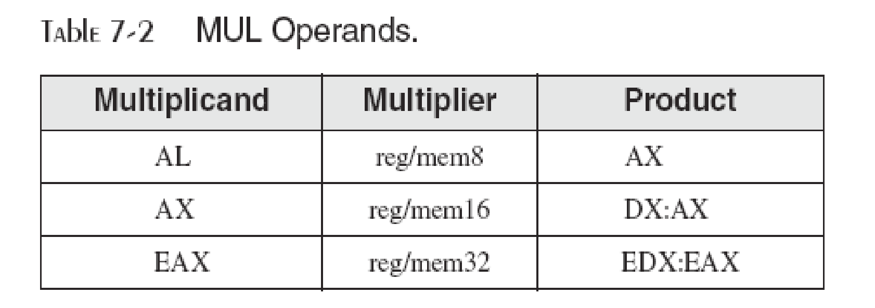
MUL Instruction
In 32-bit mode, MUL (unsigned multiply) instruction multiplies an 8-, 16-, or 32-bit operand by either AL, AX, or EAX.
The instruction formats are:
    MUL r/m8
    MUL r/m16
    MUL r/m32
Multiplicand
Product
AL
AX
8-bit
AX
DX
AX
16-bit
EAX
EDX
EAX
32-bit

Slide 38
64-Bit MUL Instruction
In 64-bit mode, MUL (unsigned multiply) instruction multiplies a 64-bit operand by RAX, producing a 128-bit product.
The instruction formats are:
    MUL r/m64
Example:
mov rax,0FFFF0000FFFF0000h
mov rbx,2
mul rbx ; RDX:RAX = 0000000000000001FFFE0001FFFE0000

Slide 39
MUL Examples
100h * 2000h, using 16-bit operands:
.data
val1 WORD 2000h
val2 WORD 100h
.code
mov ax,val1
mul val2 ; DX:AX = 00200000h, CF=1
The Carry flag indicates whether or not the upper half of the product contains significant digits.
12345h * 1000h, using 32-bit operands:
mov eax,12345h
mov ebx,1000h
mul ebx ; EDX:EAX = 0000000012345000h, CF=0
Binary Multiplications with SHL
Notes:
補上例子例連結

Slide 40
Your turn . . .
What will be the hexadecimal values of DX, AX, and the Carry flag after the following instructions execute?
mov ax,1234h
mov bx,100h
mul bx
DX = 0012h, AX = 3400h, CF = 1

Slide 41
Your turn . . .
What will be the hexadecimal values of EDX, EAX, and the Carry flag after the following instructions execute?
mov eax,00128765h
mov ecx,10000h
mul ecx
EDX = 00000012h, EAX = 87650000h, CF = 1

Slide 42
IMUL Instruction
IMUL (signed integer multiply ) multiplies an 8-, 16-, or 32-bit signed operand by either AL, AX, or EAX
Preserves the sign of the product by sign-extending it into the upper half of the destination register
Example: multiply 48 * 4, using 8-bit operands:
mov al,48 ; AL = 30h
mov bl,4 ; BL = 04h
imul bl ; AX = 00C0h, OF=1
00110000b | AL
00000100b | BL
00000000 | 11000000b | AX
OF=1 because AH is not a sign extension of AL.
Notes:
補上register儲存狀況
實驗了很多組imul，得到的結論：在imul下，cf和of會同時被set，不會有不同的情形產生。
According to books page 290：因為product長度定義的關係，不可能會有overflow的情形產生。而當higher part不單單只是 sign extention時，overflow flag 跟 sign flag 會被同時設為1
原文：
As in the case of MUL, the storage size of the product makes overflow impossible. Also, the carry and overflow flags are set if the upper half of the product is not a sign extension of the lower half. You can use this information to decide whether to ignore the upper half of the product.

Slide 43
Using IMUL in 64-Bit Mode
You can use 64-bit operands. In the two-operand format, a 64-bit register or memory operand is multiplied against RDX
  128-bit product produced in RDX:RAX
The three-operand format produces a 64-bit product in RAX
.data
multiplicand QWORD -16
.code
imul rax, multiplicand, 4 ; RAX = FFFFFFFFFFFFFFC0 (-64)

Slide 44
IMUL Examples
Multiply 4,823,424 * −423:
mov eax,4823424
mov ebx,-423
imul ebx ; EDX:EAX = FFFFFFFF86635D80h, OF=0
OF=0 because EDX is a sign extension of EAX.

Slide 45
Your turn . . .
What will be the hexadecimal values of DX, AX, and the Carry flag after the following instructions execute?
mov ax,8760h
mov bx,100h
imul bx
DX = FF87h, AX = 6000h, OF = 1

Slide 46
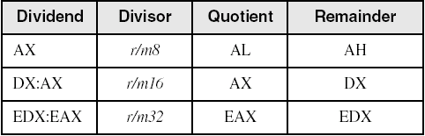
DIV Instruction
The DIV (unsigned divide) instruction performs 8-bit, 16-bit, and 32-bit division on unsigned integers
A single operand is supplied (register or memory operand), which is assumed to be the divisor
Instruction formats:
mov ax, Dividend
div r/m8
mov dx, Dividend_Hign
mov ax, Dividend_Low
div r/m16
mov edx, Dividend_Hign
mov eax, Dividend_Low
div r/m32
Default Operands:
Notes:
補上舊版資訊（mov）

Slide 47
DIV Examples
Divide 8003h by 100h, using 16-bit operands:
mov dx,0 ; clear dividend, high
mov ax,8003h ; dividend, low
mov cx,100h ; divisor
div cx ; AX = 0080h, DX = 3
Same division, using 32-bit operands:
mov edx,0 ; clear dividend, high
mov eax,8003h ; dividend, low
mov ecx,100h ; divisor
div ecx ; EAX = 00000080h, DX = 3

Slide 48
64-Bit DIV Example
Divide 000001080000000033300020h by 00010000h:
.data
dividend_hi QWORD 00000108h
dividend_lo QWORD 33300020h
divisor QWORD 00010000h
.code
mov rdx, dividend_hi
mov rax, dividend_lo
div divisor ; RAX = quotient
; RDX = remainder
quotient: 0108000000003330h
remainder: 0000000000000020h
Default Operands:
Dividend | Divisor | Quotient | Remainder
RDX:RAX | r/m64 | RAX | RDX
Notes:
補上64bits使用的table

Slide 49
Your turn . . .
What will be the hexadecimal values of DX and AX after the following instructions execute? Or, if divide overflow occurs, you can indicate that as your answer:
mov dx,0087h
mov ax,6000h
mov bx,100h
div bx
DX = 0000h, AX = 8760h

Slide 50
Your turn . . .
What will be the hexadecimal values of DX and AX after the following instructions execute? Or, if divide overflow occurs, you can indicate that as your answer:
mov dx,0087h
mov ax,6002h
mov bx,10h
div bx
Divide Overflow

Slide 51
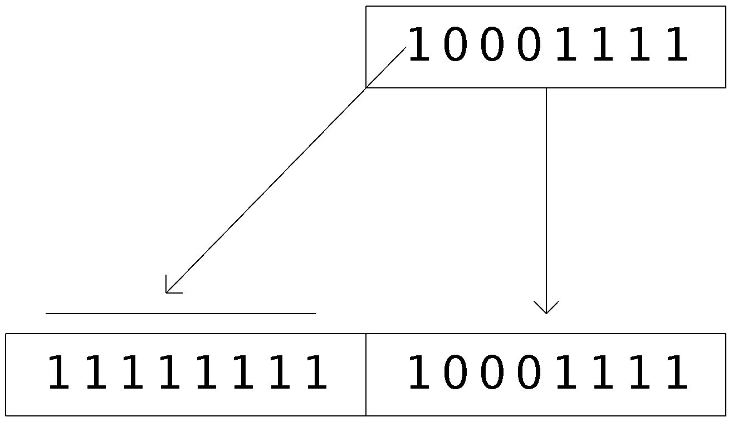
Signed Integer Division (IDIV)
Signed integers must be sign-extended before division takes place
  fill high byte/word/doubleword with a copy of the low byte/word/doubleword's sign bit
For example, the high byte contains a copy of the sign bit from the low byte:

Slide 52
CBW, CWD, CDQ Instructions
The CBW, CWD, and CDQ instructions provide important sign-extension operations:
  CBW (convert byte to word) extends AL into AH
  CWD (convert word to doubleword) extends AX into DX
  CDQ (convert doubleword to quadword) extends EAX into EDX
Example:
    .data
    dwordVal SDWORD -101 ; FFFFFF9Bh
    .code
    mov eax,dwordVal
    cdq ; EDX:EAX = FFFFFFFFFFFFFF9Bh

Slide 53
IDIV Instruction
IDIV (signed divide) performs signed integer division
Same syntax and operands as DIV instruction
Default Operands:
Example: 8-bit division of –48 by 5
mov al,-48
cbw ; extend AL into AH
mov bl,5
idiv bl ; AL = -9, AH = -3
Notes:
補上舊板資訊（表格）

Slide 54
IDIV Examples
Example: 16-bit division of –48 by 5
mov ax,-48
cwd ; extend AX into DX
mov bx,5
idiv bx ; AX = -9, DX = -3
Example: 32-bit division of –48 by 5
mov eax,-48
cdq ; extend EAX into EDX
mov ebx,5
idiv ebx ; EAX = -9, EDX = -3

Slide 55
Your turn . . .
What will be the hexadecimal values of DX and AX after the following instructions execute? Or, if divide overflow occurs, you can indicate that as your answer:
mov ax,0FDFFh ; -513
cwd
mov bx,100h
idiv bx
DX = FFFFh (−1), AX = FFFEh (−2)

Slide 56
Unsigned Arithmetic Expressions
Some good reasons to learn how to implement integer expressions:
  Learn how do compilers do it
  Test your understanding of MUL, IMUL, DIV, IDIV
  Check for overflow (Carry and Overflow flags)
Example: var4 = (var1 + var2) * var3
; Assume unsigned operands
mov eax,var1
add eax,var2 ; EAX = var1 + var2
mul var3 ; EAX = EAX * var3
jc TooBig ; check for carry
mov var4,eax ; save product

Slide 57
Signed Arithmetic Expressions
Example: eax = (-var1 * var2) + var3
mov eax,var1
neg eax
imul var2
jo TooBig ; check for overflow
add eax,var3
jo TooBig ; check for overflow
Example: var4 = (var1 * 5) / (var2 – 3)
mov eax,var1 ; left side
mov ebx,5
imul ebx ; EDX:EAX = product
mov ebx,var2 ; right side
sub ebx,3
idiv ebx ; EAX = quotient
mov var4,eax

Slide 58
Signed Arithmetic Expressions (2 of 2)
Example: var4 = (var1 * -5) / (-var2 % var3);
mov eax,var2 ; begin right side
neg eax
cdq ; sign-extend dividend
idiv var3 ; EDX = remainder
mov ebx,edx ; EBX = right side
mov eax,-5 ; begin left side
imul var1 ; EDX:EAX = left side
idiv ebx ; final division
mov var4,eax ; quotient
Sometimes it's easiest to calculate the right-hand term of an expression first.
Notes:
這一頁不講（因為沒有檢查flag
拿掉連結

Slide 59
Your turn . . .
Implement the following expression using signed 32-bit integers:
eax = (ebx * 20) / ecx
mov eax,20
imul ebx
idiv ecx

Slide 60
Your turn . . .
Implement the following expression using signed 32-bit integers. Save and restore ECX and EDX:
eax = (ecx * edx) / eax
push edx
push eax ; EAX needed later
mov eax,ecx
imul edx ; left side: EDX:EAX
pop ebx ; saved value of EAX
idiv ebx ; EAX = quotient
pop edx ; restore EDX, ECX

Slide 61
Your turn . . .
Implement the following expression using signed 32-bit integers. Do not modify any variables other than var3:
var3 = (var1 * -var2) / (var3 – ebx)
mov eax,var1
mov edx,var2
neg edx
imul edx ; left side: EDX:EAX
mov ecx,var3
sub ecx,ebx
idiv ecx ; EAX = quotient
mov var3,eax

Slide 62
What's Next
Shift and Rotate Instructions
Shift and Rotate Applications
Multiplication and Division Instructions
Extended Addition and Subtraction
ASCII and UnPacked Decimal Arithmetic
Packed Decimal Arithmetic

Slide 63
Extended Addition and Subtraction
ADC Instruction
Extended Precision Addition
SBB Instruction
Extended Precision Subtraction
The instructions in this section do not apply to 64-bit mode programming.

Slide 64
Extended Precision Addition
Adding two operands that are longer than the computer's word size (32 bits).
  Virtually no limit to the size of the operands
The arithmetic must be performed in steps
  The Carry value from each step is passed on to the next step.

Slide 65
ADC Instruction
ADC (add with carry) instruction adds both a source operand and the contents of the Carry flag to a destination operand.
Operands are binary values
  Same syntax as ADD, SUB, etc.
Example
  Add two 32-bit integers (FFFFFFFFh + FFFFFFFFh), producing a 64-bit sum in EDX:EAX:
    mov edx,0
    mov eax,0FFFFFFFFh
    add eax,0FFFFFFFFh
    adc edx,0 ;EDX:EAX = 00000001FFFFFFFEh

Slide 66
Extended Addition Example
Task: Add 1 to EDX:EAX
  Starting value of EDX:EAX: 00000000FFFFFFFFh
  Add the lower 32 bits first, setting the Carry flag.
  Add the upper 32 bits, and include the Carry flag.
mov edx,0 ; set upper half
mov eax,0FFFFFFFFh ; set lower half
add eax,1 ; add lower half
adc edx,0 ; add upper half
    EDX:EAX = 00000001 00000000

Slide 67
SBB Instruction
The SBB (subtract with borrow) instruction subtracts both a source operand and the value of the Carry flag from a destination operand.
Operand syntax:
  Same as for the ADC instruction

Slide 68
Extended Subtraction Example
Task: Subtract 1 from EDX:EAX
  Starting value of EDX:EAX: 0000000100000000h
  Subtract the lower 32 bits first, setting the Carry flag.
  Subtract the upper 32 bits, and include the Carry flag.
mov edx,1 ; set upper half
mov eax,0 ; set lower half
sub eax,1 ; subtract lower half
sbb edx,0 ; subtract upper half
EDX:EAX = 00000000 FFFFFFFF

Slide 69
What's Next
Shift and Rotate Instructions
Shift and Rotate Applications
Multiplication and Division Instructions
Extended Addition and Subtraction
ASCII and UnPacked Decimal Arithmetic
Packed Decimal Arithmetic

Slide 70
ASCII and Packed Decimal Arithmetic
Binary Coded Decimal
ASCII Decimal
AAA Instruction
AAS Instruction
AAM Instruction
AAD Instruction
Packed Decimal Integers
DAA Instruction
DAS Instruction
The instructions in this section do not apply to 64-bit mode programming.

Slide 71
Binary-Coded Decimal
Binary-coded decimal (BCD) integers use 4 binary bits to represent each decimal digit
A number using unpacked BCD representation stores a decimal digit in the lower four bits of each byte
  For example, 5,678 is stored as the following sequence of hexadecimal bytes:
05
06
07
08

Slide 72
ASCII Decimal
A number using ASCII Decimal representation stores a single ASCII digit in each byte
  For example, 5,678 is stored as the following sequence of hexadecimal bytes:
35
36
37
38

Slide 73
AAA Instruction
The AAA (ASCII adjust after addition) instruction adjusts the binary result of an ADD or ADC instruction. It makes the result in AL consistent with ASCII decimal representation.
  The Carry value, if any ends up in AH
Example: Add '8' and '2'
mov ah,0
mov al,'8' ; AX = 0038h
add al,'2' ; AX = 006Ah
aaa ; AX = 0100h (adjust result)
or ax,3030h ; AX = 3130h = '10'

Slide 74
AAS Instruction
The AAS (ASCII adjust after subtraction) instruction adjusts the binary result of an SUB or SBB instruction. It makes the result in AL consistent with ASCII decimal representation.
  It places the Carry value, if any, in AH
Example: Subtract '9' from '8'
mov ah,0
mov al,'8' ; AX = 0038h
sub al,'9' ; AX = 00FFh
aas ; AX = FF09h, CF=1
or al,30h ; AL = '9'

Slide 75
AAM Instruction
The AAM (ASCII adjust after multiplication) instruction adjusts the binary result of a MUL instruction. The multiplication must have been performed on unpacked BCD numbers.
mov bl,05h ; first operand
mov al,06h ; second operand
mul bl ; AX = 001Eh
aam ; AX = 0300h

Slide 76
AAD Instruction
The AAD (ASCII adjust before division) instruction adjusts the unpacked BCD dividend in AX before a division operation
.data
quotient BYTE ?
remainder BYTE ?
.code
mov ax,0307h ; dividend
aad ; AX = 0025h
mov bl,5 ; divisor
div bl ; AX = 0207h
mov quotient,al
mov remainder,ah

Slide 77
What's Next
Shift and Rotate Instructions
Shift and Rotate Applications
Multiplication and Division Instructions
Extended Addition and Subtraction
ASCII and UnPacked Decimal Arithmetic
Packed Decimal Arithmetic

Slide 78
Packed Decimal Arithmetic
Packed decimal integers store two decimal digits per byte
  For example, 12,345,678 can be stored as the following sequence of hexadecimal bytes:
12
34
56
78
Packed decimal is also known as packed BCD.
Good for financial values – extended precision possible, without rounding errors.

Slide 79
DAA Instruction
The DAA (decimal adjust after addition) instruction converts the binary result of an ADD or ADC operation to packed decimal format.
  The value to be adjusted must be in AL
  If the lower digit is adjusted, the Auxiliary Carry flag is set.
  If the upper digit is adjusted, the Carry flag is set.

Slide 80
DAA Logic
If (AL(lo) > 9) or (AuxCarry = 1)
AL = AL + 6
AuxCarry = 1
Else
AuxCarry = 0
Endif
If (AL(hi) > 9) or Carry = 1
AL = AL + 60h
Carry = 1
Else
Carry = 0
Endif
If AL = AL + 6 sets the Carry flag, its value is used when evaluating AL(hi).

Slide 81
DAA Examples
Example: calculate BCD 35 + 48
mov al,35h
add al,48h ; AL = 7Dh
daa ; AL = 83h, CF = 0
Example: calculate BCD 35 + 65
mov al,35h
add al,65h ; AL = 9Ah
daa ; AL = 00h, CF = 1
Example: calculate BCD 69 + 29
mov al,69h
add al,29h ; AL = 92h
daa ; AL = 98h, CF = 0

Slide 82
Your turn . . .
A temporary malfunction in your computer's processor has disabled the DAA instruction. Write a procedure in assembly language that performs the same actions as DAA.
Test your procedure using the values from the previous slide.

Slide 83
DAS Instruction
The DAS (decimal adjust after subtraction) instruction converts the binary result of a SUB or SBB operation to packed decimal format.
The value must be in AL
Example: subtract BCD 48 from 85
mov al,48h
sub al,35h ; AL = 13h
das ; AL = 13h CF = 0

Slide 84
DAS Logic
If (AL(lo) > 9) OR (AuxCarry = 1)
AL = AL − 6;
AuxCarry = 1;
Else
  AuxCarry = 0;
Endif
If (AL > 9FH) or (Carry = 1)
AL = AL − 60h;
Carry = 1;
Else
Carry = 0;
Endif
If AL = AL − 6 sets the Carry flag, its value is used when evaluating AL in the second IF statement.

Slide 85
DAS Examples (1 of 2)
Example: subtract BCD 48 – 35
mov al,48h
sub al,35h ; AL = 13h
das ; AL = 13h CF = 0
Example: subtract BCD 62 – 35
mov al,62h
sub al,35h ; AL = 2Dh, CF = 0
das ; AL = 27h, CF = 0
Example: subtract BCD 32 – 29
mov al,32h
add al,29h ; AL = 09h, CF = 0
daa ; AL = 03h, CF = 0

Slide 86
DAS Examples (2 of 2)
Example: subtract BCD 32 – 39
mov al,32h
sub al,39h ; AL = F9h, CF = 1
das ; AL = 93h, CF = 1
Steps:
AL = F9h
CF = 1, so subtract 6 from F9h
AL = F3h
F3h > 9Fh, so subtract 60h from F3h
AL = 93h, CF = 1

Slide 87
Your turn . . .
A temporary malfunction in your computer's processor has disabled the DAS instruction. Write a procedure in assembly language that performs the same actions as DAS.
Test your procedure using the values from the previous two slides.

