Slide 1
Assembly Language for x86 Processors 7th Edition , Global Edition
Kip R. Irvine
Chapter 10: Structures and Macros
Slide show prepared by the author
Revision date: 1/15/2014
(c) Pearson Education, 2015. All rights reserved. You may modify and copy this slide show for your personal use, or for use in the classroom, as long as this copyright statement, the author's name, and the title are not changed.

Slide 2
Chapter Overview
Structures
Macros
Conditional-Assembly Directives
Defining Repeat Blocks

Slide 3
Summary
Use a structure to define complex types
contains fields of different types
Macro – named block of statements
substituted by the assembler preprocessor
Conditional assembly directives
IF, IFNB, IFIDNI, ...
Operators: &, %, <>, !
Repeat block directives (assembly time)
WHILE, REPEAT, FOR, FORC

Slide 4

4D 77 69 73 68 6F

Slide 5
Structures - Overview
Defining Structures
Declaring Structure Variables
Referencing Structure Variables
Example: Displaying the System Time
Nested Structures
Example: Drunkard's Walk
Declaring and Using Unions

Slide 6
Structure
A template or pattern given to a logically related group of variables.
field - structure member containing data
Program access to a structure:
entire structure as a complete unit
individual fields
Useful way to pass multiple related arguments to a procedure
example: file directory information

Slide 7
Using a Structure
Using a structure involves three sequential steps:
1. Define the structure.
2. Declare one or more variables of the structure type, called structure variables.
3. Write runtime instructions that access the structure.

Slide 8
Structure Definition Syntax
name STRUCT
field-declarations
name ENDS
Field-declarations are identical to variable declarations

Slide 9
COORD Structure
The COORD structure used by the MS-Windows programming library identifies X and Y screen coordinates
COORD STRUCT
X WORD ? ; offset 00
Y WORD ? ; offset 02
COORD ENDS

Slide 10
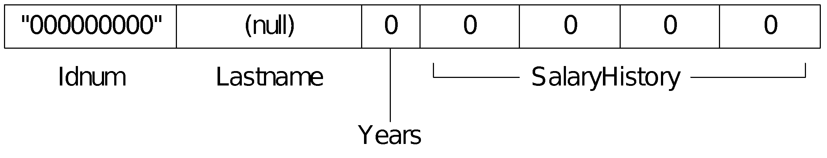
Employee Structure
A structure is ideal for combining fields of different types:
Employee STRUCT
IdNum BYTE "000000000"
LastName BYTE 30 DUP(0)
Years WORD 0
SalaryHistory DWORD 0,0,0,0
Employee ENDS

Slide 11
Declaring Structure Variables
Structure name is a user-defined type
Insert replacement initializers between brackets:
< . . . >
Empty brackets <> retain the structure's default field initializers
Examples:
.data
point1 COORD <5,10>
point2 COORD <>
worker Employee <>

Slide 12
Initializing Array Fields
Use the DUP operator to initialize one or more elements of an array field:
.data
emp Employee <,,,2 DUP(20000)>

Slide 13
Array of Structures
An array of structure objects can be defined using the DUP operator.
Initializers can be used
NumPoints = 3
AllPoints COORD NumPoints DUP(<0,0>)
RD_Dept Employee 20 DUP(<>)
accounting Employee 10 DUP(<,,,4 DUP(20000) >)

Slide 14
Referencing Structure Variables
Employee STRUCT ; bytes
IdNum BYTE "000000000" ; 9
LastName BYTE 30 DUP(0) ; 30
Years WORD 0 ; 2
SalaryHistory DWORD 0,0,0,0 ; 16
Employee ENDS ; 57
.data
worker Employee <>
mov eax,TYPE Employee ; 57
mov eax,SIZEOF Employee ; 57
mov eax,SIZEOF worker ; 57
mov eax,TYPE Employee.SalaryHistory ; 4
mov eax,LENGTHOF Employee.SalaryHistory ; 4
mov eax,SIZEOF Employee.SalaryHistory ; 16

Slide 15
. . . continued
mov dx,worker.Years
mov worker.SalaryHistory,20000 ; first salary
mov worker.SalaryHistory+4,30000 ; second salary
mov edx,OFFSET worker.LastName
mov esi,OFFSET worker
mov ax,(Employee PTR [esi]).Years
mov ax,[esi].Years ; invalid operand (ambiguous)

Slide 16
Looping Through an Array of Points
Sets the X and Y coordinates of the AllPoints array to sequentially increasing values (1,1), (2,2), ...
.data
NumPoints = 3
AllPoints COORD NumPoints DUP(<0,0>)
.code
mov edi,0 ; array index
mov ecx,NumPoints ; loop counter
mov ax,1 ; starting X, Y values
L1:
mov (COORD PTR AllPoints[edi]).X,ax
mov (COORD PTR AllPoints[edi]).Y,ax
add edi,TYPE COORD
inc ax
Loop L1

Slide 17
Example: Displaying the System Time (1 of 3)
Retrieves and displays the system time at a selected screen location.
Uses COORD and SYSTEMTIME structures:
SYSTEMTIME STRUCT
wYear WORD ?
wMonth WORD ?
wDayOfWeek WORD ?
wDay WORD ?
wHour WORD ?
wMinute WORD ?
wSecond WORD ?
wMilliseconds WORD ?
SYSTEMTIME ENDS

Slide 18
Example: Displaying the System Time (2 of 3)
GetStdHandle gets the standard console output handle.
SetConsoleCursorPosition positions the cursor.
GetLocalTime gets the current time of day.
.data
sysTime SYSTEMTIME <>
XYPos COORD <10,5>
consoleHandle DWORD ?
.code
INVOKE GetStdHandle, STD_OUTPUT_HANDLE
mov consoleHandle,eax
INVOKE SetConsoleCursorPosition, consoleHandle, XYPos
INVOKE GetLocalTime, ADDR sysTime

Slide 19
Example: Displaying the System Time (3 of 3)
Display the time using library calls:
mov edx,OFFSET TheTimeIs ; "The time is "
call WriteString
movzx eax,sysTime.wHour ; hours
call WriteDec
mov edx,offset colonStr ; ":"
call WriteString
movzx eax,sysTime.wMinute ; minutes
call WriteDec
mov edx,offset colonStr ; ":"
call WriteString
movzx eax,sysTime.wSecond ; seconds
call WriteDec

Slide 20
Nested Structures (1 of 2)
Define a structure that contains other structures.
Used nested braces (or brackets) to initialize each COORD structure.
COORD STRUCT
X WORD ?
Y WORD ?
COORD ENDS
Rectangle STRUCT
UpperLeft COORD <>
LowerRight COORD <>
Rectangle ENDS
.data
rect1 Rectangle { {10,10}, {50,20} }
rect2 Rectangle < <10,10>, <50,20> >

Slide 21
Nested Structures (2 of 2)
Use the dot (.) qualifier to access nested fields.
Use indirect addressing to access the overall structure or one of its fields
mov rect1.UpperLeft.X, 10
mov esi,OFFSET rect1
mov (Rectangle PTR [esi]).UpperLeft.Y, 10
// use the OFFSET operator
mov edi,OFFSET rect2.LowerRight
mov (COORD PTR [edi]).X, 50
mov edi,OFFSET rect2.LowerRight.X
mov WORD PTR [edi], 50

Slide 22
Example: Drunkard's Walk
Random-path simulation
Uses a nested structure to accumulate path data as the simulation is running
Uses a multiple branch structure to choose the direction
WalkMax = 50
DrunkardWalk STRUCT
path COORD WalkMax DUP(<0,0>)
pathsUsed WORD 0
DrunkardWalk ENDS
View the source code

Slide 23
Declaring and Using Unions
A union is similar to a structure in that it contains multiple fields
All of the fields in a union begin at the same offset
(differs from a structure)
Provides alternate ways to access the same data
Syntax:
unionname UNION
union-fields
unionname ENDS

Slide 24
Integer Union Example
The Integer union consumes 4 bytes (equal to the largest field)
Integer UNION
D DWORD 0
W WORD 0
B BYTE 0
Integer ENDS
D, W, and B are often called variant fields.
Integer can be used to define data:
.data
val1 Integer <12345678h>
val2 Integer <100h>
val3 Integer <>

Slide 25
Integer Union Example
The variant field name is required when accessing the union:
mov val3.B, al
mov ax,val3.W
add val3.D, eax

Slide 26
Union Inside a Structure
An Integer union can be enclosed inside a FileInfo structure:
Integer UNION
D DWORD 0
W WORD 0
B BYTE 0
Integer ENDS
FileInfo STRUCT
FileID Integer <>
FileName BYTE 64 DUP(?)
FileInfo ENDS
.data
myFile FileInfo <>
.code
mov myFile.FileID.W, ax

Slide 27
What's Next
Structures
Macros
Conditional-Assembly Directives
Defining Repeat Blocks

Slide 28
Macros
Introducing Macros
Defining Macros
Invoking Macros
Invalid Argument
Blank Argument
Macro Examples
Nested Macros
Example Program: Wrappers

Slide 29
Introducing Macros
A macro¹ is a named block of assembly language statements.
Once defined, it can be invoked (called) one or more times.
During the assembler's preprocessing step, each macro call is expanded into a copy of the macro.
The expanded code is passed to the assembly step, where it is checked for correctness.
¹Also called a macro procedure.

Slide 30
Defining Macros
A macro must be defined before it can be used.
Parameters are optional.
Each parameter follows the rules for identifiers. It is a string that is assigned a value when the macro is invoked.
Syntax:
macroname MACRO [parameter-1, parameter-2,...]
statement-list
ENDM

Slide 31
mNewLine Macro Example
This is how you define and invoke a simple macro.
mNewLine MACRO ; define the macro
call Crlf
ENDM
.data
.code
mNewLine ; invoke the macro
The assembler will substitute "call crlf" for "mNewLine".

Slide 32
mPutChar Macro
Writes a single character to standard output.
mPutchar MACRO char
push eax
mov al,char
call WriteChar
pop eax
ENDM
Definition:
Invocation:
.code
mPutchar 'A'
1 push eax
1 mov al,'A'
1 call WriteChar
1 pop eax
viewed in the listing file
Expansion:

Slide 33
Invoking Macros (1 of 2)
When you invoke a macro, each argument you pass matches a declared parameter.
Each parameter is replaced by its corresponding argument when the macro is expanded.
When a macro expands, it generates assembly language source code.
Arguments are treated as simple text by the preprocessor.

Slide 34
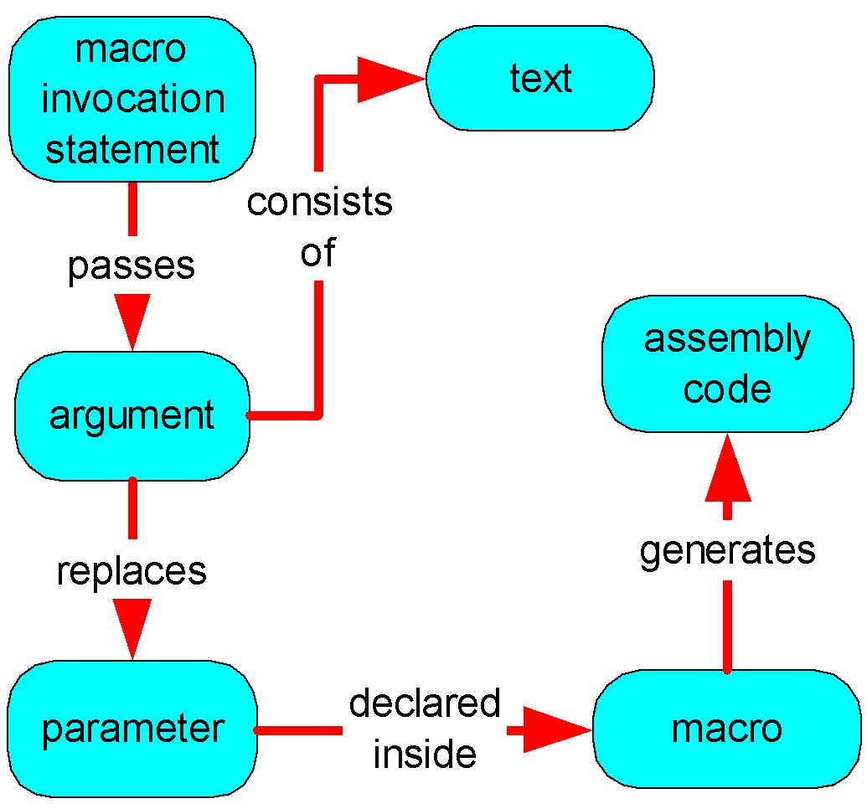
Invoking Macros (2 of 2)
Relationships between macros, arguments, and parameters:

Slide 35
mWriteStr Macro (1 of 2)
Provides a convenient way to display a string, by passing the string name as an argument.
mWriteStr MACRO buffer
push edx
mov edx,OFFSET buffer
call WriteString
pop edx
ENDM
.data
str1 BYTE "Welcome!",0
.code
mWriteStr str1

Slide 36
mWriteStr Macro (2 of 2)
The expanded code shows how the str1 argument replaced the parameter named buffer:
mWriteStr MACRO buffer
push edx
mov edx,OFFSET buffer
call WriteString
pop edx
ENDM
1 push edx
1 mov edx,OFFSET str1
1 call WriteString
1 pop edx

Slide 37
Invalid Argument
If you pass an invalid argument, the error is caught when the expanded code is assembled.
Example:
.code
mPutchar 1234h
1 push eax
1 mov al,1234h ; error!
1 call WriteChar
1 pop eax

Slide 38
Blank Argument
If you pass a blank argument, the error is also caught when the expanded code is assembled.
Example:
.code
mPutchar
1 push eax
1 mov al,
1 call WriteChar
1 pop eax

Slide 39
Macro Examples
mReadStr - reads string from standard input
mGotoXY - locates the cursor on screen
mDumpMem - dumps a range of memory

Slide 40
mReadStr
The mReadStr macro provides a convenient wrapper around ReadString procedure calls.
mReadStr MACRO varName
push ecx
push edx
mov edx,OFFSET varName
mov ecx,(SIZEOF varName) - 1
call ReadString
pop edx
pop ecx
ENDM
.data
firstName BYTE 30 DUP(?)
.code
mReadStr firstName

Slide 41
mGotoXY
The mGotoXY macro ets the console cursor position by calling the Gotoxy library procedure.
mGotoxy MACRO X:REQ, Y:REQ
push edx
mov dh,Y
mov dl,X
call Gotoxy
pop edx
ENDM
The REQ next to X and Y identifies them as required parameters.

Slide 42
mDumpMem
The mDumpMem macro streamlines calls to the link library's DumpMem procedure.
mDumpMem MACRO address, itemCount, componentSize
push ebx
push ecx
push esi
mov esi,address
mov ecx,itemCount
mov ebx,componentSize
call DumpMem
pop esi
pop ecx
pop ebx
ENDM

Slide 43
mDump
The mDump macro displays a variable, using its known attributes. If <useLabel> is nonblank, the name of the variable is displayed.
mDump MACRO varName:REQ, useLabel
IFB <varName>
EXITM
ENDIF
call Crlf
IFNB <useLabel>
mWrite "Variable name: &varName"
ELSE
mWrite " "
ENDIF
mDumpMem OFFSET varName, LENGTHOF varName,
TYPE varName
ENDM

Slide 44
mWrite
The mWrite macro writes a string literal to standard output. It is a good example of a macro that contains both code and data.
mWrite MACRO text
LOCAL string
.data ;; data segment
string BYTE text,0 ;; define local string
.code ;; code segment
push edx
mov edx,OFFSET string
call Writestring
pop edx
ENDM
The LOCAL directive prevents string from becoming a global label.

Slide 45
Nested Macros
The mWriteLn macro contains a nested macro (a macro invoked by another macro).
mWriteLn MACRO text
mWrite text
call Crlf
ENDM
mWriteLn "My Sample Macro Program"
2 .data
2 ??0002 BYTE "My Sample Macro Program",0
2 .code
2 push edx
2 mov edx,OFFSET ??0002
2 call Writestring
2 pop edx
1 call Crlf
nesting level

Slide 46
Your turn . . .
Write a nested macro named mAskForString that clears the screen, locates the cursor at a given row and column, prompts the user, and inputs a string. Use any macros shown so far.
Use the following code and data to test your macro:
.data
acctNum BYTE 30 DUP(?)
.code
main proc
mAskForString 5,10,"Input Account Number: ", \
acctNum
Solution . . .

Slide 47
. . . Solution
mAskForString MACRO row, col, prompt, inbuf
call Clrscr
mGotoXY col, row
mWrite prompt
mReadStr inbuf
ENDM
View the solution program

Slide 48
Example Program: Wrappers
The Wraps.asm program demonstrates various macros from this chapter. It shows how macros can simplify the passing of register arguments to library procedures.
View the source code

Slide 49
What's Next
Structures
Macros
Conditional-Assembly Directives
Defining Repeat Blocks

Slide 50
Conditional-Assembly Directives
Checking for Missing Arguments
Default Argument Initializers
Boolean Expressions
IF, ELSE, and ENDIF Directives
The IFIDN and IFIDNI Directives
Special Operators
Macro Functions

Slide 51
Checking for Missing Arguments
The IFB directive returns true if its argument is blank. For example:
IFB <row> ;; if row is blank,
EXITM ;; exit the macro
ENDIF

Slide 52
mWriteString Example
Display a message during assembly if the string parameter is empty:
mWriteStr MACRO string
IFB <string>
ECHO -----------------------------------------
ECHO * Error: parameter missing in mWriteStr
ECHO * (no code generated)
ECHO -----------------------------------------
EXITM
ENDIF
push edx
mov edx,OFFSET string
call WriteString
pop edx
ENDM

Slide 53
Default Argument Initializers
A default argument initializer automatically assigns a value to a parameter when a macro argument is left blank. For example, mWriteln can be invoked either with or without a string argument:
mWriteLn MACRO text:=<" ">
mWrite text
call Crlf
ENDM
.code
mWriteln "Line one"
mWriteln
mWriteln "Line three"
Sample output:
Line one
Line three

Slide 54
Boolean Expressions
A boolean expression can be formed using the following operators:
LT - Less than
GT - Greater than
EQ - Equal to
NE - Not equal to
LE - Less than or equal to
GE - Greater than or equal to
Only assembly-time constants may be compared using these operators.

Slide 55
IF, ELSE, and ENDIF Directives
A block of statements is assembled if the boolean expression evaluates to true. An alternate block of statements can be assembled if the expression is false.
IF boolean-expression
statements
[ELSE
statements]
ENDIF

Slide 56
Simple Example
The following IF directive permits two MOV instructions to be assembled if a constant named RealMode is equal to 1:
IF RealMode EQ 1
mov ax,@data
mov ds,ax
ENDIF
RealMode can be defined in the source code any of the following ways:
RealMode = 1
RealMode EQU 1
RealMode TEXTEQU 1

Slide 57
The IFIDN and IFIDNI Directives
IFIDN compares two symbols and returns true if they are equal (case-sensitive)
IFIDNI also compares two symbols, using a case-insensitive comparison
Syntax:
IFIDNI <symbol>, <symbol>
statements
ENDIF
Can be used to prevent the caller of a macro from passing an argument that would conflict with register usage inside the macro.

Slide 58
IFIDNI Example
Prevents the user from passing EDX as the second argument to the mReadBuf macro:
mReadBuf MACRO bufferPtr, maxChars
IFIDNI <maxChars>,<EDX>
ECHO Warning: Second argument cannot be EDX
ECHO **************************************
EXITM
ENDIF
.
.
ENDM

Slide 59
Special Operators
The substitution (&) operator resolves ambiguous references to parameter names within a macro.
The expansion operator (%) expands text macros or converts constant expressions into their text representations.
The literal-text operator (<>) groups one or more characters and symbols into a single text literal. It prevents the preprocessor from interpreting members of the list as separate arguments.
The literal-character operator (!) forces the preprocessor to treat a predefined operator as an ordinary character.

Slide 60
Substitution (&)
Text passed as regName is substituted into the literal string definition:
ShowRegister MACRO regName
.data
tempStr BYTE " &regName=",0
.
.
.code
ShowRegister EDX ; invoke the macro
Macro expansion:
tempStr BYTE " EDX=",0

Slide 61
Expansion (%)
Forces the evaluation of an integer expression. After the expression has been evaluated, its value is passed as a macro argument:
mGotoXY %(5 * 10),%(3 + 4)
The preprocessor generates the following code:
1 push edx
1 mov dl,50
1 mov dh,7
1 call Gotoxy
1 pop edx

Slide 62
Literal-Text (<>)
The first macro call passes three arguments. The second call passes a single argument:
mWrite "Line three", 0dh, 0ah
mWrite <"Line three", 0dh, 0ah>

Slide 63
Literal-Character (!)
The following declaration prematurely ends the text definition when the first > character is reached.
BadYValue TEXTEQU Warning: <Y-coordinate is > 24>
The following declaration continues the text definition until the final > character is reached.
BadYValue TEXTEQU <Warning: Y-coordinate is !> 24>

Slide 64
Macro Functions (1 of 2)
A macro function returns an integer or string constant
The value is returned by the EXITM directive
Example: The IsDefined macro acts as a wrapper for the IFDEF directive.
IsDefined MACRO symbol
IFDEF symbol
EXITM <-1> ;; True
ELSE
EXITM <0> ;; False
ENDIF
ENDM
Notice how the assembler defines True and False.

Slide 65
Macro Functions (2 of 2)
When calling a macro function, the argument(s) must be enclosed in parentheses
The following code permits the two MOV statements to be assembled only if the RealMode symbol has been defined:
IF IsDefined( RealMode )
mov ax,@data
mov ds,ax
ENDIF

Slide 66
What's Next
Structures
Macros
Conditional-Assembly Directives
Defining Repeat Blocks

Slide 67
Defining Repeat Blocks
WHILE Directive
REPEAT Directive
FOR Directive
FORC Directive
Example: Linked List

Slide 68
WHILE Directive
The WHILE directive repeats a statement block as long as a particular constant expression is true.
Syntax:
WHILE constExpression
statements
ENDM

Slide 69
WHILE Example
Generates Fibonacci integers between 1 and F0000000h at assembly time:
.data
val1 = 1
val2 = 1
DWORD val1 ; first two values
DWORD val2
val3 = val1 + val2
WHILE val3 LT 0F0000000h
DWORD val3
val1 = val2
val2 = val3
val3 = val1 + val2
ENDM

Slide 70
REPEAT Directive
The REPEAT directive repeats a statement block a fixed number of times.
Syntax:
REPEAT constExpression
statements
ENDM
ConstExpression, an unsigned constant integer expression, determines the number of repetitions.

Slide 71
REPEAT Example
The following code generates 100 integer data definitions in the sequence 10, 20, 30, . . .
iVal = 10
REPEAT 100
DWORD iVal
iVal = iVal + 10
ENDM
How might we assign a data name to this list of integers?

Slide 72
Your turn . . .
What will be the last integer to be generated by the following loop?
500
rows = 10
columns = 5
.data
iVal = 10
REPEAT rows * columns
DWORD iVal
iVal = iVal + 10
ENDM

Slide 73
FOR Directive
The FOR directive repeats a statement block by iterating over a comma-delimited list of symbols.
Each symbol in the list causes one iteration of the loop.
Syntax:
FOR parameter,<arg1,arg2,arg3,...>
statements
ENDM

Slide 74
FOR Example
The following Window structure contains frame, title bar, background, and foreground colors. The field definitions are created using a FOR directive:
Window STRUCT
FOR color,<frame,titlebar,background,foreground>
color DWORD ?
ENDM
Window ENDS
Window STRUCT
frame DWORD ?
titlebar DWORD ?
background DWORD ?
foreground DWORD ?
Window ENDS
Generated code:

Slide 75
FORC Directive
The FORC directive repeats a statement block by iterating over a string of characters. Each character in the string causes one iteration of the loop.
Syntax:
FORC parameter, <string>
statements
ENDM

Slide 76
FORC Example
Suppose we need to accumulate seven sets of integer data for an experiment. Their label names are to be Group_A, Group_B, Group_C, and so on. The FORC directive creates the variables:
FORC code,<ABCDEFG>
Group_&code WORD ?
ENDM
Group_A WORD ?
Group_B WORD ?
Group_C WORD ?
Group_D WORD ?
Group_E WORD ?
Group_F WORD ?
Group_G WORD ?
Generated code:

Slide 77
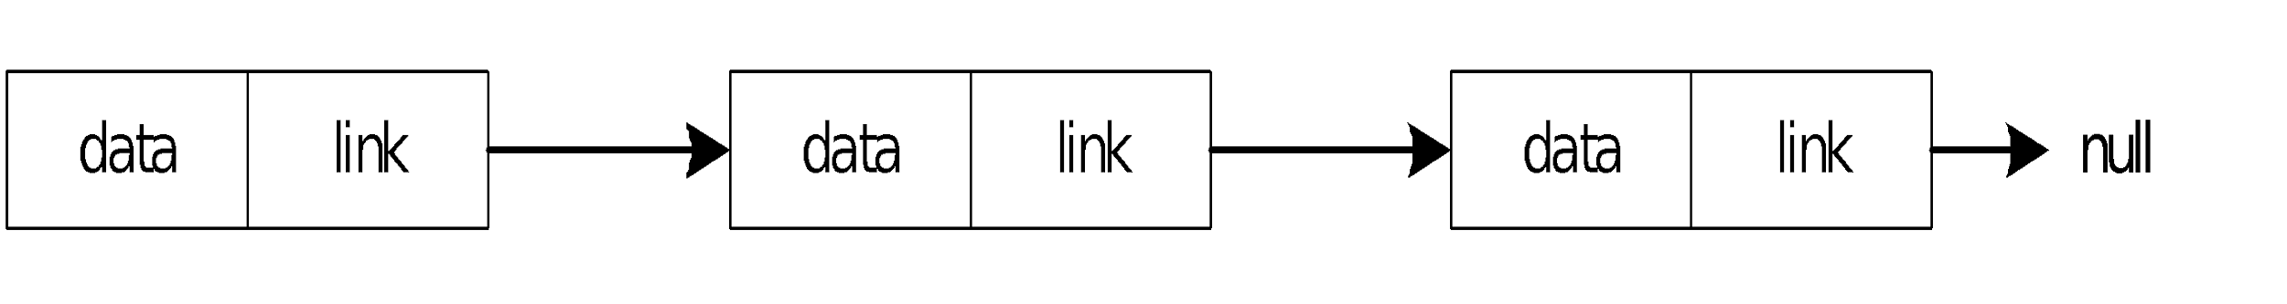
Example: Linked List (1 of 5)
We can use the REPT directive to create a singly linked list at assembly time.
Each node contains a pointer to the next node.
A null pointer in the last node marks the end of the list

Slide 78
Linked List (2 of 5)
Each node in the list is defined by a ListNode structure:
ListNode STRUCT
NodeData DWORD ? ; the node's data
NextPtr DWORD ? ; pointer to next node
ListNode ENDS
TotalNodeCount = 15
NULL = 0
Counter = 0

Slide 79
Linked List (3 of 5)
The REPEAT directive generates the nodes.
Each ListNode is initialized with a counter and an address that points 8 bytes beyond the current node's location:
.data
LinkedList LABEL PTR ListNode
REPEAT TotalNodeCount
Counter = Counter + 1
ListNode <Counter, ($ + Counter * SIZEOF ListNode)>
ENDM
The value of $ does not change—it remains fixed at the location of the LinkedList label.

Slide 80
Linked List (4 of 5)
The following hexadecimal values in each node show how each NextPtr field contains the address of its following node.
offset contents
00000000 00000001
00000008
00000008 00000002
00000010
00000010 00000003
00000018
00000018 00000004
00000020
00000020 (etc.)
NextPtr

Slide 81
Linked List (5 of 5)
View the program's source code
1
2
3
4
5
6
7
8
9
10
11
12
13
14
15
Sample output:

