Slide 1

A Survey: Engineering Challenges to Implement VANET Security

Slide 2
Outline
VANET
Cyber-risks
Hackers motivation
Security mechanism
Block chain

Slide 3
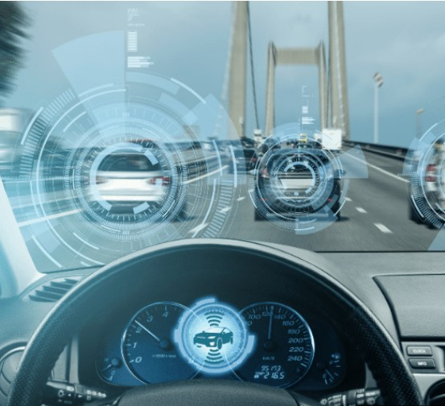
The advancement of
ICT, IoT, AI, Big Data and 5G
Short communication latency
High speed transmission
More reaction time for human to confront
For more advanced safety and convenience

Slide 4
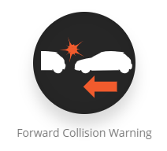
Cyber-risks on VANET
Crash warning applications with VANET are not designed to control vehicles directly, therefore, they would not threaten road-users immediately [3]

Slide 5
Various hackers motivations
Attack (surface) types on VANET

Slide 6
Motivation
Examples
a
Blocking true messages.
Radio interference
c
Sending false messages, and get unfair advantages for unscrupulous drivers
d
Steal PII (Personally identifiable information),e.g. drivers driving histories
b
DoS(Denial of Service)
Sending false messages, and degrade drivers trust on these applications
manipulating sensors/devices that generate their messages
transmit false messages from the inside/outside of the network
eavesdrop messages from the target vehicle locally
acquire the driving history of the target vehicle stored on the vehicle or a server

Slide 7
Security Mechanism
CA (Certification Authority)
Revocation Lists
Privacy protection mechanism
Anonymity:
Non-traceability:
Security/non-traceability:

Slide 8
Concept: Privacy protection on VANET [4]

Slide 9
Security mechanisms Challenges
Above mention security mechanism on VANET need centralized communication network
Trade-off between safety and security
Performance of encryption, decryption, and certification
Physical-type attacks
Privacy infringement(侵犯隱私權)

Slide 10
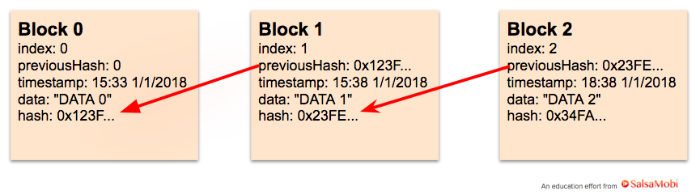
DLT (Distributed Ledger Technologies)
Blockchain
A block contains a set of transactions
Creating a chain of block linked with each other[1]

Slide 11
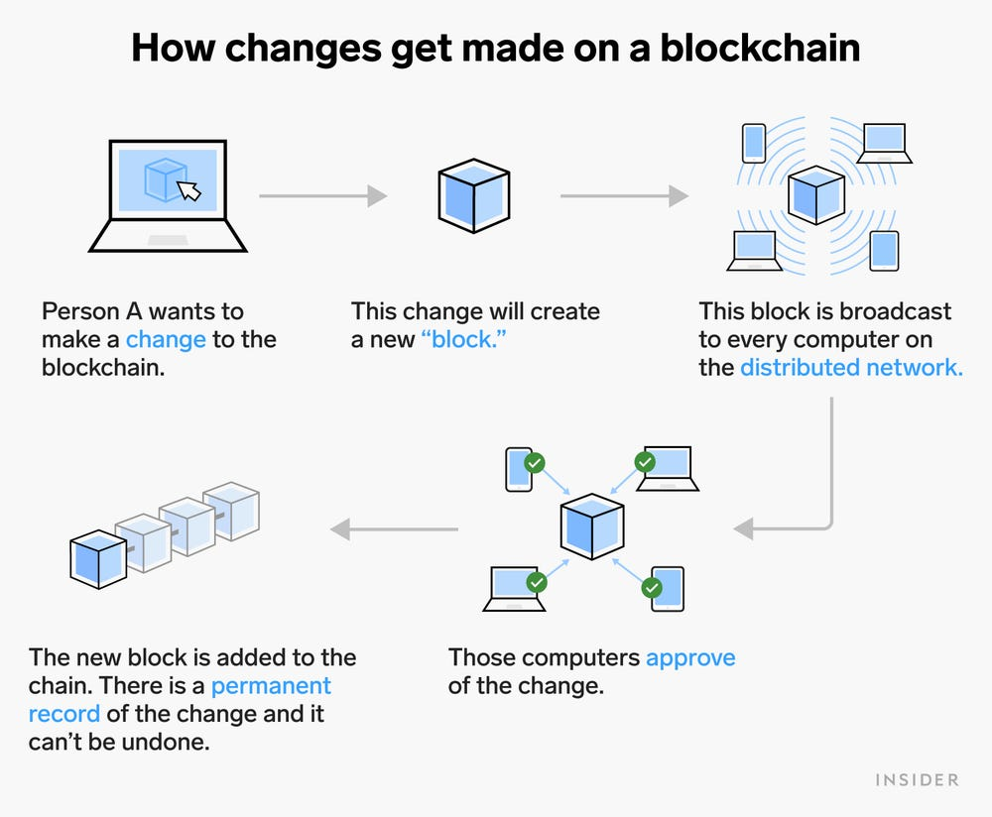
Methods
Proceedings of Blockchain[2]

Slide 12
Blockchain potential
Strong resistance, lack of need of CA
record location, materials, and machinery
repairs/inspections responding to recalls
Control the insurance related information
car-sharing/electric-charging/parking/tolling fee

Slide 13
Results
 | VANET | VANET + (DLT)Blockchain
framework | CA | DLT
frequent network topology |  | ✓
Consensus process |  | ✓
Sufficient innocent vehicles (51%ISSUE) |  | ✓
Privacy protection | ✓(need) | ✓(need)
Faces problems

Slide 14
It is difficult to synchronize distributed ledgers of individual vehicles
without a centralized network which covers all vehicles in the area.

Slide 15
Discussion
The largest technical Challenge is that the currently proposed security mechanism requires the communication infrastructure to make CAs and individual vehicles exchange certificates/security-keys. In so doing, VANET would lose its largest advantage, i.e., not needing a network infrastructure.

Slide 16
References
[1] https://miro.medium.com/max/1400/1*KYYL_lfp6tN4C9Sg_XF7xQ.webp
[2] BIOTC '21: Proceedings of the 2021 3rd Blockchain and Internet of Things Conference July 2021
[3] Armor, “The Black Market Report,” (Mar. 2018).
/app/uploads/2018/03/27222933/2018-Q1-Reports-
BlackMarket-DIGITAL-min.pdf
[4] K. Oka (ETAS), “Security Technique to ensure V2V and V2I Security,”
(Sep. 2015), (Japanese).at monoist.atmarkit.co.jp/mn/articles/1509/16/news009.html
[5] H. Onishi, et al. “Approaches for Vehicle Cyber-Security in the US,”(20174086), International Journal of Automotive Engineering 8 (2017)1-6. at www.jstage.jst.go.jp/article/jsaeijae/8/1/8_20174086/_pdf.

