Slide 1

A Survey: Engineering Challenges to Implement VANET Security

Slide 2
Outline
VANET
Cyber-risks
Security mechanism
Block chain
Hackers motivation

Slide 3
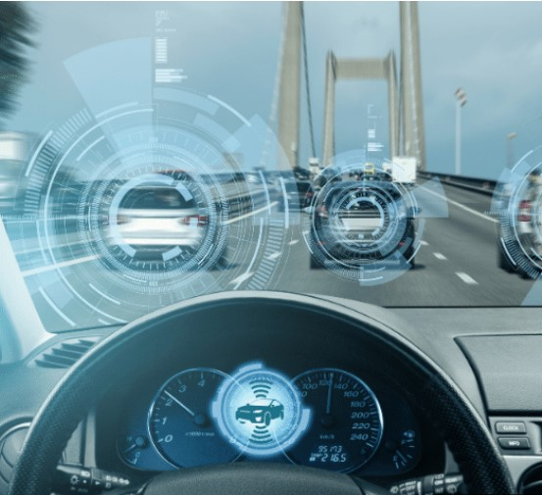
The advancement of
ICT, IoT, AI, Big Data and 5G
Short communication latency
High speed transmission
More reaction time for human to confront
For more advanced safety and convenience

Slide 4
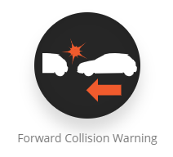
Crash warning applications with VANET are not designed to control vehicles directly, therefore, they would not threaten road-users immediately [3]

Slide 5
Various hackers motivations
Attack (surface) types on VANET

Slide 6
Motivation
Examples
a
Blocking true messages.
Radio interference
c
Sending false messages, and get unfair advantages for unscrupulous drivers
d
Steal PII (Personally identifiable information),e.g. drivers driving histories
b
DoS(Denial of Service)
Sending false messages, and degrade drivers trust on these applications
manipulating sensors/devices that generate their messages
transmit false messages from the inside/outside of the network
eavesdrop messages from the target vehicle locally
acquire the driving history of the target vehicle stored on the vehicle or a server

Slide 7
Security Mechanism
CA (Certification Authority)
Only certified vehicles can transmit messages.
Neighboring vehicles can easily identify if certified vehicles transmitted the message.

Slide 8
Concept: Privacy protection on VANET [4]

Slide 9
Certificates Revocation Lists(CRL)
CA and vehicles monitor misbehaviors (suspicious certificates or messages)
Detected misbehaviors are reported, and per necessity, reported vehicles’ information is added on the CRL, then the CRL is circulated to all vehicles in the network.

Slide 10
Privacy protection mechanism
Anonymity : Messages between neighboring vehicles should not include keys
Non-traceability : ID of adjacent node needs to be updated several times a day.
Security : Message logs should be securely stored, and even once message logs stored on vehicles or servers were disclosed, these logs should not be abused.

Slide 11
Security mechanisms Challenges
Above mention security mechanism on VANET need centralized communication network
Trade-off between safety and security
Performance of encryption, decryption, and certification
Physical-type attacks
Privacy infringement

Slide 12
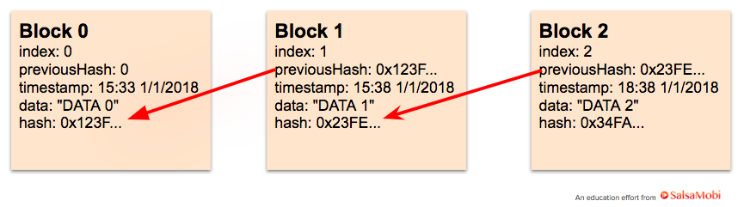
Methods
DLT (Distributed Ledger Technologies)
Blockchain
A block contains a set of transactions Creating a chain of block linked with each other[1]
Decentralized and Immutable

Slide 13
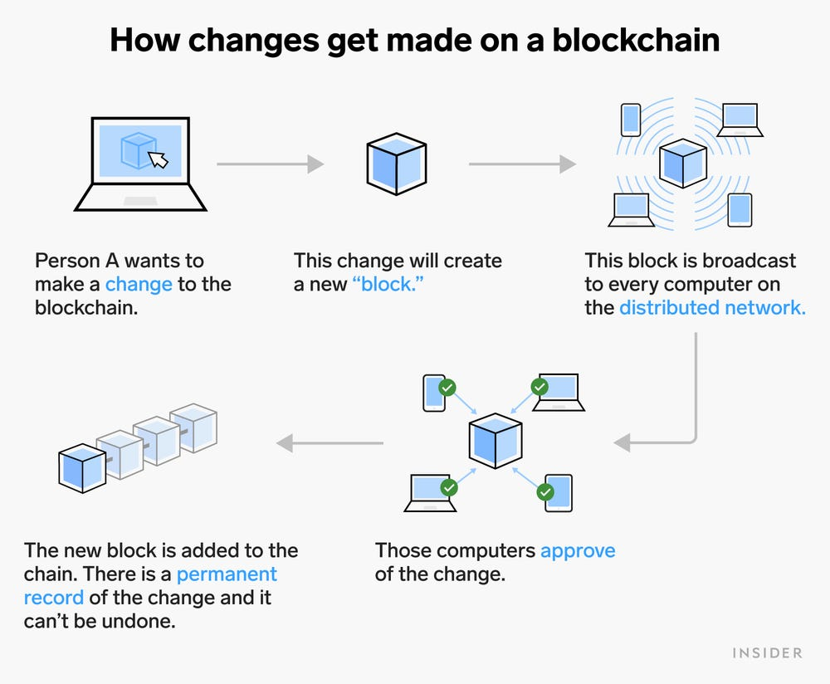
Proceedings of Blockchain[2]

Slide 14
Blockchain potential and application
Manufacturing and logistics :
Strong resistance, lack of need of CA, record location, date, and machinery
Maintenance and inspections :
repairs/inspections responding to recalls
Ownership :
Control the insurance related information :
Financial :
car-sharing/electric-charging/mobile payment/parking/tolling fee

Slide 15
Blockchain limitations
Power Use
Cost
Time-Consuming
Immaturity
Legal Formality

Slide 16
Frequent network topology
It is difficult to synchronize distributed ledgers of individual vehicles
without a centralized network which covers all vehicles in the area.

Slide 17
Results
 | VANET | VANET + (DLT)Blockchain
framework | CA | DLT
frequent network topology |  | ✓
Consensus process (Blockchain response) |  | ✓
Sufficient innocent vehicles (51% ISSUE) |  | ✓
Privacy protection | ✓(need) | ✓(need) (long-term, short-term certificates)
Faces problems

Slide 18
Discussion
Currently proposed security mechanism requires the communication infrastructure to make CAs and individual vehicles exchange certificates/security-keys.
In so doing, VANET would lose its largest advantage, i.e., not needing a network infrastructure.

Slide 19
References
[1] https://miro.medium.com/max/1400/1*KYYL_lfp6tN4C9Sg_XF7xQ.webp
[2] BIOTC '21: Proceedings of the 2021 3rd Blockchain and Internet of Things Conference July 2021
[3] Armor, “The Black Market Report,” (Mar. 2018)./app/uploads/2018/03/27222933/2018-Q1-Reports-BlackMarket-DIGITAL-min.pdf
[4] K. Oka (ETAS), “Security Technique to ensure V2V and V2I Security,”(Sep. 2015), (Japanese).at monoist.atmarkit.co.jp/mn/articles/1509/16/news009.html
[5] H. Onishi, et al. “Approaches for Vehicle Cyber-Security in the US,”(20174086), International Journal of Automotive Engineering 8 (2017)1-6.at www.jstage.jst.go.jp/article/jsaeijae/8/1/8_20174086/_pdf.

