Slide 1
MongoDB Applied Research
AW0361 蘇柏瑜(Brian-Su)

Slide 2

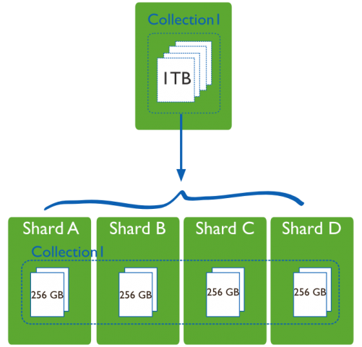
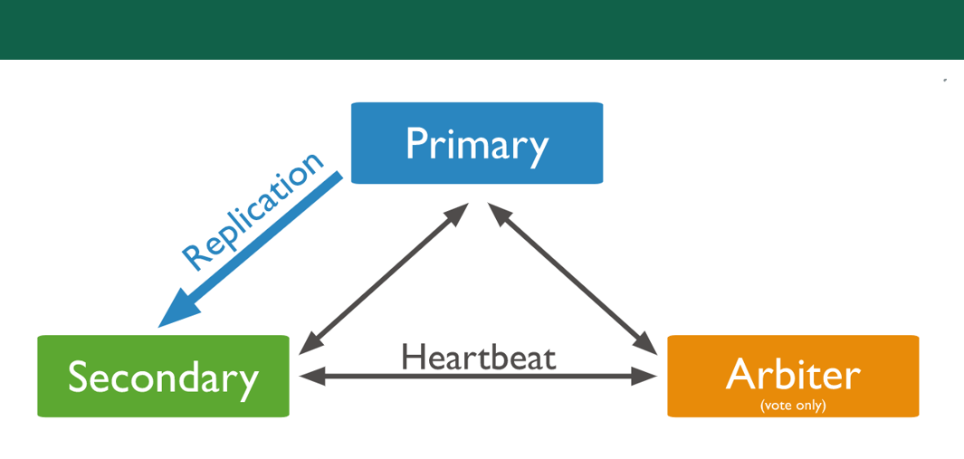
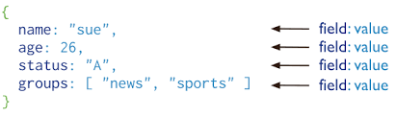
MongoDB Characteristic
Sharding
Replication
Json document
Copy to other machines
Gather them into groups
Members are automatically synced
Json automatic format conversion
Split the raw material
stored on different machines
Avoid out of space problems
Server 1
Server 2
Server 3
Server 4

Slide 3








MongoDB Applications
IoT Manufacture
Retail
E-commerce
Game Entertainment
Financial Services
Efficiency
Big-data
Low cost
Cloudification
BOM management
Backup physical Data File
Catalogs, just-in-time inventory
Mobile Device Management (MDM) MongoDB Atlas cloud services
production and sales history
supply chain management system

Slide 4

Project Outline
Asis & Tobe Compare
BOM UX Query & Export
Transferred BOM Import To MongoDB
BOM Transfer to Mongo Format
Structure Analysis
Demand Calculation
Recursively expand by Level

Slide 5

Data conversion method
BOM
Structures
BOM
Components
MTL
System
Items
BOM3
parameter substitution and SQL query
Import MongoDB sequentially
BOM2
BOM4
BOM1
BOM5

Slide 6
Asis & Tobe Compare

Slide 7
Relation-DB vs No-SQL MongoDB
 | RDBMS | MongoDB
Read & Write | Structure must be created before writing | Easy to read and write
Structure | Join Normalization | Document Nested-structure De-Normalization
Efficiency | Sacrifice performance | High efficiency (Big-data)
Security | Good security | Low security, Low accuracy

Slide 8
Contribution to WNC
Work with ERP team, complete the performance analysis & feasibility test of MongoDB
Study the new database system MongoDB, organize data, provide a new mechanism for querying BOM tables

Slide 9
Future Works
At Engineering change orders (ECO) time, MongoDB may have an advantage at this time.
Develop and test API servers to achieve message exchange for multiple users.

Slide 10


Slide 11
Thank You!

