Slide 1
MongoDB Applied Research
AW0361 蘇柏瑜(Brian-Su)

Slide 2






brian09088
2018-2022
NCU Math-Science
2020 / 2022 Summer
Military Service
Army 257 Brigade
2023/07~2023/08
WNC Summer Internship
2015-2018
National Experimental High School
(Central TW Science Park)
2020~2022
Minor-specialty:
Computer Science & Programming
2021~2023
Online-Tutor
2023/02~
Graduate student
Computer-Science Engineering
NSYSU-WCMC Lab

Slide 3
Project Outline
BOM Transfer to Mongo Format
Transferred BOM Import To MongoDB
BOM UX Query & Export
Structure Analysis
Demand Calculation
Recursively expand by Level
Asis & Tobe Compare

Slide 4
BOM Transfer & Import
Transfer order(top-down)
Env Support Type | Python | MongoDB | OracleDB
SQL-query | ✔ | ✔(partial) | ✔
Html | ✔ | ✔(csv,tsv) | ✔(xml)
Text | ✔ | ✔ | ✔
Json | ✔ | ✔
Dictionary | ✔ | ✔
Dataframe | ✔
cursor | ✔
List | ✔
SQL-query (load out from Oracle)
Insert to MongoDB
Create index and ensure the uniqueness
Cursor execute traverse query
Dataframe to dictionary (get column name)
Fetch dataframe
1
2
3
4
5
6

Slide 5
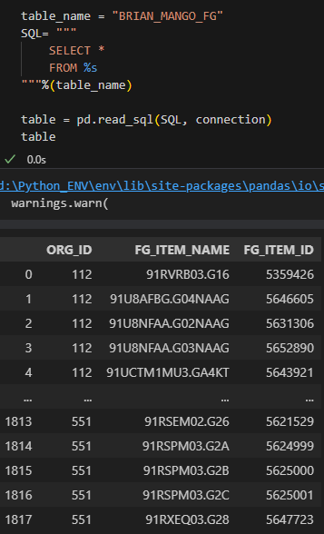
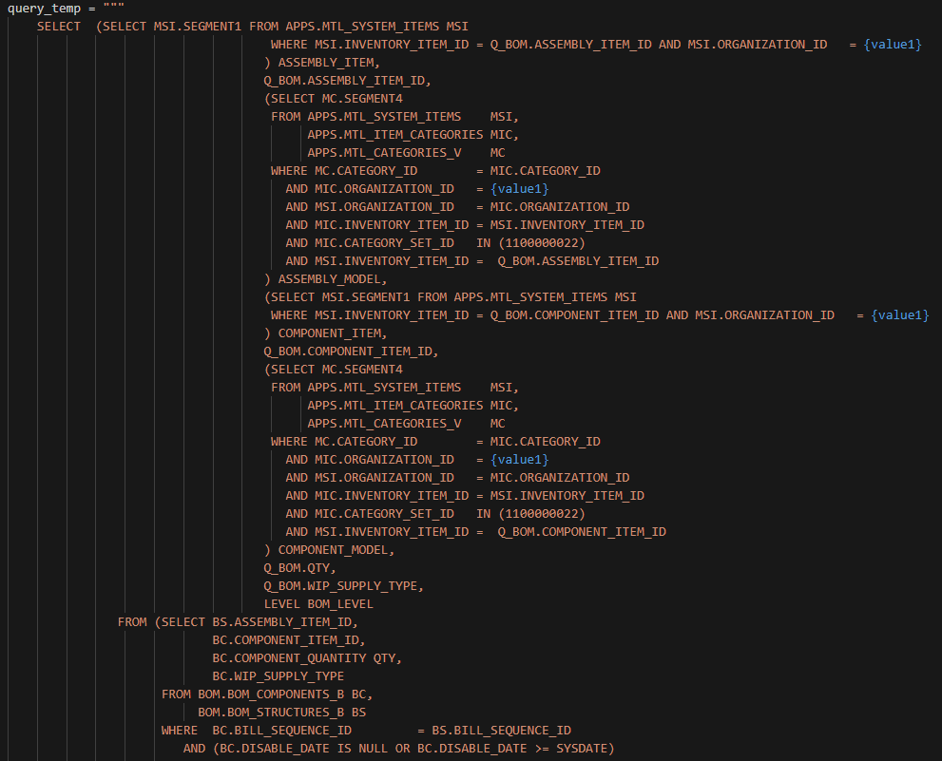
BOM Transfer & Export from Oracle (SQL-query)

Slide 6
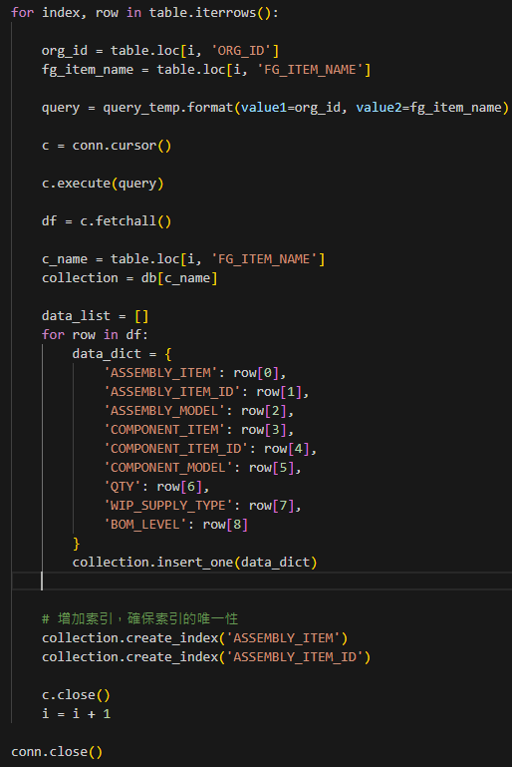
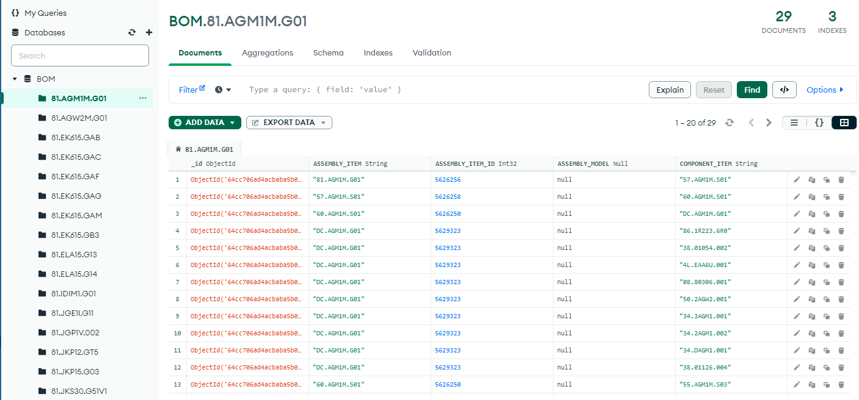
BOM MongoDB Import
Replace id, item_name
Create dictionary to fit in

Slide 7
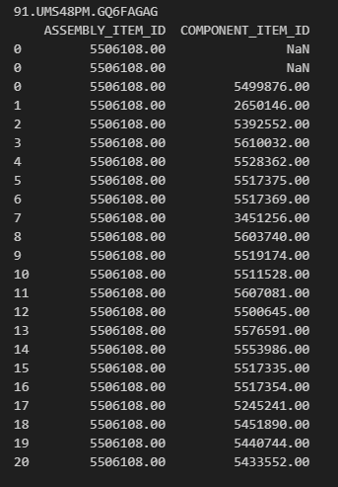
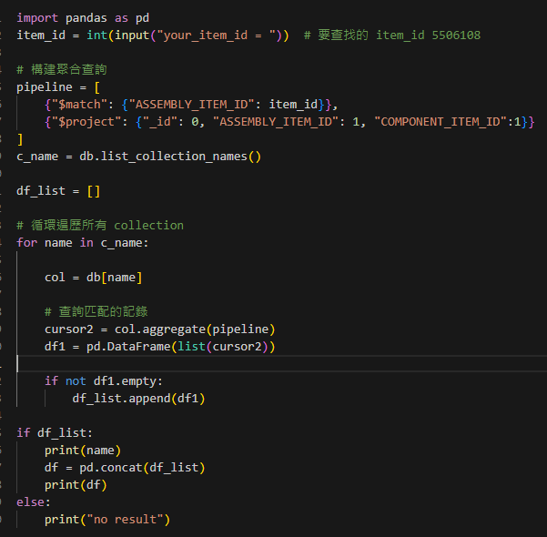
BOM UX Query (Structure Analysis) & Export
For more complex screening criteria:
Advanced query using aggregation list
List which components are included with this assembly item, under which item assembly list.

Slide 8
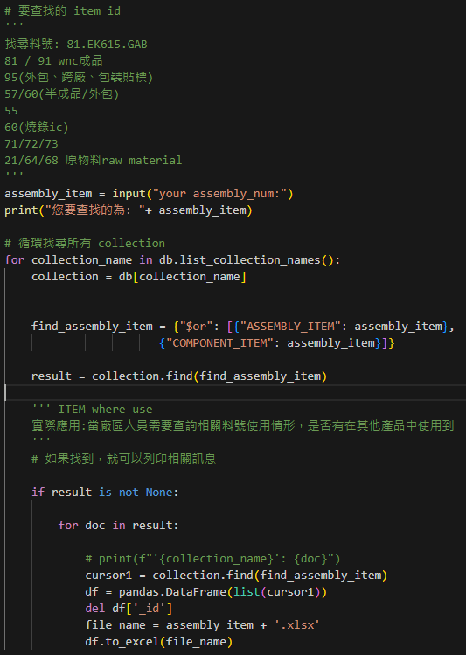
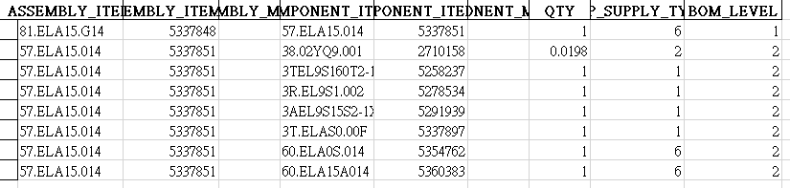
BOM (Recursively expand by Level) & Excel Export
BOM_level
Ascending
According to the input assembly item to view all the included items below, the quantity and item number can also be used to see the relevance of product components through this table.
Expand the output form to the spreadsheet at the same time, which is more convenient for users to view.

Slide 9
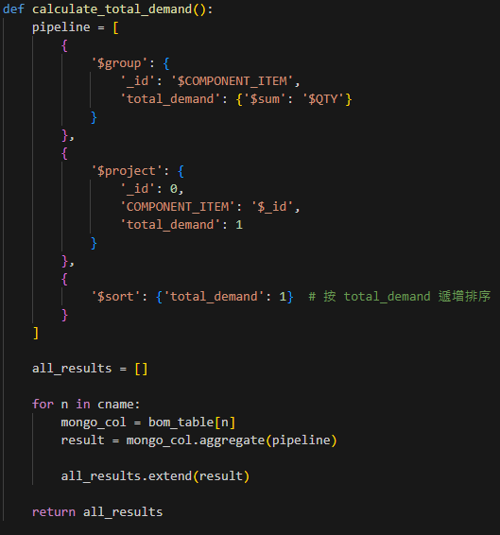
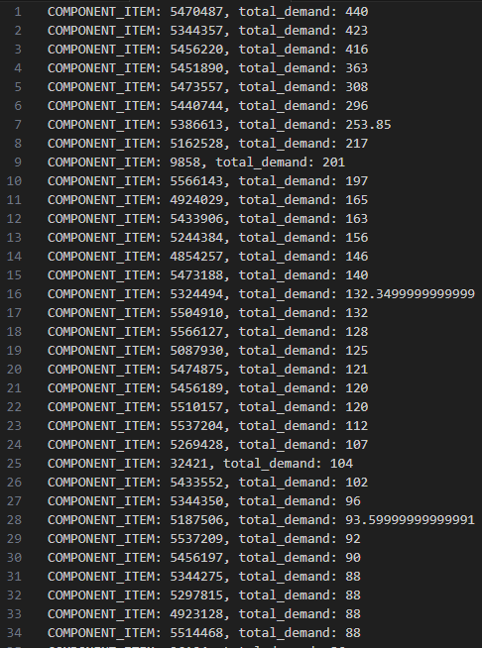
BOM UX Query(Demand Calculation)
There are 46048 records in total, and 17735 different component items
Sorting and totaling according to different subgroup materials
Calculate how much each material is used, and you can check it to make up for it when it is missing or insufficient.

Slide 10
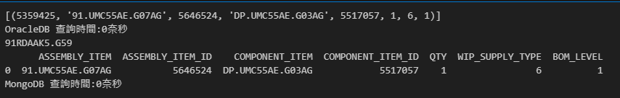
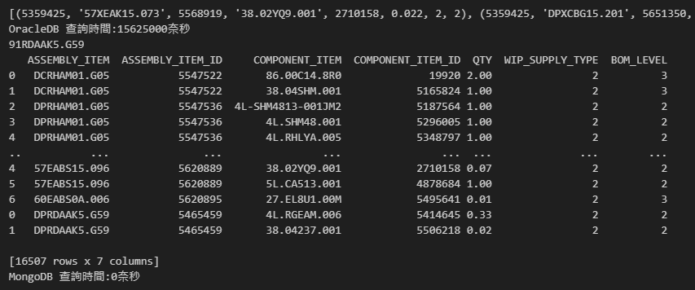
Asis & Tobe Compare query time
For a single data query, both are very fast
Query specific item_id (only one result)
Based on the same query logic, it is obvious that MongoDB is much faster than OracleDB in the case of a large number of records
Therefore, for large-scale data(at least 1TB) queries, MongoDB is more efficient
Query specific supply_type (16587 results)

Slide 11
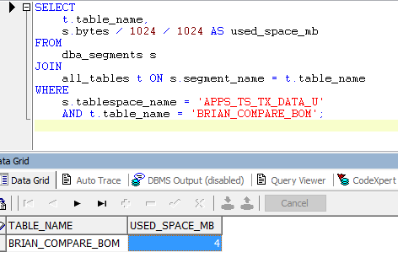
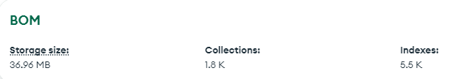
Asis & Tobe Compare storage usage

Slide 12
MongoDB vs OracleDB
MongoDB | OracleDB
No-SQL(unstructed) | SQL(structed)
Easy to read and write | Structure must be created before writing
Data is easy to change | Changes need to move the structure
Data increase or decrease consumes resources | Large objects are difficult to manage
Open source and free | Expensive, must purchase a license

Slide 13
SQL vs No-SQL databases
 | SQL | No-SQL
Principle | ACID (Atomicity, Consistency, Isolation, Durability) | CAP Theorem (Impossible to satisfy at the same time: Consistency, Availability, Partition tolerance)
Purpose | Transaction consistency | Eventual consistency
Structure | Join Normalization, Denormalization | Document-keyvalue Nested-structure Informalization
Expansion | Vertical-scaling Increase host CPU, memory | Horizontal-scaling Exploiting Nodes with Decentralized Systems
Efficacy | Sacrifice performance | High efficiency(Huge amount of data)
Security | Good security | Low security, Low accuracy
Applicable Environment | Relevance data Structured data Enterprise Resource Allocation | Retail E-commerce Weather data, Stock market information

Slide 14
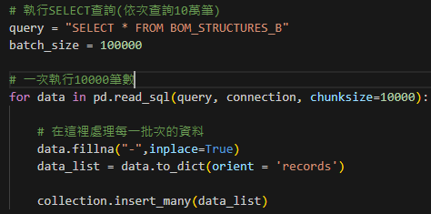
Bottleneck Solution
The amount of data set is too large, resulting in memory exhaustion (16 GB) when reading data.
Set the number of shard collections and the number of batch reads to ensure sufficient memory space. (batch_size & chunk_size)

Slide 15
Contribution to WNC
Complete the feasibility test of MongoDB on the ERP system.
Study the new database system MongoDB, provide a new mechanism for querying BOM tables, and improve user experience.
At Engineering change orders (ECO) time, the whole change will affect the structure, and MongoDB may have an advantage at this time.
(Unstructured can handle a single situation independently)

Slide 16
Future Works
In the future, if the data is too large for the machine to load, you can use MongoDB fragmentation technology to evenly distribute the data among multiple computers.
Transaction can restore the status of the changed data, similar to small-scale backup and restore.
Develop and test API servers to achieve message exchange for multiple users.

Slide 17


Slide 18
Thank You!

