Slide 1
Yuanta_API connection instructions
Speaker:Brian SU

Slide 2
Set up
IDE : VS-code
Anaconda-64bits
API download link
after download above link, unzip this whole file to C:/Yuanta
(need to new a file name : Yuanta)
Yuanta futures account and password (to test if can successfully connect)

Slide 3
Environment and version set up :
python3.9 under python-32 bits
anaconda 64-bits
create python 32-bits environment under Anconda
Python packages : wxpython(4.1.1)、comtypes(1.1.11)

Slide 4

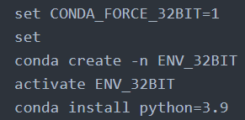
Set up python-32 bits environment
Go to anaconda prompt
Activate this prompt through system administrator
Key in these 5-lines command to set up
(or watch YouTube below)
YouTube-Create 32-bit Python Environments from a 64-bit Conda Installation

Slide 5
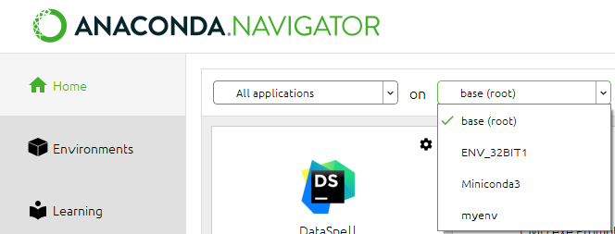


Install packages
Type command code for install comtypes
(do it in anaonda prompt)
Change environment from base(root) to ENV_32BIT
launch vs-code, for running Yuantaapi.py (see in the unzip-download file)
after download wxpython 32-bits (download link),move whl file to vs-code terminal directory (C:\Users\User)
Type pip install command at vs-code terminal to install wxpython

Slide 6
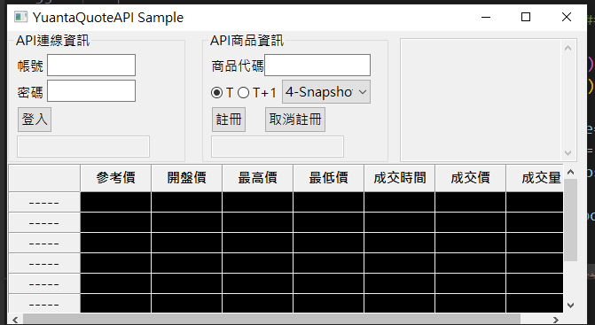
program execution phase
After above packages install, then run this Yuantaapi.py file
Jump out of the window, enter the account , password to log in
Enter product code (TXFE3) to register

Slide 7

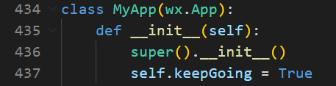
Python file debug
Yuantaapi.py debug
If there is error-report :
MainLoop() missing 1 required positional argument: 'keepgoing’
Need to declare keepgoing under class Myapp

Slide 8
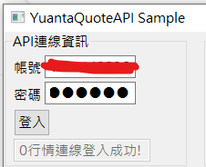
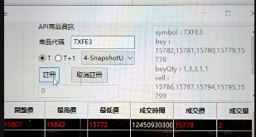
SUCCESS!
(Later will give you account/password)
Enter product code
See if there is something load into
the chart.

Slide 9
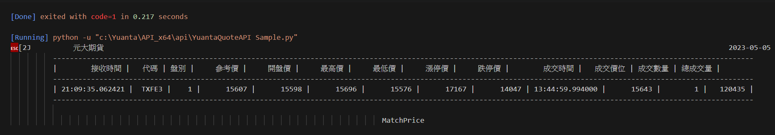
Get Transaction Information through API
YuantaQuoteAPI.py file
Obtain transaction information such as quotation information and quantity of the day(The picture below takes the 2023/5/5 small Taiwan index as an example)

Slide 10

Resource links share
My own GitHub step-by-step
GitHub ID : brian09088
Repositories : Yuanta_API
Anaconda.org
Wxpython-32bits download link
Create python-32bit environment yt-video link
product registration code table
Stackoverflow QA

