Slide 1
Lab 2: FreeRTOS
Chun-Hsian Huang (黃駿賢)
Dept. of Electrical Engineering
National Changhua University of Education

Slide 2
About FreeRTOS
FreeRTOSTM is a real time operating system (RTOS) from Real Time Engineers Ltd.
FreeRTOS supports 40+ CPU architectures
Free to use in commercial products without any requirement to expose your proprietary source code
It is used in market sector from toys to aircraft navigation
FreeRTOS features
Small (less than 15,000 lines of code), easy to port
Support priority-based multi-tasking and time-slicing
No virtual memory support, all threads sits in a common physical address space
No multi-core SMP support for most architecture

Slide 3
FreeRTOS 核心 (1/2)
任務 (Task): FreeRTOS 的核心程式碼約有一半是用來處理多數作業系統首要關注的問題 - 任務
任務是擁有優先權的用戶所定義的 C 函數。
task.c 和 task.h 負責所有關於建立、排程和維護任務的繁重工作。
通訊 (Communication): FreeRTOS 第二項議題 - 通訊
FreeRTOS 核心程式碼大約有 40% 是用來處理通訊的。
queue.c 和 queue.h 負責處理 FreeRTOS 的通訊，任務和中斷(interrupt)使用佇列(佇列，queue)互相發送數據，並且使用 semaphore 和 mutex 來派發 critical section 的使用信號。

Slide 4
FreeRTOS 核心
硬體界面:
基本的 FreeRTOS (約 9,000 行)是與硬體無關的(hardware-independent)，這份程式碼可以在不同硬體平台上運行。
大約有 6% 的 FreeRTOS 核心代碼，在與硬體無關的 FreeRTOS 核心和與硬體相關的程式碼間扮演著墊片(shim)的角色

Slide 5
Source Codes
核心程式碼
tasks.c：主要掌管 task 的檔案
queue.c：管理 task 間 communication (message queue 的概念)
list.c：提供系統與應用實作會用到的 list 資料結構
與硬體相關的檔案
portmacro.h：定義了與硬體相關的變數，如資料型態定義，以及與硬體相關的函式呼叫名稱定義
port.c：定義了包含與硬體相關的程式碼實作
FreeRTOSConfig.h：包含 clock speed, heap size, mutexes 等等都在此定義(需自行建立)

Slide 6
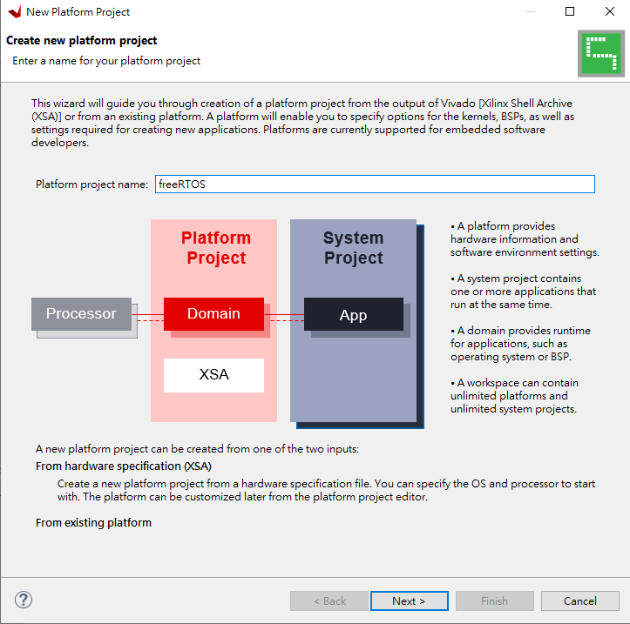
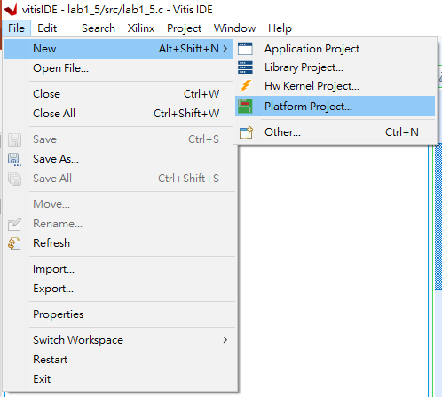
Create a FreeRTOS Application (1/6)

Slide 7
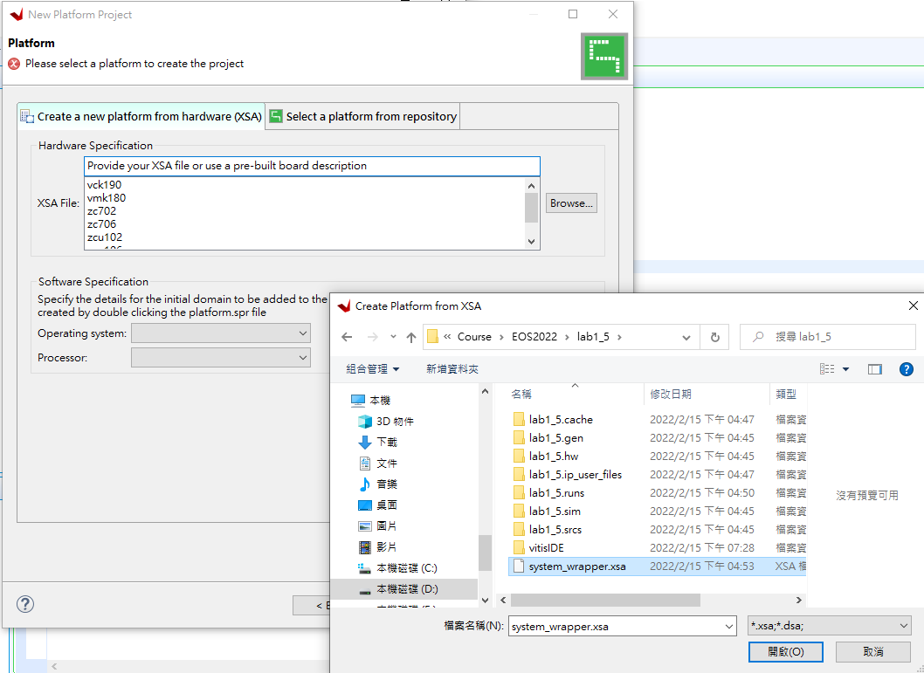
Create a FreeRTOS Application (2/6)
利用先前vivado產生的xsa來建置平台

Slide 8
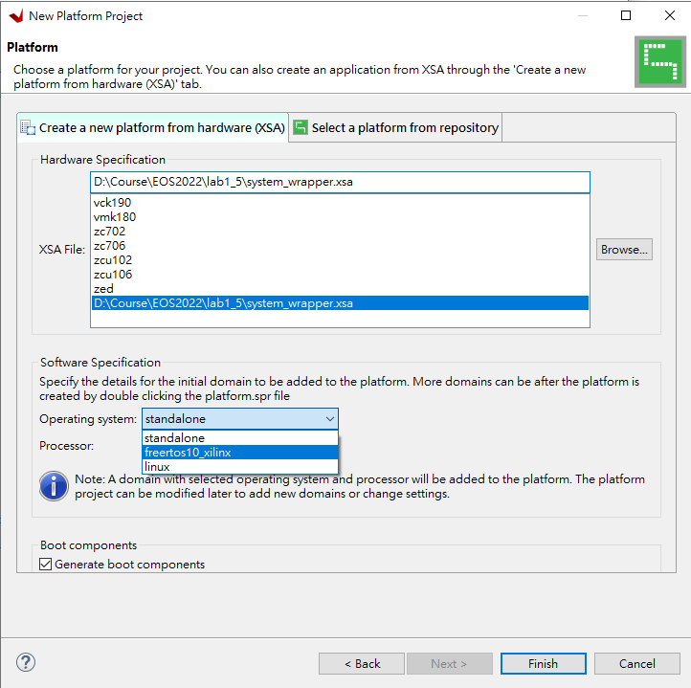
Create a FreeRTOS Application (3/6)
Operating system改選freertos10_xilinx後，點選Finish

Slide 9
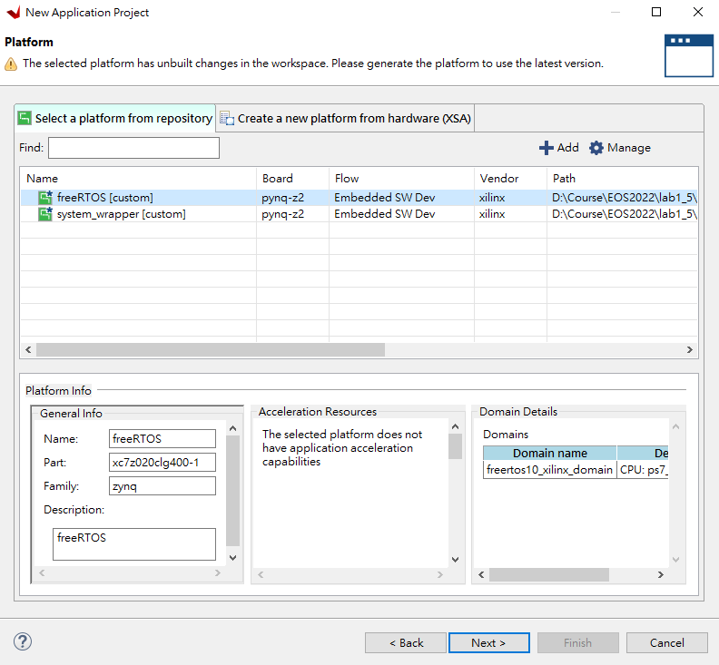
Create a FreeRTOS Application (4/6)
依序選取 File → New → Application Project後，選擇之前建立的freeRTOS當成platform

Slide 10
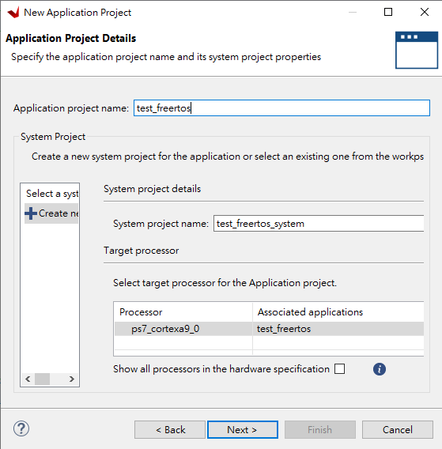
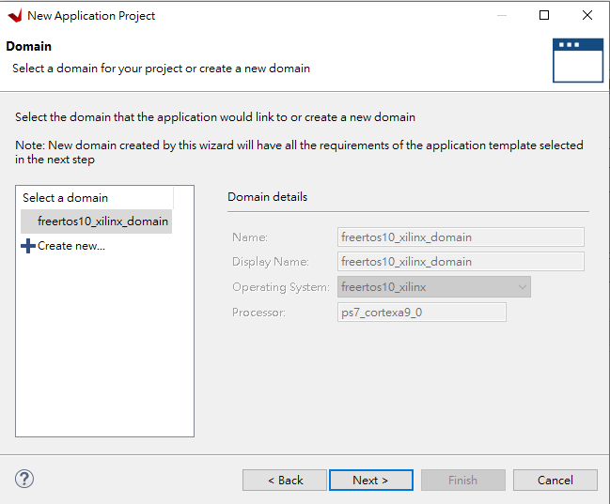
Create a FreeRTOS Application (5/6)
Application project name命名為test_freertos

Slide 11
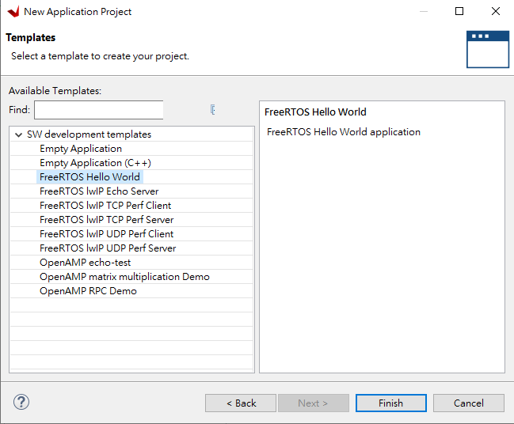
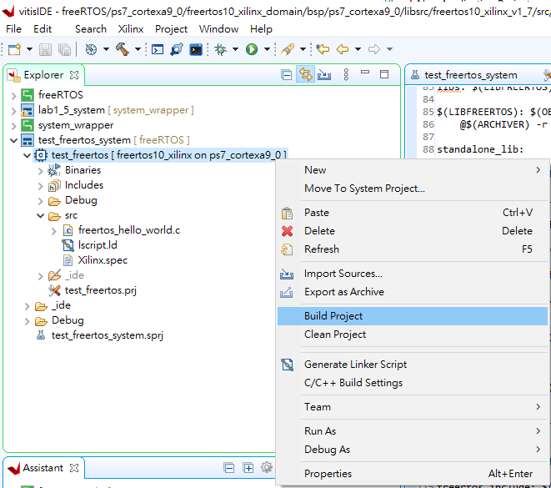
Create a FreeRTOS Application (6/6)
1. 選擇FreeRTOS Hello World的樣版，點選Finish
2. 選擇該application project後進行Build Project，其完成後將軟體程式載入到處理器執行

Slide 12
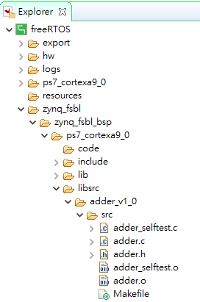
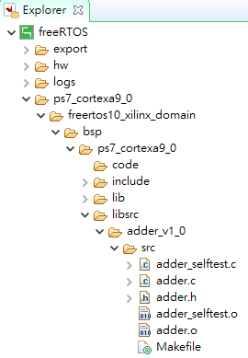
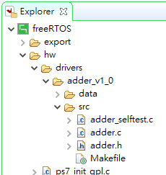
注意: 若系統中含有AXI-Lite based的HW IP，需將其對應的三個Makefile進行修正 (參考Lab 1的P57~59將adder對應產生的三個Makefile進行修正的方法)

Slide 13
任務 (task)
FreeRTOS 中執行的基本單位，每個 task 都是由一個 C 函數所組成，再用 xTaskCreate() 這個 API 來建立一個 task
返回值必須是 void，其中通常會有一個無限迴圈，所有關於這個 task 的工作都會在迴圈中進行
不會有 return，FreeRTOS 不允許 task 自行結束(使用 return 或執行到函數的最後一行)
Task 被建立出來後，它會配置有自己的堆疊空間和 stack variable(就是 function 中定義的變數)

Slide 14
典型的 task function
void ATaskFunction(void *pvParameters)
{
int i = 0; // 每個用這個函數建立的 task 都有自己的一份 i 變數
while(1)
{ /* do something here */ }
/*
* 如果你的 task 就是需要離開 loop 並結束
* 需要用 vTaskDelete 來刪除自己而非使用 return 或自然結束(執行到最後一行)
* 這個參數的 NULL 值是表示自己
*/
vTaskDelete(NULL);
}

Slide 15
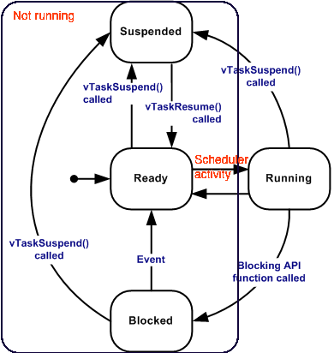
Task 的狀態
Ready：準備好要執行的狀態
Running：正在由 CPU 執行的狀態
Blocked：如果有個 task 要等待某個目前無法取得的資源(被其他 task 佔用中)，則會被設為 blocked 狀態。這是被動的，OS 會呼叫 blocking API 來設定 task 進入 blocked queue
Suspended：等待中的狀態(透過 API 來要求退出排程)。suspended 與 blocked 的差異在於，suspended 是 task 主動呼叫 API 來要求讓自己進入暫停狀態的

Slide 16
建立 task 的函數
portBASE_TYPE xTaskCreate( pdTASK_CODE pvTaskCode,
const char * pcName,
unsigned portSHORT usStackDepth,
void *pvParameters,
unsigned portBASE_TYPE uxPriority,
xTaskHandle *pxCreatedTask );
pvTaskCode：就是我們定義好用來建立 task 的 C 函數
pcName：任意給定的 task name，這個名稱只被用來作識別，不會在 task 管理中被採用
usStackDepth：堆疊的大小
pvParameters：要傳給 task 的參數陣列，也就是我們在 C 函數宣告的參數
uxPriority：定義這個任務的優先權，在 FreeRTOS 中，0 最低，(configMAX_PRIORITIES – 1) 最高
pxCreatedTask：handle，是一個被建立出來的 task 可以用到的識別符號

Slide 17
刪除 task 的函數
void vTaskDelete( xTaskHandle pxTaskToDelete );
pxTaskToDelete: 利用handle去識別出哪一個task。這種可能性存在於如果在 loop 中發生執行錯誤 (fail)，則需要跳出迴圈並終止(自己)執行，此時就需要使用 vTaskDelete 來刪除自己
發生錯誤的例子：
假如今天一個 task 是要存取資料庫，但是資料庫或資料表不存在，則應該結束 task
假如今天一個 client task 是要跟 server 做連線( listening 就是 loop)，卻發現 client 端沒有網路連線，則應結束 task

Slide 18
#include "FreeRTOS.h"
#include "task.h"
#include "queue.h"
#include "timers.h"
#include "xil_printf.h"
#define MAX_delay 50000000
void vTask1( void *pvParameters )
{ int i;
for( ;; )
{
xil_printf("Task 1 is running\r\n");
for(i=0; i<MAX_delay; i++){};
}
}
void vTask2( void *pvParameters )
{ int i;
for( ;; )
{
xil_printf("Task 2 is running\r\n");
for(i=0; i<MAX_delay; i++){};
}
}
Example 1: Task 產生

Slide 19
int main( void )
{
/* Create one of the two tasks. Note that a real application should check
the return value of the xTaskCreate() call to ensure the task was created
successfully. */
xTaskCreate( vTask1, /* Pointer to the function that implements the task. */
(const char *) "Task 1",/* Text name for the task.*/
1000, /* Stack depth - most small microcontrollers will use much
less stack than this. */
NULL, /* We are not using the task parameter. */
1, /* This task will run at priority 1. */
NULL ); /* We are not going to use the task handle. */
/* Create the other task in exactly the same way and at the same priority. */
xTaskCreate( vTask2, (const char *) "Task 2", 1000, NULL, 1, NULL );
/* Start the scheduler so the tasks start executing. */
vTaskStartScheduler();
/* If all is well then main() will never reach here as the scheduler will now be running the tasks. If main() does reach here then it is likely that there was insufficient heap memory available for the idle task to be created.*/
for( ;; );
}

Slide 20
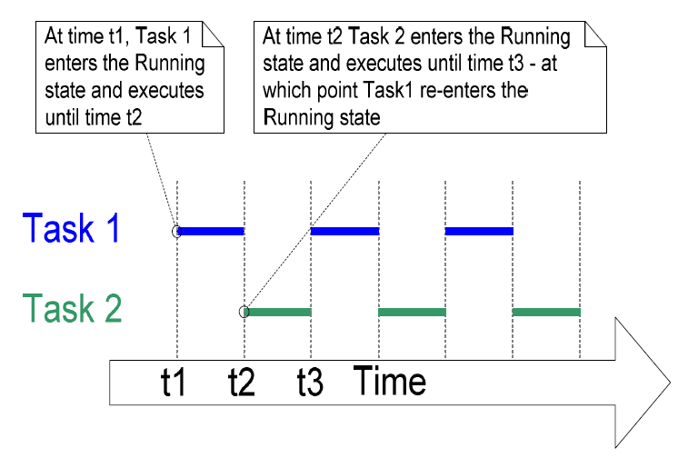
void vApplicationMallocFailedHook( void )
{
/* do something */
for( ;; );
}
void vApplicationSetupHardware( void )
{
/* Do nothing */
}

Slide 21
Example 1 created both tasks from within main() prior to starting the scheduler. It is also possible to create a task from within another task.
We could have created Task1 from main(), and then created Task2 from within Task1. Task2 would not get created until after the scheduler had been started but the output produced by the example would be the same.
void vTask1( void *pvParameters )
{
int i;
xTaskCreate( vTask2, (const char * )"Task 2", 1000, NULL, 1, NULL );
for( ;; )
{
xil_printf("Task 1 is running\r\n");
for(i=0; i<MAX_delay; i++){};
}
}

Slide 22
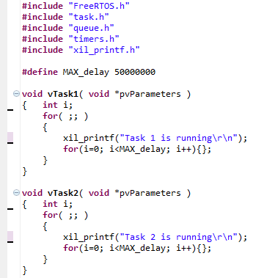
Example 2: 採用Task Parameter
char *pcTaskName = (char *)pvParameters;
xil_printf("%s\r\n", pcTaskName);

Slide 23
int main( void )
{
char *pcTextForTask1 = "Task 1 is running through its parameter!";
char *pcTextForTask2 = "Task 2 is running through its parameter!"; xTaskCreate( vTask1, (const char * )"Task 1", 1000, (void*)pcTextForTask1, 1, NULL );
xTaskCreate( vTask2, (const char * )"Task 2", 1000, (void*)pcTextForTask2, 1, NULL );
vTaskStartScheduler();
for( ;; );
}
void vApplicationMallocFailedHook( void )
{
/* do something */
for( ;; );
}
void vApplicationSetupHardware( void )
{
/* Do nothing */
}

Slide 24
Task Priorities
uxPriority parameter of the xTaskCreate() API function assigns an initial priority to the task being created.
The priority can be changed after the scheduler has been started by using the vTaskPrioritySet() API function.
The maximum number of priorities available is set by the application defined configMAX_PRIORITIES compile time configuration constant within FreeRTOSConfig.h.
Low numeric priority values denote low priority tasks, with priority 0 being the lowest priority possible.

Slide 25
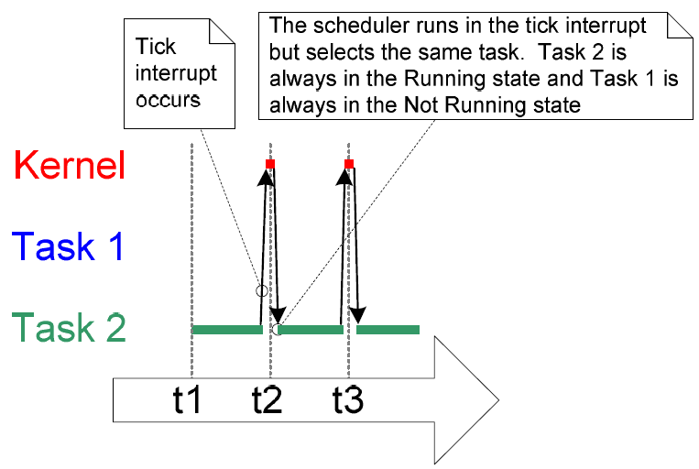
Example 3: Task Priority
int main( void )
{
char *pcTextForTask1 = "Task 1 is running through its parameter!";
char *pcTextForTask2 = "Task 2 is running through its parameter!"; xTaskCreate( vTask1, (const char * )"Task 1", 1000, (void*)pcTextForTask1, 1, NULL );
xTaskCreate( vTask2, (const char * )"Task 2", 1000, (void*)pcTextForTask2, 2, NULL );
vTaskStartScheduler();
for( ;; );
}
void vApplicationMallocFailedHook( void )
{
/* do something */
for( ;; );
}
void vApplicationSetupHardware( void )
{
/* Do nothing */
}

Slide 26
Blocked State
A task that is waiting for an event is said to be in the ‘Blocked’ state.
Temporal events – the event being either a delay period expiring or an absolute time being reached.
For example a task may enter the Blocked state to wait for 10 milliseconds to pass.
Synchronization events – where the events originate from another task or interrupt.
For example, a task may enter the Blocked state to wait for data to arrive on a queue. Synchronization events cover a broad range of event types.

Slide 27
Example 4: Blocked state產生delay
void vTask1( void *pvParameters )
{
char *pcTaskName = (char *)pvParameters;
for( ;; )
{
xil_printf("%s\r\n", pcTaskName);
vTaskDelay( 250 / portTICK_RATE_MS );
}
}
void vTask2( void *pvParameters )
{
char *pcTaskName = (char *)pvParameters;
for( ;; )
{
xil_printf("%s\r\n", pcTaskName);
vTaskDelay( 250 / portTICK_RATE_MS );
}
}
P.S. The constant portTICK_RATE_MS can be used to convert milliseconds into ticks.

Slide 28
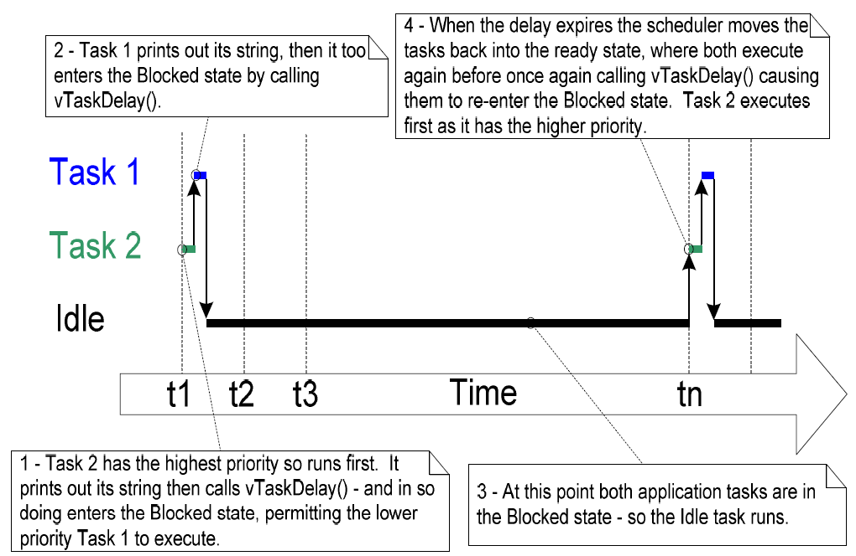

Slide 29
void vTask1( void *pvParameters )
{
char *pcTaskName = (char *)pvParameters;
portTickType xLastWakeTime;
xLastWakeTime = xTaskGetTickCount();
/* The xLastWakeTime variable needs to be initialized with the current tick count. Note that this is the only time the variable is written to explicitly. After this xLastWakeTime is updated automatically internally within vTaskDelayUntil(). */
for( ;; )
{
xil_printf("%s\r\n", pcTaskName);
/* This task should execute exactly every 250 milliseconds. As per
the vTaskDelay() function, time is measured in ticks, and the
portTICK_RATE_MS constant is used to convert milliseconds into ticks. xLastWakeTime is automatically updated within vTaskDelayUntil() so is not explicitly updated by the task. */
vTaskDelayUntil( &xLastWakeTime, ( 250 / portTICK_RATE_MS ) );
}
}
Example 5: Periodic task

Slide 30
Example 6: Combining blocking and non-blocking tasks
void vContinuousTask( void *pvParameters )
{
char *pcTaskName = (char *)pvParameters;
for( ;; )
{
xil_printf("%s\r\n", pcTaskName);
}
}
void vPeriodicTask( void *pvParameters )
{
portTickType xLastWakeTime;
xLastWakeTime = xTaskGetTickCount();
for( ;; )
{
xil_printf("Periodic task running\r\n");
/* The task should execute every 10 milliseconds exactly. */
vTaskDelayUntil( &xLastWakeTime, ( 10 / portTICK_RATE_MS ) );
}
}

Slide 31
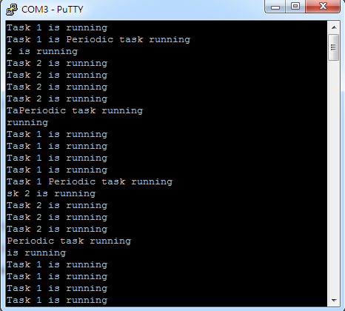
int main( void )
{
char *pcTextForTask1 = "Task 1 is running";
char *pcTextForTask2 = "Task 2 is running";
xTaskCreate(vContinuousTask, (const char * )"Task 1", 1000, (void*)pcTextForTask1, 1, NULL );
xTaskCreate(vContinuousTask, (const char * )"Task 2", 1000, (void*)pcTextForTask2, 1, NULL );
xTaskCreate( vPeriodicTask, (const char * )"Task 3", 1000, NULL, 2, NULL );
vTaskStartScheduler();
for( ;; );
}
void vApplicationMallocFailedHook( void )
{
/* do something */
for( ;; );
}
void vApplicationSetupHardware( void )
{
/* Do nothing */
}
Lab 2-1: 將terminal畫面擷取下來傳至雲端學院

Slide 32
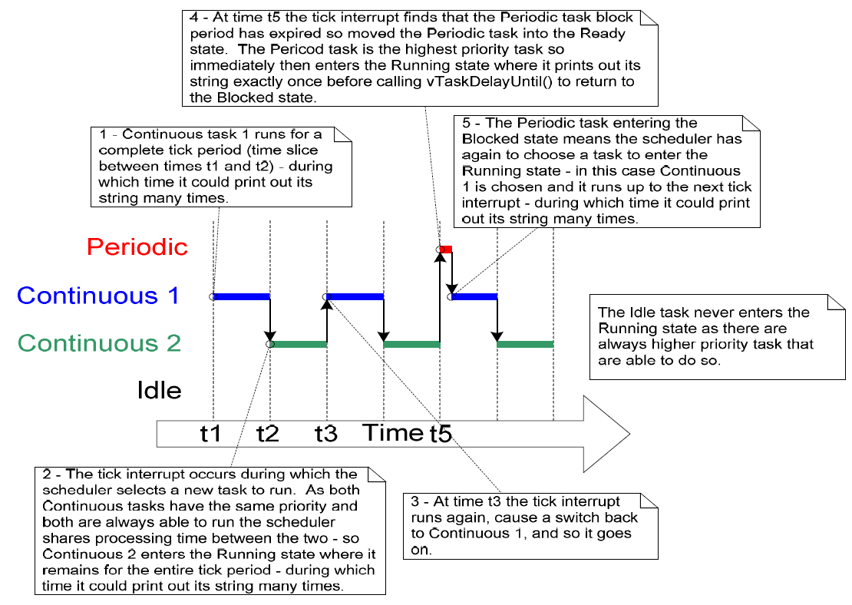

Slide 33
Example 7: Changing task priorities
#include "FreeRTOS.h"
#include "task.h"
#include "queue.h"
#include "timers.h"
#include "xil_printf.h"
xTaskHandle xTask2Handle;
void vTask1( void *pvParameters )
{
unsigned portBASE_TYPE uxPriority;
uxPriority = uxTaskPriorityGet( NULL );
for( ;; )
{
xil_printf( "Task1 is running\r\n" );
xil_printf( "To raise the Task2 priority\r\n" );
vTaskPrioritySet( xTask2Handle, ( uxPriority + 1 ) );
}
}

Slide 34
void vTask2( void *pvParameters )
{
unsigned portBASE_TYPE uxPriority;
uxPriority = uxTaskPriorityGet( NULL );
for( ;; )
{
xil_printf( "Task2 is running\r\n" );
xil_printf( "To lower the Task2 priority\r\n" );
vTaskPrioritySet( NULL, ( uxPriority - 2 ) );
}
}
int main( void )
{
xTaskCreate( vTask1, (const char * )"Task 1", 1000, NULL, 2, NULL );
xTaskCreate( vTask2, (const char * )"Task 2", 1000, NULL, 1, &xTask2Handle );
vTaskStartScheduler();
for( ;; );
}

Slide 35
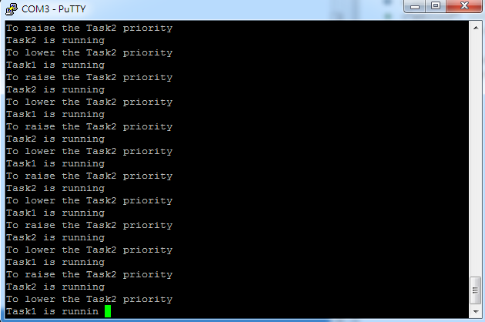
void vApplicationMallocFailedHook( void )
{
/* do something */
for( ;; );
}
void vApplicationSetupHardware( void )
{
/* Do nothing */
}

Slide 36
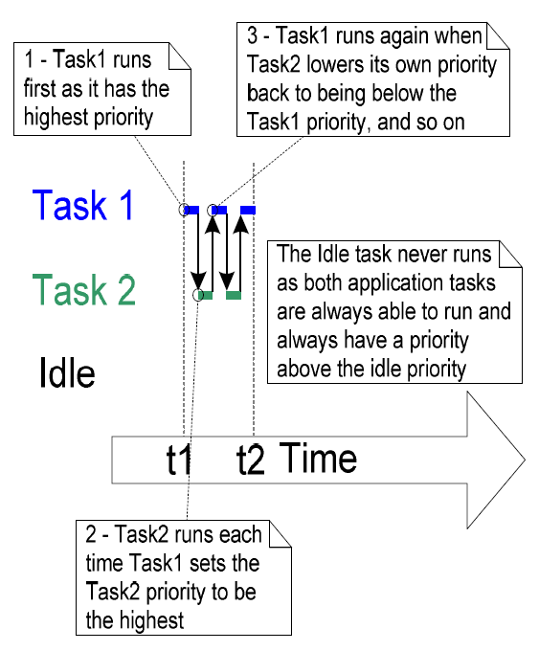

Slide 37
#include "FreeRTOS.h"
#include "task.h"
#include "queue.h"
#include "timers.h"
#include "xil_printf.h"
xTaskHandle xTask2Handle;
void vTask2( void *pvParameters )
{
for( ;; )
{
xil_printf( "Task2 is running and will delete itself\r\n" );
vTaskDelete( xTask2Handle );
}
}
void vTask1( void *pvParameters )
{
for( ;; )
{
xil_printf( "Task1 is running\r\n" );
xTaskCreate( vTask2, (const char * )"Task 2", 1000, NULL, 2, &xTask2Handle );
vTaskDelay(100/portTICK_RATE_MS);
}
}
Example 8: Deleting tasks

Slide 38
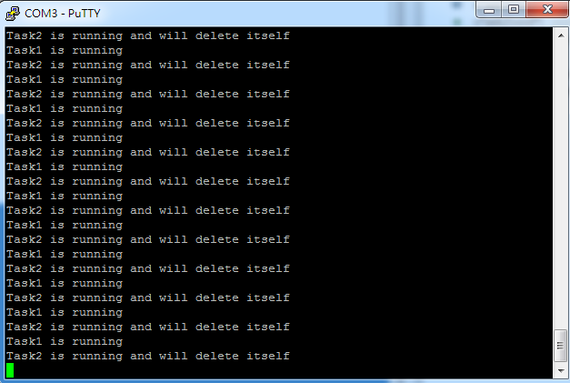
int main( void )
{
xTaskCreate( vTask1, (const char * )"Task 1", 1000, NULL, 1, NULL );
vTaskStartScheduler();
for( ;; );
}
void vApplicationMallocFailedHook( void )
{
/* do something */
for( ;; );
}
void vApplicationSetupHardware( void )
{
/* Do nothing */
}

Slide 39
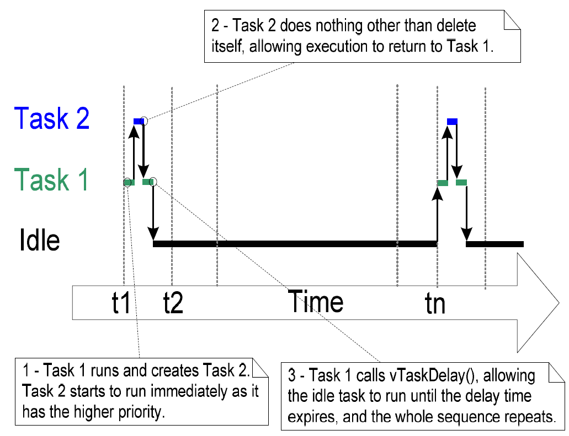

Slide 40
Scheduling Algorithm
Fixed Prioritized Preemptive Scheduling
Each task is assigned a priority.
Each task can exist in one of several states.
Only one task can exist in the Running state at any one time.
The scheduler will always select the highest priority Ready state task to enter the Running state.

Slide 41
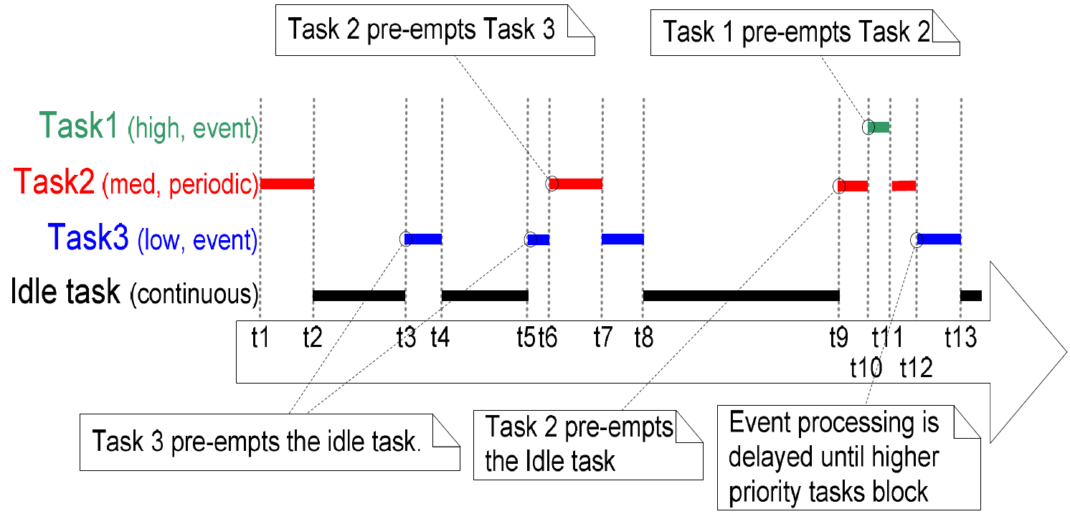

Slide 42
Resource Management
There is the potential for a conflict to arise in a multitasking system if one task starts to access a resource but does not complete its access before being transitioned out of the Running state.
When the task left the resource in an inconsistent state then access to the same resource by any other task or interrupt could result in data corruption or other similar error.

Slide 43
Accessing Peripherals
Task A executes and starts to write the string “Hello world” to the LCD.
Task A is pre-empted by Task B after outputting just the beginning of the string – “Hello w”.
Task B writes “Abort, Retry, Fail?” to the LCD before entering the Blocked state.
Task A continues from the point at which it was pre-empted and completes outputting the remaining characters – “orld”.
The LCD will now be displaying the corrupted string “Hello wAbort, Retry, Fail?orld”.

Slide 44
Read, Modify, Write Operations
The value of PORTA is first read from memory into a register, modified within the register, and then written back to memory.
This is a ‘non-atomic’ operation because it takes more than one instruction to complete and can be interrupted. Consider the following scenario where two tasks attempt to update a memory mapped register called PORTA:

Slide 45
Read, Modify, Write Operations (cont.)
Task A loads the value of PORTA into a register – the read portion of the operation.
Task A is pre-empted by Task B before it completes the modify and write portions of the same operation.
Task B updates the value of PORTA, then enters the Blocked state.
Task A continues from the point at which it was pre-empted. It modifies the copy of the PORTA value that it already holds in a register before writing the updated value back to PORTA.

Slide 46
Mutual Exclusion
Access to a resource that is shared either between tasks or between tasks and interrupts needs to be managed using a ‘mutual exclusion’ technique to ensure data consistency is maintained at all times.
The goal is to ensure that once a task starts to access a shared resource the same task has exclusive access until the resource has been returned to a consistent state.

Slide 47
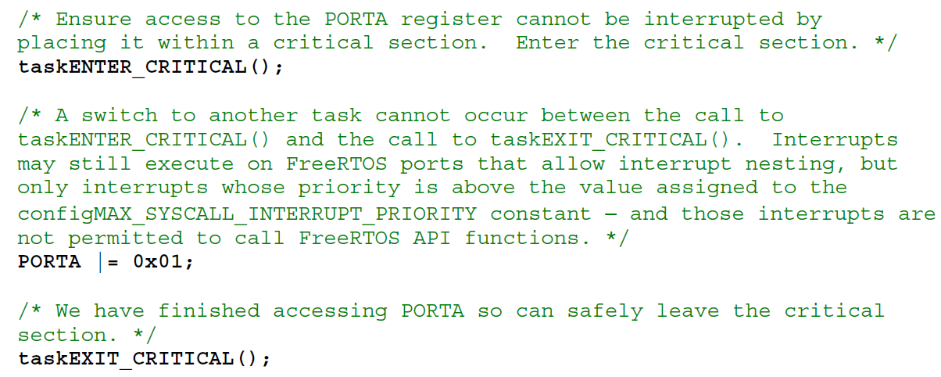
Critical Sections
Basic critical sections are regions of code that are surrounded by calls to the macros taskENTER_CRITICAL() and taskEXIT_CRITICAL().

Slide 48
Mutexes
A mutex is a special type of binary semaphore that is used to control access to a resource that is shared between two or more tasks.
The word MUTEX originates from “MUTual Exclusion”.
When used in a mutual exclusion scenario the mutex can be conceptually thought of as a token that is associated with the resource being shared.

Slide 49
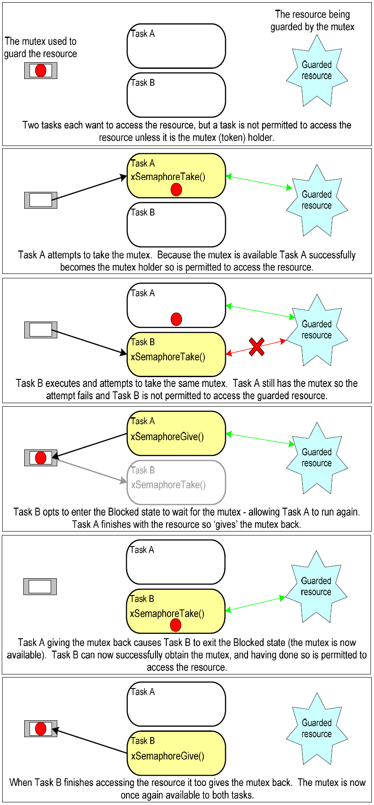

Slide 51
#include "FreeRTOS.h"
#include "task.h"
#include "queue.h"
#include "timers.h"
#include "xil_printf.h"
#include "semphr.h"
#include <stdio.h>
#include <stdlib.h>
xSemaphoreHandle xMutex;
void prvNewPrintString( const portCHAR *pcString )
{
xSemaphoreTake( xMutex, portMAX_DELAY );
{
xil_printf( "%s", pcString );
}
xSemaphoreGive( xMutex );
}

Slide 52
void prvPrintTask( void *pvParameters )
{
char *pcStringToPrint;
pcStringToPrint = ( char * ) pvParameters;
for( ;; )
{
prvNewPrintString( pcStringToPrint );
vTaskDelay( ( rand() & 0x1FF ) );
}
}
int main( void )
{
xMutex = xSemaphoreCreateMutex();
srand( 567 );
if( xMutex != NULL )
{
xTaskCreate( prvPrintTask, (const char * )"Print1", 1000,
"Task 1 ***************************************\r\n", 1, NULL );
xTaskCreate( prvPrintTask, (const char * )"Print2", 1000,
"Task 2 ---------------------------------------\r\n", 2, NULL );
vTaskStartScheduler();
}
for( ;; );
}

Slide 53
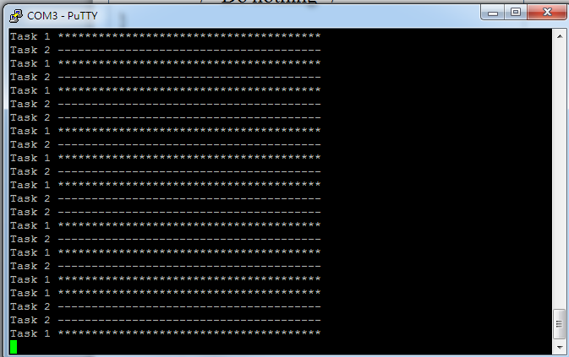
void vApplicationMallocFailedHook( void )
{
/* do something */
for( ;; );
}
void vApplicationSetupHardware( void )
{
/* Do nothing */
}
Lab 2-2: 將terminal畫面擷取下來傳至雲端學院

Slide 54
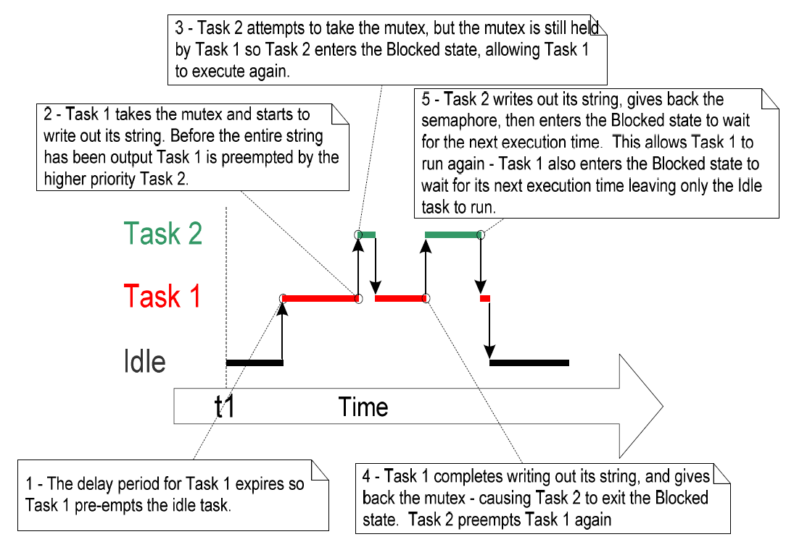

Slide 55
Priority Inversion
The previous example shows a potential pitfalls of using a mutex to provide mutual exclusion.
The possible sequence of execution depicted shows the higher priority Task 2 has to wait for the lower priority Task 1 to give up control of the mutex.
A higher priority task being delayed by a lower priority task in this manner is called ‘priority inversion’.

Slide 56
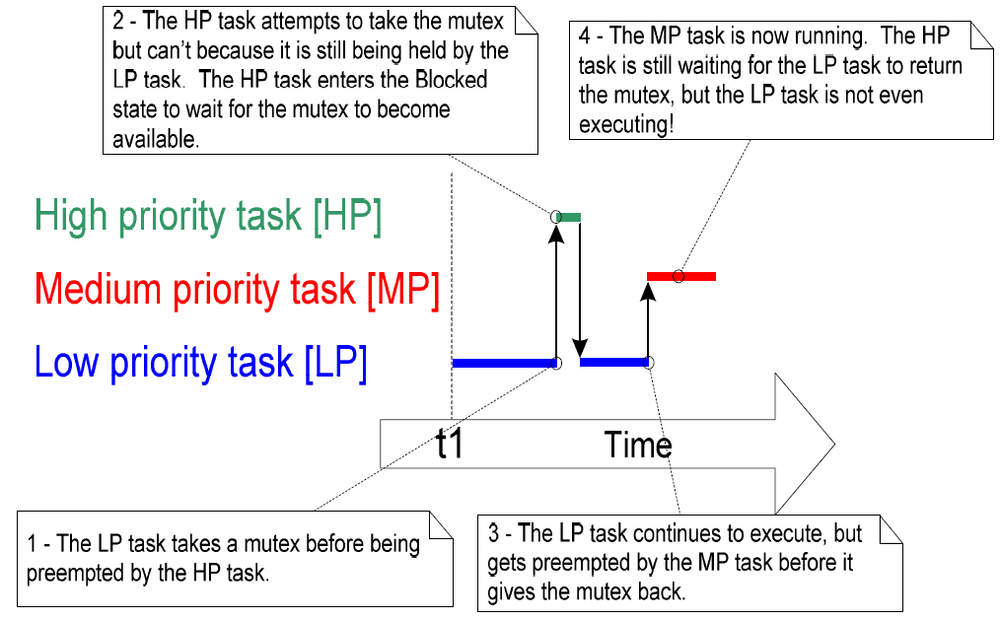

Slide 57
Priority Inheritance
A scheme is to minimize the negative effects of priority inversion – it does not ‘fix’ priority inversion, it merely lessens its impact.
Priority inheritance works by temporarily raising the priority of the mutex holder to that of the highest priority task that is attempting to obtain the same mutex.
The low priority task that holds the mutex ‘inherits’ the priority of the task waiting for the mutex.

Slide 58
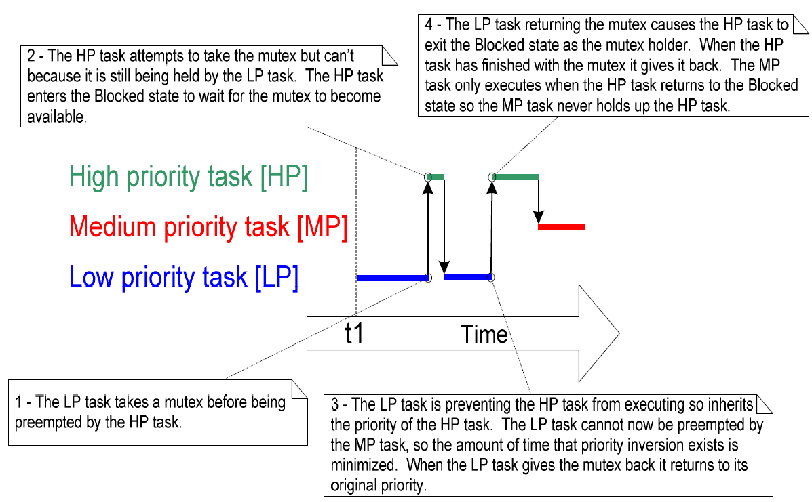

Slide 59
References
http://www.freertos.org
Richard Berry, using the FreeRTOS Realtime Kernel, 2010.
成大資工Wiki, FreeRTOS

