Slide 1

SLIDE 1: Title
The Bagel

Slide 2

SLIDE 2: Image
The image from the poem is of the protagonist rolling down the street "head over heels, one complete somersault after another like a bagel". This image reflects the main theme of the poem, which is how the protagonist is able to find joy in the seemingly mundane task of trying to catch a bagel rolling away in the wind. By using the metaphor of rolling like a bagel, the author is conveying how the protagonist is able to find joy in something that may seem trivial or silly. This image serves to subtly emphasize the main point of the poem, which is that there is joy to be found in even the simplest of tasks.

Slide 3

SLIDE 3: Three Lines
1. “as if it were a portent” – This line of imagery describes the bagel being dropped as if it was a sign of something else that is being foreshadowed. This could be interpreted as a metaphor for the narrator’s life, as if the dropped bagel is a sign of something bigger in the future. 2. “Faster and faster it rolled” – This line creates an image of the bagel rolling away, faster and faster, which implies that the protagonist is struggling in his attempt to catch the bagel. This could be interpreted as a metaphor for the narrator’s life, as if the fast-moving bagel represents the fast-paced nature of life and the narrator’s inability to keep up with it. 3. “and I found myself doubled over and rolling down the street” – This line of imagery describes the narrator’s attempt to catch the bagel, as he finds himself bending over and rolling down the street, head over heels. This could be interpreted as a metaphor for the narrator’s life, as if he is struggling to stay on the right path in his life’s journey.

Slide 4
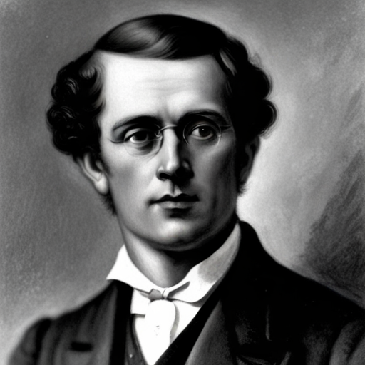
SLIDE 4: Biographical Information
The current position of the author is unknown. David Ignatow is an American poet and writer who was born in New York City in 1914 and died in 1997. He is known for his innovative and often experimental poetry which often explored themes of identity and mortality. He is considered one of the most important figures in modern American literature and poetry.

Slide 5

SLIDE 5: Question
What metaphor is David Ignatow using to describe his experience of chasing after the bagel?

Slide 6

SLIDE 6: Enhancements
Images: -A picture of a person running after a rolling bagel-A closeup of the bagel-A person grinning and rolling head over heels down the streetVideos:-A video of someone running after a rolling bagel-A video of someone somersaulting down the streetSound:-The sound of the wind blowing-The sound of someone running-The sound of cracking a bagel open

Slide 7

SLIDE 7: Why?
David Ignatow’s poem “The Bagel” is a humorous and lighthearted take on the idea of chasing after one’s dreams. Billy Collins chose to include this poem in his collection to showcase the power of simple moments and to remind readers that even when things appear to be out of reach, they can still be attained through perseverance and determination.

