Slide 1
Insights Sharing
The insights that we found by analyzing the Consumption data set

Slide 2
Executive summary template
Tenure of customers matters
Data shows that tenure of customers directly is highly correlated to churn rate
Electricity Consumption past 12M (Model evaluation)
Electricity consumption of the past 12 months can contribute much to our model
Net margin (Model evaluation)
The net margin regarding customers are also crucial for model
Best cut-off rate
The indicated cut-off rate for optimal revenue

Slide 3
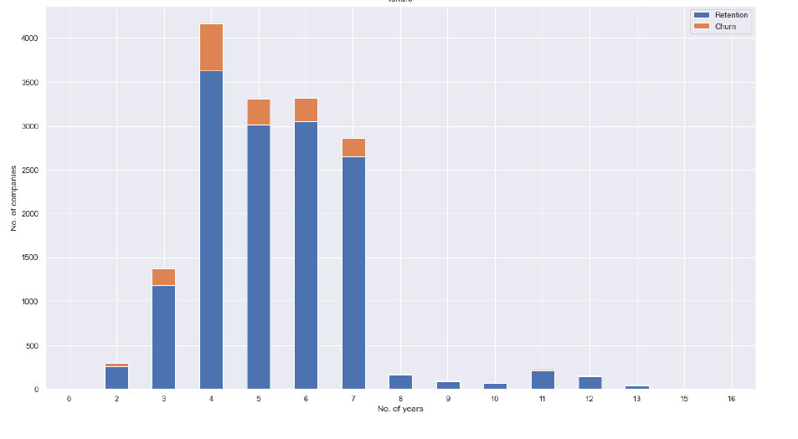
Tenure
We Define the tenure of each customers to be:
Date of end – Date of activation
We can clearly that churn is very low for companies which joined recently or that have made the contract a long time ago.
With the higher number of churners within the 3-7 years of tenure.
We will also transform the dates provided in such a way that we can make more sense out of those

Slide 4
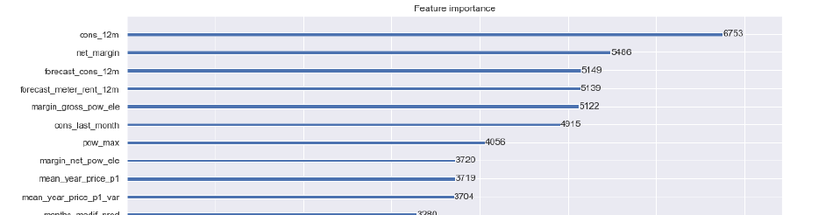
Electricity Consumption & Net margin
After building model that predict the churn rate of our customers.
We found out that the Electricity Consumption of last 12month
And the net_margin are the two most decisive factors for our model
This can also serve as a supplement when dealing with important customers

Slide 5
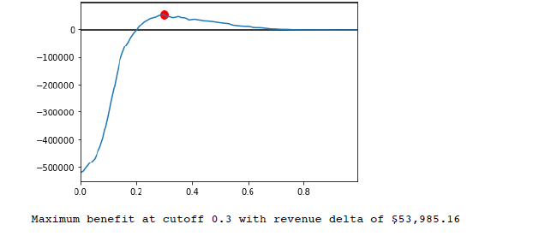
Best cut-off rate
Based on our model.
With 75% precision, we can predict the probability of customer’s Churn rate.
And we found out if we set 0.3 as the cutoff rate,
We can obtain 53,985 plus in revenue.

