Slide 1

Group 14
Kickstarter funding
0510846 陳奕安
0513239 朱怡安
Notes:
Hi everyone. We’re group 14. Today we going to introduce you guys with our project.
And because we already did a lot of basic EDA in our homework, in our project we won’t mention that. Instead we’ll focus on the project goal itself.

Slide 2
Kickstarter
Crowdfunding platform
Determine the Fundraising goals by the fundraiser
Different factors may affect the success rate
Data from 2009 to 2017
Notes:
And the project is based one dataset that contains transaction records on the kickstarter.
Kickstarter is a crowdfunding platform.Just as you know.
In such platform,the project owner can decide how much is their fundraising goal,and how long is the fundraising duration. If they didn’t achieve such goal in the duration time they set,the whole fundraising process will fail. And they cannot get a penny.
So it’s obvious that besides from the project content itself,other external factors also will impact the successful rate of the project.

Slide 3



Project goal
Which are the most important features of a project?
Which features have the biggest impact on the project success?
How does changes in those features affect the project success?
Notes:
So our project focus on three main goal.
1, which are the most important feature of a project. (Does not have direct relation with the success rate, weighting.)
2,Which features have the biggest impact on the project success.
3,How does changes in those features affect the project success?

Slide 4
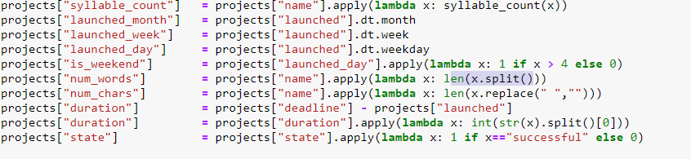
Data engineering
Syllable_count : How many vowels in the name of the project.
num_words : How many words in the name of the project.
num_char : How many characters in the name of the project.
Notes:
At very beginning ,I did some preprocessing and data engineering.
In our dataset, we originally have the project name, the final result of fundraising,how much is their goal etc.
Specifically, I count how many vowels,how many words, and how many characters in the project name. Because I think the name is an integral part of the project, I will use them in further research.
And I also transform other feature to more easy accessible data type.

Slide 5
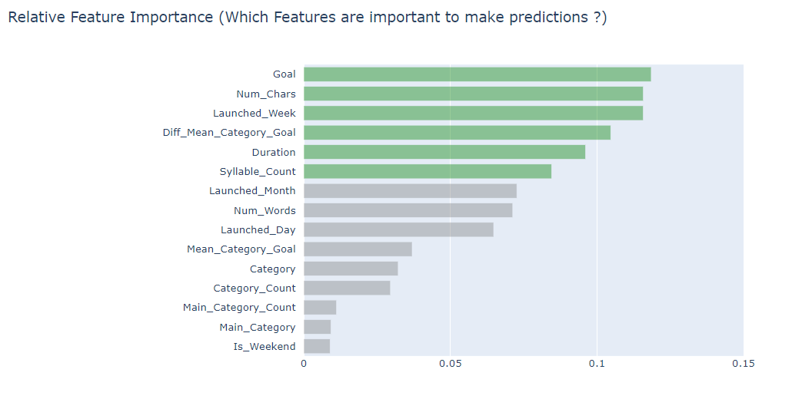
Relative importance
RandomForestClassifier.feature_importances_
Notes:
Firstly, We gonna focus on finding out which is the most important feature.We use the random forest classifier to fit our data.
And there is an intrinsic attribute that is quite helpful for us,that is feature_importances. According to documents, this feature_importances is based on relative importance.
We can see from the graph. The fundraising goal is the most important feature,which is quite make sense. Following are the number of characters, and the launched_week etc.
(Diff…. : the difference between their goal and the mean goal of that category)

Slide 6
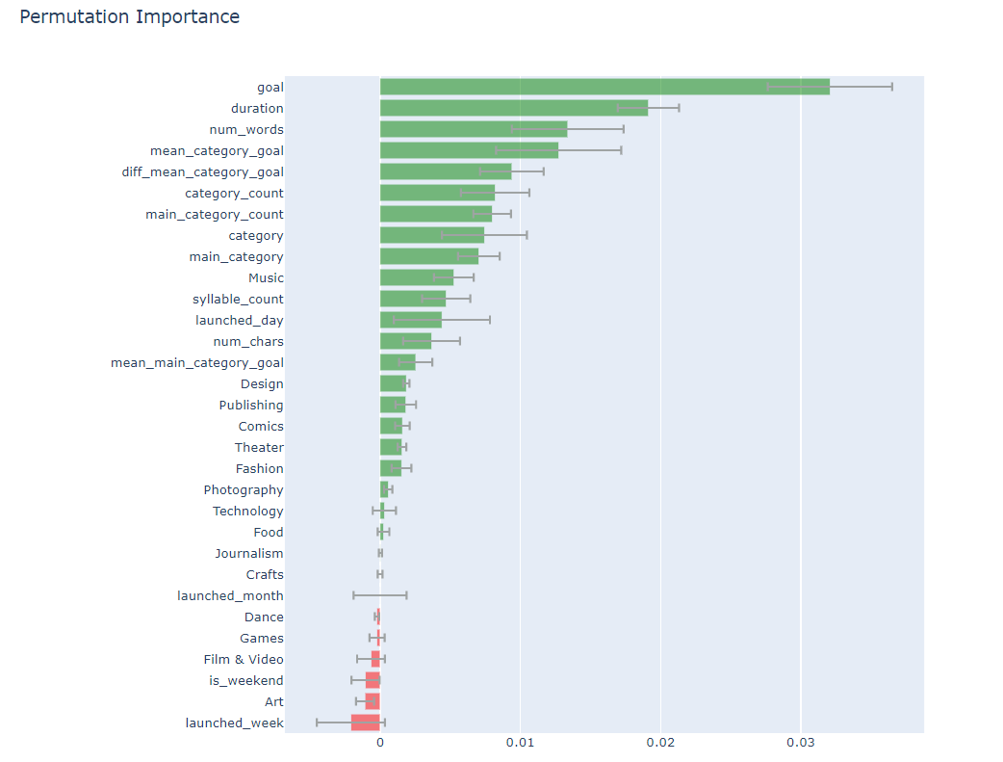
Permutation importance
from eli5.sklearn import PermutationImportance
Notes:
Further we want to do a rather comprehensive comparison.We use the permutation importance, which also is supported by ELI5 library.
Permutation importance basically is another method to check the importance for each feature.
The target goal is still the most important one, But we can see that this time is the fundraising duration is the second important feature. To illustrates the distinction between relative importance and permutation importance I combine them into one graph

Slide 7
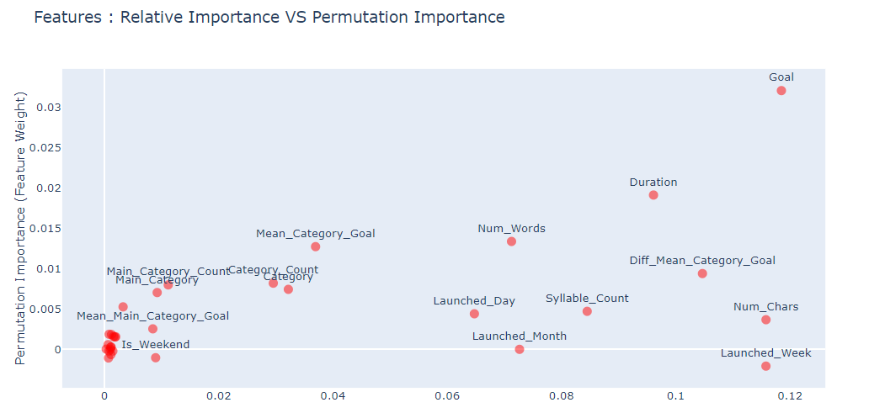
Relative vs Permutation importance
Notes:
From this graph, the horizontal axis represents for Relative, the vertical axis for permutation.Whichever the feature is on the up right side is more important
And it’s quite clear that the target goal is the dominantly important feature.By the graph we can conclude that, target goal, fundraising duration are the most important features.

Slide 8
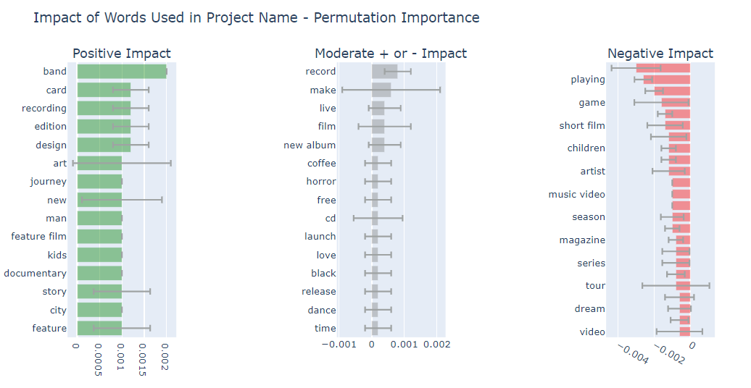
Impact of the words used in Name
Notes:
pi_df = eli5.explain_weights_df(perm, feature_names = X_test2.columns.tolist(), feature_filter=lambda x: x[0] == '_')
pi_df["feature"] = pi_df["feature"].apply(lambda x : x[1:])
highs = pi_df[pi_df.weight >= 0.001]
med = pi_df[(pi_df.weight > -0.0005) & (pi_df.weight < 0.001)]
lows = pi_df[pi_df.weight <= -0.0005]
And we also use the ELI5 library, to found the positive or negative influence regarding each key words.We found out that there are certain words such as band,card, recording will increase the successful rate of project.
Record,make,live these are rather neutral key words,they have neutral influence toward the successful rate.
And words like playing , game , short film,contraryly, will do bad to the success rate for the project.

Slide 9
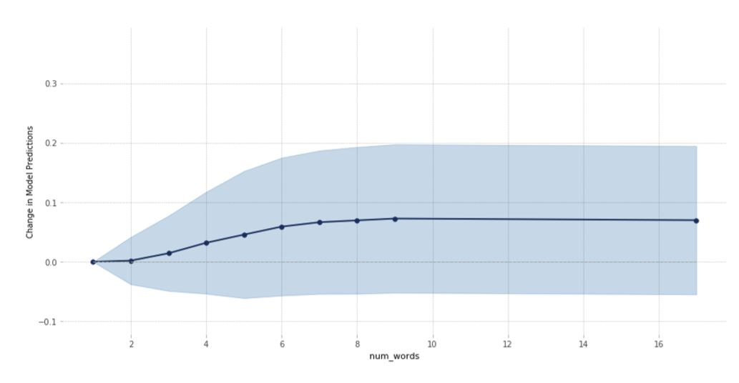
Impact of the number of words in Name
Notes:
this graph Impact of the number of words in Name
If a project has less than 3 words in the project name, it will not have some significant improvement.
However, we can observe that if the project name has 2 to 7 words, the corresponding successful rate also increases linearly.
When the words more than ten, the successful ratet hit the plateau, and doesn’t fluctuate a lot.
Hence, the ideal word limit is somewhere around 7 - 10.

Slide 10
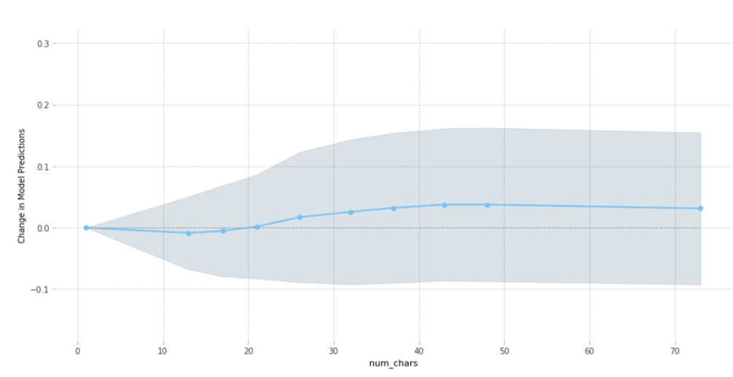
Impact of the number characters of words in Name
Notes:
Next, we want to dig deeper and analyze how the number of characters in project name will influence the successful rate.
Firstly, when the number of characters is less than 20, the project actually performs worse than a average value.
The successful rate continues growing along with the character number, and it stop growing until about 50 characters.
Even it decrease a little bit.

Slide 11
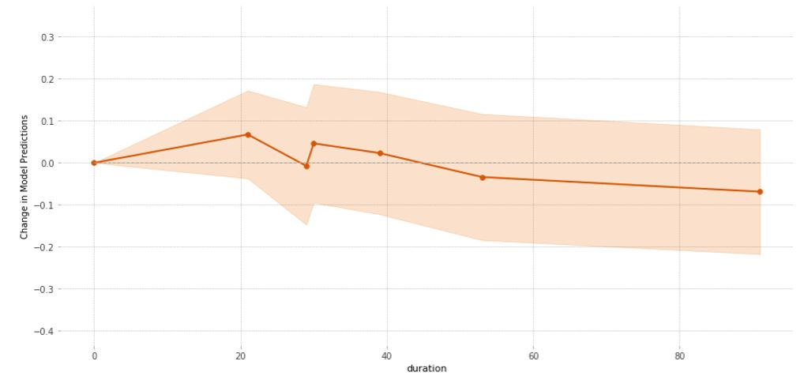
Impact of the duration of the Project
Notes:
Next, we move on to focus on the impact of project duration will bring.
For shorter project duration (let’s say,less than 20 days), the chances of success will be higher.
The 20 days will be the peak.
However if the duration of a project increased to say 60-90 days, it is less likely to achieve its goal.

Slide 12
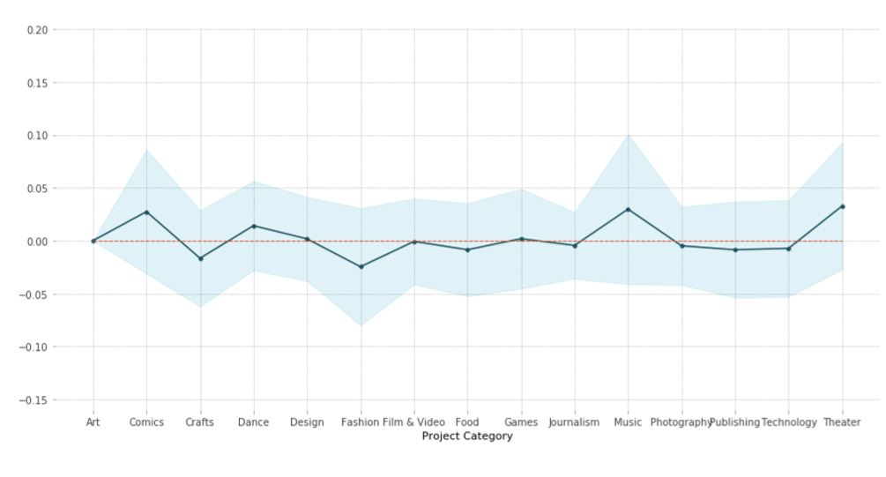
Impact of the project category
Notes:
This graph shows that the categories of the project also heavily impact the success rate.
the project success rate increases if it belongs to "Music", "Comics", "Theater", or "Dance" categories.
On the other hand, It decreases if it belongs to "Crafts", "Fashion Film & Video".
By this graph, we can find which categories is the most popular among the public.

Slide 13
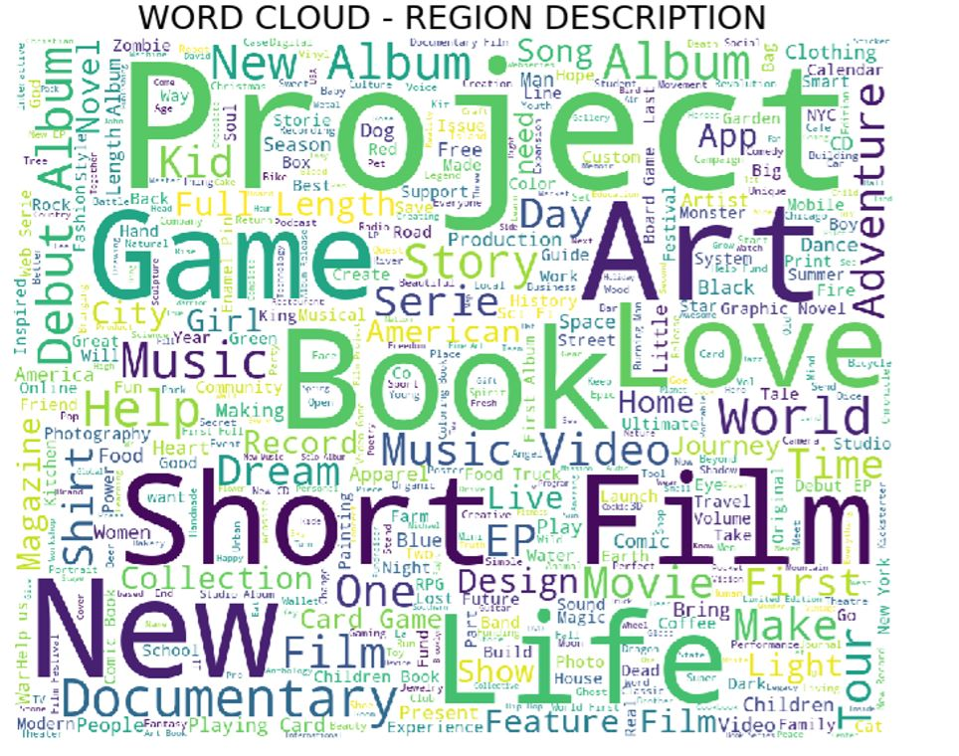
Notes:
we use the package named word cloud in python.
it counts the words of the whole project name, and shows the most frequent words that project owners choose.
such as project,game…….

Slide 14
Thanks for listening

