Slide 1
Object-Oriented Programming
95-712
MISM/MSIT
Carnegie Mellon University
Lecture 1: Introduction to OOP

Slide 2
Expected Background
“A one-semester college course in programming.” (MISM admissions policy)
I assume you can write a program in some language, understand variables, control structures, functions/subroutines.
The Eckel CD has background on C.
If in doubt, let’s talk.

Slide 3
Course Outline
Week 1: Background, basics of O-O, first Java program, programming environments
Week 2: Raw materials: types, variables, operators, program control
Week 3: Classes: declarations, constructors, cleanup & garbage collection
Week 4: Packages, access specifiers, finals, class loading

Slide 4
Course Outline (cont.)
Week 5: Polymorphism, abstract classes, design patterns
Week 6: Interfaces & extends, inner classes, callbacks via inner classes
Week 7: Arrays, container classes, iterators
Week 8: More on collections, collections of references, choosing between types

Slide 5
Course Outline (cont.)
Week 9: Exception handling
Week 10: Java I/O
Week 11: Applets, applications, Swing
Week 12: JDBC, threads

Slide 6
Administrative Details
Professor: Stephen F. Roehrig
Office: Hamburg Hall, 2101A
“Business hours”: 10 am to 10 pm
Email: roehrig@andrew.cmu.edu
Course Web sites
  www.heinz.cmu.edu/~roehrig/java/syllabus.html
  www.cmu.edu/blackboard
Blackboard points to the real Web site.
Blackboard used for grades, discussion board.

Slide 7
Administrative Details (cont.)
12 weeks
Two consecutive 80-minute lectures per week, a break in between the lectures.
Course notes in PowerPoint or HTML, attached to the syllabus.
Course notes available (usually) Sunday before class.
Send course questions to Blackboard, personal questions to me.

Slide 8
Administrative Details (cont.)
Everything is attached to the syllabus. Don’t look for assignments, etc. on Blackboard. Look at the syllabus!
Homework usually weekly.
Submission instructions with each assignment, usually printed listings and a diskette.
Printing slides? Three to a page, at least. Save a tree!

Slide 9



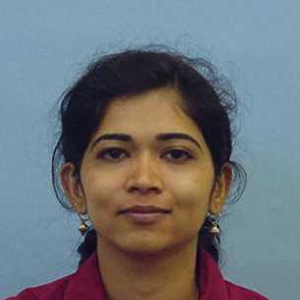
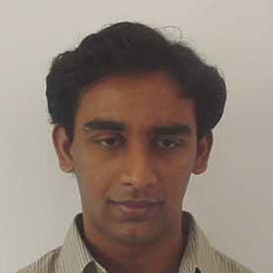
Administrative Details (cont.)
Text: Bruce Eckel, “Thinking in Java,” 2nd edition, Prentice Hall.
Teaching assistants are
  Abhi Anantharaman
  Smit Gupta
  Gautam Sampath Kumar
  Jun Lu
  Poornima Makashir
Office hours TBD

Slide 10
Administrative Details (cont.)
Attendance is not required, but…
…you are responsible for everything said in class.
I encourage you to ask questions in class.
This is America…you are supposed to ask questions. Don’t guess, ask a question!

Slide 11
My Policy on Cheating
Cheating means “submitting, without proper attribution, any computer code that is directly traceable to the computer code written by another person.”
I give students a failing course grade for any cheating. Expulsion is also possible.
This doesn’t help your job prospects.

Slide 12
My Policy on Cheating
You may discuss homework problems with classmates (although it is not to your advantage to do so).
You can use ideas from the literature (with proper citation).
You can use anything from the textbook/notes.
The code you submit must be written completely by you.

Slide 13
Even More On Cheating
“In addition to any penalties imposed by the instructor, including failing the course, all cheating and plagiarism infractions will be reported in writing to the Associate Dean for the program, the Associate Dean of Faculty, the Dean of Student Affairs, and the Dean. They will review and determine if expulsion should be recommended. The report will become part of the student’s permanent record.”

Slide 14
Course Etiquette
Etiquette is “conduct in polite society”
No cell phones
No random comings and goings
If you are sleepy, go home
If you want to read email or surf the Web, please do it elsewhere

Slide 15
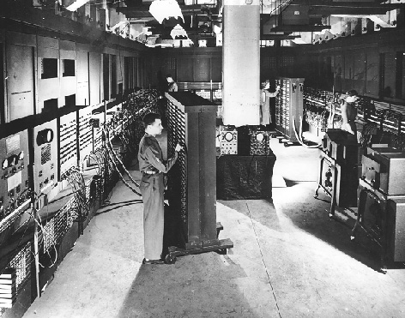

Slide 16
Programming Language Evolution
Machine language
Assembler
“3rd generation” (COBOL, FORTRAN, C)
Specialized (Lisp, Prolog, APL)
“4th generation” (SQL, GAMS, spreadsheets, Mathematica)
“5th generation” (example, anyone?)

Slide 17
Why So Many Languages?
Bring the language “closer” to the problem.
But 4GLs are typically focused on specialized domains (e.g., relational databases).
We want a language that is general purpose, yet can easily be “tailored” to any domain.
An inspiration from an odd place…

Slide 18
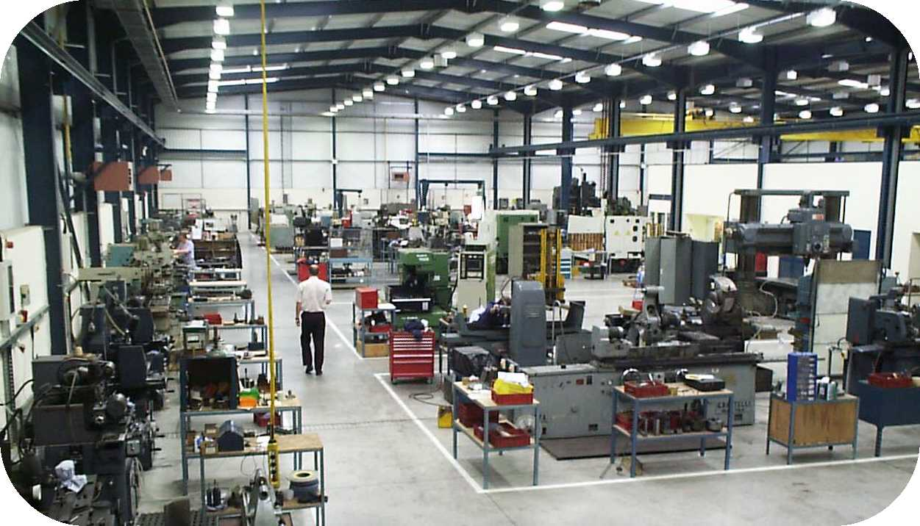

Slide 19
Simula
Designed to simulate job shops, banks, etc.
To code, you create “classes” (like milling machines) and “instances” (machine #1, etc.).
All milling machines have properties (how much time to make Part #1).
All milling machines have abilities (mill to depth n, move part to position x).
Job shop operations simulated by “making” the machines, and moving material through them.

Slide 20
What’s Cool Here?
Very close to the problem; domain experts can pitch in easily.
It’s possible to make new types of machines (e.g., drill press).
Description of the shop floor is transparent:
millingMachine#1. millPart (part#3, depth 2mm)
drillPress#2. idleUntil (Poisson(0.2))

Slide 21
Programming = Simulation?
For a stock market application, we might write:
value = Stock1.determineValue()
risk = Stock1.determineRisk()
if (Stock1.f(value, risk) > 0.12) then Stock1.sell()
So Simula inspired more general-purpose object-oriented languages.

Slide 22
Object-Oriented Languages
Smalltalk, C++, Java, etc…
You can make any kind of objects you want
How different from procedural languages?
  No different at all: Every (reasonable) language is “Turing complete”
  Very different: Make expression easier, less error-prone

Slide 23
O-O Languages (Alan Kay)
Everything is an object.
A program is a bunch of objects telling each other what to do, by sending messages.
Each object has its own memory, and is made up of other objects.
Every object has a type (class).
All objects of the same type can receive the same messages.

Slide 24
Making Java Work
It's “easy as pie” to write procedural code in Java.
It takes some discipline (an attitude) to think O-O.
It's worthwhile to do it.

Slide 25
Objects
An object has an interface, determined by its class.
A class is an abstract data type, or user-defined type.
Designing a class means defining its interface.

Slide 26
Built-In Types
Think of an int…
  What is its interface?
  How do you “send it messages”?
  How do you make one?
  Where does it go when you’re done with it?
In solving a computational problem, the goal is to
  Dream up useful classes, and
  Endow them with appropriate characteristics.

Slide 27
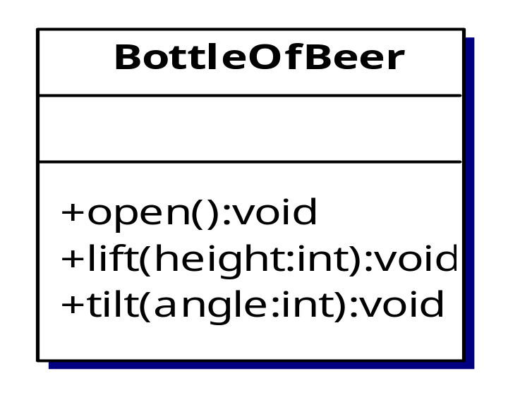
Example
Suppose I’ve defined this class in Java:
To make one, I type
BottleOfBeer myBeer = new BottleOfBeer;

Slide 28
But Why Not Just…
This is legal, but just makes a “reference variable” named myBeer
This variable can refer to any BottleOfBeer object, but currently refers to nothing
The operator new actually causes an object to be created, so we tell it what kind we want
BottleOfBeer myBeer;

Slide 29
Example (cont.)
If I want many beers, I might say
BottleOfBeer[ ] ninetyNineBottlesOfBeer;
But this only declares a reference to an (empty) array. To actually create the bottles, I need to say
ninetyNineBottlesOfBeer = new BottleOfBeer[99];
// and a for loop to create the 99 bottles…
If I want myBeer opened, I say
myBeer.open();

Slide 30
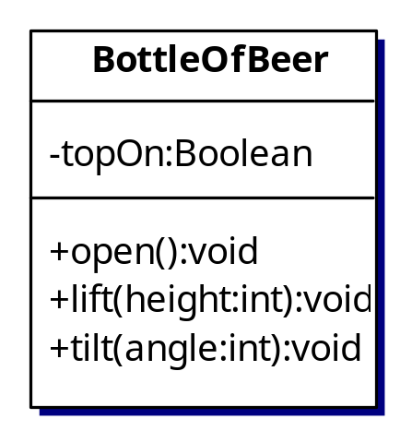
Designers Design, Users Use
The interface is the critical part, but the details (implementation) are important too.
Users use the interface (the “public part”); the implementation is hidden by “access control”.

Slide 31
Objects vs. Procedural Libraries
C libraries are like this, sort of:
  The library designer invents a useful struct.
  Then she provides some useful functions for it.
  The user creates an instance of the struct, then applies library functions to it.
One big difference is that anyone can change any part of the struct. Booo, hsss!
Another difference is in initialization.

Slide 32
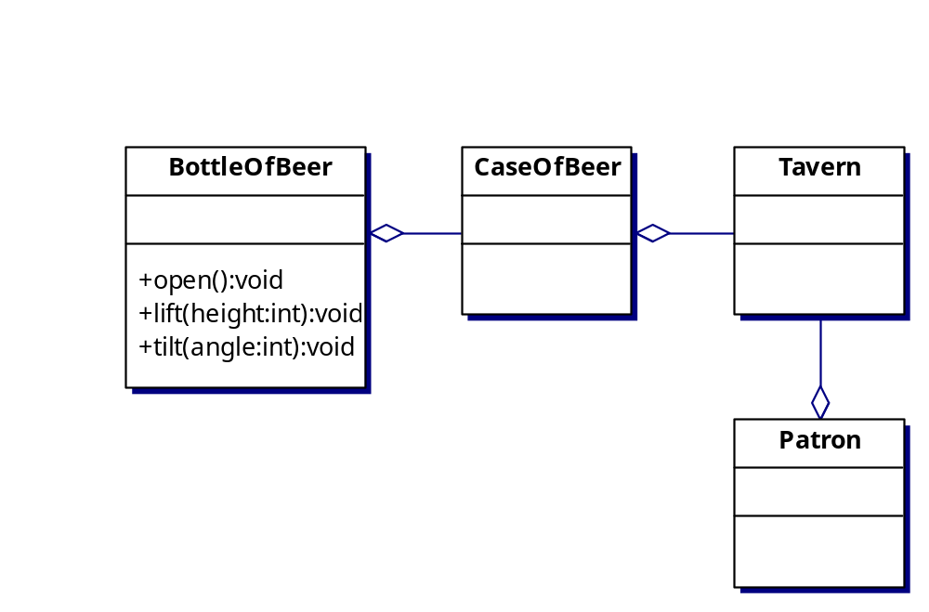
Two Ways of Reusing Classes
Composition: One class has another as a part (indicated by the diamond “aggregation” symbol).

Slide 33
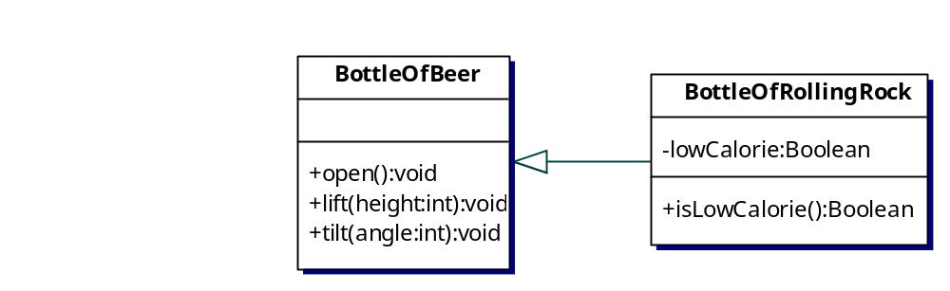
Two Ways of Reusing Classes
Inheritance: One class is a specialized version of another (indicated by the triangle “inheritance” symbol).

Slide 34
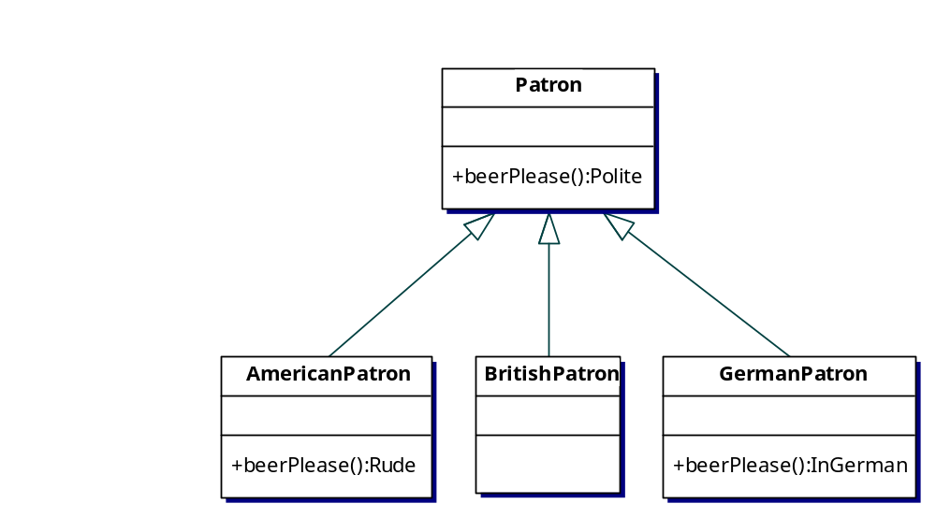
Polymorphism
Different subclasses respond to the same message, possibly with different actions.

Slide 35
Some Java Code
Patron p1 = new Patron();
Patron p2 = new YankPatron();
Patron p3 = new BritPatron();
Patron p4 = new GermanPatron();
p1.BeerPlease() // polite request
p2. BeerPlease() // rude request
p3.BeerPlease() // polite request
p4.BeerPlease() // request in German (but polite)
This is a bit of a trick: it requires late binding of the function call.

Slide 36
Creating Objects
We usually assume this is free; with built-in types like int or char, we just say
int i;
char c;
With user-defined types (the ones we make), we need to be explicit about what we want:
  constructor function
This is a very important issue!

Slide 37
Destroying Objects
If an object goes “out of scope,” it can no longer be used (its name is no longer known).
In C++, we might need to write an explicit function to free memory allocated to an object.
Java uses references and “garbage collection”.

Slide 38
Example of Object Scope
public String getTitle(int lectureNumber) {
LectureNotes lect;
lect = syllabus.getLecture(lectureNumber);
String s = lect.getLine(1);
return s;
}
What happens to lect?
The LectureNotes object still exists, but the reference lect disappears (it’s out of scope after return).
Eventually, the garbage collector removes the actual object.

Slide 39
A Simple Model of Memory
The reference variable lect
holds a memory location
The LectureNotes object
is at that location
0x1234
memory
22
C++ Versus Java\n…
When you “speak of” the variable lect, you are “referring to”
the actual LectureNotes object. When lect goes out of scope
it is automatically destroyed. The LectureNotes object lives
on, but nobody can use it…

Slide 40
Java’s Use of Memory
Registers
Stack
Heap
Static variables
Constants
Non-RAM storage

Slide 41
Java’s Primitive Types
Type | Size | Wrapper type
boolean | - | Boolean
char | 16-bit | Character
byte | 8-bit | Byte
short | 16-bit | Short
int | 32-bit | Integer
long | 64-bit | Long
float | 32-bit | Float
double | 64-bit | Double
void | - | Void

Slide 42
Wrapper Types
Variables of primitive types are “automatic”, i.e., they are stored on the stack.
They are automatically deleted when they go out of scope.
What if you want an object holding a primitive type? Example:
char c = ‘x’;
Character C = new Character(‘x’);

Slide 43
Really Big Numbers
BigInteger, BigDecimal
These are arbitrary precision, as big as they need to be.
You can’t use the usual operators (+-*/) since they are objects. But there are methods (functions) to do these things.
How might these be implemented?

Slide 44
Creating New Types
class MyNewType {
// definition here
}
Now it’s legal to say
MyNewType m = new MyNewType();

Slide 45
Class Members
Fields (a.k.a. member variables, data members)
Methods (a.k.a. member functions)
class MyClass {
int a;
YourClass b;
float memberFunction(int x, float f) {
return 0;
}
}

Slide 46
Let’s Write Something
// Our first program. File: helloDate.java
import java.util.*;
public class HelloDate {
public static void main(String[] args) {
System.out.println(“Hello, it is ”);
System.out.println(new Date());
}
}

Slide 47
The Major Issues
Editing
  Use any text editor you like (not a word processor!); save as helloDate.java
Compiling
  From a DOS or UNIX command line, type
  > javac helloDate.java
  This should produce the file helloDate.class
Running
  Again from the command prompt, type
  > java helloDate

Slide 48
The Together® Environment
For us:
  An editor that knows Java syntax and Java library classes.
  An easy way to organize .java and .class files.
  An easy way to run the compiler.
  An easy way to find where the compiler thinks you’ve goofed.
  An easy way to run the debugger and other tools.

Slide 49
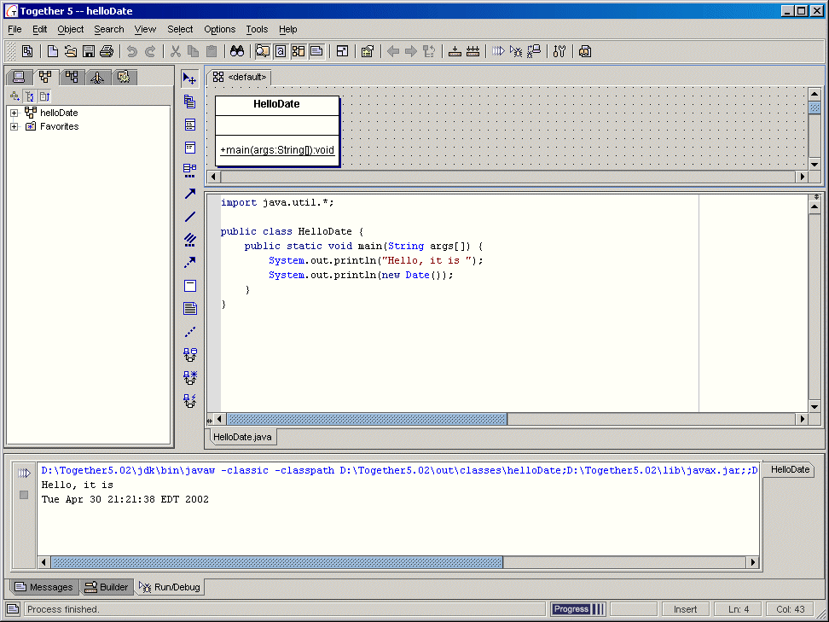

Slide 50
More on Together
It is built for “Model-Build-Deploy”.
It creates UML and code simultaneously (umm…“together”).
We won’t worry about UML in this course.
We’ll use Together again in Object-Oriented Analysis and Design, when we do worry about UML.

Slide 51
Together Demonstration
Editor
Explain Run Configurations
Running and seeing output from System.out
Debugging, setting breakpoints and watches

Slide 52
Another Simple Program
import java.util.*;
public class DoubleSpace {
public static void main(String[] args) {
SimpleInput keyboard = new SimpleInput();
System.out.println("Enter the name of a file to doublespace: ");
String fName = new String(keyboard.nextLine());
SimpleInput file = new SimpleInput(fName);
String lineFromFile = new String();
lineFromFile = file.nextLine();
while(lineFromFile != null) {
System.out.println(lineFromFile);
System.out.println();
lineFromFile = file.nextLine();
}
System.out.println("We're done.");
}
}

Slide 53
Notes on DoubleSpace
We use the class SimpleInput. See the file SimpleInput.html that is attached to the syllabus.
DoubleSpace just adds a blank line after every line in the file.

