Slide 1
Object-Oriented Programming
95-712
Sakir YUCEL
MISM/MSIT
Carnegie Mellon University
Lecture: Arrays, Collection Classes, Iterators
Slides adapted from Prof. Steven Roehrig

Slide 2
Today’s Topics
More on arrays
Shallow copies, deep copies, and cloning
Sorting & searching in arrays
Introduction to containers
The ArrayList class
Iterators
Collections: Lists and Maps
Hash functions
Maps
Some speed comparisons

Slide 3
Arrays
An array is a “first-class object,” unlike a C/C++ array, which is just a bunch of contiguous memory locations.
As for all objects, the array name is a reference to the actual object.
This object has space sufficient for
  the number of references you specify, if your array holds objects, or
  the number of primitive values you specify, if your array holds primitive types,
  plus space to hold the array length.

Slide 4
Arrays of Primitives
int[] a = new int[3]; // compiler does initialization
3
0
0
0
This is schematic only,
e.g., length may not be
first in memory.
a.length a[0] a[1] a[2]
int[] a = {41, 32, 19}; // compiler does initialization
3
41
32
19
a.length a[0] a[1] a[2]

Slide 5
Arrays of Primitives (cont.)
Here are two common (compile) errors:
But this is OK:
int[] a;
a[2] = 5; // a uninitialized
int[] b;
int len = b.length; // b uninitialized
int[] a = {41, 32, 19};
int[] b;
b = a;
int len = b.length;

Slide 6
Arrays of Objects
class Stock {
int sharesHeld = 0;
double currentPrice = 100.00;
}
Stock[] a = new Stock[3]; // initialization to ∅
3
∅
∅
∅
The array components
a[0], a[1] and a[2] are
null (∅) references.
a
a.length a[0] a[1] a[2]

Slide 7
Arrays of Objects
for (int i = 0; i < 3; i++)
a[i] = new Stock();
3
f0
f12
f24
Stock
Stock
Stock
a
a.length a[0] a[1] a[2]

Slide 8
Passing Arrays to Methods
public class Stock {
Stock() {}
Stock(int s, double p, String name) {
sharesHeld = s;
currentPrice = p;
symbol = name;
}
int sharesHeld = 0;
double currentPrice = 100.00;
String symbol;
public String toString() {
String s = new String();
s += sharesHeld + " shares of " + symbol + " at $" + currentPrice;
return s;
}
}

Slide 9
Investor
public class Investor {
Stock[] portfolio;
Advisor ohTrustedOne;
double value;
Investor() {portfolio = new Stock[0];}
Investor(Stock[] p, Advisor a) {
portfolio = p;
ohTrustedOne = a;
value = ohTrustedOne.findValue(p);
}
// more below

Slide 10
Investor (cont.)
String describePortfolio() {
String s = new String();
s += "My portfolio is: \n";
for (int i = 0; i < portfolio.length; i++)
s += portfolio[i] + "\n";
s += "The total value is $" + value;
return s;
}
void askAdvice() {
ohTrustedOne.advise(portfolio);
}
}

Slide 11
Advisor
public class Advisor {
double findValue(Stock[] p) {
double value = 0;
for (int i = 0; i < p.length; i++)
value += p[i].currentPrice * p[i].sharesHeld;
return value;
}
void advise(Stock[] p) { swindle(p); }
void swindle(Stock[] p) {
for (int i = 0; i < p.length; i++)
p[i].sharesHeld /= 2;
}
}

Slide 12
Test Passing Arrays
public class TestInvestments {
public static void main(String[] args) {
Stock[] p = new Stock[] {new Stock(1000, 53.45, "GnMotr"),
new Stock(100, 29.05, "GenElec"),
new Stock(220, 44.08, "GenMills")};
Advisor deweyCheethamAndHowe = new Advisor();
Investor sucker = new Investor(p, deweyCheethamAndHowe);
System.out.println(sucker.describePortfolio());
sucker.askAdvice();
System.out.println(sucker.describePortfolio());
}
}

Slide 13
Dangers in Passing Arrays
The called method gets a reference to the actual array, and can modify it.
Using final is a possibility, but not in this example (at least not easily).
If you are cautious, you can make a copy and send that.

Slide 14
Copies of Arrays
Shallowest: make a copy of the array reference
Shallow: make a new array of references of the same type and size, and copy into it the existing array of references
Deep: the above, plus make copies of all the objects themselves
The method System.arraycopy() does a shallow copy—arghhh!

Slide 15
Deep Copy of an Array
Stock[] copyPortfolio() { // illustrates returning an array
Stock[] copy = new Stock[portfolio.length];
for (int i = 0; i < portfolio.length; i++) {
Stock s = new Stock();
s.currentPrice = portfolio[i].currentPrice;
s.sharesHeld = portfolio[i].sharesHeld;
s.symbol = new String(portfolio[i].symbol);
copy[i] = s;
}
return copy;
}

Slide 16
Aside: Cloning
Java doesn’t have the equivalent of C++’s copy constructor, but does have cloning.
If a class implements the Cloneable interface, then you can make a “duplicate copy” by calling clone().
To implement, override Object’s clone() method as a public method in your class.
clone() returns an Object, which you can then cast to the correct type.

Slide 17
Cloning Example
public class SimpleObject implements Cloneable {
private int i;
SimpleObject(int i) {this.i = i;}
public String toString() {
String s = new String();
s += "I'm a SimpleObject with i = " + i;
s += " and address " + super.toString();
return s;
}

Slide 18
Cloning Example (cont.)
public Object clone() {
Object o = null;
try {
o = super.clone();
}
catch(CloneNotSupportedException e) {
System.out.println("SimpleClass can't clone.");
}
return o;
}
}

Slide 19
Cloning Example (cont.)
public class CloneTest {
public static void main(String[] args) {
SimpleObject s1 = new SimpleObject(1);
System.out.println(s1);
SimpleObject s2 = (SimpleObject) s1.clone();
System.out.println(s2);
}
}
One run produces this:
I'm a SimpleObject with i = 1 and address SimpleObject@158269a
I'm a SimpleObject with i = 1 and address SimpleObject@15829aa

Slide 20
Arrays Are “Type-Safe”
You explicitly declare the type of objects held in the array.
The compiler checks to make sure your usage agrees with your declaration.
A very common usage is to write a class hierarchy, then use an array of the type “highest” in the hierarchy (an array of Nodes, for example).
Polymorphism is then used to work with the array elements.

Slide 21
The Arrays Class
In java.util
Provides many versions of the static methods:
  asList()
  binarySearch()
  equals()
  fill()
  sort()
Versions of these for byte, char,
double, float, int, long, Object
and short. The Object versions of
binarySearch() and sort() allow
you to specify a comparator.

Slide 22
Sorting Students
public static void main(String[] args) {
Student s1 = new Student("Fred", 3.0F);
Student s2 = new Student("Sam", 3.5F);
Student s3 = new Student("Steve", 2.1F);
Student[] students = new Student[] {s1, s2, s3};
for (int i = 0; i < students.length; i++)
System.out.println(students[i].getName()
+ "\t" + students[i].getGpa());
Arrays.sort(students);
for (int i = 0; i < students.length; i++)
System.out.println(students[i].getName()
+ "\t" + students[i].getGpa());
}

Slide 23
Sorting Students (cont.)
This gives, as expected, the following:
This example used the natural
comparison method compareTo()
that we provided in the Student
class (which implemented the
Comparable interface). That
comparison method compared
gpas.
sort() also allows you to specify
a different comparison method
if you want…
Fred 3.0
Sam 3.5
Steve 2.1
Steve 2.1
Fred 3.0
Sam 3.5

Slide 24
Sorting With a Comparator
The Comparator interface allows you to define “objects that know how to compare two things.”
This interface expects you to define the compare() method (and perhaps also the equals() method).
Let’s try it for Students.

Slide 25
Student Comparator
import java.util.*;
public class CompareStudentNames implements Comparator {
public int compare(Object s1, Object s2) {
return
((Student) s1).getName().compareTo(
((Student) s2).getName());
}
}

Slide 26
Let’s Try It
Student s1 = new Student("Sam", 3.5F); // note I changed
Student s2 = new Student("Steve", 2.1F); // the order of
Student s3 = new Student("Fred", 3.0F); // the students!
Student[] students = new Student[] {s1, s2, s3};
for (int i = 0; i < students.length; i++)
System.out.println(students[i].getName()
+ "\t" + students[i].getGpa());
Arrays.sort(students, new CompareStudentNames());
for (int i = 0; i < students.length; i++)
System.out.println(students[i].getName()
+ "\t" + students[i].getGpa());

Slide 27
Now Try Filling
Arrays.fill(students, s1);
for (int i = 0; i < students.length; i++)
System.out.println(students[i].getName()
+ "\t" + students[i].getGpa());
students[1].setName("Gautam");
for (int i = 0; i < students.length; i++)
System.out.println(students[i].getName()
+ "\t" + students[i].getGpa());
This gives:
Fred 3.0
Fred 3.0
Fred 3.0
Gautam 3.0
Gautam 3.0
Gautam 3.0
This is probably not what we want!

Slide 28
The Java Container Classes
A container class object could be
  your bookcase
  your photo album
  your suitcase
  your “junk drawer” in the kitchen
  your apartment
Containers hold Object references, so can be dangerous.
We can learn to live with danger…

Slide 29
Container Classes: Collection
List and Set, essentially, with some specializations. They store individual objects, and give you
  add(Object)
  remove(Object)
  contains(Object)
  size()
  other methods too

Slide 30
Container Classes: Map
These hold pairs of things, a key and a value.
  Pairs are held in a map, ordered by the key
Methods include
  containsKey(Object key)
  containsValue(Object value)
  put(Object key, Object value)
  get(Object key)
  remove(Object key)

Slide 31
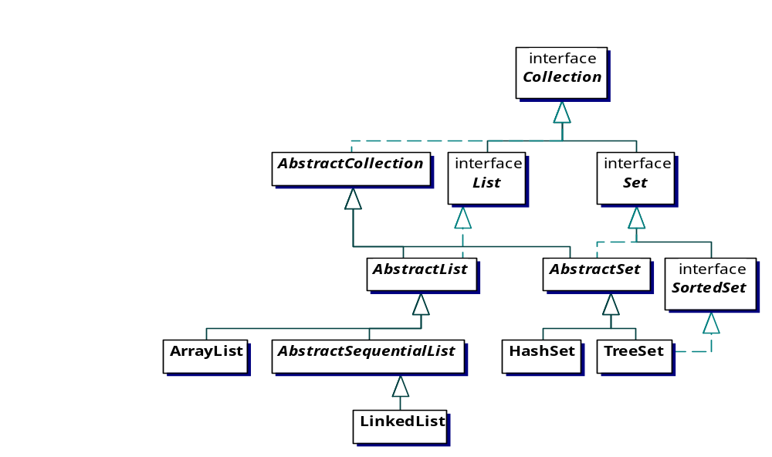
The Java Collection Classes

Slide 32
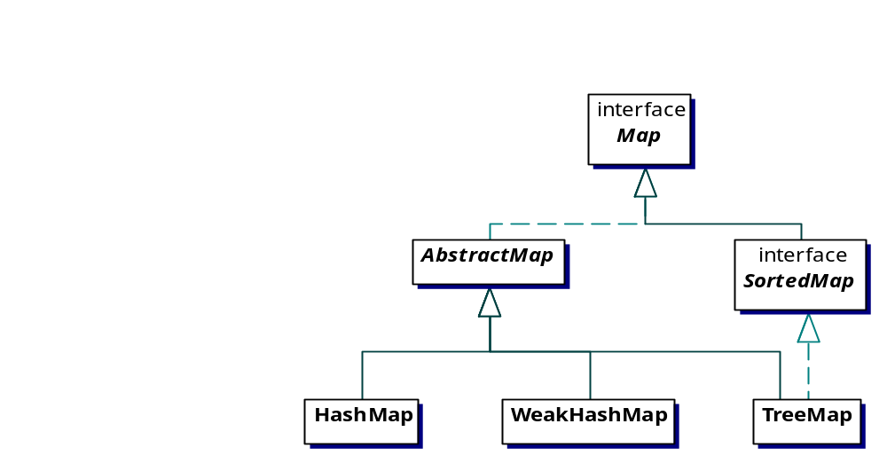
The Java Map Classes

Slide 33
Containers Illustration
import java.util.*;
public class PrintingContainers {
static Collection fill(Collection c) {
c.add(“dog”); c.add(“dog”); c.add(“cat”);
return c;
}
static Map fill(Map m) {
m.put(“dog”, “Bosco”); m.put(“dog”, “Spot”); m.put(“cat”, “Rags”);
return m;
}
public static void main(String[] args) {
System.out.println(fill(new ArrayList())); // toString() used
System.out.println(fill(new HashSet()));
System.out.println(fill(new HashMap()));
}
}

Slide 34
Containers Illustration
The arguments and return types of fill() are the general interface types, for generality.
The results look like this:
Elements of Sets and keys of Maps are unique, and ordered (here, lexicographically).
Lists hold things in the order in which you enter them.
[dog, dog, cat]
[cat, dog]
{cat=Rags, dog=Spot}

Slide 35
Java Containers Hold “Objects”
All the container classes are defined (by Sun) to hold (references to) Objects.
So, the exact type of an object is lost.
This is far less safe than ordinary arrays, but is more powerful.
If you know what type of thing went into the container, you can cast it to the correct type.

Slide 36
Eckel’s Cats’n’Dogs
public class Cat {
private int catNumber;
Cat(int i) { catNumber = i; }
void print() {
System.out.println(“Cat #” + catNumber);
}
}
public class Dog {
private int dogNumber;
Dog(int i) { dogNumber = i; }
void print() {
System.out.println(“Dog #” + dogNumber);
}
}

Slide 37
Cats’n’Dogs (cont.)
import java.util.*;
public class CatsAndDogs {
public static void main(String[] args) {
ArrayList cats = new ArrayList();
for (int i = 0; i < 7; i++)
cats.add(new Cat(i));
// here’s trouble
cats.add(new Dog(8));
for(int i = 0; i < cats.size(); i++)
( (Cat) cats.get(i) ).print();
}
}

Slide 38
Cats’n’Dogs (cont.)
A Dog in the cats ArrayList is perfectly legal.
The compiler has no way of knowing this is wrong.
At runtime, when the Dog is cast to a Cat, trouble occurs (giving an exception).
(Note the extra set of parentheses in the cast.)

Slide 39
A Type-Conscious ArrayList
import java.util.*;
public class CatList { // no Dogs allowed
private ArrayList list = new ArrayList();
public void add(Cat c) {
list.add(c);
}
public Cat get(int index) {
return (Cat) list.get(index);
}
public int size() { return list.size(); }
}

Slide 40
Iterators For Collections
The Iterator interface specifies
  boolean hasNext()
  Object next()
  void remove()
You just have to be careful
  to check hasNext() before using next()
  to not modify the Collection while iterating, except by using remove()

Slide 41
Simple Iterator Example
ArrayList cats = new ArrayList();
for (int i = 0; i < 7; i++)
cats.add(new Cat(i));
Iterator e = cats.iterator();
while (e.hasNext())
( (Cat)e.next()).print();
We get the iterator by asking the ArrayList for one.
On creation, it is positioned “just before the beginning” of the ArrayList.

Slide 42
Let’s Be Clear On This!
Iterator e = cats.iterator();
while (e.hasNext())
( (Cat)e.next()).print();
When e is here,
hasNext() returns
false.
ArrayList cats

Slide 43
Another Example
class Printer {
static void printAll(Iterator e) {
while(e.hasNext())
System.out.println(e.next());
}
There is no knowledge about the type of thing being iterated over.
This also shows the power of the “toString() idea”.

Slide 44
Collection Interface Methods
boolean add(Object)
boolean addAll(Collection)
void clear()
boolean contains(Object)
boolean containsAll(Collection)
boolean isEmpty()
Iterator iterator()
“optional”

Slide 45
Collection Interface Methods
boolean remove(Object)
boolean removeAll(Collection)
boolean retainAll(Collection)
int size()
Object[] toArray()
Object[] toArray(Object[] a)
“optional”

Slide 46
What’s Missing?
All the methods that use indexes:
  boolean add(int, Object)
  boolean addAll(int, Collection)
  Object get(int)
  int indexOf(Object)
  Object set(int, Object)
Why? Sets (HashSet, TreeSet) have their own way of ordering their contents. But ArrayList and LinkedList have these methods, since they are…lists.

Slide 47
Collections Example
public class AABattery {
public String toString() { return "AABattery"; }
}
public class NineVoltBattery {
public String toString() { return "NineVoltBattery"; }
}
public class RollOfRibbon {
public String toString() { return "RollOfRibbon"; }
}
public class PaperClip {
int i;
PaperClip(int i) { this.i = i; }
public String toString() { return "PaperClip(" + i + ")"; }
}

Slide 48
Collections Example (cont.)
public class BandAid {
public String toString() { return "BandAid"; }
}
public class Box {
ArrayList moreStuff = new ArrayList();
public String toString() {
String s = new String("Box");
s += moreStuff;
return s;
}
}

Slide 49
Collections Example (cont.)
public class BoxOfPaperClips {
ArrayList clips = new ArrayList();
public String toString() {
String s = new String("BoxOfPaperClips");
s += clips;
return s;
}
}

Slide 50
Collections Example (cont.)
public class JunkDrawer {
ArrayList contents = new ArrayList();
public void fillDrawer() {
contents.add(new RollOfRibbon());
contents.add(new AABattery());
contents.add(new NineVoltBattery());
BoxOfPaperClips boxOfClips = new BoxOfPaperClips();
for (int i = 0; i < 3; i++)
boxOfClips.clips.add(new PaperClip(i));
contents.add(boxOfClips);
Box box = new Box();
box.moreStuff.add(new AABattery());
box.moreStuff.add(new BandAid());
contents.add(box);
contents.add(new AABattery());
}

Slide 51
Collections Example (cont.)
public static void main(String[] args) {
JunkDrawer kitchenDrawer = new JunkDrawer();
kitchenDrawer.fillDrawer();
System.out.println(kitchenDrawer.contents);
}
}
This prints
[RollOfRibbon, AABattery, NineVoltBattery,
BoxOfPaperClips[PaperClip(0), PaperClip(1), PaperClip(2)],
Box[AABattery, BandAid], AABattery]

Slide 52
Removing Stuff
void takeAnAABattery() {
boolean b = contents.remove(new AABattery());
if (b)
System.out.println("One AABattery removed");
}
This doesn’t work at all!
You need to have a reference to a battery actually in the drawer.
How do you figure out if something is an AABattery?

Slide 53
Using RTTI
boolean takeAnAABattery() {
Iterator i = contents.iterator();
Object aa = null; // initialize, or compiler complains
while(i.hasNext()) {
if ( (aa = i.next()) instanceof AABattery ) {
contents.remove(aa);
return true;
}
}
return false;
}

Slide 54
Containers Are Good, But…
Everything in a container is “just an Object.”
If you aren’t sure what’s in there, and its location, then finding what you want can be tedious.
Can we do better?

Slide 55
A “More Organized” Drawer
public class MarthaStewartDrawer {
ArrayList contents = new ArrayList();
ArrayList aaBatteries = new ArrayList();
public void fillDrawer() {
contents.add(new RollOfRibbon());
AABattery a1 = new AABattery();
AABattery a2 = new AABattery();
contents.add(a1);
aaBatteries.add(a1);
//add all the rest…
contents.add(a2);
aaBatteries.add(a2);
}

Slide 56
Remove An Entire Collection
boolean takeAllAABatteries() {
return contents.removeAll(aaBatteries);
}
public static void main(String[] args) {
MarthaStewartDrawer kitchenDrawer
= new MarthaStewartDrawer();
kitchenDrawer.fillDrawer();
System.out.println(kitchenDrawer.contents);
if (kitchenDrawer.takeAllAABatteries())
System.out.println("All AABatteries removed");
System.out.println(kitchenDrawer.contents);
}
}

Slide 57
Or, Remove Everything Except...
This is actually the “set intersection” of contents with aaBatteries.
Note, however, that this removes the AABatterys in the Box…
boolean leaveOnlyAABatteries() {
return contents.retainAll(aaBatteries);
}

Slide 58
Specialized Collections
The List interface:
  Gives you the Collection interface, plus more
  Insertion order is preserved
  You can “index into” a List
  The concrete types are ArrayList and LinkedList.
The Set interface:
  Just the Collection interface, but with specialized behavior
  Insertion order isn’t preserved.
  The concrete types are HashSet and TreeSet.

Slide 59
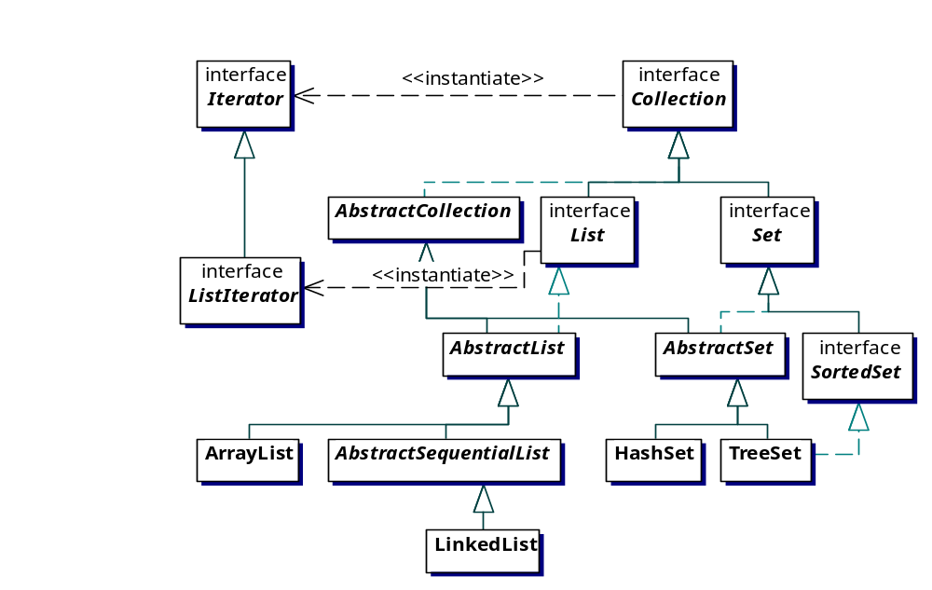
Lists Produce ListIterators

Slide 60
Operational Efficiencies
ArrayList
  Holds data internally as an array (duh!)
  Random access is fast, just “index into” the array
  Insertion (except at the end) is very slow
LinkedList
  Random access is slow (but provided for)
  Insertion anywhere is fast (once you are there!)

Slide 61
ListIterator
void add(Object)
boolean hasNext()
boolean hasPrevious()
Object next()
int nextIndex()
Object previous()
int previousIndex()
void remove()
void set(Object) (this does replacement)

Slide 62
LinkedList
void addFirst(Object)
void addLast(Object)
Object getFirst()
Object getLast()
Object removeFirst()
Object removeLast()
It seems clear that a
LinkedList is really
a doubly-linked list.
You can easily make
a queue, deque, or
stack class by simply
deriving a subclass of
LinkedList and limiting
the subclass behavior.
This is called “adapting.”

Slide 63
The Set Interface
Elements in Set implementations are unique—no duplicates allowed.
Objects added to Sets must have equals() defined.
Generally, there is no guarantee that elements will be in any particular order,
but concrete instances (HashSet, TreeSet) don’t just randomly place elements!

Slide 64
TreeSet
Guaranteed to keep elements in ascending order, according to their natural ordering, or through a Comparator.
Each element must be comparable to every other element. You probably won’t put PaperClips and AABatterys into the same TreeSet
Iterators are fail-fast, meaning that you get an exception right away if you use the iterator on a TreeSet that’s been modified other than through remove().
log(n) performance for the basic operations.

Slide 65
HashSet
Constant time performance for the basic operations (at least on average).
Iterators are fail-fast.
Requires that objects implement a hashCode() method (one is provided by Object, but may not be optimal).
In general, objects are not stored in order.

Slide 66
Hash Tables And Hash Functions
A sneaky method for storage where fast look-up is desired.
Two major components:
  A bucket array, maintained by the hash table, and
  A hash function, typically belonging to the class of objects to be stored.
These two work in concert.

Slide 67
Storing Integers In A Hash Table
(From Goodrich & Tomassia)
Hash function h(k) = k % 13
0 1 2 3 4 5 6 7 8 9 10 11 12
41
18
36
90
28
10
12
54
“collisions”
38
25
Bucket array size = “initial capacity” = 13
Load factor = #objects/array size = 10/13

Slide 68
Adding The Integer 33
Hash function h(k) = k % 13 = 33 % 13 = 7
0 1 2 3 4 5 6 7 8 9 10 11 12
41
18
33
36
90
28
10
12
54
38
25

Slide 69
Adding The Integer 23
Hash function h(k) = k % 13 = 23 % 13 = 10
0 1 2 3 4 5 6 7 8 9 10 11 12
41
18
33
36
90
28
10
12
54
23
38
25

Slide 70
Finding The Integer 28
Hash function h(k) = k % 13 = 28 % 13 = 2
0 1 2 3 4 5 6 7 8 9 10 11 12
Start here
41
18
33
36
90
28
10
12
54
23
38
25

Slide 71
The Hash Function
Should provide a “relatively unique” integer for each object stored.
Every time it is invoked for the same object, it must return the same integer!
If two objects are equal (according to equals(Object)), then they must return the same integer.
If two objects are unequal, they need not return different integers (although they probably should).
The default Object hashMap() method turns the address of an object into an int.

Slide 72
Hash Function Example
public class Student implements Comparable {
public Student(String name, float gpa) {
this.name = name;
this.gpa = gpa;
}
public Student() {}
public int compareTo(Object o) {
if ( ((Student)o).gpa < gpa )
return 1;
else if ( ((Student)o).gpa > gpa )
return -1;
else
return 0;
}

Slide 73
Hash Function Example (cont.)
public boolean equals(Object o) {
if (gpa == ((Student) o).gpa)
return true;
else
return false;
}
public int hashCode() {
return (int) (gpa*10.0);
}
public String getName() { return name;}
public float getGpa() { return gpa;}
private String name;
private float gpa = 0.0F; //make sure hashing works!
}

Slide 74
Hash Function Example (cont.)
public static void main(String[] args) {
Student s1 = new Student("Fred", 3.0F);
Student s2 = new Student("Sam", 3.5F);
Student s3 = new Student("Steve", 2.1F);
//Set studentSet = new TreeSet();
Set studentSet = new HashSet();
studentSet.add(s1);
studentSet.add(s2);
studentSet.add(s3);
Iterator i = studentSet.iterator();
while(i.hasNext())
System.out.println( ((Student)i.next()).getName());
}

Slide 75
“Re-Hashing”
If the load factor gets too large, searching performance goes way down.
Typically, a hash table “adjusts itself” when the load factor exceeds some value (typically 0.75).
The bucket size is increased, and the elements are “re-hashed”, resulting in a new storage layout.
Our original example had load factor 0.77, so let’s re-hash it.

Slide 76
The Original Hash Table
Hash function h(k) = k % 13
0 1 2 3 4 5 6 7 8 9 10 11 12
41
18
36
90
28
10
12
54
38
25
Bucket array size = 13
Load factor = 0.77
Increase bucket array size to 17

Slide 77
The Table Re-Hashed
Hash function h(k) = k % 17
0 1 2 3 4 5 6 7 8 9 10 11 12 13 14 15 16
18
54
90
41
28
12
10
36
38
25
Bucket array size = 17
Load factor = 0.59

Slide 78
The Map Interface
A Map is for storing (key, value) pairs of objects.
Also known as a dictionary or associative container.
There are TreeMap, HashMap, and WeakHashMap.
TreeMap is sorted (like TreeSet).

Slide 79
The Java Map Classes

Slide 80
Map Example: Counting Words
Much ado lately about a work newly attributed to Shakespeare, as a result of computer analysis.
Let’s write a program to tally the word frequencies in Shakespeare’s plays.
This follows Eckel’s “Statistics” example (sort of…)

Slide 81
A Class To Hold The Counts
public class WordCount {
int i = 1;
public String toString() {return Integer.toString(i); }
}
This will be the value part of the (key, value) pair.
It just holds an int, that will be incremented whenever
its associated key (a word) is encountered again.
Remember, both key and value must be objects.

Slide 82
A Class To Hold The Map
public class WordFrequencies {
public HashMap hm = new HashMap();
public void put(String c) {
if (hm.containsKey(c))
((WordCount)hm.get(c)).i++;
else
hm.put(c, new WordCount());
}
public String toString() { return hm.toString(); }
}
The put() method looks to see if the word is already
in the map. If so, it updates the WordCount object.
If not, it makes a new one.

Slide 83
A Class To Do The Work
public class FindWordFrequencies {
SimpleInput file = null;
WordFrequencies wf = new WordFrequencies();
FindWordFrequencies() {}
FindWordFrequencies(String fileName) {
file = new SimpleInput(fileName);
file.setDelimiters(" \t,:;.?-[]{}!");
}
The constructor opens a file, and sets SimpleInput’s
delimiters. Punctuation and whitespace are ignored.

Slide 84
A Class To Do The Work (cont.)
void buildWordFrequencyMap() {
String nextWord = file.nextWord();
while (nextWord != null) { // haven’t reached EOF
nextWord = nextWord.toLowerCase();
wf.put(nextWord);
nextWord = file.nextWord();
}
}
public String toString() { return wf.toString(); }
}
String’s toLowerCase() method is used so that e.g.,
“King” and “king” are considered the same word.

Slide 85
Finally, A Class To Test Everything
public class Shakespeare {
public static void main(String[] args) {
FindWordFrequencies findFrequencies
= new FindWordFrequencies("midsummer.txt");
findFrequencies.buildWordFrequencyMap();
System.out.println(findFrequencies.toString());
}
}

Slide 86
Results
On “A Midsummer Night’s Dream”, we get
  a=280, abate=1, abide=2, abjure=1, able=2…
  …yourself=3, yourselves=3, youth=7
There are 17,214 total words, 3036 different words. “Love” is the most popular word longer than three letters (168 in various forms!); hate = 18, midsummer=10, methinks=9
HashMap takes 1.735 sec., TreeMap takes 2.594 sec.

Slide 87
List Speed Comparisons
Type | Get | Iteration | Insert | Remove
array | 1,430 | 3,850 | na | na
ArrayList | 3,070 | 12,200 | 500 | 46,850
LinkedList | 16,320 | 9,110 | 110 | 60
Vector | 4,890 | 16,250 | 550 | 46,850

