Slide 1
Object-Oriented Programming
95-712
MISM/MSIT
Carnegie Mellon University
Lecture: Threads & JDBC

Slide 2
Today’s Topics
Threads
Intro to JDBC

Slide 3
Java’s Thread Class (From Eckel)
Classes are one way to encapsulate program code.
Threads provide another way:
  Your application or applet runs in its own process, with its own memory space.
  The operating system allocates CPU cycles to your application’s process (multi-tasking).
  A thread is a subtask, that runs independently in your program’s process.
  Java allocates time to your threads.

Slide 4
Why Bother With Threads?
The standard example is responsive user interfaces:
  One part of your program is CPU-intensive (e.g., computing a new generation of symbolic regression trees).
  You have a Pause button in your user interface, but clicking it does nothing because program control isn’t currently checking for mouse clicks.

Slide 5
How Do Threads Help?
One solution:
  Have your Evolver methods constantly check if mouse clicks have come in.
  But where should you add these checks?
  What to do if you detect them?
  This results in convoluted code.
A better solution:
  Run the GUI code and number-crunching code in separate threads.

Slide 6
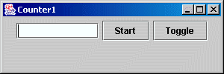
A Dysfunctional GUI
Here’s the outline:
public class Counter1 extends JApplet {
private int count = 0;
private boolean runFlag = true;
private JButton start = new JButton("Start"),
onOff = new JButton("Toggle");
private JTextField t = new JTextField(10);
public void init() { // set up the GUI }
public void go() { // do something when Start is clicked
// but stop doing it if Toggle is clicked
}
class StartL implements ActionListener {
public void actionPerformed(ActionEvent e) { go(); }
}
class OnOffL implements ActionListener {
public void actionPerformed(ActionEvent e) { runFlag = !runFlag; }
}
}

Slide 7
A Dysfunctional GUI
A JApplet subclass, with two buttons and a text field:
import javax.swing.*;
import java.awt.event.*;
import java.awt.*;
public class Counter1 extends JApplet {
private int count = 0;
private JButton
start = new JButton("Start"),
onOff = new JButton("Toggle");
private JTextField t = new JTextField(10);
private boolean runFlag = true;

Slide 8
A Dysfunctional GUI
Nested ActionListeners for the buttons:
class StartL implements ActionListener {
public void actionPerformed(ActionEvent e) {
go();
}
}
class OnOffL implements ActionListener {
public void actionPerformed(ActionEvent e) {
runFlag = !runFlag;
}
}

Slide 9
A Dysfunctional GUI
An init() method to setup the widgets:
public void init() {
Container cp = getContentPane();
cp.setLayout(new FlowLayout());
cp.add(t);
start.addActionListener(new StartL());
cp.add(start);
onOff.addActionListener(new OnOffL());
cp.add(onOff);
}

Slide 10
A Dysfunctional GUI
A go() method to do something:
public void go() {
while(true) {
try {
Thread.sleep(100);
} catch(InterruptedException e) {
System.out.println("Interrupted");
}
if (runFlag) {
t.setText(Integer.toString(count++));
System.out.println(Integer.toString(count));
}
}
}

Slide 11
A Dysfunctional GUI
This doesn’t work at all! Why?
When the Start button is clicked,
  The method go() is called.
  go() contains a while(true) loop, so go() is never exited.
  Control never gets back to the handler for the Toggle button.

Slide 12
A Better GUI With a Thread
Put the CPU-intensive activity inside a separate thread.
The GUI has its own thread, and control comes back to it from time to time (as determined by the Java runtime system).
Users interact with the GUI, and it responds in what seems like real time.
(Demo Counter2 now)

Slide 13
A Better GUI With a Thread
public class Counter2 extends JApplet {
private class SeparateSubTask extends Thread {
private int count = 0;
private boolean runFlag = true;
SeparateSubTask() { start(); }
void invertFlag() { runFlag = !runFlag; }
public void run() {
while (true) {
try {
sleep(100);
} catch(InterruptedException e) {
System.out.println("Interrupted");
}
if (runFlag)
t.setText(Integer.toString(count++));
}
}
}

Slide 14
A Better GUI With a Thread
The Listeners have to change a little:
private SeparateSubTask sp = null;
class StartL implements ActionListener {
public void actionPerformed(ActionEvent e) {
if (sp == null)
sp = new SeparateSubTask();
}
}
class OnOffL implements ActionListener {
public void actionPerformed(ActionEvent e) {
if (sp != null)
sp.invertFlag();
}
}

Slide 15
A Better GUI With a Thread
The subtask runs in its own little thread, but the larger program still listens for user mouse clicks.
Thus mouse clicks on the Toggle button can effectively interrupt the program.

Slide 16
Java Database Connectivity
Studies suggest that half of all software development involves client/server operations.
Akhilesh disses UML because “most” applications revolve around databases.
Hmmm, database is a core course for MISM and MSIT.
Maybe we should be able to connect to a database??

Slide 17
Which DBMS Should We Use?
Following its “platform independent” nature, Java doesn’t say.
JDBC is supposed to be generic (not genetic!), so it supports standard SQL.
DBMS vendors (Oracle, IBM, etc) provide a driver for each product, and these drivers allow for product-specific “customizations”.
Insofar as possible, we should write “vanilla” Java code, so it’s portable.

Slide 18
The Basic Steps
We need:
  a database(duh!)
  a “database URL” that identifies the protocol and the database itself
  a driver for the protocol
  a Java Connection object to link our program to the database
Once this is accomplished, we can create a Statement object through which we execute queries.

Slide 19
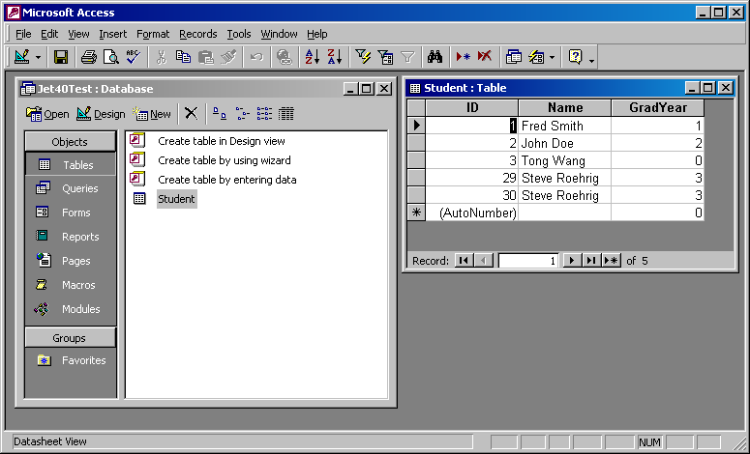
Seems Simple…And Is (Usually)
Here’s a trivial Access database:

Slide 20
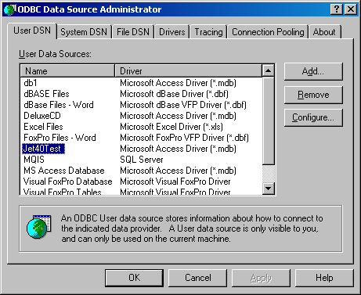
Registering the Database
The registered name is Jet40Test.
(If you don’t see 32-bit ODBC in your Windows Control Panel,
use Windows Help on ODBC, and click on the Data Sources link.)

Slide 21
Let’s Try It
import java.sql.*;
public class FirstDB {
public static void main(String[] args)
throws SQLException, ClassNotFoundException {
Class.forName("sun.jdbc.odbc.JdbcOdbcDriver");
String dbUrl = "jdbc:odbc:Jet40Test";
String user = "";
String password = "";
Connection c = DriverManager.getConnection(dbUrl, user, password);
Statement s = c.createStatement();
ResultSet r = s.executeQuery("SELECT ID, NAME FROM Student");
while (r.next()) {
System.out.println(r.getString("ID") + ", " + r.getString("NAME"));
}
s.close();
}
}

Slide 22
Some Comments
SQLExceptions may be thrown if the driver can’t be found.
The “JDBC-ODBC bridge driver” is explicitly loaded by the statement
Class.forName("sun.jdbc.odbc.JdbcOdbcDriver");
and this registers the driver with Java’s driver manager.
The driver manager is supposed to load all the right drivers, but if you don’t use the Class.forName statement, you get exceptions.
Ways of telling the driver manager what to load are given in the DriverManager documentation.

Slide 23
More Comments
Once the JDBC driver is loaded, the form of the URL is determined. For our driver, and this example, it is
  String dbUrl = "jdbc:odbc:Jet40Test";
If the database were somewhere across a network, then the URL would be more complicated…
The little Access database doesn’t require a user name or password, so these are blank Strings.
Finally, the DriverManager is called to get a Connection object, through which all the work is done.

Slide 24
The Connection Interface
Representative methods include:
  Statement createStatement()
  String getCatalog()
  DatabaseMetaData getMetaData()
  void rollback()
  void commit()
  void close()
Danger! commit() is automatic after each Statement is executed, unless you explicitly disable it (with setAutoCommit(false)).

Slide 25
DatabaseMetaData
DatabaseMetaData md = c.getMetaData();
System.out.println(md.getNumericFunctions());
produces
ABS,ATAN,CEILING,COS,EXP,FLOOR,LOG,MOD,POWER,
RAND,ROUND,SIGN,SIN,SQRT,TAN

Slide 26
DatabaseMetaData (cont.)
getSQLKeywords() produces Access SQL keywords that aren’t SQL92 keywords.
That is, “extensions” to SQL92 that may not be usable by any other database product.

Slide 27
DatabaseMetaData (cont.)
System.out.println(md.getSQLKeywords());
produces
ALPHANUMERIC,AUTOINCREMENT,BINARY,BYTE,
COUNTER,CURRENCY,DATABASE,DATABASENAME,
DATETIME,DISALLOW,DISTINCTROW,DOUBLEFLOAT,
FLOAT4,FLOAT8,GENERAL,IEEEDOUBLE,IEEESINGLE,
IGNORE,INT,INTEGER1,INTEGER2,INTEGER4,LEVEL,
LOGICAL,LOGICAL1,LONG,LONGBINARY,LONGCHAR,
LONGTEXT,MEMO,MONEY,NOTE,NUMBER,
OLEOBJECT,OPTION,OWNERACCESS,PARAMETERS,
PERCENT,PIVOT,SHORT,SINGLE,SINGLEFLOAT,
SMALLINT,STDEV,STDEVP,STRING,TABLEID,TEXT,
TOP,TRANSFORM,UNSIGNEDBYTE,VALUES,VAR,
VARBINARY,VARP,YESNO

Slide 28
DatabaseMetaData (cont.)
Some of the DatabaseMetaData methods return a ResultSet, which can be examined in the usual way.
Access doesn’t support many of the metadata methods.
In particular, I couldn’t find a way to even list the table names or attribute names within a table. (Execute a query and ask the ResultSet.)

Slide 29
The ResultSet Interface
Maintains a cursor pointing to the current row.
next() moves the cursor to the next row, returning true if there is a next row, false if not.
getXXX() methods take either a column name or column number.

Slide 30
getXXX() Methods
getBoolean()
getBlob()
getByte()
getClob() (Character Large Object)
getDouble()
getObject()
etc. etc.

Slide 31
Scrollable ResultSets
Statement stmt = con.createStatement(
ResultSet.TYPE_SCROLL_INSENSITIVE,
ResultSet.CONCUR_UPDATABLE);
ResultSet rs = stmt.executeQuery("SELECT a, b FROM TABLE2");
// rs will be scrollable, will not show changes made by others,
// and will be updatable

Slide 32
Updating Rows
rs.absolute(5); // moves the cursor to the fifth row of rs
rs.updateString("NAME", "AINSWORTH"); // updates the
// NAME column of row 5 to be AINSWORTH
rs.updateRow(); // updates the row in the data source
rs.moveToInsertRow(); // moves cursor to the insert row
rs.updateString(1, "AINSWORTH"); // updates the
// first column of the insert row to be AINSWORTH
rs.updateInt(2,35); // updates the second column to be 35
rs.updateBoolean(3, true); // updates the third row to true
rs.insertRow();
rs.moveToCurrentRow();

Slide 33
Databases and Java’s Table
The Table class provides a “grid” interface that’s perfect for showing DB tables.
Typically we use the TableModel interface, which specifies (among others)
  getColumnCount()
  getRowCount()
  getValueAt(int, int)
  setValueAt(Object, int, int)

Slide 34
AbstractTableModel
Just like listener adapters, there is a “filled in” version of TableModel: AbstractTableModel.
This provides do-nothing method implementations for all except
  getRowCount()
  getColumnCount()
  getValueAt(int, int)

Slide 35
Table and TableModel
A Table can be created by calling the constructor that takes a TableModel as an argument.
The Table then knows how to set itself up with the right number of rows and columns.
This is remarkably easy; a great design!

Slide 36
TableModel In Action
class DataModel extends AbstractTableModel {
Connection c;
Statement s;
ResultSet r;
int rowCount;
public DataModel() throws SQLException, ClassNotFoundException {
Class.forName("sun.jdbc.odbc.JdbcOdbcDriver");
String dbUrl = "jdbc:odbc:Jet40Test";
c = DriverManager.getConnection(dbUrl, "", "");
s = c.createStatement(ResultSet.TYPE_SCROLL_INSENSITIVE,
ResultSet.CONCUR_READ_ONLY);
r = s.executeQuery("SELECT ID, NAME FROM Student");
r.last();
rowCount = r.getRow();
r.first();
}

Slide 37
TableModel In Action
public int getColumnCount() { return 2; }
public int getRowCount() { return rowCount; }
public Object getValueAt(int row, int col) {
String st = null;
try {
r.absolute(row+1);
st = r.getString(col+1);
}
catch(SQLException e){}
return st;
}
public boolean isCellEditable(int row, int col) {
return false;
}

Slide 38
Build An Applet
public class FirstDB extends JApplet {
public void init() {
Container cp = getContentPane();
JTable table = null;
try {
table = new JTable(new DataModel());
}
catch(SQLException e) {}
catch(ClassNotFoundException e) {}
cp.add(new JScrollPane(table));
}
public static void main(String[] args) {
Console.run(new FirstDB(), 350, 200);
}
}

Slide 39
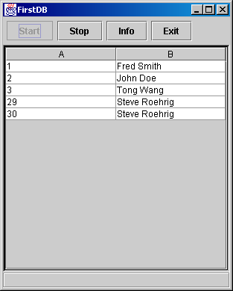
Here’s The Result

Slide 40
The 613th Slide
That’s all, folks!

