Slide 1
Object-Oriented Programming
95-712 C
Sakir YUCEL
MISM/MSIT
Carnegie Mellon University
Lecture: Applications, Applets & Swing
Slides adapted from Prof .Steven Roehrig

Slide 2
Today’s Topics
Applets
Applications
Swing

Slide 3
Applets
An applet is a little Java program that can run inside a Web browser.
It typically shows up inside a rectangular area (which may be transparent) on the browser screen.
Applets can include all the usual GUI components that we see in everyday life.
Applets can be distributed over the Web, giving folks anywhere the fruits of our programming labor.

Slide 4
Applet Restrictions
Security issues are important, since the provider of an applet may not be trustworthy.
Applets can’t touch your system resources (file system, OS, etc.), although some browsers give extra privileges to “trusted applets”.
Applets can be slow, since the whole thing must be downloaded each time it’s run.

Slide 5
Applications (My Definition)
An application is a stand-alone program that runs locally.
Applications can use console I/O, or can have a GUI developed using the Java class library.
Applications have no system resource restrictions.

Slide 6
Java GUI Libraries
Originally, Abstract Windowing Toolkit (AWT).
Pretty bad, but workable.
More recently, Swing.
Very nice! Very O-O, easy to do simple things, scales fairly well to do more complex things.
Caution: to use the Swing components on the Web, a browser needs a current plug-in
See http://java.sun.com/j2se/1.4.2/download.html

Slide 7
Development Frameworks
Some library classes are designed for use “as-is” (e.g., the collection classes).
Other classes are intended to be reused through subclassing.
A development framework is a set of classes that provide basic behavior for an application or applet.
To use a framework, you write subclasses that specialize the framework classes’ behavior.

Slide 8
JApplet
The basic applet class, providing methods for creation and execution in a Web page.
  init(): automatically called to do initialization and layout
  start(): called each time the applet “comes in sight” in the browser
  stop(): called each time the applet “goes out of sight” in the browser
  destroy(): called when the applet is unloaded

Slide 9
A Simple Applet
import javax.swing.*;
import java.awt.*;
public class BabyApplet extends JApplet {
public void init() {
Container cp = getContentPane(); // a JApplet method
cp.add(new JLabel(“Hello Applet”));
}
}

Slide 10
A Simple .html File
Put this in a file named BabyApplet.html
<applet code="BabyApplet.class" width=300 height=300
</applet>

Slide 11
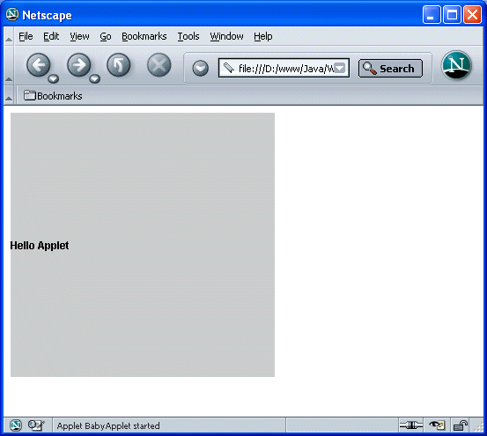
View It in a Web Browser

Slide 12
Applet Notes
Applets don’t write a main() method.
The init() method is called automatically.
To view in a browser, use the <applet> command in an HTML file.
appletviewer can also be used. It just looks for the applet tag, and ignores the rest of the page.

Slide 13
The Applet Tag
In “the good old days” we would write
  <applet code=“BabyApplet.class” width=300 height=300
  </applet>
Then Microsoft got into the act, and then we had to write about 20 lines of obscure stuff.
Browsers often don’t support recent versions of Java, so it’s necessary to use “Java plugin”
With the plugin, we can again write simply <applet code=“BabyApplet.class” width=300 height=300
  </applet>

Slide 14
Other Ways To Run Applets
Write a main method that creates the applet, then puts it inside a JFrame, then calls init().
JFrame is (roughly) the “application” equivalent of JApplet.
Don’t forget to call setVisible(), and arrange for the application to close!
See Horstmann & Cornell (p. 496) for all the details and discussion.

Slide 15
Let’s Make Some Buttons
import javax.swing.*;
import java.awt.*;
public class Button1 extends JApplet {
JButton b1 = new JButton("Button1");
JButton b2 = new JButton("Button2");
public void init() {
Container cp = getContentPane();
cp.setLayout(new FlowLayout());
cp.add(b1);
cp.add(b2);
}
}

Slide 16
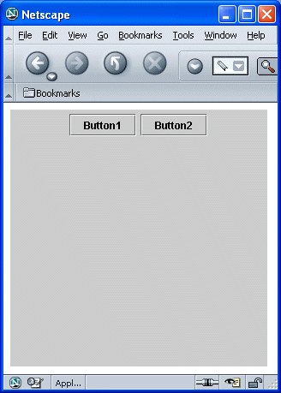
Here’s What We Get

Slide 17
Layout Classes
In the Button example, a FlowLayout was used, so that the buttons would “flow” from left to right in the applet window.
There are many other layout classes.
They can be very confusing!

Slide 18
Layout Classes (cont.)
The reason for the complexity is the goal that when an applet or application is resized, the GUI elements should retain their relative proportions.
This implies that trying to hardwire a button’s location is a bad thing to do.
The layout managers have the ability to resize individual components (buttons, text boxes, etc.) so the GUI looks the same at different sizes.

Slide 19
Layout Classes (cont.)
The main ones are
  BorderLayout
  FlowLayout
  GridLayout
  BoxLayout
  GridBagLayout
  CardLayout
  OverlayLayout
More about these later.

Slide 20
Layout Classes (cont.)
A common strategy for GUI construction is to form the app window as a nested set of containers, each with an appropriate layout manager:
BorderLayout
GridLayout
FlowLayout

Slide 21
Layout Classes (cont.)
This can be very tedious!
For any serious GUI design, use a GUI builder app.
JBuilder is one.
Together 6 has a GUI builder.

Slide 22
Back to the Buttons
You click `em and they don’t do anything!
Well, what should they do? Java doesn’t know!
Capture the event that a button has been clicked, and write code to carry out the reaction.
Any Swing component (like JButton) can report any or all the things that happen to it.
You express your interest (or not) by writing event handlers (or not).
An extended button example is this. (Demonstration--ButtonTest)

Slide 23
Buttons That Do Something
public class ShowButtons extends JApplet {
JButton
b1 = new JButton("Button1"),
b2 = new JButton("Button2");
JTextField txt = new JTextField(10);
class BL implements ActionListener {
public void actionPerformed(ActionEvent e) {
String name = ((JButton)e.getSource()).getText();
txt.setText(name);
}
}
BL al = new BL();

Slide 24
Buttons That Do Something
public void init() {
b1.addActionListener(al);
b2.addActionListener(al);
Container cp = getContentPane();
cp.setLayout(new FlowLayout());
cp.add(b1);
cp.add(b2);
cp.add(txt);
}
}

Slide 25
The Swing Event Model
Swing components can “fire” different kinds of events.
Each type of event is represented by a distinct class.
When an event is fired, it is received by any listener that has “signed up” to respond to the event, by implementing the associated listener interface.
The listener can be most anywhere (e.g., Button2 could listen for events fired by Button1).
This “separates interface from implementation” (here interface means GUI interface!).

Slide 26
Various Kinds of EventListeners
ActionListener
ChangeListener
DragSourceListener
KeyListener
MouseListener
TreeSelectionListener
VetoableChangeListener
Etc…..

Slide 27
Stupid Pet Tricks
We can make Button1 change its text when the mouse passes over it.
Use an event handler for a MouseEvent.
The handler implements the MouseListener interface.
A button (or anything else) can have many listeners attached to it. (Demonstration--ButtonEnterExit)

Slide 28
Example
class ML implements MouseListener {
public void mouseClicked(MouseEvent e) {}
public void mouseEntered(MouseEvent e) {
b1.setText(“Lose $100");
}
public void mouseExited(MouseEvent e) {
b1.setText(“Win $100");
}
public void mousePressed(MouseEvent e) {}
public void mouseReleased(MouseEvent e) {}
}
BL al = new BL();
ML ml = new ML();
public void init() {
b1.addActionListener(al);
b2.addActionListener(al);
b1.addMouseListener(ml);

Slide 29
MouseListener
This interface has five methods, all of which must be defined. Tedious, especially since we don’t care about many of them.
Solution: use the corresponding Adapter, called MouseAdaptor.
This is an abstract class, with null methods.

Slide 30
Using MouseAdapter Instead
class ML extends MouseAdapter {
public void mouseEntered(MouseEvent e) {
b1.setText(“Lose $100");
}
public void mouseExited(MouseEvent e) {
b1.setText(“Win $100");
}
}

Slide 31
TextAreas and Scrollers
A TextArea is just what it seems: a chunk of real estate that knows how to display text.
We specify the number of rows and columns it is supposed to hold.
These numbers determine its size in an app.
If we think the actual text (imported at run-time, perhaps) may be too big, we can wrap the TextArea inside a JScrollPane.

Slide 32
TextAreas and Scrollers
public class ReadFile extends JApplet {
JTextArea t = new JTextArea(15, 40);
BufferedReader in;
public void init() {
String line;
try {
in = new BufferedReader(new FileReader("ReadFile.java"));
while((line = in.readLine()) != null) {
t.append(line);
t.append("\n");
}
}
catch(Exception e){System.err.println("Error reading file");}
Container cp = getContentPane();
cp.setLayout(new FlowLayout());
cp.add(new JScrollPane(t));
}
}

Slide 33
Dialog Boxes
The Swing class JOptionPane has a number of “stock” dialogs for
  alerting
  informing
  getting a yes/no answer
  getting a user to choose between several named options
  enter a text string
  etc.
You can create custom dialog boxes as well, using JDialog

Slide 34
Stupid Dialog Tricks
public class AreYouSure extends JApplet {
JButton b = new JButton("Quit");
String beginMessage = new String("Are you");
String midMessage = new String();
String endMessage = new String(" sure you want to quit?");
String message;
// add ActionListener here (next slide)
BL al = new BL();
public void init() {
b.addActionListener(al);
Container cp = getContentPane();
cp.setLayout(new FlowLayout());
cp.add(b);
}
}

Slide 35
The ActionListener
class BL implements ActionListener {
public void actionPerformed(ActionEvent e) {
message = beginMessage + endMessage;
int i = JOptionPane.YES_OPTION;
while (i != JOptionPane.NO_OPTION) {
i = JOptionPane.showConfirmDialog(null,
message, "Choose one",
JOptionPane.YES_NO_OPTION);
midMessage += " really";
message = beginMessage + midMessage + endMessage;
}
midMessage = "";
}
}

Slide 36
JOptionPane
The general form is
JOptionPane.showXXX(parent, message,
title, optionType,
messageType)
where XXX is
  ConfirmDialog
  InputDialog
  MessageDialog
  OptionDialog

Slide 37
The Basic Window Classes
JApplet- a small program not intended to be run on its own.
JFrame- a top-level window with a title and border.
JWindow- like a JFrame, with no title or border.
JDialog- starter class for building dialogs.

Slide 38
The Basic Window Classes
Each of these holds a Container, which you get with getContentPane().
A container has a method setLayout(), letting you choose which layout you want. BorderLayout() is the default.
A Container holds Components (aka widgets) and/or other Containers.
A JPanel is an often-used standard lightweight Container.

