Slide 1
Object-Oriented Programming
95-712 C
Sakir YUCEL
MISM/MSIT
Carnegie Mellon University
Lecture 1: Introduction to OOP
Slides adapted from Steven Roehrig

Slide 2
Expected Background
“A one-semester college course in programming.” (MISM admissions policy)
I assume you can write a program in some language, understand variables, control structures, functions/subroutines.
If in doubt, let’s talk.

Slide 3
Course Outline
Week 1: Background, basics of O-O, first Java program, programming environments
Week 2: Raw materials: types, variables, operators, program control
Week 3: Classes: declarations, constructors, cleanup & garbage collection
Week 4: Packages, access specifiers, finals, class loading

Slide 4
Course Outline (cont.)
Week 5: Polymorphism, abstract classes, design patterns
Week 6: Interfaces & extends, inner classes, callbacks via inner classes
Week 7: Applets, Applications, Swing
Week 8: Graphics and Multimedia
Week 9: Arrays, container classes, iterators

Slide 5
Course Outline (cont.)
Week 10: Exception handling, threads
Week 11: Java I/O, networking
Week 12: JDBC and object persistency

Slide 6
Administrative Details
Professor: Sakir Yucel
Office: Hamburg Hall, 3021
Office Hours: Wed 4:45pm-5:15pm, 8:30-9:00, or by appointment
Email: syucel@andrew.cmu.edu
Course Web sites
  www.andrew.cmu.edu/~syucel/Java
  www.cmu.edu/blackboard
Blackboard points to the real Web site.
Blackboard used for grades, discussion board.

Slide 7
Administrative Details (cont.)
Our teaching assistant is
  Karen Chen
She will be setting up times for office hours shortly

Slide 8
Administrative Details (cont.)
Required Text: Horstmann & Cornell, “Core Java, Volume 1 - Fundamentals,” Sun Microsystems Press
Additional Online Texts:
  The Java Tutorial http://java.sun.com/docs/books/tutorial/
  Thinking in Java by Bruce Eckel http://mindview.net/Books/TIJ/

Slide 9
Administrative Details (cont.)
14 weeks
Two consecutive 80-minute lectures per week, a break in between the lectures.
Course notes in PowerPoint or HTML.
Course notes available (usually) Tuesday before class.
Send course questions to Blackboard’s Discussion Group, personal questions to me.

Slide 10
Administrative Details (cont.)
Midterm and final exams
Homework: 50%
Midterm exam 20%
Final exam: 30%
I will give one A+.

Slide 11
Administrative Details (cont.)
Everything is attached to the syllabus. Don’t look for assignments, etc. on Blackboard. Look at the syllabus!
Homework usually weekly.
Submission instructions with each assignment, usually printed listings and a zip file.
Printing slides? Three to a page, at least. Save a tree! Remove the PowerPoint background before printing. Save toner!

Slide 12
Administrative Details (cont.)
Attendance is not required, but…
…you are responsible for everything said in class.
I encourage you to ask questions in class. Don’t guess, ask a question!

Slide 13
My Policy on Cheating
Cheating means “submitting, without proper attribution, any computer code that is directly traceable to the computer code written by another person.”
I give students a failing course grade for any cheating. Expulsion is also possible.
This doesn’t help your job prospects.

Slide 14
My Policy on Cheating
You may discuss homework problems with classmates, after you have made a serious effort in trying the homework on your own.
You can use ideas from the literature (with proper citation).
You can use anything from the textbook/notes.
The code you submit must be written completely by you.

Slide 15
Even More On Cheating
“In addition to any penalties imposed by the instructor, including failing the course, all cheating and plagiarism infractions will be reported in writing to the Associate Dean for the program, the Associate Dean of Faculty, the Dean of Student Affairs, and the Dean. They will review and determine if expulsion should be recommended. The report will become part of the student’s permanent record.”

Slide 16
Course Etiquette
Etiquette is “conduct in polite society”
No cell phones
No random comings and goings
If you are sleepy, go home
If you want to read email or surf the Web, please do it elsewhere

Slide 17
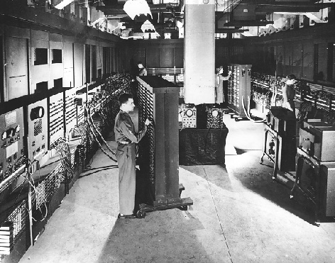

Slide 18
Programming Language Evolution
Machine language
Assembler
“3rd generation” (COBOL, FORTRAN, C)
Specialized (Lisp, Prolog, APL)
“4th generation” (SQL, spreadsheets, Mathematica)
“5th generation” (example, anyone?)

Slide 19
Why So Many Languages?
Bring the language “closer” to the problem.
But 4GLs are typically focused on specialized domains (e.g., relational databases).
We want a language that is general purpose, yet can easily be “tailored” to any domain.

Slide 20
Object-Oriented Languages
Smalltalk, C++, Java, etc…
You can make any kind of objects you want
How different from procedural languages?
  No different at all: Every (reasonable) language is “Turing complete”
  Very different: Make expression easier, less error-prone

Slide 21
O-O Languages (Alan Kay)
Everything is an object.
A program is a bunch of objects telling each other what to do, by sending messages.
Each object has its own memory, and is made up of other objects.
Every object has a type (class).
All objects of the same type can receive the same messages.

Slide 22
Making Java Work
It's “easy as pie” to write procedural code in Java.
It takes some discipline (an attitude) to think O-O.
It's worthwhile to do it.

Slide 23
Objects
An object has an interface, determined by its class.
A class is an abstract data type, or user-defined type.
Designing a class means defining its interface.

Slide 24
Built-In Types
Think of an int…
  What is its interface?
  How do you “send it messages”?
  How do you make one?
  Where does it go when you’re done with it?
In solving a computational problem, the goal is to
  Dream up useful classes, and
  Endow them with appropriate characteristics.

Slide 25
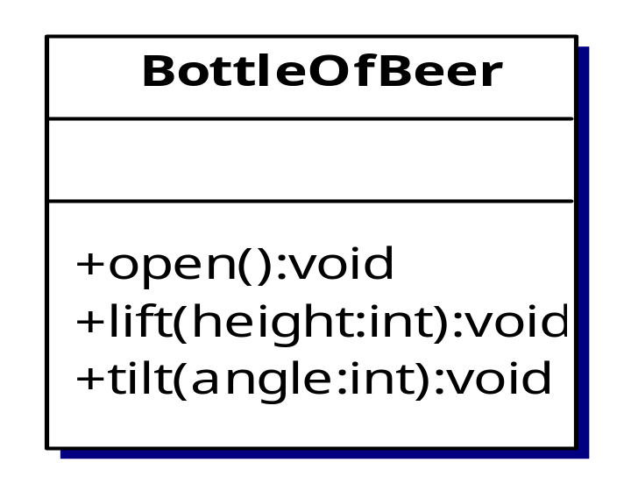
Example
Suppose I’ve defined this class in Java:
To make one, I type
BottleOfBeer myBeer = new BottleOfBeer();
If I want myBeer opened, I say
myBeer.open();

Slide 26
But Why Not Just…
BottleOfBeer myBeer;
This is legal, but just makes a “reference variable” named myBeer
This variable can refer to any BottleOfBeer object, but currently refers to nothing
The operator new actually causes an object to be created, so we tell it what kind we want

Slide 27
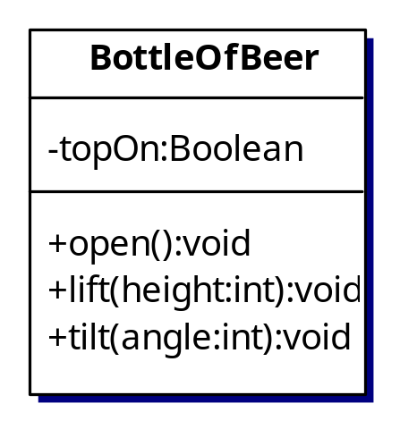
Designers Design, Users Use
The interface is the critical part, but the details (implementation) are important too.
Users use the interface (the “public part”); the implementation is hidden by “access control”.

Slide 28
Objects vs. Procedural Libraries
C libraries are like this, sort of:
  The library designer invents a useful struct.
  Then she provides some useful functions for it.
  The user creates an instance of the struct, then applies library functions to it.
One big difference is that anyone can change any part of the struct. Booo, hsss!
Another difference is in initialization.

Slide 29
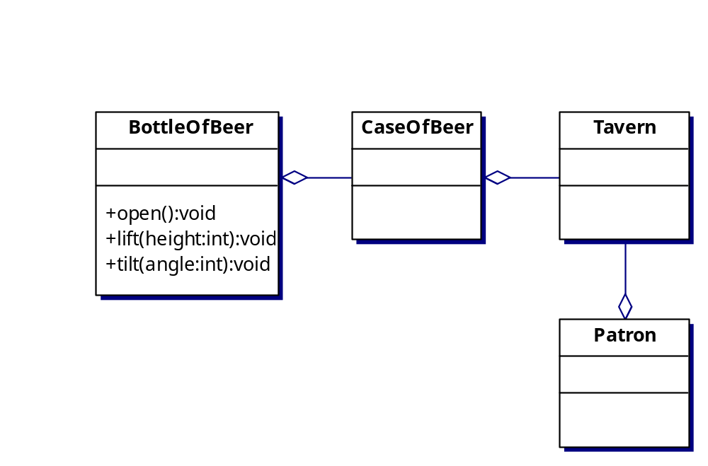
Two Ways of Reusing Classes
Composition: One class has another as a part (indicated by the diamond “aggregation” symbol).

Slide 30
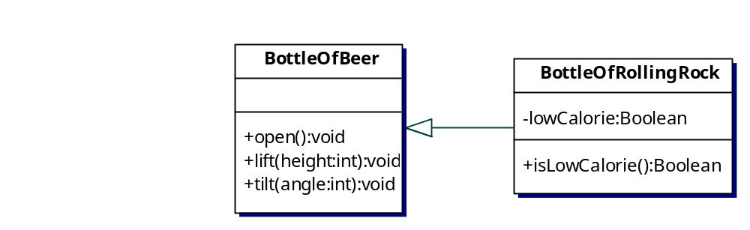
Two Ways of Reusing Classes
Inheritance: One class is a specialized version of another (indicated by the triangle “inheritance” symbol).

Slide 31
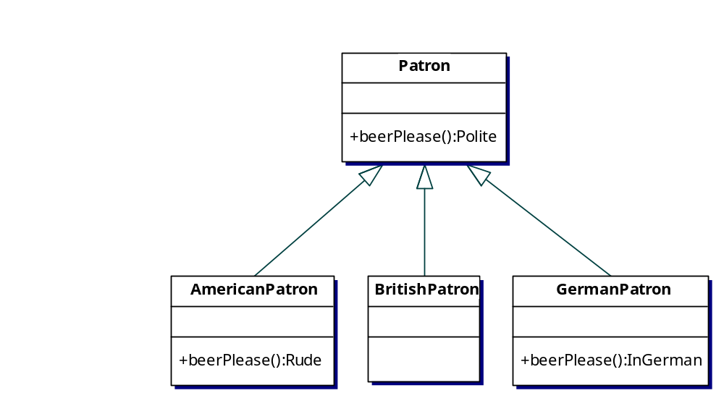
Polymorphism
Different subclasses respond to the same message, possibly with different actions.

Slide 32
Some Java Code
Patron p1 = new Patron();
Patron p2 = new YankPatron();
Patron p3 = new BritPatron();
Patron p4 = new GermanPatron();
p1.BeerPlease() // polite request
p2. BeerPlease() // rude request
p3.BeerPlease() // polite request
p4.BeerPlease() // request in German (but polite)
This is a bit of a trick: it requires late binding of the function call.

Slide 33
Creating Objects
We usually assume this is free; with built-in types like int or char, we just say
int i;
char c;
With user-defined types (the ones we make), we need to be explicit about what we want:
  constructor function
This is a very important issue!

Slide 34
Destroying Objects
If an object goes “out of scope,” it can no longer be used (its name is no longer known).
In C++, we might need to write an explicit function to free memory allocated to an object.
Java uses references and “garbage collection”.

Slide 35
Example of Object Scope
public String getTitle(int lectureNumber) {
LectureNotes lect;
lect = syllabus.getLecture(lectureNumber);
String s = lect.getLine(1);
return s;
}
What happens to lect?
The LectureNotes object still exists, but the reference lect disappears (it’s out of scope after return).
Eventually, the garbage collector removes the actual LectureNotes object.

Slide 36
A Simple Model of Memory
The reference variable lect
holds a memory location
The LectureNotes object
is at that location
0x1234
memory
22
C++ Versus Java\n…
When you “speak of” the variable lect, you are “referring to”
the actual LectureNotes object. When lect goes out of scope
it is automatically destroyed. The LectureNotes object lives
on, but nobody can use it…unless there are other references to it

Slide 37
Java’s Use of Memory
Stack
Heap
Static variables
Constants
Non-RAM storage

Slide 38
Java’s Primitive Types
Type | Size | Wrapper type
boolean | - | Boolean
char | 16-bit | Character
byte | 8-bit | Byte
short | 16-bit | Short
int | 32-bit | Integer
long | 64-bit | Long
float | 32-bit | Float
double | 64-bit | Double
void | - | Void

Slide 39
Wrapper Types
Variables of primitive types are “automatic”, i.e., they are stored on the stack.
They are automatically deleted when they go out of scope.
What if you want an object holding a primitive type? Example:
char c = ‘x’;
Character C = new Character(‘x’);

Slide 40
Really Big Numbers
BigInteger, BigDecimal
These are arbitrary precision, as big as they need to be.
You can’t use the usual operators (+-*/) since they are objects. But there are methods (functions) to do these things.

Slide 41
Creating New Types
class MyNewType {
// definition here
}
Now it’s legal to say
MyNewType m = new MyNewType();

Slide 42
Class Members
Fields (a.k.a. member variables, data members)
Methods (a.k.a. member functions)
class MyClass {
int a;
YourClass b;
float memberFunction(int x, float f) {
return 0;
}
}

Slide 43
Let’s Write Something
// Our first program. File: HelloDate.java
// Note that the file name is exactly the same
// as the class name, including capitalization.
import java.util.*;
public class HelloDate {
public static void main(String[] args) {
System.out.println(“Hello, it is ”);
System.out.println(new Date());
}
}

Slide 44
The Major Issues
Editing
  Use any text editor you like (not a word processor!); save as HelloDate.java
Compiling
  From a DOS or UNIX command line, type
  > javac HelloDate.java
  This should produce the file HelloDate.class
Running
  Again from the command prompt, type
  > java HelloDate

Slide 45
Getting the Java Documentation
Point your browser to
http://java.sun.com/docs/index.html
Download version 1.4.2 of the J2SE API
Bookmark the file so you can always get to it easily
Or, just bookmark the index page on Sun’s Java Web site

