Slide 1
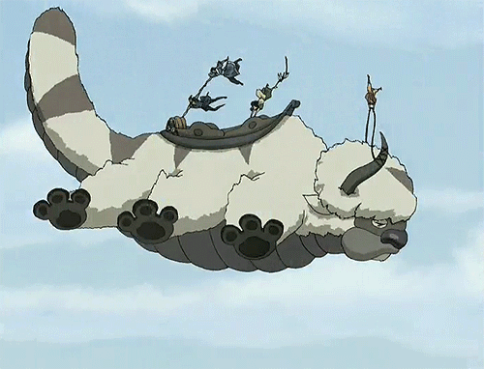
Team Flying Bison
Jamie Zimmerman
Brian Leeson
Amie Corso

Slide 2
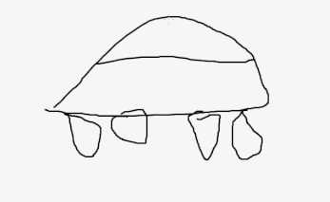
MVP

Slide 3


1) Data collection and processing
Determine relevant data fields
  Programming language experience
  Schedule availability
  Mutual requests
Create method for gathering data from students
  Google survey
Process data (CSV) and store data in object-oriented structure

Slide 4
2) Object-oriented data storage
Class Object
  Team Objects
    Student Objects
      Attribute
      Attribute
      ……
Intermediate Steps:
Small set of data fields
Basic methods only
(no algorithm-related methods)

Slide 5
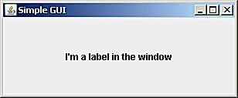
MVP
1) Data collection
2) Data storage
3) User interface

Slide 6
3) User Interface
Very simple GUI
Ability to:
  - Import CSV file
  Initiate sorting algorithm
  Display team results
Wish list:
Manual sort override option
User re-weighting of criteria
Intermediate Steps:
Arbitrary team creation
(no intelligent algorithm)
- Display of results

Slide 7

MVP
1) Data collection
2) Data storage
3) User interface
4) Algorithm

Slide 8
4) Sorting Algorithm
Simple logic initially
Focus on satisfying strict requirements:
  For example, must have some overlapping programming languages
  Must have some overlapping time slots
Take requests into account
Computational complexity??

Slide 9
4) Sorting Algorithm
Wish list:
More optimal as opposed to acceptable
Inclusion of more data fields
Option for user to adjust relative weights of importance
Option for manual override of sort
(drag and drop)

Slide 10
MVP
1) Data collection
2) Data storage
3) User interface
4) Algorithm

