Slide 1

CS 620
Final Project:
Fake News Detection
Template by Slidesgo
Briana Johnson & Nick Carpenter

Slide 2
Table of contents
01
02
Introduction
Libraries and Preprocessing
03
04
05
Model Building
Results
BONUS!
Problem, Purpose, and Data Description
Workflow for Getting Started
3 ML Models for Fake News Detection
Performance of Classifiers and Visuals
Real-Time News Article Prediction and Final Conclusions
Notes:
*NOT SPEAKER NOTES*:
Section 01- 3 slides -Briana
Section 02- 6 slides (12 after transitions) -Nick for 3 then Briana for Workflow Summary
Section 03- 2 slides -Nick
Section 04- 2 slides -Briana
Section 05- 4 slides -Nick

Slide 3
01
Introduction
Problem, Purpose, and Data Description

Slide 4


What is the problem?
Social media fosters an environment for many sources of live news, which can go unverified:
Twitter/X
Facebook
Instagram
Tik Tok
In a world full of misinformation, how can we evaluate if the news we’re reading is true or fake?
Notes:
Social media (e.g., Twitter/X and Facebook) has become a new ecosystem for spreading news.
Unfortunately, social media is full of fake news since most social media posts can spread unverified information.
Fake news refers to fabricated or misleading information that is intentionally and verifiably false but presented as factual news to deceive readers
Fake news is often motivated by chasing personal or organizational profits.

Slide 5

What is the purpose?
Fake news detection helps determine truthfulness of news by analyzing the content and related information.
This project aimed to:
Build fake news classifiers
Analyze their accuracy
The main objective of the project is to build and compare classification models that best detects news validity.
Notes:
Detection determining the truthfulness of the news is done by analyzing the news contents and related information such as propagation patterns.
It attracts a lot of attention to resolve this problem from different aspects, where supervised learning based fake news detection dominates this domain.
The goal of this team project is to build classifiers via the three machine Learning Methods of support vector machine (SVM), Random Forest, and Logistic Regression, and compare their performance.

Slide 6
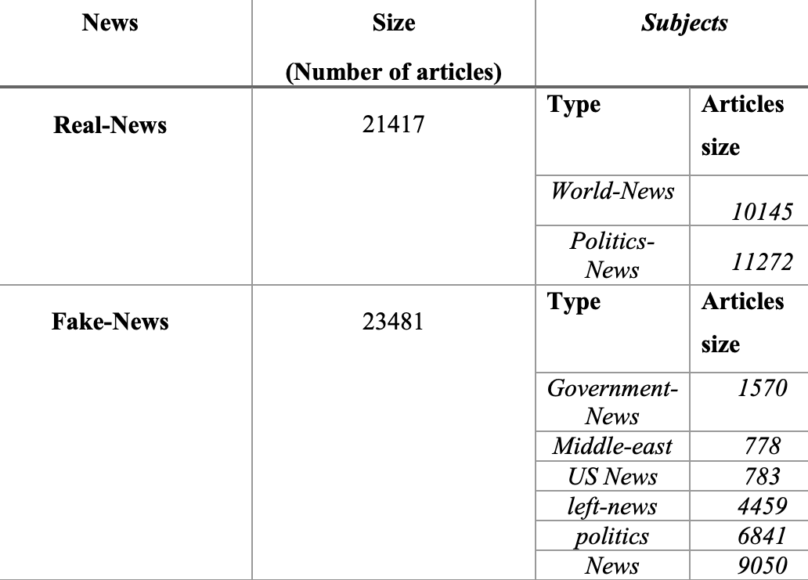
What is the data?
Two CSV Files
Downloaded from Kaggle
ISOT Fake News Dataset.
Each file has more than 12,600 articles collected from 2016 to 2017:
True.csv
Fake.csv
Article information in the datasets:
Title
Text
Type
Date (of publication)
Notes:
About the Data
The dataset contains two CSV files of articles containing real and fake news.
The first file named “True.csv” contains more than 12,600 articles from reuter.com.
The second file named “Fake.csv” contains more than 12,600 articles from different fake news outlet resources that were flagged by Politifact (a fact-checking organization in the USA) and Wikipedia
Each article contains the following information: article title, text, type and the date the article was published on.
To match the fake news data collected for kaggle.com, articles were mostly collected from 2016 to 2017.
The data collected were cleaned and processed, however, the punctuations and mistakes that existed in the fake news were kept in the text.

Slide 7
Libraries and Preprocessing
02
Workflow for Getting Started
Notes:
The following slide aim to review the work flow and overview the necessary libraries to complete the model used.

Slide 8
Required Packages
Installs
Data & Visualization
Machine Learning with Scikit-learn
Text Preprocessing & Scraping Tools
Notes:
There were various packages needed to complete this project as listed. Each served an important purpose in the completion of the detection models.

Slide 9
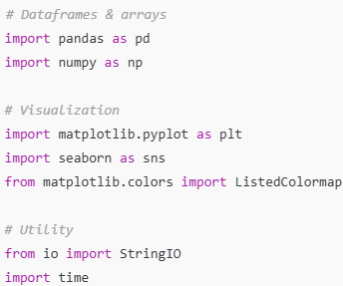
Data Handling & Visualization
“CTRL”
Used for reading, cleaning, manipulating, structuring, and visualizing data/ results.
Notes:
To start, we used standard Python libraries for data handling and visualization.
Pandas and NumPy were crucial for loading and organizing the data. Pandas helped us manipulate tabular data, while NumPy handled arrays and numerical operations.
For visualizations, we used Matplotlib and Seaborn to plot accuracy scores, confusion matrices, and training time comparisons. These visuals helped us evaluate model performance.
We also imported utility tools like StringIO for reading in text-based content, and time to measure how long our models took to train.
Overall, this group of libraries helped us clean, structure, and visually interpret our data.

Slide 10
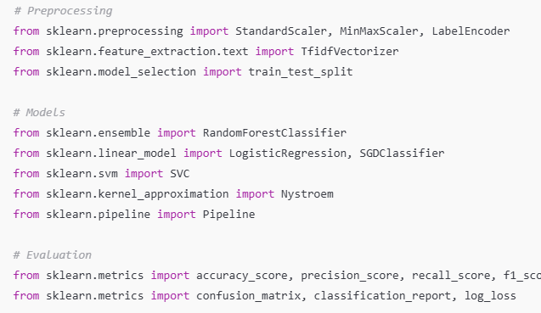
Machine learning with Scikit-learn
“CTRL”
Used to build models, and evaluate performance.
3 Sklearn ML models used and compared:
Random Forest
Logistic Regression
Support Vector Machines (SVM)
Notes:
Next, we used Scikit-learn to build and evaluate our machine learning models.
For modeling, we trained Random Forest, Logistic Regression, and Support Vector Machines (SVM).
The metrics module gave us accuracy, precision, recall, F1 scores, and confusion matrices — all critical for evaluating how well each model performed on test data.
These tools made it easy to implement, train, and evaluate traditional ML models before we moved on to the GPU-accelerated versions.

Slide 11
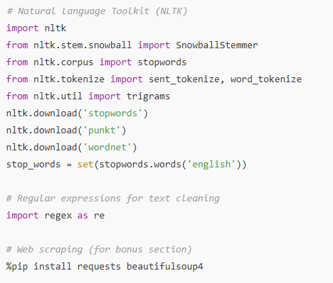
Text Processing & Web Scraping
“CTRL”
Used to preprocess text, clean and prepare natural language text, and retrieve online content.
Main Text preprocessing:
Remove missing values
Stemming
Remove stop words
Split into training and test data (0.2 ratio)
Extract features with TF-IDF to build samples
Notes:
Since we were working with news articles in raw text format, we had to preprocess that text for machine learning.
Under preprocessing, we used Term Frequency — Inverse Document Frequency (TF-IDF) vectorization to convert news articles into numerical features. We also used scalers and encoders, though not all were required in this specific project.
NLTK, the Natural Language Toolkit, was used for removing stop words, applying stemming, and tokenizing text. This step cleaned and standardized the language so our models could focus on meaningful patterns.

Slide 12
Text Processing & Web Scraping
“CTRL”
Used to preprocess text, clean and prepare natural language text, and retrieve online content.
Notes:
We also used regular expressions with the regex library to strip out punctuation, numbers, and special characters.
For our bonus section — where we tested the model on live news articles — we installed Requests and BeautifulSoup to scrape article text directly from URLs.
This group of tools ensured our input data was clean, consistent, and usable for both training and real-time predictions.

Slide 13
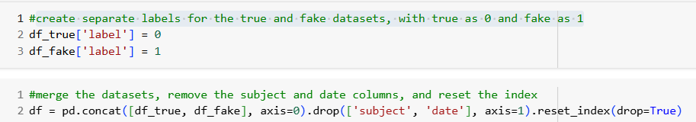
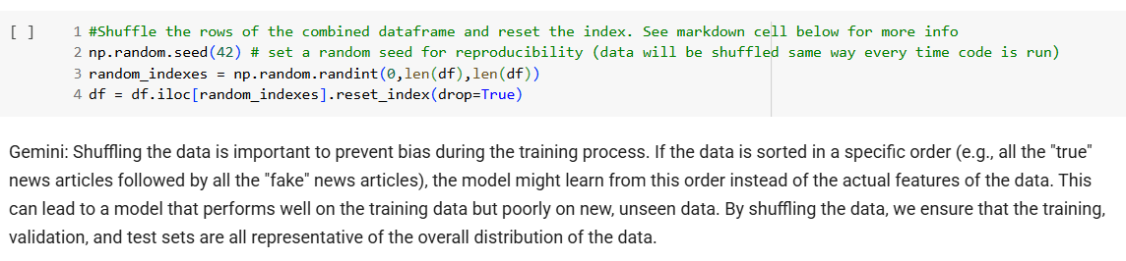
Workflow Summary
01
Load & Merge Data
Notes:
To summarize our library use and preprocessing steps:
We started by loading real and fake news datasets, and removing any missing values.
After labeling the true data as 0 and fake data as 1, the datasets were merged with pandas
We also merged the title and body text columns into a combined text column.
All unneeded columns were dropped, then we shuffled all of the data with a reproducible random seed.

Slide 14
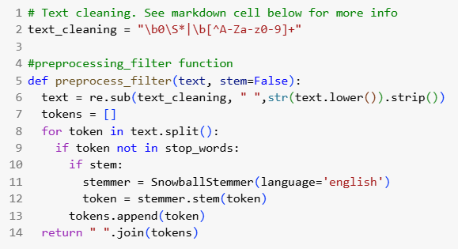
Workflow Summary
01
02
Load & Merge Data
Clean & Preprocess Text
Notes:
2. Then, we cleaned the text — applying stemming, stripping out stop words, and removing non-alphanumeric characters using NLTK and regex

Slide 15
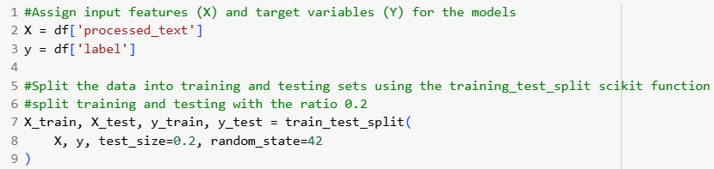
Workflow Summary
01
02
03
Split into Train/ Test Sets (0.2 ratio)
Load & Merge Data
Clean & Preprocess Text
Notes:
3. We then split the data into training and testing sets using an 80/20 ratio.

Slide 16
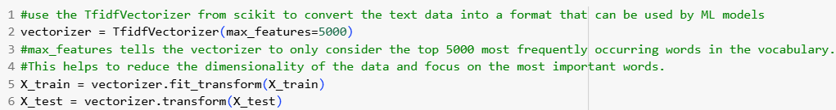
Workflow Summary
01
02
03
04
Split into Train/ Test Sets (0.2 ratio)
Transform with TF-IDF
Load & Merge Data
Clean & Preprocess Text
Notes:
4. Next, we used TF-IDF vectorization to convert the training and test text data into numerical features that machine learning models can interpret.
TF-IDF measures how important a word is across documents

Slide 17
Workflow Summary
01
02
03
04
Split into Train/ Test Sets (0.2 ratio)
Transform with TF-IDF
Load & Merge Data
Clean & Preprocess Text
05
Train 3 ML Models (sklearn)
Notes:
5. After that, we trained the three machine learning models from Scikit-learn

Slide 18
Workflow Summary
01
02
03
04
Split into Train/ Test Sets (0.2 ratio)
Transform with TF-IDF
Load & Merge Data
Clean & Preprocess Text
05
06
Train 3 ML Models (sklearn)
Evaluate & Visualize Results
Notes:
6. We evaluated each model by recording training time and accuracy, and visualized performance using Matplotlib.

Slide 19
Workflow Summary
01
02
03
04
Split into Train/ Test Sets (0.2 ratio)
Transform with TF-IDF
Load & Merge Data
Clean & Preprocess Text
05
06
07
Train 3 ML Models (sklearn)
Evaluate & Visualize Results
(Bonus) Predict Fake/ True News from Live URLS using Trained Models
Notes:
7. Lastly, as a bonus feature, we added functionality to predict fake or real news from live article URLs using web scraping and our trained models.
This end-to-end workflow highlights how preprocessing, model training, and evaluation are all supported by our selected Python libraries.

Slide 20
03
Model Building
3 ML Models for Fake News Detection

Slide 21
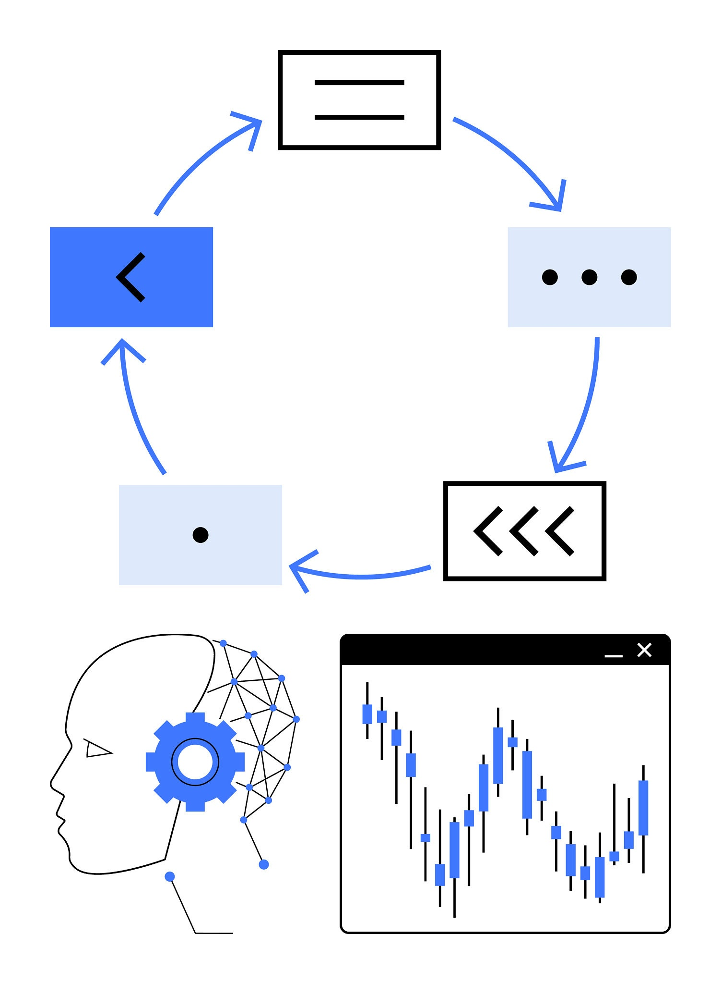

Overview of Model Building & Training
3 ML models built & trained:
Random Forest (100 estimators)
Logistic Regression (1000 max iterations)
Support Vector Machines (SVM) (linear kernel)
Notes:
Here are the specific parameters we used for the three machine learning models we built and trained to compare their accuracy and efficiency.
These are text-based classification approaches.

Slide 22
Preprocessing for Modeling
Combined title + text columns -> combined_text
Applied:
Lowercasing
Stop word removal (NLTK)
Stemming
Regular Expression
Transformed with TfidVectorizer (top 5,000 features)
80/20 train-split
Notes:
*SKIPPED TO SAVE TIME* (content gone over already)
Before training our models, we cleaned the news articles by removing stop words, applying stemming, and stripping out non-alphabetic characters.
We then transformed the cleaned text into numerical features using TF-IDF, which measures how important a word is across documents.
Finally, we split the data into training and testing sets using an 80/20 ratio.

Slide 23
Model Evaluation with Scikit-learn
3 ML models were trained on TF-IDF matrix. The results were evaluated with sklearn metrics:
Accuracy score
Classification report (Precision, Recall, F1-score, support)
Confusion matrix
Training time (seconds) was also reported.
Notes:
All models used the TF-IDF feature matrix of transformed train and test data as inputs
The results were evaluated using sklearn metrics of accuracy scores and classification reports.
We also generated confusion matrices to visualize true vs. false predictions.
Additionally, the training time (or the time each model takes to complete) was recorded.

Slide 24
Results
04
Performance of Classifiers and Visuals
Notes:
Finally, the results!

Slide 25
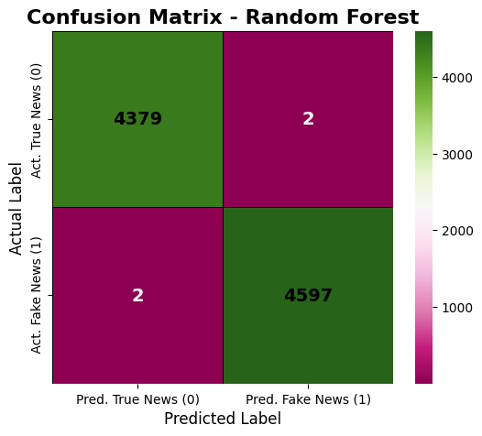
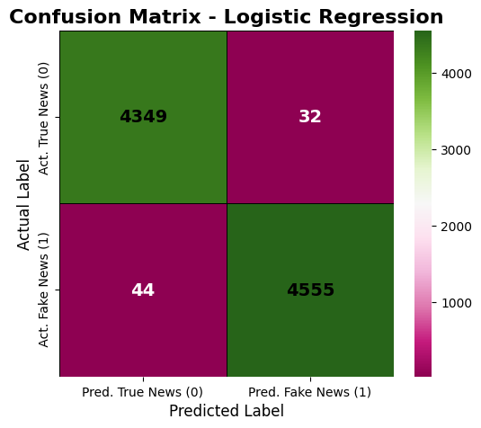
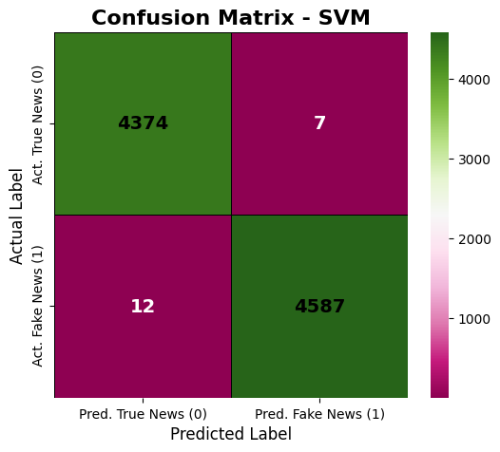
Model Performance Comparison
Model | Training Time | Accuracy | Precision | Recall | F1-Score
Random Forest | 63.27 seconds | 99.96% | 1.00 | 1.00 | 1.00
Logistic Regression | 0.82 seconds | 99.15% | 0.99 | 0.99 | 0.99
SVM | 433.77 seconds | 99.79% | 1.00 | 1.00 | 1.00
Notes:
This table summarizes how each of our three models performed.
Random Forest achieved the highest accuracy at 99.98%, with perfect precision, recall, and F1-score.
Logistic Regression was the fastest to train — under half a second — while still maintaining solid performance at 99.15% accuracy, but this was the lowest and had more labels confused.
SVM also performed well, but took significantly longer to train due to the computational cost of handling high-dimensional TF-IDF features.
Overall, all models had relatively good performance with trade-offs between speed and complexity.
Looking deeper into the classification reports:
Random Forest and SVM showed perfect or near-perfect classification — every true and fake article was labeled correctly.
Logistic Regression had slightly lower precision and recall, but still maintained a 99% F1-score.
There were no signs of class imbalance, and the consistent performance across metrics shows our preprocessing and feature engineering steps were effective.

Slide 26
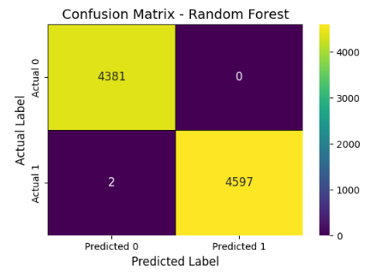
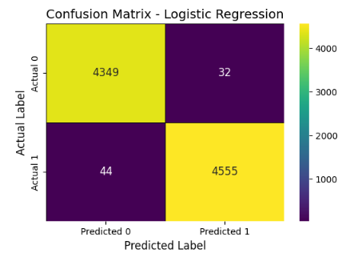
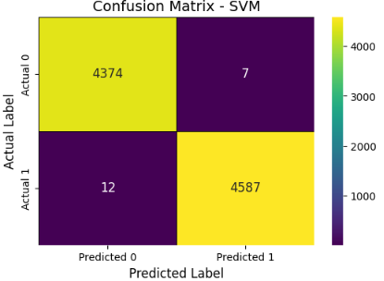
Model Performance Comparison
Model | Accuracy | Training Time | Precision | Recall | F1-Score
Random Forest | 99.98% | 66.62 Seconds | 1.00 | 1.00 | 1.00
Logistic Regression | 99.15% | 0.44 Seconds | 0.99 | 0.99 | 0.99
SVM | 99.79% | 423.33 Seconds | 1.00 | 1.00 | 1.00
Notes:
*SKIPPED TO SAVE ORIGINAL CONTENT* (previous slide the same just with updated visuals)
This table summarizes how each of our three models performed.
Random Forest achieved the highest accuracy at 99.98%, with perfect precision, recall, and F1-score.
Logistic Regression was the fastest to train — under half a second — while still maintaining solid performance at 99.15% accuracy.
SVM also performed well, but took significantly longer to train due to the computational cost of handling high-dimensional TF-IDF features.
Overall, all models performed at a high level, with trade-offs between speed and complexity.
Looking deeper into the classification reports:
Random Forest and SVM showed perfect or near-perfect classification — every true and fake article was labeled correctly.
Logistic Regression had slightly lower precision and recall, but still maintained a 99% F1-score.
There were no signs of class imbalance, and the consistent performance across metrics shows our preprocessing and feature engineering steps were effective.

Slide 27
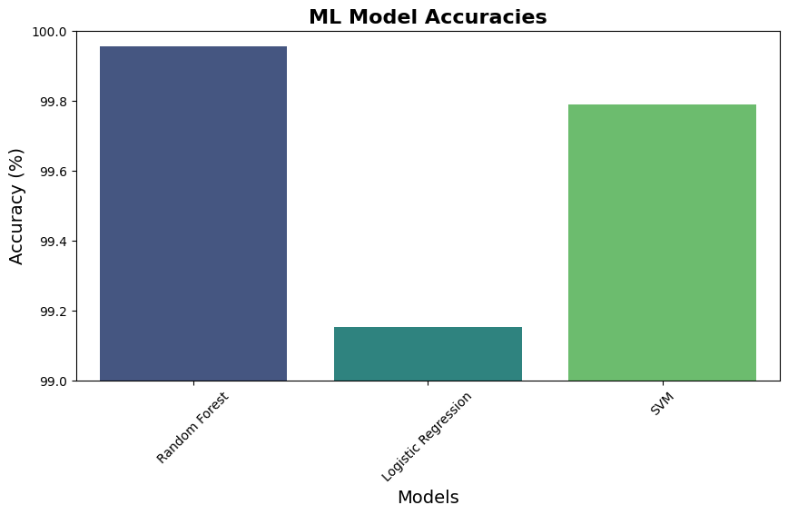
Model Accuracies
Notes:
*SKIPPED TO SAVE TIME*
Every model achieved an accuracy above 99%, showing that the preprocessing and feature extraction steps (especially TF-IDF) created highly separable data for classification.
At 99.98%, Random Forest slightly outperformed the others. This suggests strong generalization and robustness across the dataset.
At 99.15%, it's still very accurate and was by far the fastest model to train. This makes it ideal for lightweight or real-time applications.
With 99.79% accuracy, SVM was highly effective — but its much longer training time (shown on another slide) may be a limitation in larger-scale applications.
The accuracy differences between models are visually subtle, reinforcing that all three models were well-suited for this classification task.
Although all models performed similarly in terms of accuracy, additional factors like training speed, interpretability, and scalability can guide the choice of model in real-world deployment.

Slide 28
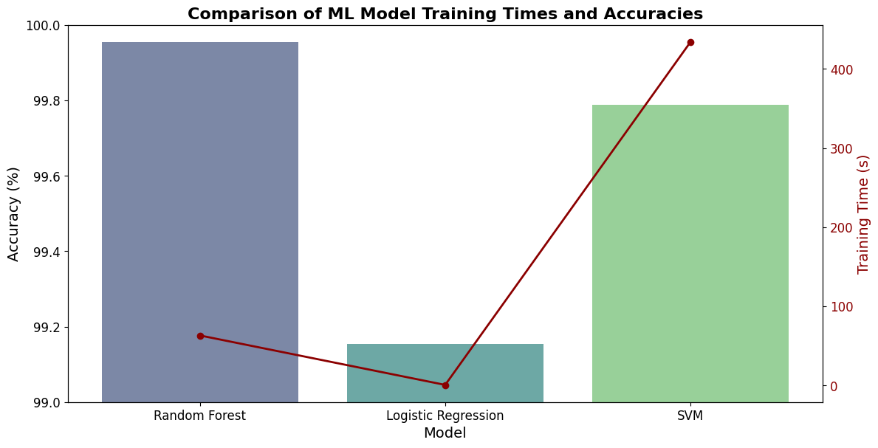
Training Time vs Accuracy Comparison
Notes:
Visuals
The bar height represents the accuracies in percent, with the different models in different colors. The dark red line represents the accuracy for the corresponding model.
The space between the point and the height of the bar highlights the trade-offs between speed and performance for each model
Random Forest balances speed and accuracy
It trained in about 63.27 seconds, which is significantly faster than SVM and had the highest accuracy at 99.96%. It offers a strong trade-off between performance and efficiency.
Logistic Regression is the fastest model by far
With a training time of just 0.82 seconds, Logistic Regression is ideal for time-sensitive or resource-constrained applications. While the accuracy was still over 99%, it was the least accurate with more confusions.
SVM is accurate - but the slowest
Although its accuracy was nearly perfect (99.79%), SVM took over 433 seconds to train, making it less practical for larger datasets or real-time training scenarios.
This combined plot clearly shows the trade-offs between training time and accuracy.
Random Forest offers the best balance — strong accuracy with reasonable training time.
Logistic Regression is extremely fast but has slightly lower accuracy.
SVM gives high accuracy but comes at a significant computational cost.
These insights help determine which model is most suitable depending on application needs — whether that's speed, accuracy, or a combination of both.

Slide 29
05
BONUS!
Real-Time News Article Prediction
Notes:
As a bonus, we created a function that lets users input a URL to a news article.
This demonstrates how the models can be deployed for real-world use beyond the static dataset

Slide 30
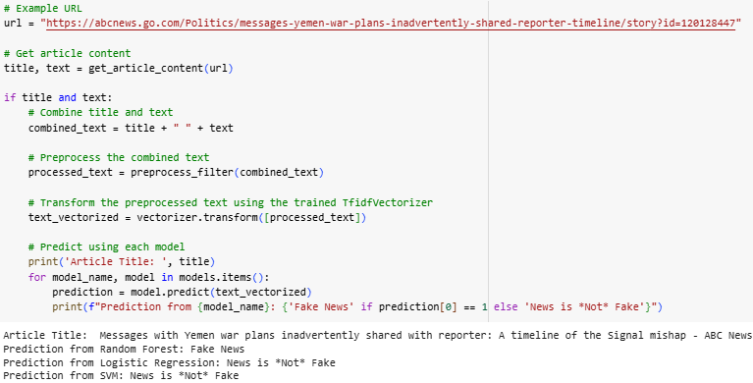
Bonus: Web Scraping & Test Prediction
Script uses the input of a url to an article to see what label (true, 0, or fake, 1) each ML model assigns to it
Notes:
In the notebook, we created a Python function that takes a news article URL as input.
The script scrapes the article's title and content, applies the same preprocessing steps, and then uses the same 3 trained models to predict whether the news is real or fake.
This function:
Fetched the HTML content of the article from the given URL.
Extracted the title and the main text of the article.
Combined the extracted title and text into a single string.
Preprocessed this combined text using the same preprocessing steps applied to the main dataset in the notebook.
Use the pre-trained machine learning models (already available in the notebook) to predict whether the news article is fake (1) or not fake (0).
Finally, displayed the prediction results from each model.
Some sample URLs to use...
"Fake" articles from 2016 (The Onion)
"True" articles (Reuters, which was used in the source dataset, gives a client retrieval error so these ones are articles on other websites with similar headlines also posted on Reuters)

Slide 31
Sample Input URLs
"Fake" articles from 2016 (The Onion):
"True" articles from 2025 (Reuters Alt. Sources)
"True" article from 2025 that may have sounded “fake” in 2016 (ABC News)
All 3 models give correct prediction of 0 (‘Fake News’)
( https://theonion.com/exxonmobil-ceo-relieved-it-finally-too-late-to-do-anyth-1819578782/ )
( https://theonion.com/clinton-campaign-treasurer-crushed-to-death-after-stack-1819578773/ )
( https://theonion.com/new-uber-update-allows-users-to-file-lawsuit-against-co-1819578934/ )
All 3 models give correct prediction of 1 (‘News is *Not* Fake’)
( https://www.yahoo.com/news/trump-sign-executive-order-fundamentally-170049685.html ) - same/ similar article posted on Reuters by Yahoo
( https://www.reuters.com/graphics/USA-TRUMP/PUBLIC-LANDS/zdpxkxdwnvx/ ) - Graphics Reuters articles don't give errors
Random Forest gives INCORRECT prediction of 0 (‘Fake News’)
( https://abcnews.go.com/Politics/messages-yemen-war-plans-inadvertently-shared-reporter-timeline/story?id=120128447 )
Notes:
A few sample urls are provided in the notebook. The sample fake urls are from “The Onion,” which is a popular satire website that creates joke content and is widely understood to contain fictional information.
If you input any of these onion article urls, all 3 models will indicate the content is “fake news”
We tried to get Reuters articles for the “true” url samples, but most Reuters urls will give a client retrieval error so two urls are articles on other websites with similar headlines also posted on Reuters
All 3 models will give correct result for the two alternative reuters urls
And a third url from abc news is provided as an example of a true news story that may “sound” fake.

Slide 32
Sample Input URLs
"True" article from 2025 that may have sounded “fake” in 2016 (ABC News)
Random Forest gives INCORRECT prediction of 0 (‘Fake News’)
( https://abcnews.go.com/Politics/messages-yemen-war-plans-inadvertently-shared-reporter-timeline/story?id=120128447 )
Notes:
Here is the result of using that ABC news article url.
Despite the story being “true,” the Random Forest model actually ended up labeling it incorrectly as fake news, while the other 2 models gave it the correct label

Slide 33
Final Conclusions
Over 99% accuracy
The Winner: Balance
Fastest
Achievements for all models!
Random Forest!
Logistic Regression
Notes:
To conclude, this project demonstrated how machine learning can be used effectively to detect fake news.
However, our bonus section may suggest that it can be important to update training data as politics and the news industry shifts over the years
All three models performed well, with Random Forest offering the best balance between speed and accuracy, but Logistic Regression being the fastest and nearly instantaneous.
Our preprocessing pipeline and TF-IDF transformation were essential to the models' success.
We also implemented a bonus feature that brings this functionality into a real-world use case by predicting fake or real news from any article URL.
Overall, our results show strong promise for deploying this system in practical scenarios — and there's room to grow it further with more complex features or larger datasets.

Slide 34
Thank you!
“Template By Slidesgo”
Please keep this slide for attribution

Slide 35
References
bagira22. (2022a, August 7). Newspaper with fake articles on mobile phone. Reader holds magnifying glass and found lie in the press. Consumer found fake news in newspaper. Social media with propaganda or hoax. - stock illustration. Getty Images. https://www.gettyimages.com/detail/illustration/newspaper-with-fake-articles-on-mobile-phone-royalty-free-illustration/1413106934
bagira22. (2022b, August 7). Newspaper with fake news. Red stamp - fake. Social media with propaganda or hoax. Cartoon design template. - stock illustration. Getty Images. https://www.gettyimages.com/detail/illustration/newspaper-with-fake-news-red-stamp-fake-royalty-free-illustration/1413390545
bagira22. (2022c, August 29). Fake news on mobile phone. Social media with propaganda or hoax.... Getty Images. https://www.gettyimages.com/detail/illustration/fake-news-on-mobile-phone-social-media-with-royalty-free-illustration/1419000505
Bozkus, E. (2022). Fake news detection datasets. Kaggle. https://www.kaggle.com/datasets/emineyetm/fake-news-detection-datasets/data
omaraymanatia. (2024, November 27). Fake news detection - NLP using NLTK. Kaggle. https://www.kaggle.com/code/omaraymanatia/fake-news-detection-nlp-using-nltk
robuart. (2025, May 22). Cycle of Artificial Intelligence with Human Head and Stock Market Analysis Chart in Blue Highlights - stock illustration. Getty Images. https://www.gettyimages.com/detail/illustration/cycle-of-artificial-intelligence-with-human-royalty-free-illustration/2216518596
satyamsss. (2024, February 21). Fake news prediction LSTM 97% accurate. Kaggle. https://www.kaggle.com/code/satyamsss/fake-news-prediction-lstm-97-accurate
sorbetto. (2020, August 9). Internet - Fake News - stock illustration. Getty Images. https://www.gettyimages.com/detail/illustration/internet-fake-news-royalty-free-illustration/1264479476
zimhadi1. (2023, October 4). Logestic_Reg, SVM, naive_bayes, random_forset. Kaggle. https://www.kaggle.com/code/zimhadi1/logestic-reg-svm-naive-bayes-random-forset

