Slide 1
CS 4102, Algorithms, Spring 2015
Tom Horton horton.uva@gmail.com
Mark Floryan
mfloryan@cs.virginia.edu
Course Mechanics
Course content
Topics from earlier classes
CS4102 course learning objectives
What’s the course all about? A quick tour

Slide 2
Course introduction

Slide 3
General Info
See beginning of course memo for general information
Pre-requisites:
CS 2150 is absolutely required (with C- or better)
Math topics: proof by induction, proof by contradiction, exponents, logarithms, limits, simple differentiations (covered in APMA 1090 or MATH 1210 or MATH 1310)
Teaching Assistants
Graduates (3):
Ke Dou, John Lanchantin, Lingjie Zhang
Undergraduates (4)
Andi Yang, Sugandha Agrawal, Dasith Gunawardhana, Rachel Brown
Both will hold office hours, which will start next week
Locations and hours TBA
Also, we’ll use Piazza for questions
Post all questions about HW, topics, etc to Piazza NOT email to instructors!

Slide 4
Expectations
For a given week/unit, I will post:
The slides for that unit
Any proofs that we are doing in class so you can review them
This will allow us to:
Have more interesting class sessions than just lecturing
A more successful educational experience (better grades)
Let’s all live up to our expectations (the high ones)!

Slide 5
Expectations
Of you:
When asked, prepare for things in advance
Participate in class activities when asked
Act mature, professional.
Plan ahead.
Don’t take advantage. Follow the Honor Code. (See the BOCM.)
Of me:
Be fair, open, and considerate.
Seek and listen to your feedback.
Not to waste your time.
Be effective in letting you know how you’re doing

Slide 6
General Info
Required Textbook:
Introduction to Algorithms, 3rd edition, by Cormen, et. al.
Other references:
Your CS2150 textbook
Discrete Math textbook / references
Other readings may be assigned
We’ll see…

Slide 7
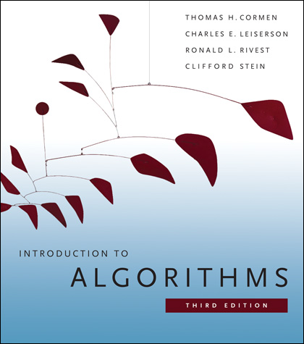
Textbook
Introduction to Algorithms by Cormen, et. al.
ISBN 0262033844
We will follow selected section of the textbook, but many lecture examples will not follow the textbook examples

Slide 8
Topics (not in order!) to be covered this semester
Course introduction
Algorithm analysis and design (chapter 2)
Divide and conquer (chapter 4)
Sorting (chapters 6-8)
Dynamic programming (chapter 15)
Greedy algorithms (chapter 16)
Advanced data structures (chapters 18-21)
Graphs (chapters 22-24)
Network flow (chapter 26)
NP (chapter 34)
PSPACE (not in the textbook)
We didn’t actually get to this one last semester
Artificial Intelligence Algorithms (not in the textbook)

Slide 9
Exam Info
Four exams (54% total):
Exam 1, 12%. Friday, February 13, in class
Exam 2, 12%. Friday, March 20, in class
Exam 3, 12%. Friday, April 17, in class
Final exam, 18%. TBD. We have requested an evening exam for both sections to take it at the same time. Likely early in the exam period (perhaps Thursday or Friday)
Final is (roughly) half on topics after the second midterm, and (roughly) half on earlier topics.

Slide 10
Other Classwork
Homework (worth 46% of your grade):
Will be part (typed) math-style assignments and part programming assignments
This will be the vast majority of your work in this course
So why isn’t it worth more of the grade?
I expect one assignment a week, on average
Sometimes more, sometimes less
Won’t have HW on weeks of exams
Due on Friday mornings @ 11am

Slide 11
Does homework help?
The Big Question: How does homework help you learn better?
“Learn better” might mean doing better on exams.
Possible student points of view:
Working through problems is better than just reading (or being told) solutions.
Being required to turn it in makes me do it.
I do better on HW than exams so I need a HW score component to help my grade.
I learn better working through problems with others.
I prefer to work alone. (Perhaps: I don’t like seeing others “slide by” when working groups or pairs.)

Slide 12
Homework assignments: programming
About half of the homeworks will be programming assignments
In ICPC style
One will be assigned on Collab shortly
Nice easy warm-up problem
Due Next Friday a.m.

Slide 13
Homework assignments: programming
You may use any of four programming languages for the homeworks
I encourage you to use more than one or two.
Current languages include: C/C++, Java, Python, Ruby
See Collab for submission requirements, etc.
Future ones may be added, depending on demand
Be sure to read the language-specific details (in the Collab wiki) for whatever language you are using
Including what to name your program for it to compile and execute

Slide 14
Programming hints
Understand the problem!
Consider all boundary cases
Use pre-existing library code
Number formatting: NumberFormat in Java, printf() in C/C++
Input: Scanner in Java, scanf() in C, cin in C++
Know how to handle floating point numbers
Understand float/double precision issues
Rounding, floating-point mod
Make sure it works for the provided test cases
Then write some of your own
Make sure you read the language specific details for submission!!!

Slide 15
Programming FAQ
Do I need to write my own sorting methods.
No. Unless the point of the assignment is to learn about sorting. Ask me if you are unsure.
Why aren’t you providing a submission system that tells me if my code passes (damn you Prof. Bloomfield)?
Because now you are an adult programmer. You should be able to write your own test harness and test cases.
Will you help me debug my code?
No, I won’t. You need to learn how to do this on your own. I’m happy to give you advice on how to approach your debugging problems, but I will not sit down and debug code with you.

Slide 16
Homework assignments: written
These assignments must be typeset in LaTeX
I will provide a couple tutorials, guides, and templates when the first assignment is given out
You may not embed images of text or formulas!

Slide 17
Working in groups
For the programming homeworks, you may work together in groups of ~5 or less to discuss the algorithmic aspects ONLY
State who you worked with (in code comments)
No looking at another person’s code, or ANY code online. If I catch you doing this, you will receive an F (no leniency!)
For the written homeworks, you may work together in groups of ~5 or less, but you MUST:
State who you worked with
Type up your own assignment!
Grading will be more lenient for smaller groups

Slide 18
Late policy
You have 5 late days for the ENTIRE semester
Each late day extends the late penalty by 24 hours
They are intended for the foreseen and unforeseen: multiple exams in one week, computer crashes, interview trips, family obligations, competition trips, dog eating your textbook, zodiac signs changing, hurricanes, zombie attacks, last minute trip to burning man, Toy Story 4 comes out, etc.
Thus, there will be no exceptions for “unforeseen” situations – that’s the point of the late days
Late days apply to the FIRST assignments that you turn in late.
Thus, you do not specify if you are using late days or not.
You may not use more than 2 late days on a given assignment
Without late days, an assignment will receive 33% off per late day (one second to 24 hours)
The penalty may not appear until the very end of the semester

Slide 19
Lectures
Are not required
I may take attendance via in-class exercises, attendance quizzes, etc.
You agree to not log onto facebook, IM, twitter, addictivegames.com, etc.
What are the odds of this agreement actually working?
Many of the algorithmic solutions will NOT be in slide form, even though this lecture slide set is
You might actually have to take notes! (gasp!)

Slide 20
What you know already from CS2150
Definition of an algorithm
Definition of algorithm “complexity”
Measuring worst-case complexity
Cost as a function of input size
Asymptotic rate of growth: Big-Oh, Big-Theta
Relative ordering of rates of growth
Analyzing an algorithm's cost:
sequences, loops, if/else, functions, recursion
Focus on counting one particular statement or operation; don’t count all statements

Slide 21
What you know already from CS2150 (2)
Problems and their solutions:
Linear data structures vs. tree data structures
Searching: linear/sequential search, binary search (?), hashing
Sorting: quicksort, mergesort in CS2110 (?)
Priority Queue ADT and Heap Implementation
Graphs: basic definitions, data structures
Shortest-path: undirected and directed
Depth-first and breadth-first search, topo. sorting
Minimum spanning trees: two algorithms
Huffman Coding

Slide 22
What you know already from all your courses
Examples of Algorithm design methods:
Divide and Conquer (quicksort, mergesort)
Graphs (shortest paths, MST, traveling salesperson)
Greedy (shortest path, MST, Huffman coding)
Dynamic programming (fibonacci numbers, Floyd-Warshall)
NP-complete (traveling salesperson)

Slide 23
What you know already from Discrete Math and Theory of Computation…
From CS2102:
Proofs: induction, contradiction
If you are uncomfortable with these two, review them NOW!
Counting, probability, combinatorics, permutations
From some earlier math class:
Exponents, logarithms, limits, differentiation on polynomials and other simple functions
From CS3102 (if you have taken it)
Maturity in mathematics and computing theory
Ability to do proofs
Abstract models of computation, such as Turing machines

Slide 24
Will Your Input Change Things?
I want your input, but I also really want:
You to learn more, better.
Distinguish student performance for grading.
Maintain some level of course standards.
I can’t let you off easy.
Must make the course run smoothly
E.g. can’t grade HWs if all of them turned in at the end of term!
How to provide input?
You can just speak to me, you know
But if I’m all mean and scary, there is always e-mail
Or speaking to my TAs

Slide 25
Course Learning Objectives
At the end of the course, students will:
Comprehend fundamental ideas in algorithm analysis, including:
time and space complexity; identifying and counting basic operations; order classes and asymptotic growth; lower bounds; optimal algorithms.
Apply these fundamental ideas to analyze and evaluate important problems and algorithms in computing, including:
search, sorting, graph problems, and optimization problems.
Apply appropriate mathematical techniques in evaluation and analysis, including:
limits, logarithms, exponents, summations, recurrence relations, lower-bounds proofs and other proofs.

Slide 26
At the end of the course, students will:
Comprehend, apply and evaluate the use of algorithm design techniques such as:
divide and conquer, the greedy approach, dynamic programming, and exhaustive or brute-force solutions.
Comprehend the fundamental ideas related to the problem classes NP and NP-complete, including:
their definitions, their theoretical implications, Cook's theorem, etc. Be exposed to the design of polynomial reductions used to prove membership in NP-complete.

Slide 27
Homework 1 & reading
The Change problem, described next
This is intended to be an ‘easy’ algorithm
You will submit your code (zip file) on collab.
You will submit your writeup as both a .tex and .pdf file on collab
Practice LaTeX writeup
Yes, you have two (gasp!) howeworks the first week!

Slide 28
Questions? Concerns? Wrath to vent?

Slide 29
A first algorithm: making change

Slide 30
OK… But What’s It Really All About?
Let’s illustrate some ideas you’ll see throughout the course
Using one example
Concepts:
Describing an algorithm
Measuring algorithm efficiency
Families or types of problems
Algorithm design strategies
Alternative strategies
Lower bounds and optimal algorithms
Problems that seem very hard

Slide 31
Everyone Already Knows Many Algorithms!
Worked retail? You know how to make change!
Example:
My item costs $4.37. I give you a five dollar bill. What do you give me in change?
Answer: two quarters, a dime, three pennies
Why? How do we figure that out?

Slide 32
Making Change
The problem:
Give back the right amount of change, and…
Return the fewest number of coins!
Inputs: the dollar-amount to return
Also, the set of possible coins. (Do we have half-dollars? That affects the answer we give.)
Output: a set of coins
Note this problem statement is simply a transformation
Given input, generate output with certain properties
No statement about how to do it.
Can you describe the algorithm you use?

Slide 33
A Change Algorithm
Consider the largest coin
How many go into the amount left?
Add that many of that coin to the output
Subtract the amount for those coins from the amount left to return
If the amount left is zero, done!
If not, consider next largest coin, and go back to Step 2
Notes:
Will this always finish? Yes, because we have pennies!

Slide 34
Is this a “good” algorithm?
What makes an algorithm “good”?
Good time complexity. (Maybe space complexity.)
Better than any other algorithm
Easy to understand
How could we measure how much work an algorithm does?
Code it and time it. Issues?
Count how many “instructions” it does before implementing it
Computer scientists count basic operations, and use a rough measure of this: order class, e.g. O(n lg n)

Slide 35
Evaluating Our Greedy Algorithm
How much work does it do?
Say C is the amount of change, and N is the number of coins in our coin-set
Loop at most N times, and inside the loop we do:
A division
Add something to the output list
A subtraction, and a test
We say this is O(N), or linear in terms of the size of the coin-set
Could we do better?
Is this an optimal algorithm?
We need to do a proof somehow to show this

Slide 36
You’re Being Greedy!
This algorithm is an example of a family of algorithms called greedy algorithms
Suitable for optimization problems
There are many feasible answers that add up to the right amount, but one is optimal or best (fewest coins)
Immediately greedy: at each step, choose what looks best now. No “look-ahead” into the future!
What’s an optimization problem?
Some subset or combination of values satisfies problem constraints (feasible solutions)
But, a way of comparing these. One is best: the optimal solution

Slide 37
Does Greed Pay Off?
Greedy algorithms are often efficient.
Are they always right? Always find the optimal answer?
For some problems.
Not for checkers or chess!
Always for coin-changing problem? Depends on coin values
Say we had a 11-cent coin
What happens if we need to return 15 cents?
So how do we know?
In the real world:
Many optimization problems
Many good greedy solutions to some of these
Notes:
Use a funny name for the 11-cent coin. Name it after yourself, or call it a “Kardashian” or a Floryan or something.
If our set of coins contains a “Kardashian” plus the usual, then our algorithm will return first a Kardashian, then four pennies. Five coins. The best answer is a dime and a nickel, or two coins.

Slide 38
Formal algorithmic description
All algorithms in this course must have the following components:
Problem description (1 line max)
Inputs
Outputs
Assumptions
Strategy overview
1 or 2 sentences outlining the basic strategy, including the name of the method you are going to use for the algorithm
Algorithm description
If listed in English (as opposed to pseudo-code), then it should be listed in steps

Slide 39
Change solution (greedy)
Problem description: providing coin change of a given amount in the fewest number of coins
Inputs: the dollar-amount to return. Perhaps the possible set of coins, if it is non-obvious.
Output: a set of coins that obtains the desired amount of change in the fewest number of coins
Assumptions: If the coins are not stated, then they are the standard quarter, dime, nickel, and penny. All inputs are non-negative, and dollar amounts are ignored.
Strategy: a greedy algorithm that uses the largest coins first
Description: Issue the largest coin (quarters) until the amount left is less than the amount of a quarter ($0.25). Repeat with decreasing coin sizes (dimes, nickels, pennies).

Slide 40
Another Change Algorithm
Give me another way to do this?
Brute force:
Generate all possible combinations of coins that add up to the required amount
From these, choose the one with smallest number
What would you say about this approach?
There are other ways to solve this problem
Dynamic programming: build a table of solutions to small subproblems, work your way up

Slide 41
Change solution (brute-force)
Problem description: providing coin change of a given amount in the fewest number of coins
Inputs: the dollar-amount to return. Perhaps the possible set of coins, if it is non-obvious.
Output: a set of coins that obtains the desired amount of change in the fewest number of coins
Assumptions: If the coins are not stated, then they are the standard quarter, dime, nickel, and penny. All inputs are non-negative, and dollar amounts are ignored.
Strategy: a brute-force algorithm that considers every possibility and picks the one with the fewest number of coins
Description: Consider every possible combination of coins that add to the given amount (done via a depth-first search). Return the one with the fewest number of coins.

Slide 42
Motivating problems

Slide 43
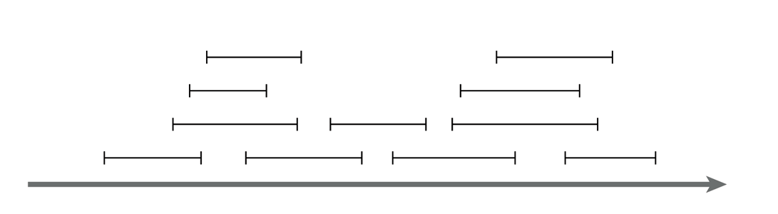
Motivating problem: Interval scheduling
Interval scheduling
Given a series of requests, each with a start time and end time, maximize the number of requests scheduled
This is solved by a greedy algorithm
Most of the CS 2150 algorithms you’ve seen are greedy algorithms: Dijkstra’s shortest path, both MST algorithms, etc.

Slide 44
Motivating problem: Weighted interval scheduling
Weighted interval scheduling
Same as the regular interval scheduling, but in addition each request has a cost associated with it
The goal is to maximize the cost from scheduling the items
This is solved by dynamic programming

Slide 45
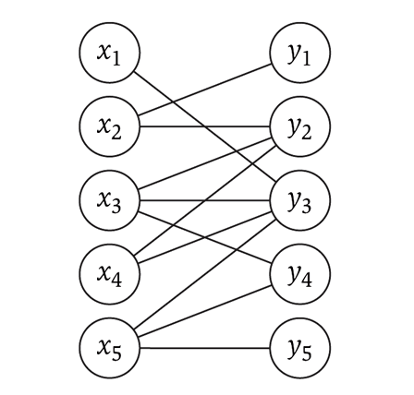
Motivating problem: Bipartite matching
Bipartite matching
Given a graph G, find the maximum sub-graph of G that partitions G into sets X and Y such that no node from X is connected to a node in Y, and vise-versa
Example: given a series of requests, and entities that can handle each request (such people, computers, etc.), find the optimal matching of requests to entities
This is a network flow problem

Slide 46
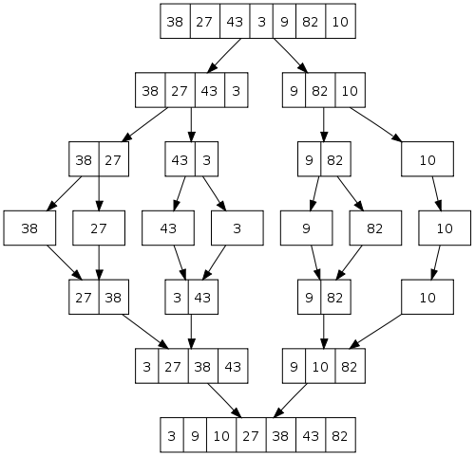
Motivating problem: Sorting
How do you implement a general-purpose sort that is as efficient as possible in both space and time, and is stable?
The (only!) solution is merge-sort
We’ll see later why quicksort, heapsort, and radix sort are not sufficient
This is an application of both sorting and divide and conquer

Slide 47
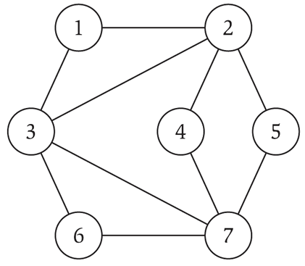
Motivating problem: Independent set
Independent set
Given a graph G, find the maximum size subset X of G such that no two nodes in X are connected to each other
This is a NP-complete problem
You’ve seen TSP (travelling salesperson problem) in CS 2150, which is a NP-complete problem

Slide 48
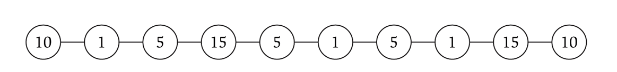
Motivating problem: Competitive facility location
Competitive facility location
Consider a graph G, where two ‘players’ choose nodes in alternating order. No two nodes can be chosen (by either side) if a connecting node is already chosen. Choose the winning strategy for your player.
This is a PSPACE problem, which are harder than NP-complete problems

