Slide 1
Final Project
Prepared by Brian Clark

Slide 2
What is CODEDCO™?
CODEDCO™ is a consultancy focused on instructional technology.
The Vision:
We are coders & educators who team up to create powerful learning experiences.

Slide 3
The Backstory
Back in 2017, I was in the process of applying to a grant to start my own venture.
Through this process, I submitted the name CODEDCO™ for trademarking.
As I started this class, I passed the pre-approval stage for the trademarking process.
Now, I have to a few months to demonstrate an “intent to use.” One way to evidence intent is through a website.
So, for my final project, I decided to build an official website for my venture.

Slide 4
Motivation
For the past 12 years, I’ve focused on developing teacher training & support programs for educators working in low-income communities, primarily in the US, India, & Malaysia
My goal is to focus on creating culturally responsive approaches to instructional technology design choices to meet the needs of students who otherwise lack access to opportunity
Starting in the fall of 2019, I hope to start a doctoral program in Instructional Technology & Media at Columbia University
Throughout my studies & beyond, it is my hope to do freelance work through CODEDCO™ around the world, collaborating with coders, educators, & curriculum writers

Slide 5




Development

Slide 6
Challenges
Domain Configuration:
Replacing www.codedco.co in GitHub had more steps that I had imagined
In order to set up the email address contact@codedco.co, I had to set up a mail exchange record (MX Record) through google’s Domain Network System (DNS)
This initially “broke” my website—but I realized that it can take 72 hours for changes to take hold
Contact Form:
I initially tried to create a “contact form” using Nodemailer.js
However, I learned that google considers sites like mine to be high risk (i.e. user information could be compromised)

Slide 7

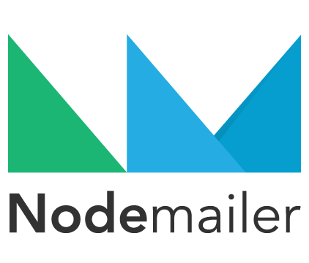

Further Development
Currently, the PayPal link connects to my personal bank account → I want to set CODEDCO up as an LLC so that the company can have its own separate bank account

Slide 8
Demo

