Slide 1
Using Machine Learning to
Predict Customer Churn
3,150
13
customer records
predictor features
Analytics Capstone 22477
15.7%
4
Briana Love Whylie
churn class
models compared
Problem statement
Telecom providers need to identify customers at risk of leaving before churn occurs so they can focus retention actions earlier and more effectively.
Main output: EDA + model comparison + business interpretation
6-minute presentation + 4-minute code demo
Research question
How reliably can supervised ML models forecast churn, and which account and behavior features are most associated with churn?

Slide 2
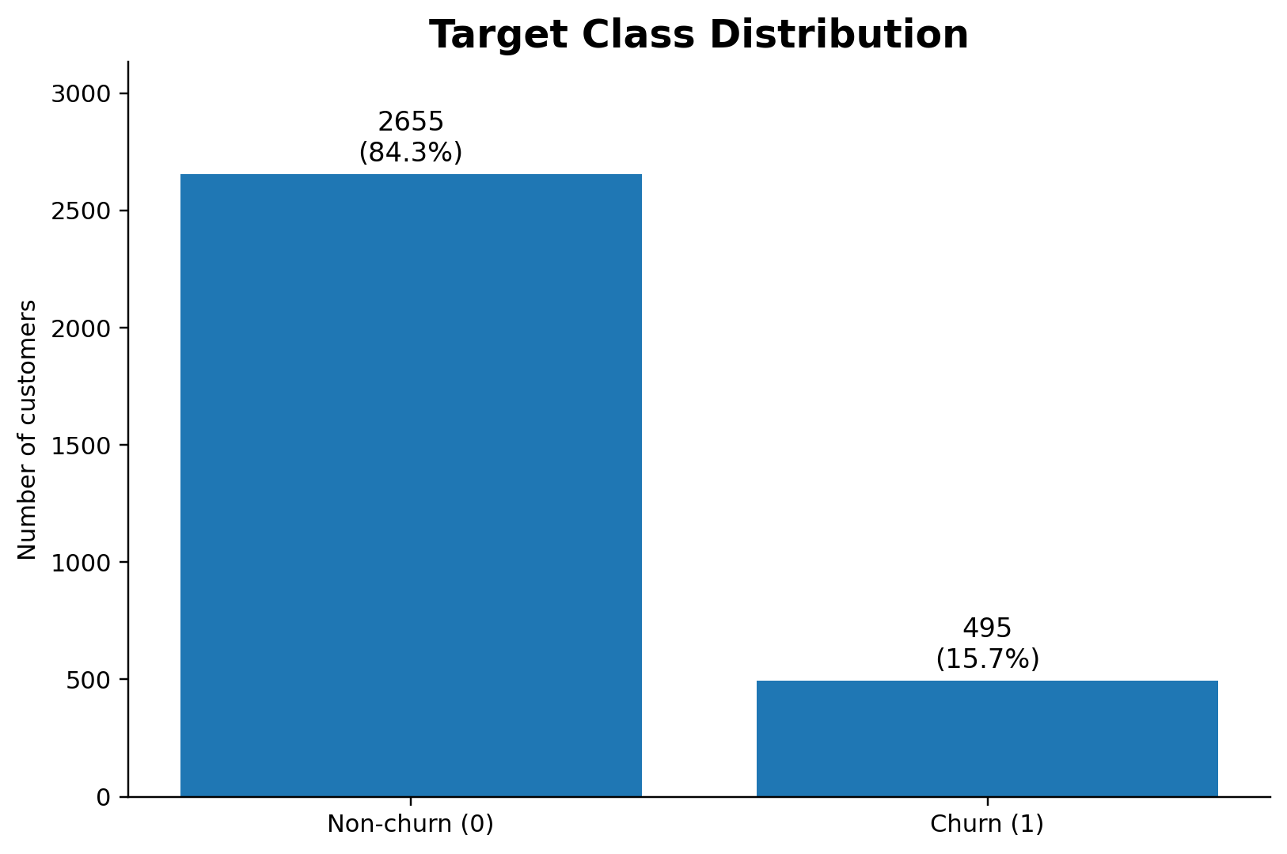
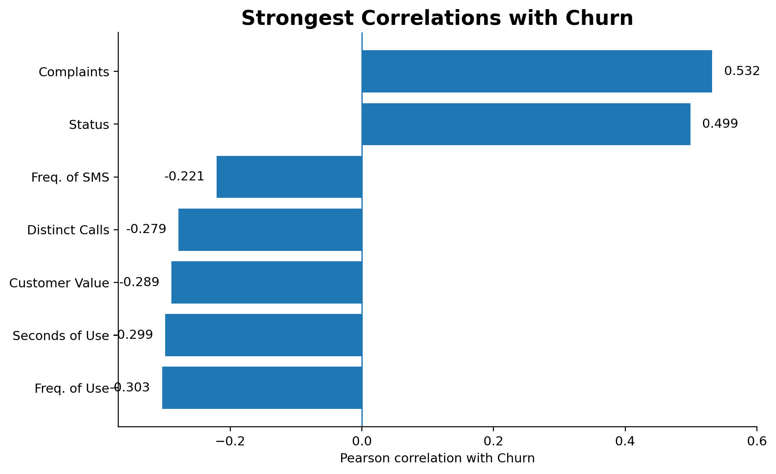
Only New EDA: What the Data Shows First
Target imbalance and churn signals
EDA TAKEAWAYS
The churn class is much smaller: 495 churners vs. 2,655 non-churners.
Accuracy alone is not enough because a majority-class model can look strong while missing churners.
Complaints and account status have the strongest positive relationship with churn.
Lower usage, lower customer value, and fewer distinct calls are associated with higher churn risk.
Briana Love Whylie | Analytics Capstone 22477 | Slide 2
Customer Churn Prediction

Slide 3
Proposed Solution: Supervised ML Pipeline
Binary classification workflow
1
Load data
2
EDA
3
Split 80/20
4
Train models
5
Evaluate
6
Interpret
Models compared
Evaluation metrics
Logistic Regression
Accuracy: overall correctness
Precision: how many flagged churners actually churned
Recall: how many true churners were found
F1-score: balance between precision and recall
ROC-AUC: separation between churn/non-churn across thresholds
Interpretable baseline; class-weighted.
Decision Tree
Simple tree benchmark; captures rules.
Random Forest
Ensemble model for nonlinear tabular patterns.
Gradient Boosting
Strong nonlinear ensemble benchmark.
Success criteria: strong recall and F1-score, high ROC-AUC, and interpretable churn drivers.
Briana Love Whylie | Analytics Capstone 22477 | Slide 3
Customer Churn Prediction

Slide 4
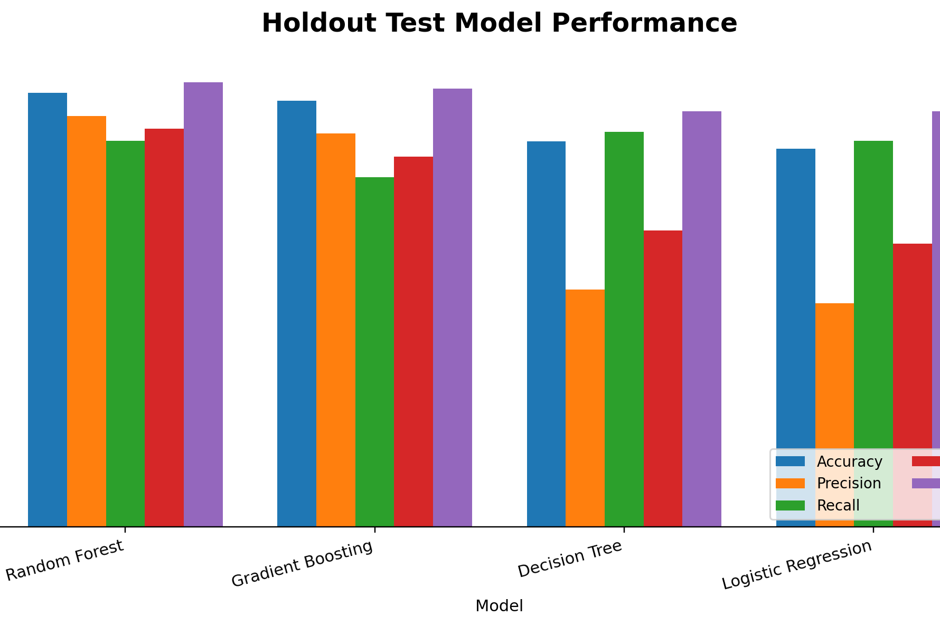
Results: Model Performance
Holdout test set comparison
Model
Acc.
Prec.
Recall
F1
AUC
Random Forest
.965
.914
.859
.885
.988
Grad. Boosting
.948
.875
.778
.824
.974
Decision Tree
.857
.527
.879
.659
.924
Logistic Reg.
.841
.497
.859
.630
.924
ANALYSIS
Random Forest had the strongest overall balance: highest accuracy, F1-score, and ROC-AUC.
Decision Tree found many churners, but created more false alarms, lowering precision.
Gradient Boosting had strong precision but missed more churners than Random Forest.
For churn prevention, F1-score and ROC-AUC are stronger success measures than accuracy alone.
Briana Love Whylie | Analytics Capstone 22477 | Slide 4
Customer Churn Prediction

Slide 5
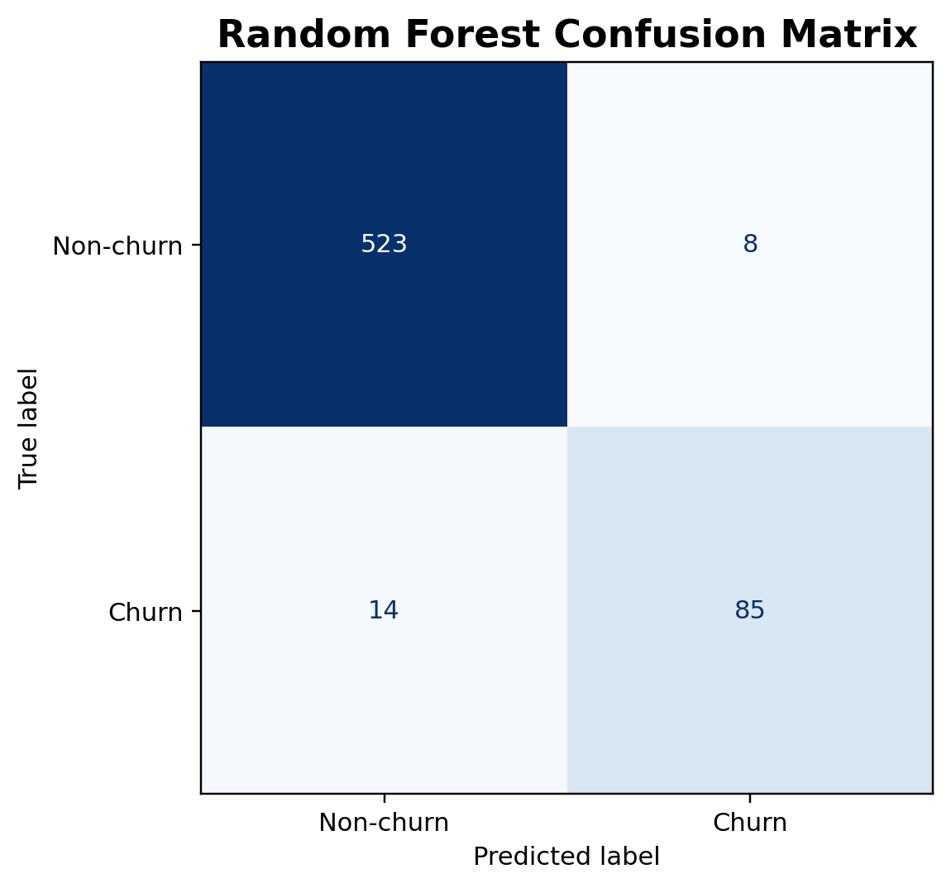
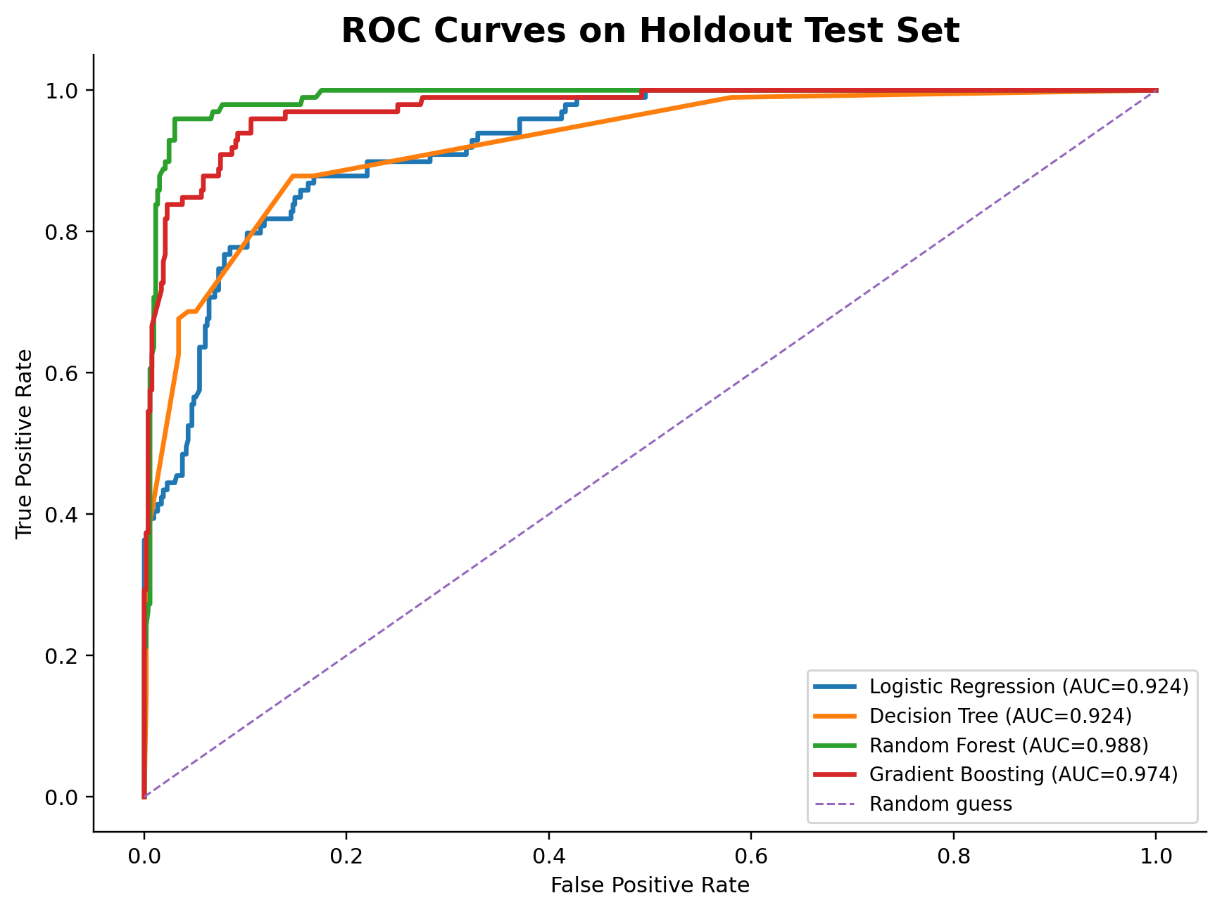
Results: Best Model Error Pattern
Random Forest confusion matrix and ROC curve
85 / 99
14
0.988
Interpretation: the model separates churners from non-churners very well, but future threshold tuning could raise recall if missing churners is more costly than false alerts.
true churners correctly identified
missed churners on test set
Random Forest ROC-AUC
Briana Love Whylie | Analytics Capstone 22477 | Slide 5
Customer Churn Prediction

Slide 6
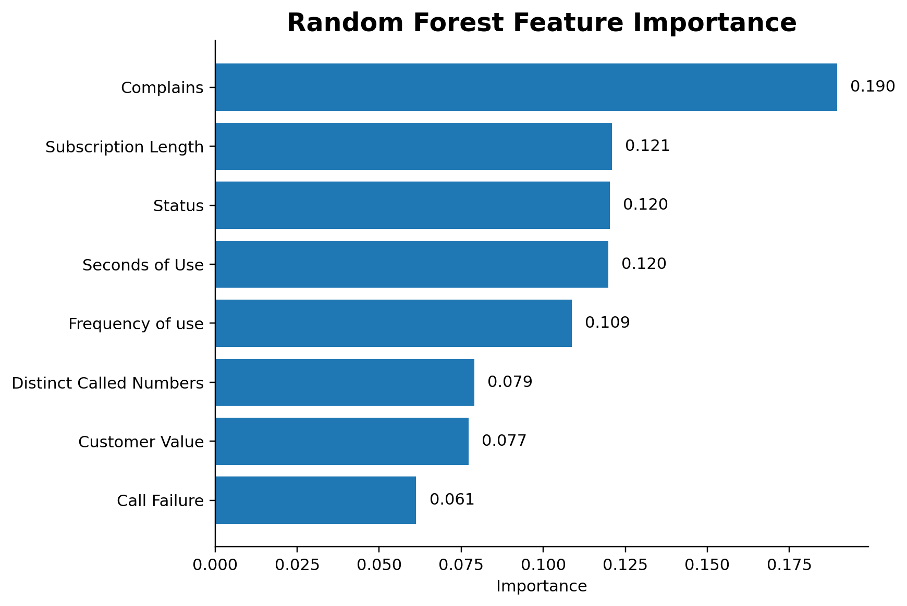
Results: What Feature Importance Means
Random Forest feature importance interpretation
MAIN POINT
A value like 0.190 for Complaints means complaints contribute about 19% of the Random Forest's total split-based importance.
• Importance scores add to 1.0 and show how much the model relied on each feature.
• A higher bar means the feature was more useful for separating churners from non-churners.
• Complaints ranks first, followed by subscription length, status, seconds of use, and frequency of use.
• It is not a churn probability and it does not prove causation by itself.
Interpretation: feature importance shows model reliance. The next step is to test whether those features also line up with real churn-rate differences in the raw data.
Interpretation: feature importance shows model reliance. The next step is to test whether those features also line up with real churn-rate differences in the raw data.
Interpretation: feature importance shows model reliance. The next step is to test whether those features also line up with real churn-rate differences in the raw data.
Briana Love Whylie | Analytics Capstone 22477 | Slide 6
Customer Churn Prediction

Slide 7
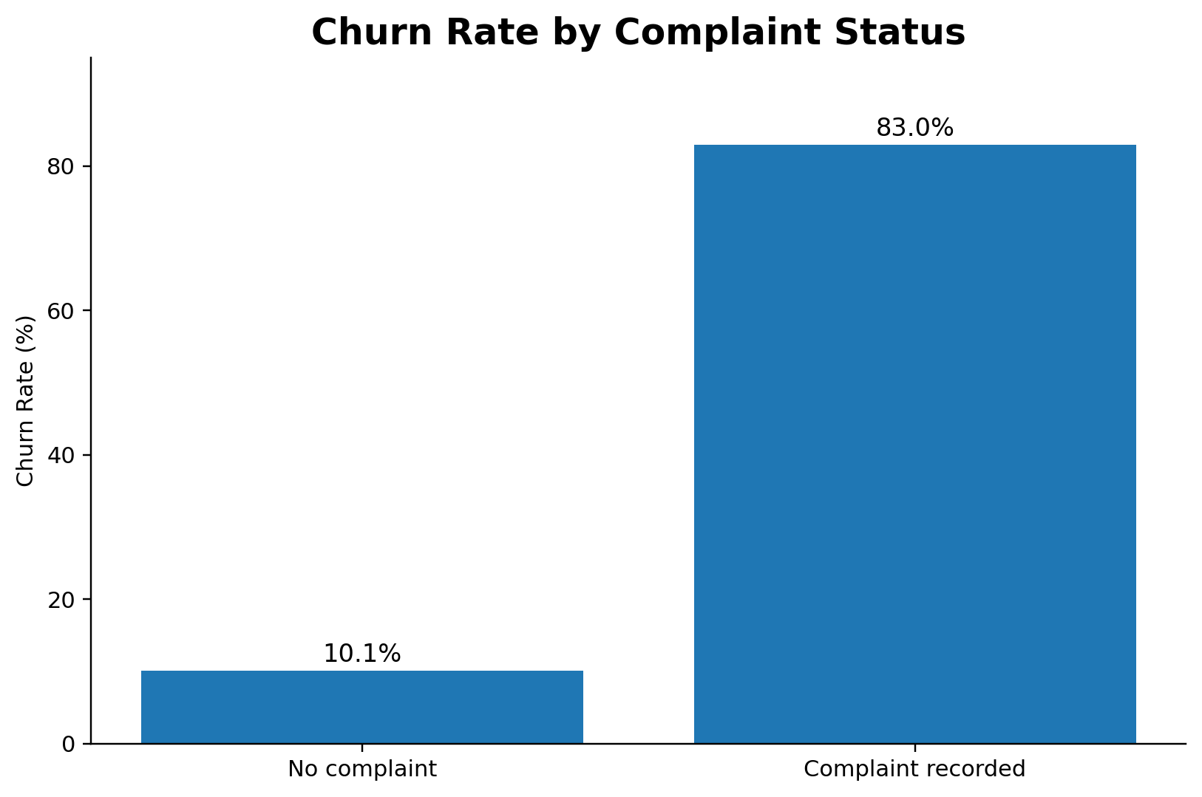
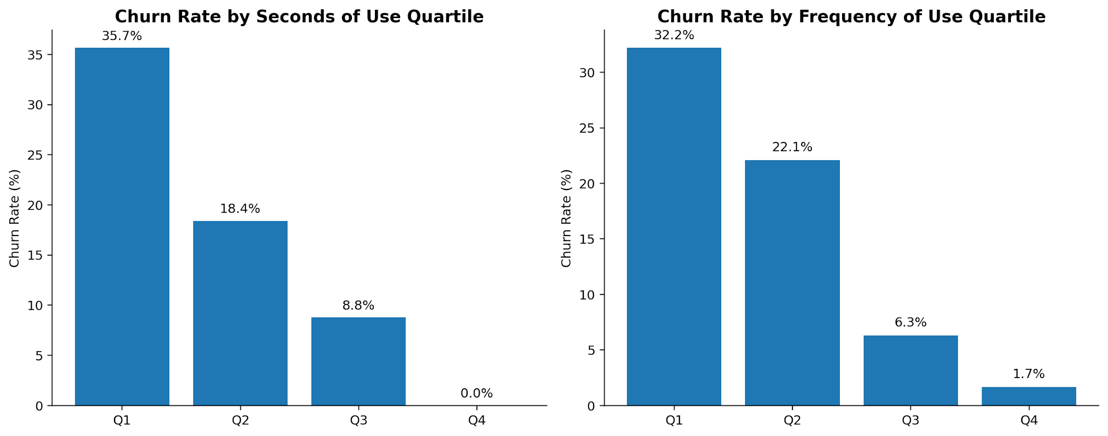
Analysis: Why Complaints and Low Usage Matter
Going beyond feature importance
1
Detect
2
Diagnose
3
Intervene
Use the model to score customers for churn probability.
Review top drivers: status, low usage, complaints, customer value.
Prioritize service recovery, plan review, and retention outreach.
WHY RANDOM FOREST WON
Logistic Regression is useful as a baseline, but it assumes simpler linear relationships.
A single Decision Tree is easy to explain but can become unstable and overfit rules.
Random Forest averages many trees, helping capture nonlinear interactions while keeping errors low.
The best model supports practical retention: fewer missed churners and a clear ranked list of drivers.
Complaints deep dive
• Complaint group churn rate = 83.0% • No-complaint group churn rate = 10.1% • Gap = 72.8 percentage points (about 8.2x higher risk)
Usage deep dive
• Lowest seconds-of-use quartile churns at 35.7% vs 0.0% in the highest quartile • Lowest frequency-of-use quartile churns at 32.2% vs 1.7% in the highest quartile
Takeaway: complaints look like dissatisfaction signals, while seconds/frequency of use behave like engagement signals. These variables strongly predict churn, but the safest academic wording is “predictors” or “warning signs,” not proof of sole causation.
Takeaway: complaints look like dissatisfaction signals, while seconds/frequency of use behave like engagement signals. These variables strongly predict churn, but the safest academic wording is “predictors” or “warning signs,” not proof of sole causation.
Overall acceptability: the solution is appropriate for an academic churn benchmark and consistent with literature favoring ensemble methods and multiple metrics.
Briana Love Whylie | Analytics Capstone 22477 | Slide 7
Customer Churn Prediction

Slide 8
Conclusion and Future Work
Final takeaway and next steps
Conclusion
Future work
Supervised machine learning can predict churn effectively on this telecom dataset.
Random Forest was the strongest model overall, with 0.965 accuracy, 0.885 F1-score, and 0.988 ROC-AUC.
The strongest churn signals are service/account status, usage behavior, complaints, and customer value.
The solution is acceptable as a capstone model because it is accurate, explainable at the feature level, and tied to retention decisions.
Tune the probability threshold based on business cost of false negatives vs. false positives.
Add SHAP or LIME for customer-level explanations.
Test calibrated probabilities and cost-sensitive learning.
Validate on additional telecom datasets or newer time periods to test generalizability.
Demo plan: run churn_analysis.py, open the metrics/charts outputs, then run demo_predict_single_customer.py for one customer risk score.
Briana Love Whylie | Analytics Capstone 22477 | Slide 8
Customer Churn Prediction

Slide 9
References
Bibliography
[1] Iranian Churn Dataset, UCI Machine Learning Repository, 2020. doi: 10.24432/C5JW3Z.
[2] A. Keramati and S. M. S. Ardabili, “Churn analysis for an Iranian mobile operator,” Telecommunications Policy, 35(4), 344-356, 2011.
[3] W. Verbeke, D. Martens, C. Mues, and B. Baesens, “Building comprehensible customer churn prediction models with advanced rule induction techniques,” Expert Systems with Applications, 38(3), 2354-2364, 2011.
[4] A. Idris, M. Rizwan, and A. Khan, “Churn prediction in telecom using Random Forest and PSO based data balancing,” Computers & Electrical Engineering, 38(6), 1808-1819, 2012.
[5] A. K. Ahmad, A. Jafar, and K. Aljoumaa, “Customer churn prediction in telecom using machine learning in big data platform,” Journal of Big Data, 6, 28, 2019.
[6] A. Barsotti et al., “A Decade of Churn Prediction Techniques in the TelCo Domain: A Survey,” SN Computer Science, 5, 404, 2024.
[7] S. S. Poudel, S. Pokharel, and M. Timilsina, “Explaining customer churn prediction in telecom industry using tabular machine learning models,” Machine Learning with Applications, 17, 100567, 2024.
This reference slide does not need to be presented in the six-minute talk unless asked.
Briana Love Whylie | Analytics Capstone 22477 | Slide 9
Customer Churn Prediction
Notes:
Do not present this slide unless the professor asks. It is included to satisfy the bibliography requirement.

