Slide 1

Which Cocoa Beans?
An analysis for Whizzo
Brian Bloom bbdata@mooman.com
Aug 15, 2021

Slide 2

01
What problem are we trying to solve?
02
What data is available for us?
03
What did the data tell us?
04
What are the next steps? Q & A
OUTLINE OF
PRESENTATION

Slide 3
01
BACKGROUND

Slide 4

Whizzo Chocolate Company is a noted chocolatier who has had some market challenges in the past. Their Whizzo Quality Assortment, which contained such flavors as Crunchy Frog, Ram’s Bladder Cup, and Spring Surprise, received negative marks from governmental hygiene inspectors.
01 BACKGROUND: Whizzo Chocolate Company
WHO
is Whizzo?

Slide 5
We have been contracted by Mr. Milton of the Whizzo Chocolate Company to research and identify the most promising countries to source high quality chocolate from so that they can re-establish themselves as a top-ranked chocolatier.
01 BACKGROUND: The Business Task
WHAT
is our task?

Slide 6
Stakeholders are Mr. Milton's confectionery development team, which includes his buyer and two members of the production team, and also my supervisor at our BI firm who is overseeing this analysis.
01 BACKGROUND: Stakeholders
WHO
are the stakeholders?

Slide 7
For this analysis, we will be providing the Whizzo Chocolate company with a summary of the best countries to source their cocoa beans from, using ratings based on those chocolates, as well as production and importer constraints.
01 BACKGROUND: Deliverables
WHAT
are the deliverables?

Slide 8
02
THE DATA

Slide 9

2400 chocolate bars, tasted, rated, and published online. http://flavorsofcacao.com/chocolate_database.html
Over 2000 chocolate bars independently rated and reviewed. https://www.c-spot.com/chocolate-census/bars/
Economic information from United Nations Food and Agriculture Organization (FAO) published online. https://www.nationmaster.com/nmx/ranking/cocoa-beans-production
(*Vietnam data was missing and sourced from: https://trendeconomy.com/data/h2/Vietnam/18 )
Data Sources
Flavors of Cacao database
The C-spot Chocolate Census
NationMaster statistics database

Slide 10
Combine the
ratings data with
the production data.
Merge in region
info and identify
which regions are highest ranked.
01
02
03
04
05
Data Workflow
(using RStudio)
Import the 2 chocolate rating data files, clean them and standardize them for merging.
Filter out the countries with production issues and sort
the others by ratings.
Do secondary extract for the best bean varietals of the
top countries.

Slide 11
03
OUR FINDINGS

Slide 12
Solomon Islands
Tobago
Congo
Cuba
Venezuela
Jamaica
Madagascar
Principe
Vietnam
Trinidad
Guatemala
Belize
Nicaragua
Haiti
Dominican Republic
Tanzania
Panama
Peru
Colombia
Honduras
Papua New Guinea
Bolivia
St. Lucia
Brazil

(highest ratings)
Overall ratings
(after combining both ratings databases)
(mediocre ratings)

Slide 13
Solomon Islands
Tobago
Congo
Cuba
Venezuela
Jamaica
Madagascar
Principe
Vietnam
Trinidad
Guatemala
Belize
Nicaragua
Haiti
Dominican Republic
Tanzania
Panama
Peru
Colombia
Honduras
Papua New Guinea
Bolivia
St. Lucia
Brazil
Overall ratings
… with production
The countries in red had declining production in both 1 year and 5 year periods, and pose a supply risk.

Slide 14
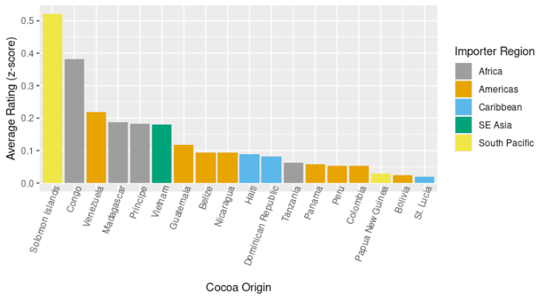
Regions that scored well
(with production risks removed)

Slide 15
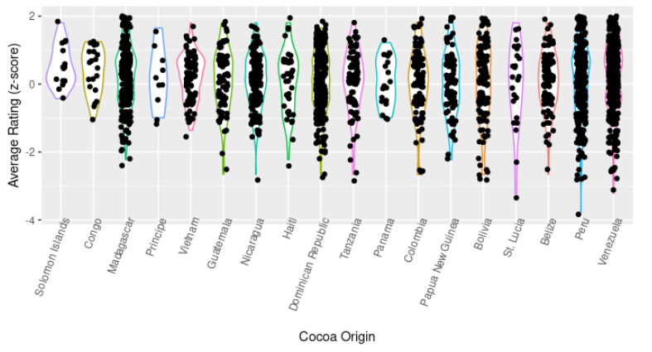
CAUTION: Even good countries make bad chocolates
Varietals and testing matters!
A Z-score of 0 means “average”, so even lowest scoring countries have winners and losers.

Slide 16
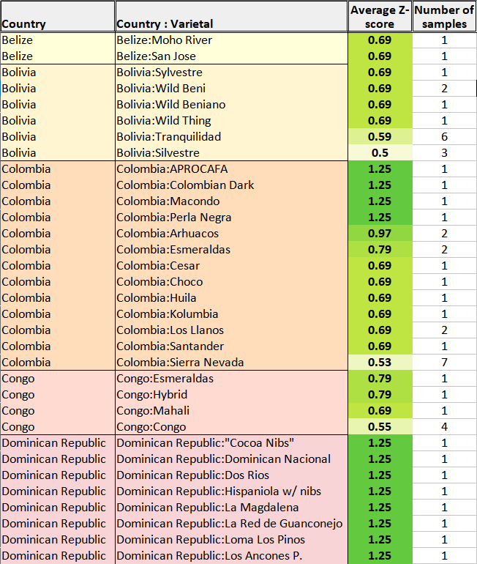
Example of the varietal spreadsheet
(being included as a deliverable for this project)

Slide 17
04
NEXT STEPS

Slide 18
01
02
03
04
05
REVIEW THE FINDINGS
FURTHER ANALYSIS?
ASSESS
IMPORTERS
GET SAMPLES
MAKE CHOCOLATE!
Review the spreadsheets & charts provided to see if there are any questions about data or methodology.
Let us know if additional analysis or research is desired.
See if your importers are able to source the recommended varietals.
Procure samples of the recommended varietals and evaluate.
See how the new chocolates taste and launch your new Whizzo line!

Slide 19
Q & A

Slide 20

Links
Link to source data, R code, and this presentation:
QR Code:
https://github.com/brianbloom/Coursera_Google_Capstone

Slide 21
Thank You!
Brian Bloom

bbdata@mooman.com

