Slide 1
Express Middleware

Slide 2
First things first
Make sure you’ve got Node v. 12.16.2 – the LTS as of this writing – as well as yarn up and running.
You’re gonna want to fork, and then clone https://github.com/brianboyko/middleware-tutorial
Switch over to the branch called “lesson-01” to start off.
Run “yarn” to install dependencies, then “yarn setupenv” to copy the example.env file to a local .env file.

Slide 3
Lesson 01
A world without Middleware

Slide 4
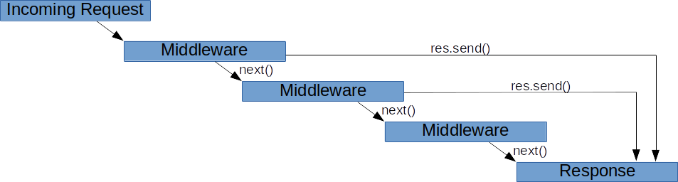
What is Express Middleware
Express Middlewares are simple JavaScript functions

Slide 5
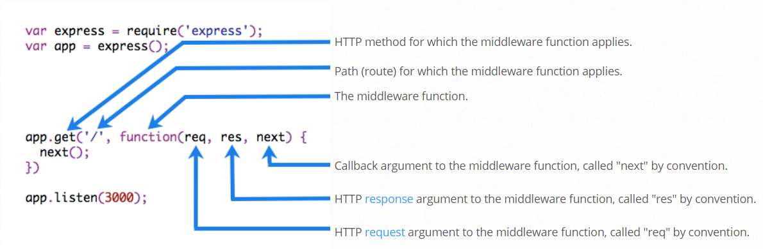
Middleware signature
Notes:
which has access to request, response and next function,
Next function is the function which invokes and executes the middleware succeeding the current one
What middleware can do –
Execute any code.
Make changes to the request and the response objects.
End the request-response cycle.
Call the next middleware in the stack.

Slide 6
Types of it
Application level Middleware
Router level Middleware
Built-in / Third Party Middleware
Error Handler Middleware

Slide 7
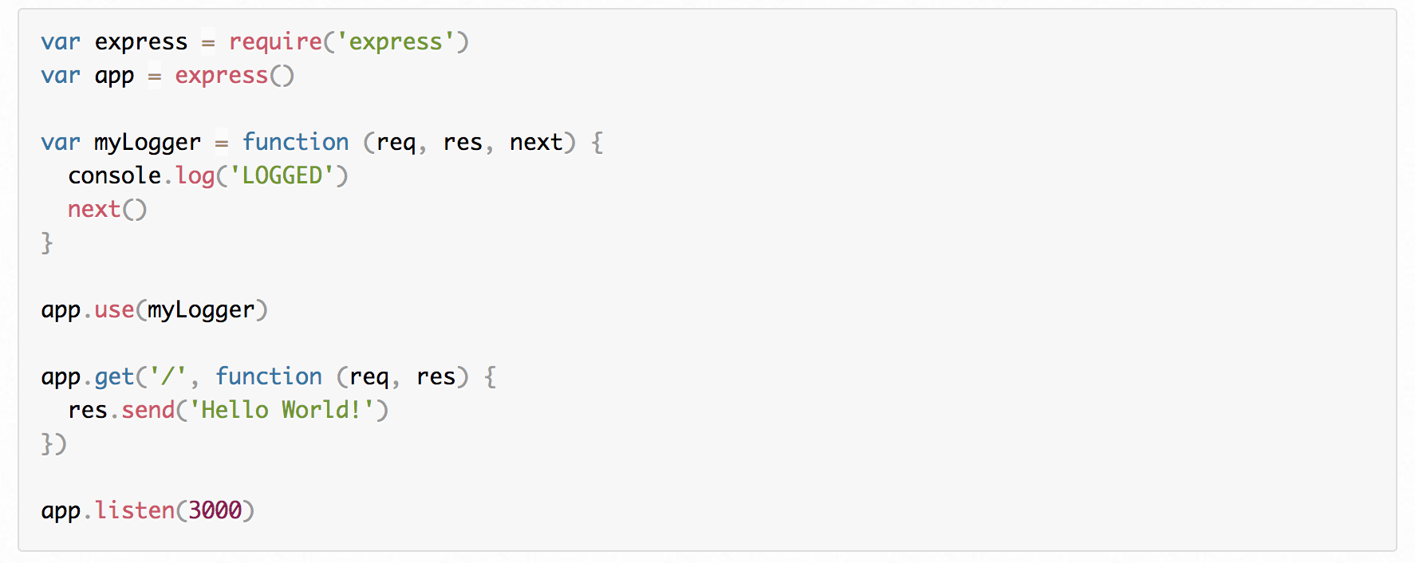
Application level middleware
Notes:
App.use and app.get from an application level middleware to bind with app context, code samples

Slide 8
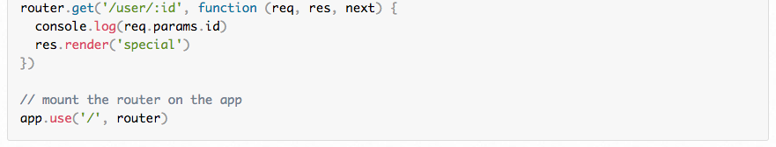
Router level middleware
Notes:
Lets implement few routes in their app and will try to add some view logics to render it and attach this extended router to their app

Slide 9
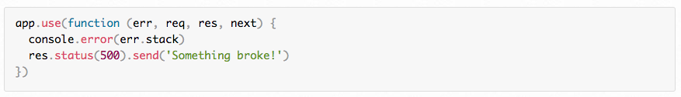
Error Handler Middleware
Notes:
Implement a error handler to the existing app they built as part of their previous home-works

Slide 10
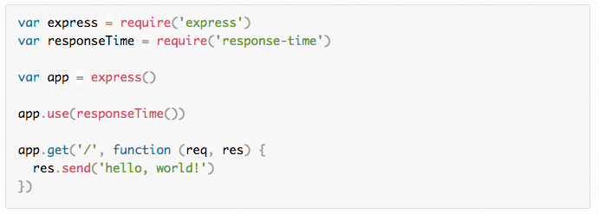
Built-In / Third-party Middleware
List of built-in and third party middleware : https://expressjs.com/en/resources/middleware.html
Notes:
< open http://latentflip.com/loupe/?code=Y29uc29sZS5sb2coIkhpISIpOwoKc2V0VGltZW91dChmdW5jdGlvbiB0aW1lb3V0KCkgewogICAgY29uc29sZS5sb2coIlRoZXJlIik7Cn0sIDUwMDApOwoKY29uc29sZS5sb2coIkV2ZXJ5Ym9keSIpOw%3D%3D!!!PGJ1dHRvbj5DbGljayBtZSE8L2J1dHRvbj4%3D >
Third party and built-in implementation is pretty similar to code

Slide 11
Useful Readings
https://expressjs.com/
https://medium.com/@KeithAlpichi/what-is-an-express-middleware-and-how-to-create-one-84064c095123
https://expressjs.com/en/guide/using-middleware.html#middleware.router

