Slide 1
Generator Composition in ES6

Slide 2
Problem
Generators cannot abstract over sync IO.

Slide 3
Two Ways to Iterate
var nums = function*() {
yield 1;
yield 2;
}

Slide 4
Iterable
function Iterable(generatorFunction) {
this[@@iterator] = generatorFunction;
};

Slide 5
Creating Iterables
let nums = new Iterable(function*() {
yield 1;
yield 2;
yield 3;
});

Slide 6
Iterating Iterables
for(let x of nums()) {
console.log(x);
}
…becomes…
let iterator = nums()[@@iterator],
pair;
while(!(pair = iterator.next()).done) {
console.log(pair.value);
}

Slide 7
IO Streams as Iterables
function getLines(fileName) {
return new Iterable(function*() {
let reader = new SyncReader(fileName);
try {
while(!reader.eof) {
yield reader.readLine();
}
}
finally {
reader.close();
}
})
};

Slide 8
Iterable Composition
Iterable.prototype.map = function(projection) {
let self = this;
return new Iterable(function*() {
for(let x of self) {
yield projection(x);
}
});
}

Slide 9
Iterable Composition (cont)
Iterable.prototype.takeWhile = function(predicate) {
let self = this;
return new Iterable(function*() {
for(let x of self) {
if (!predicate(x)) {
break;
}
yield x;
}
});
}

Slide 10
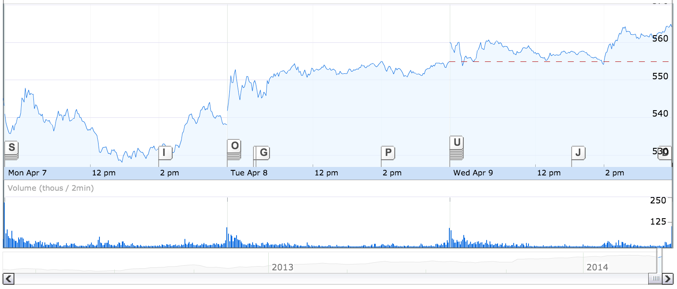


Historical Stock Ticker Visualizer
GOOG
Symbol filter
Date filter

Slide 11
Created Filtered Iterable
// massiveFileOfStockTickerHistory.txt
// {date: 7347832748932, symbol: “BAC”, price: 16.62 }\n
// {date: 7347832748939, symbol: “CTI”, price: 3.48 }\n
let records =
getLines(“massiveFileOfStockTickerHistory.txt”).
map(line => JSON.parse(line)).
filter(({symbol}) => symbol === selectedSymbol).
skipWhile(({date}) => date > dateFrom).
takeWhile(({date}) => date < dateTo);
render(records);
Lazy evaluation.
Nothing has happened.

Slide 12
Render Iterates Data
function renderGraph(stocks) {
// large file is opened.
for(let stock of stocks) {
// rendering
}
}
Is file handle closed?

Slide 13
takeWhile Leaks!
Iterable.prototype.takeWhile = function(predicate) {
return new Iterable(function*() {
for(let x of this) {
if (!predicate(x)) {
break;
}
yield x;
}
});
};
function getLines(fileName) {
return new Iterable(function*() {
let reader =
new SyncReader(fileName);
try {
while(!reader.eof) {
yield reader.readLine();
}
}
finally {
reader.close();
}
})
};
Suspends
Never executes!

Slide 14
Can not Safely Page Generators!
Leak exposed by any operator that short-circuits…
take
takeWhile
Must iterate to completion to avoid leak
for…of useless over Generators that abstract over expensive resources

Slide 15
Proposal
for…of always assumes generator creation
for…of always terminates generator function

Slide 16
Rationale
For…of creates iterator
User-land cannot invoke iterator.return(), because iterator transparently created by for…of
“If you built it, you bought it.”

