Slide 1
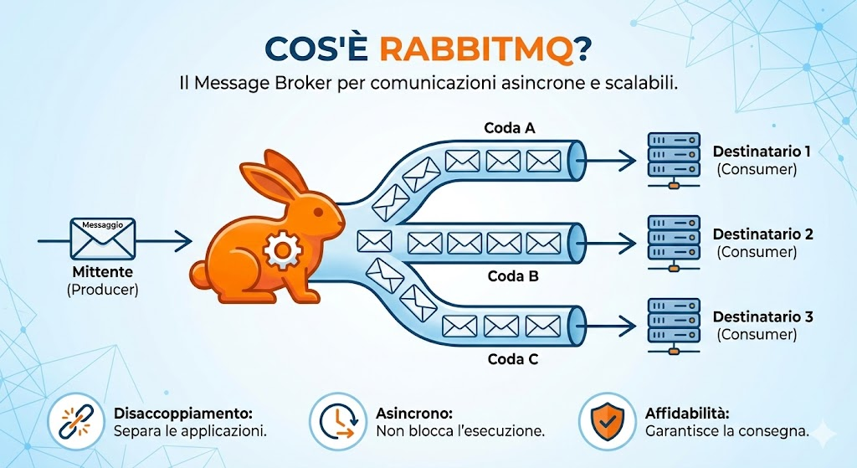
Intermediario

Slide 2
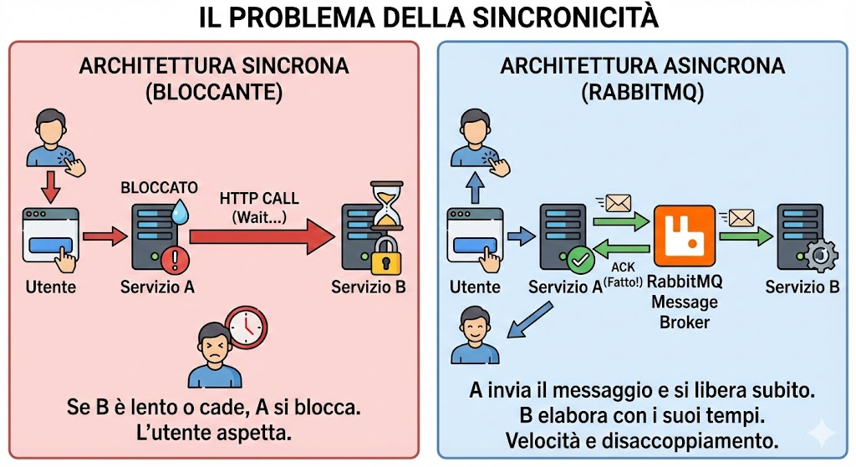
Api
Email pdf calcolo
Producer/ Cliente
Consumer/Worker
Fire and forget

Slide 3
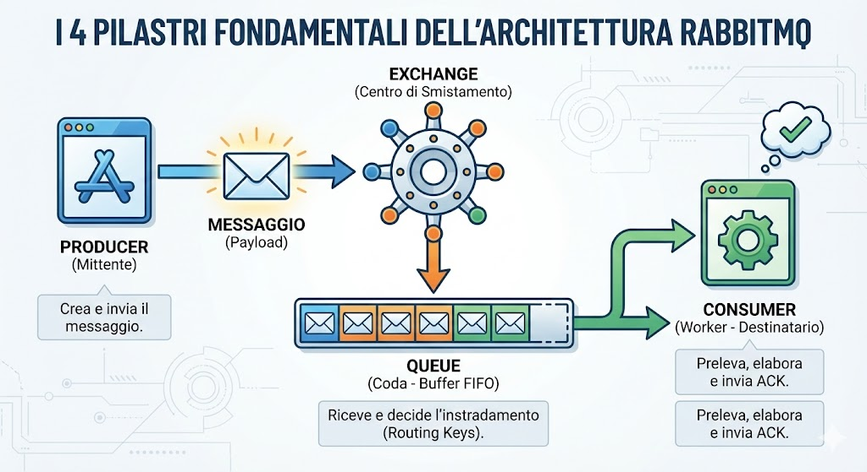

Slide 4
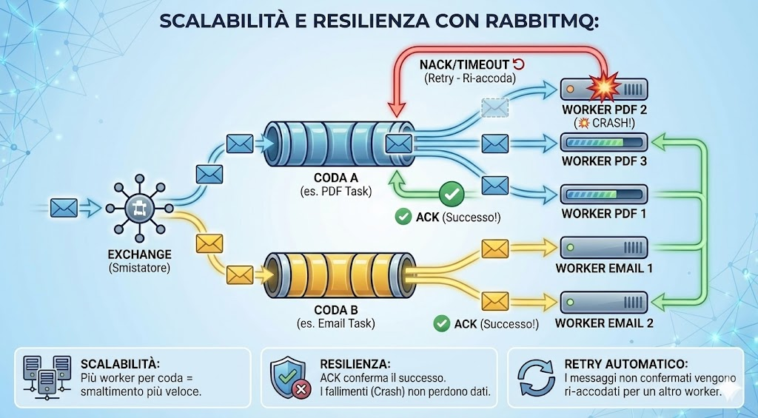

Slide 5
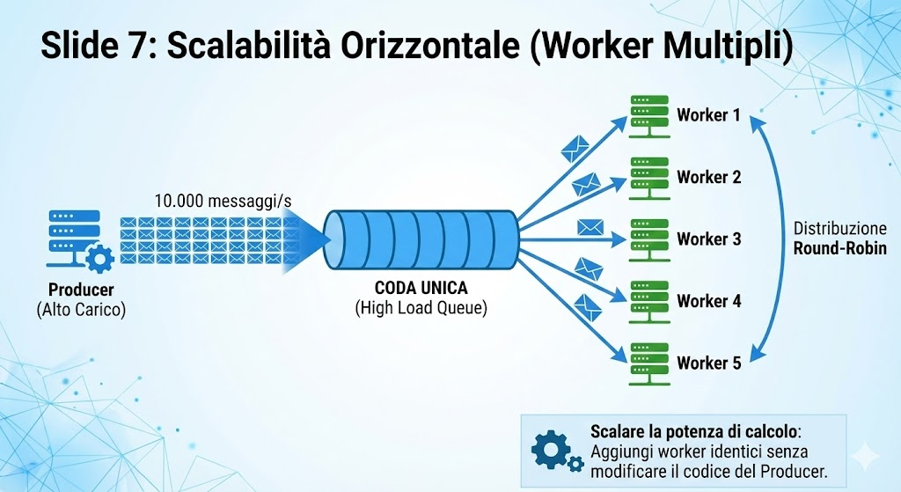

Slide 6
