Slide 1
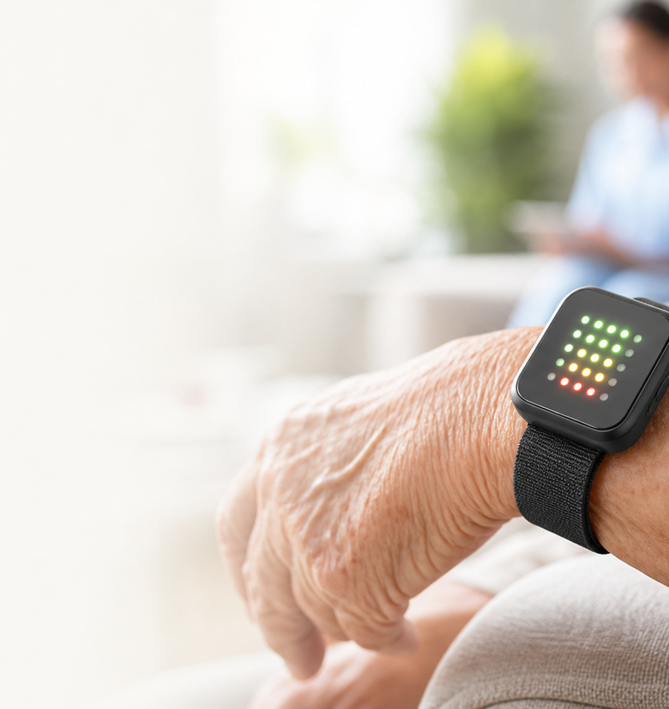
ELDER CARE WEARABLE
ShakeCare
The wristband that turns a fall, a freeze, or a desperate shake into a visible call for help.
Green means safe. Yellow means watch. Red means act.

Slide 2
The danger is not only the fall.
It is the silent minutes after it.
A phone is across the room.
A button is out of reach.
A camera feels too invasive.
ShakeCare watches for the moments when older adults cannot explain what happened.
ShakeCare | 2

Slide 3
ShakeCare makes distress obvious.
A simple product loop that works before the phone call happens.
Detect
Signal
Relay
The wristband senses sudden motion, impact, stillness, and intentional shaking.
The LED matrix moves from green to yellow to red so anyone nearby understands the risk.
A caregiver board mirrors the color and serves a live web dashboard to a computer.
ShakeCare | 3

Slide 4
The demo already proves the full loop.
One motion event becomes a caregiver-facing alert.
1
2
3
4
5
Older adult falls
Wristband turns yellow
Shake or no movement escalates
Caregiver display mirrors it
Web dashboard logs the event
ShakeCare | 4

Slide 5
It is not another panic button.
The product combines passive detection with active confirmation.
Passive safety
Active rescue
A hard impact or 10 seconds of near-stillness can trigger escalation even if the person cannot speak or press anything.
After a warning, a strong repeated shake becomes a deliberate signal: I need help now.
ShakeCare | 5

Slide 6
The first buyers are already worried.
ShakeCare fits the places where families and care teams need low-friction monitoring.
Families
Care homes
Community care
Adult children caring for parents who live alone or spend time alone at home.
Staff who need room-level alerts without putting cameras into private spaces.
Local elder-care teams that need affordable safety devices for daily visits.
ShakeCare | 6

Slide 7
We sell the care loop, not the gadget.
Hardware gets ShakeCare onto the wrist. Service keeps people connected.
Device sale
Monitoring layer
Service partners
A simple wearable and caregiver hub for families or institutions.
Dashboards, logs, and escalation workflows for care teams.
Insurance, home-care services, and community programs can bundle it.
ShakeCare | 7

Slide 8
The path to product is focused.
Keep the alert loop small, then harden reliability.
Now
Wristband prototype, caregiver board, live web dashboard
Next
Reset button, battery pack, better enclosure, real wearing tests
Pilot
Care-home trial, false-alarm tuning, SMS or app notification
Product
Smaller wearable, charging dock, care-team dashboard
ShakeCare | 8

Slide 9
We are asking for partners to test the moment that matters.
Not a future hospital system. A practical first layer that helps families and caregivers see risk sooner.
Test with real routines
Tune false alarms
Build the care network
ShakeCare

