Slide 1
Predicting basketball Games
Brian Chirn

Slide 2
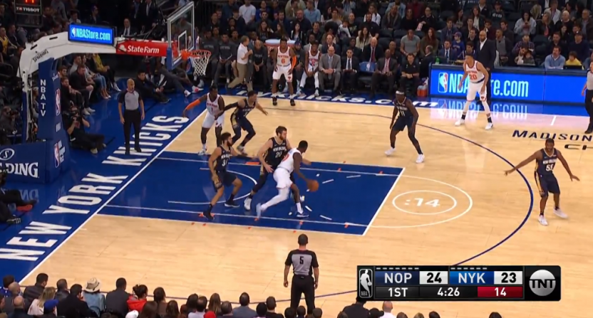
Basketball 101
Game played 5 on 5
Team scores points that getting the basketball into the hop
Team with the most points wins
Notes:
Typically 2 points for inside the line
3 point line- if you shoot the ball behind this line, you score three points
Rebounds are when you grab balls that you miss
Assists are when you pass to someone who scores
I choose basketball because of the high scoring volume of the game, easier to generate robust statistics.

Slide 3
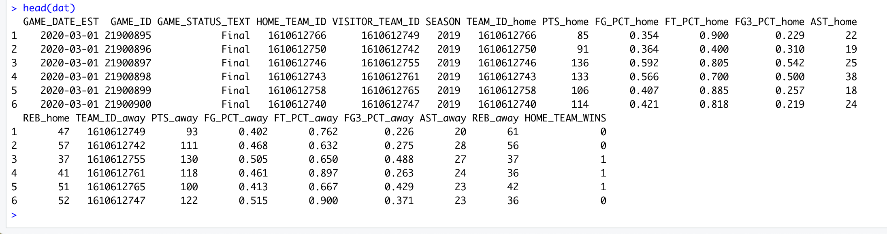
Describe the data
Data collected has every game between 2004-2020 taken from nba website
Contains stats like Points, Assist, Rebounds, Field Goal Percentage etc.. For Both the Home Team and Visiting team
Notes:
https://www.kaggle.com/nathanlauga/nba-games
Data scrapped from nba stats using Scrapper.py
23195 games
Contains all games from 2004-2020. Features include The date of the game, which team won, how many points scored and let up, rebounds, assists, 3-point percentage etc..
500,000+ plays

Slide 4
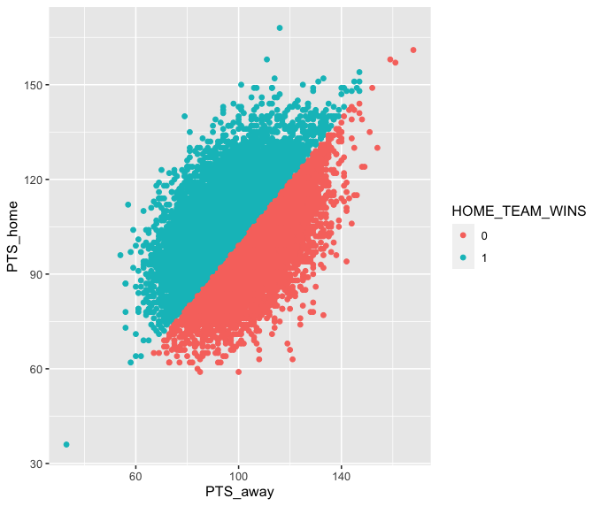
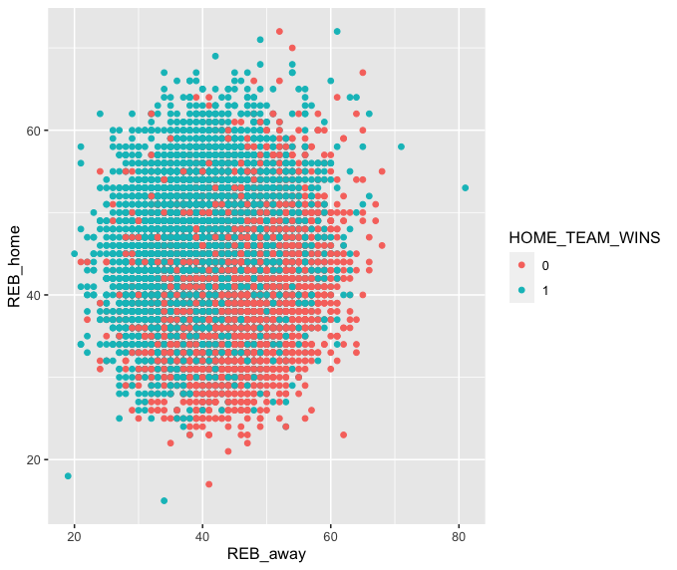
Exploratory Data Analysis

Slide 5
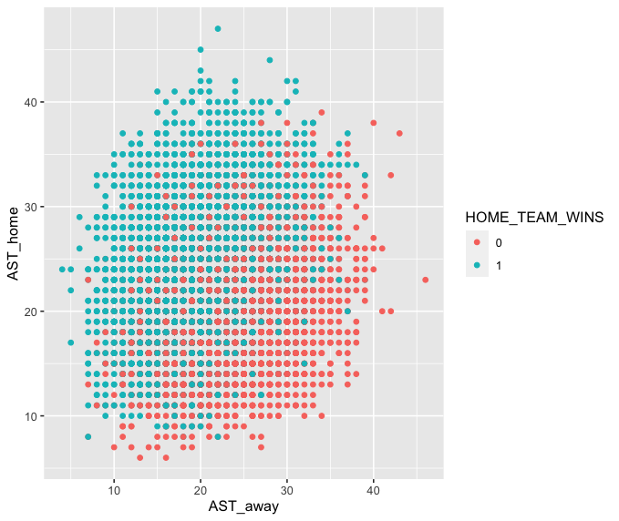
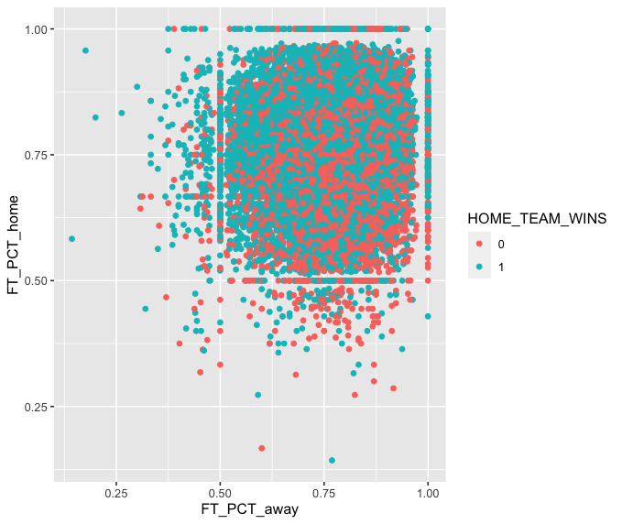
Exploratory Data Analysis

Slide 6
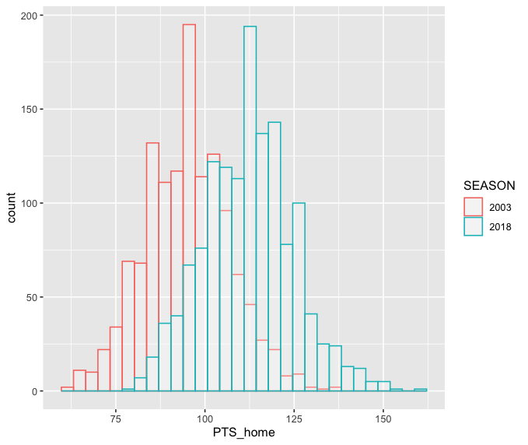
NBA is scoring

Slide 7
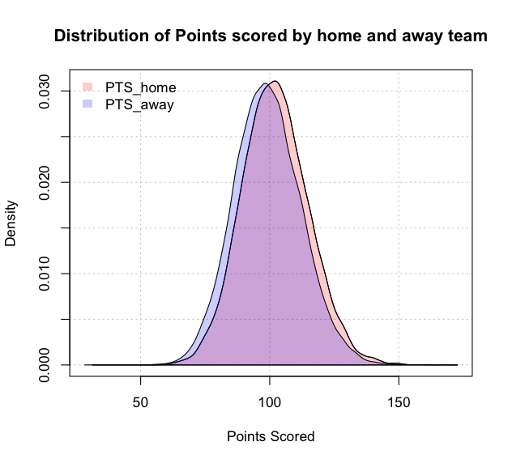
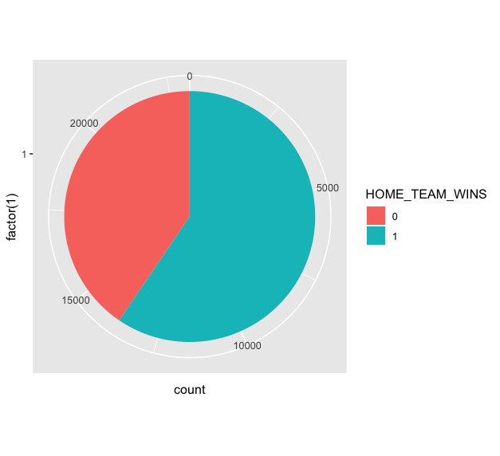
Home Court Advantage Visualized
Notes:
Hometeam wins 59% of the games

Slide 8
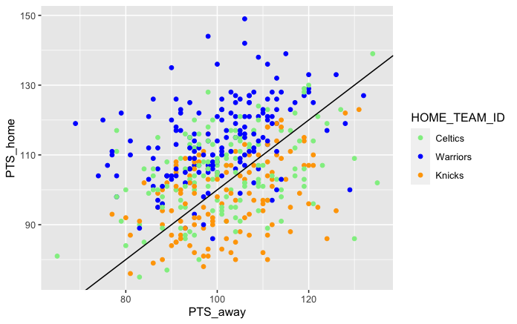
Warriors Dominance (2014-2016)

Slide 9
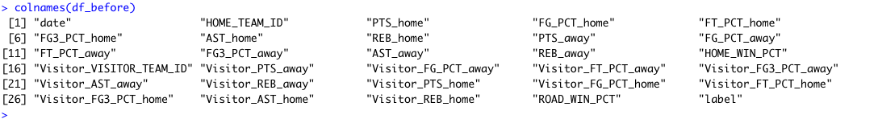
Creating a new dataset
We want our model to predict the wins BEFORE a game is played.
Calculate the average stats for home team and visiting team for each game played

Slide 10
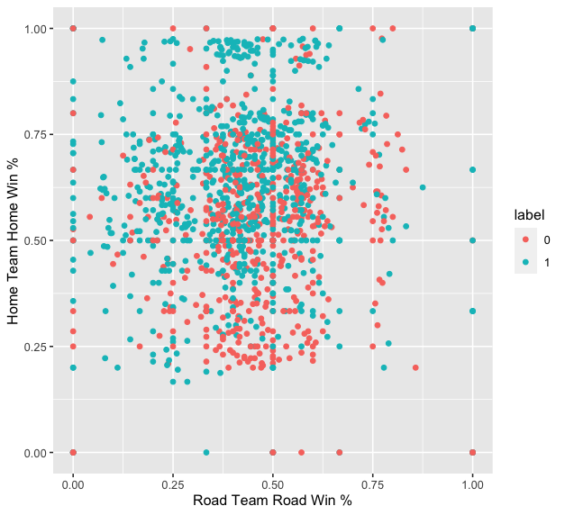
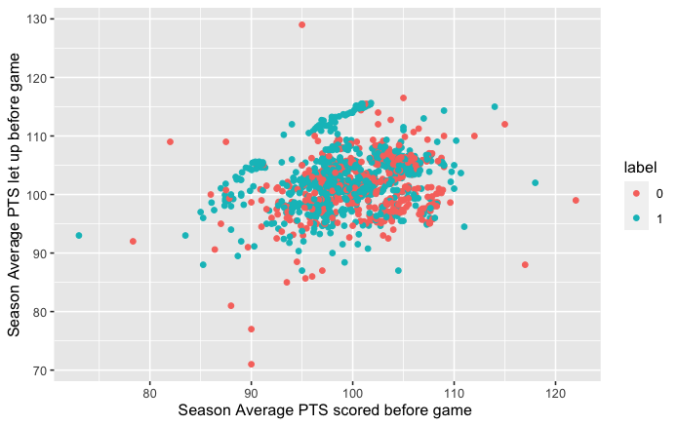
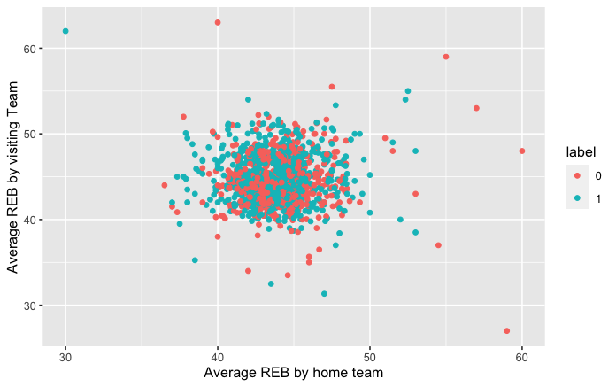
Before each game, season stats Home and road win%
Before each game, season stats PTS scored vs PTS let up
Before game Average Rebounds by home team and away team

Slide 11
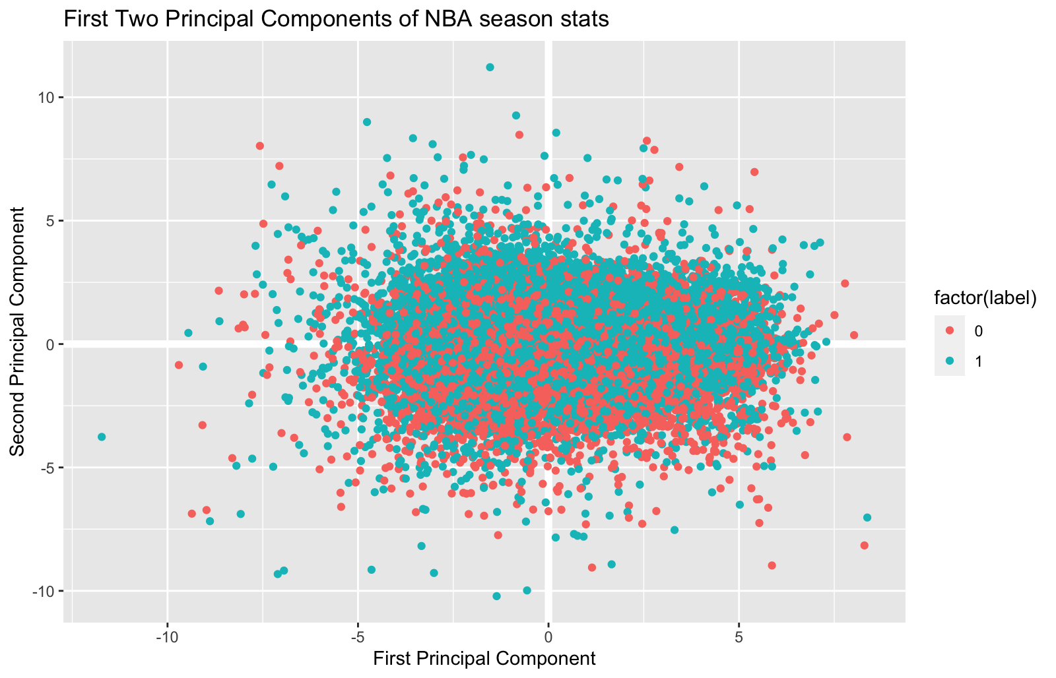
PCA

Slide 12
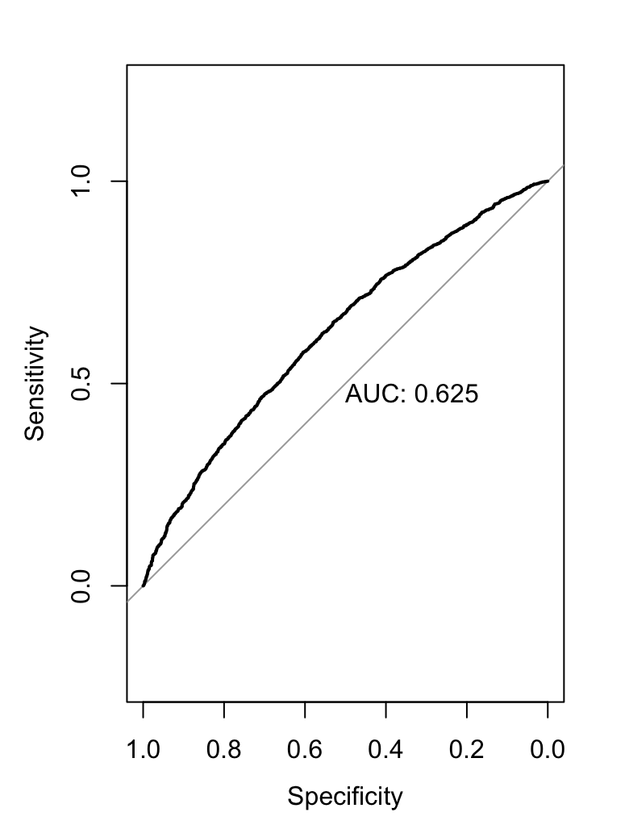
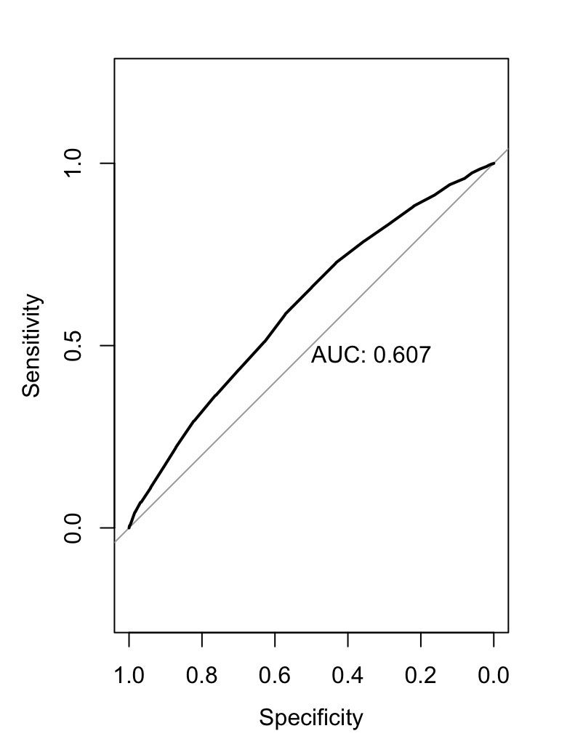
Logistic Regression and Knn (15 day average)
 | Logistic Regression | KNN
AUC | .625 | .607
Accuracy | 61.64% | 61.62%
Logistic Regression
KNN

Slide 13
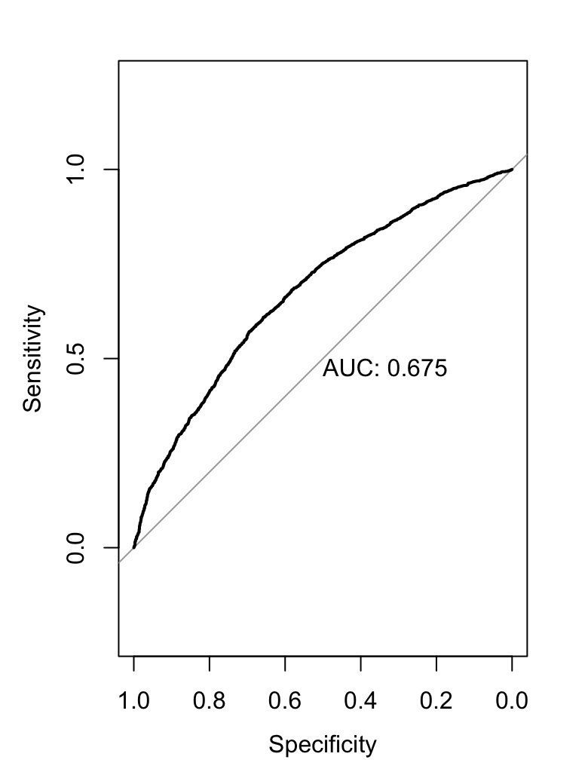

Logistic Regression and Knn (Season average)
 | Logistic Regression | KNN
AUC | 0.675 | 0.659
Accuracy | 64.46% | 64.31%
Logistic Regression
KNN

Slide 14
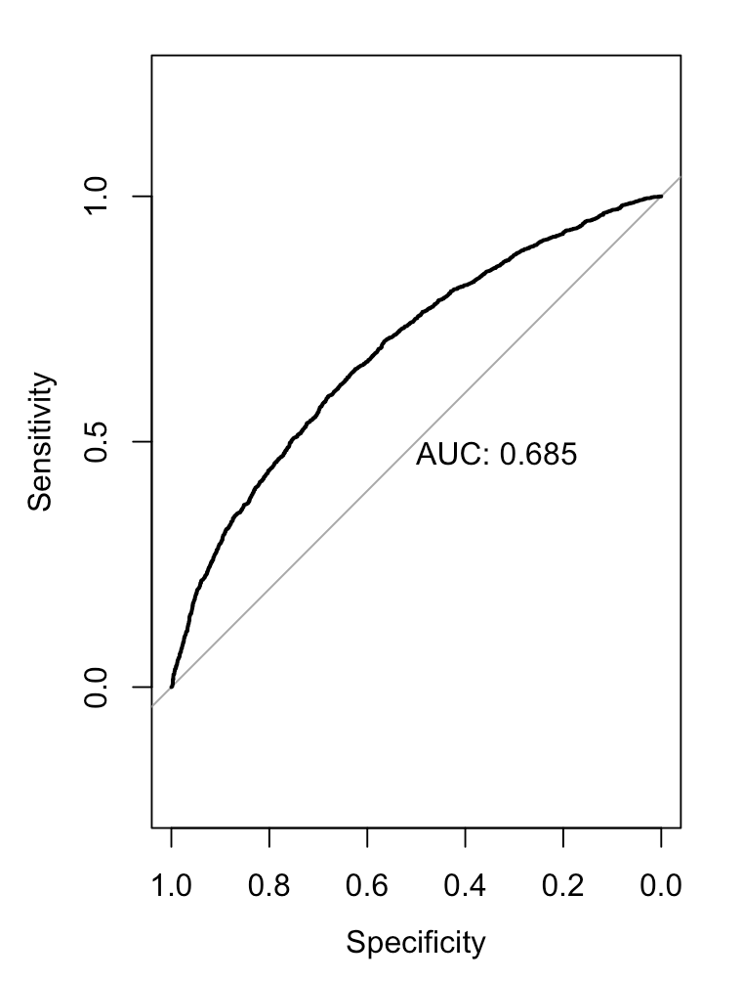
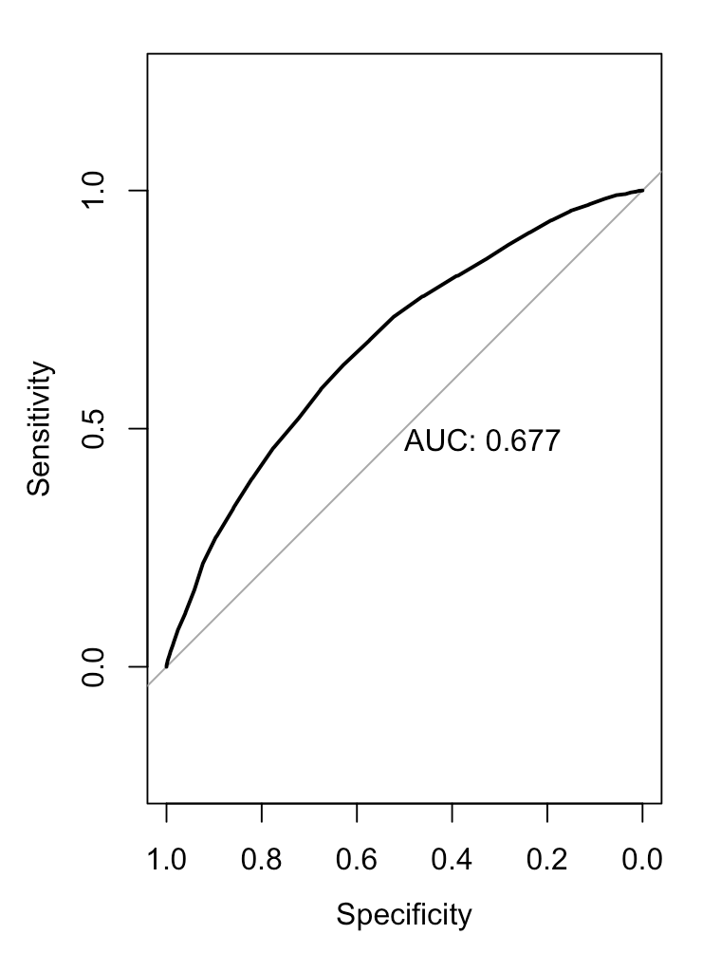
Logistic Regression and Knn with previous season included
 | Logistic Regression | KNN
AUC | 0.685 | 0.677
Accuracy | 64.43% | 64.30%

Slide 15
Summary
 | LR 15 | LR CurrentSeason | LR Previous Season + Current Season | KNN 15 | KNN Current Season | KNN Previous Season + Current Season
AUC | .625 | 0.675 | 0.685 | .607 | 0.659 | 0.677
Accuracy | 61.64% | 64.46% | 64.43% | 61.62% | 64.31% | 64.30%

Slide 16
Comparisons
Another student who had a similar idea to me had accuracy results (62.07% with SVM, 63.75% LR, 64.95% ) [1]
A group was able to achieve ~70% accuracy by incorporating individual player statistics rather than looking at team data as well as looking at previous season statistics. [2]
NBA experts predict games correctly ~70% of the time as well. [2]
1) http://cs229.stanford.edu/proj2017/final-reports/5231214.pdf
2 )https://www.mbeckler.org/coursework/2008-2009/10701_report.pdf
Notes:
http://cs229.stanford.edu/proj2017/final-reports/5231214.pdf
https://www.mbeckler.org/coursework/2008-2009/10701_report.pdf

Slide 17
Conclusion
Using the previous and current team statistics we developed a Logistic regression model with ~65% accuracy.
In the future, I would like to incorporate player data into the model, specifically examining the strength of the starting players and bench players.

Slide 19
Describe the data
Kaggle Dataset
538 Github:
Notes:
https://www.kaggle.com/nathanlauga/nba-games
Data scrapped from nba stats using Scrapper.py
23195 games
Contains all games from 2004-2020. Features include The date of the game, which team won, how many points scored and let up, rebounds, assists, 3-point percentage etc..
500,000+ plays

Slide 22
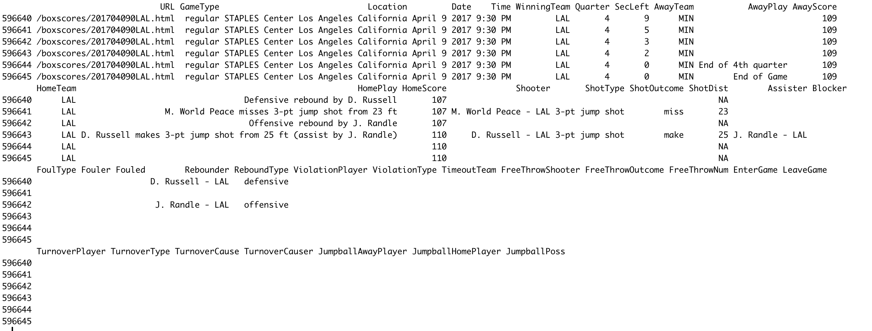

Slide 23
Dataset contains every single game played since 1947.
Features include the two teams, the scores of each team and the elo of each team using different metric (RAPTOR, elo, CARMelo), before and after the game

Slide 24
Plan follow up
Can we profile teams based on their players? Assign teams with an ELO, an overall marker of team strength. Can we train a model, based on the stats of the players that make up each team (15 players), to predict the ELO of a team?
Notes:
Profiling, rather than classification

Slide 25
Please select a data set and a research question that you are interested in for your class project and select the dates when you prefer to present by filling out this sheet: https://docs.google.com/spreadsheets/d/1AHqt3rwZnqBvE5Bup_psMmO-xf4xry9JHF7JJHphfss/edit?usp=sharing. You will give three presentations:
1. Project plan (max 5 min): 3 slides are recommended: First slide describes your research question and why it is important; second slide describes the data (# of patients, what has been measured); and third slide describes what you are planning to do (preprocessing, ML methods, etc).
2. Exploring data (max 10 min): start with describing your research question again and present an exploration of the data set you have chosen. What is the distribution of missing values? Do some of the patients cluster? What is the relationship between individual measurements and the variable you want to predict? Use for example to methods that were discussed in Lectures 3-6.
3. Final presentation: Describe your research question again, the machine learning methods used, problems you ran into and your results. It's important to evaluate how well you did but having separate training and test sets. Also, describe how you optimized your hyperparameters.
Notes:
http://cs229.stanford.edu/proj2017/final-reports/5231214.pdf
https://homepages.cae.wisc.edu/~ece539/fall13/project/AmorimTorres_rpt.pdf

