Slide 1

Git
Introduction

Slide 2


Background
Purpose of VCS
Traditional VCS
Distributed VCS and Git

Slide 3
Start using Git
Download Git
http://git-scm.com/download
Windows msysgit

Slide 4
New repo
mkdir git_practice
cd git_practice
git init
git remote --verbose

Slide 5
Clone Repo
Create a copy of a remote repo
git clone git://github.com/briancolfer/git_practice
cd git_pracitce
git remote --verbose

Slide 6
How Git Works
  Git is a system for tracking storage operations for files

Slide 7
Parts of Git
There are three main components
  The database
  The index
  The working set

Slide 8
What is in the database
Storage
Refs
Configuration
Hooks

Slide 9
Storage Model
Commits
Trees
Blobs
Tags

Slide 10
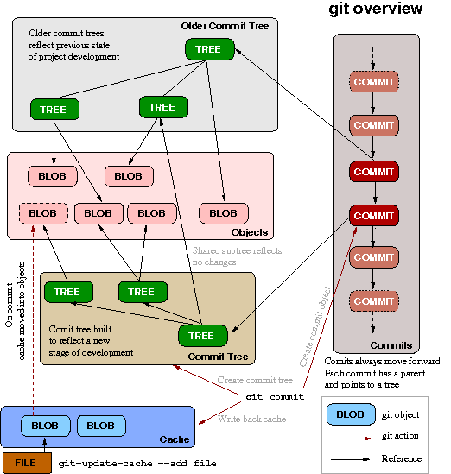
Git Workflow
http://www.technovelty.org/code/linux/git-model.html

Slide 11
Git CRUD
How to do things with Git

Slide 12
Create files
Adding files
git add .
git commit -am “Description of my commit”
Tell git to ignore certain files
.gitignore

Slide 13
Update files
Edit the file
Add to the index
git add file.txt
Commit and add
git commit -am “Yet another description”

Slide 14
Delete
To create a new version that removes a file:
git rm file
git commit -am “removed the file”
To remove the current edits before commit:
git reset --hard HEAD
To obliterate the previous commit:
git reset --hard HEAD^

Slide 15
Read
View current status:
git status
Activity log:
git log
Fancy log:
git whatchanged

Slide 16
Working Remotely
Git works with other repositories by synchronizing databases
Fetch the changes from the remote database
Resolve any conflicts
Push your new commit history to the remote

Slide 17
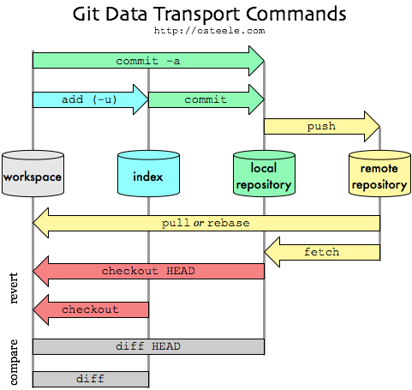
Git Remote Workflow

Slide 18
Git Branching
A branch is a reference to a commit stream
Branch names are not unique across repositories, such as master

Slide 19
Creating branches
Create a new branch:
git checkout -b new_branch
Finding branches:
git branch -a
Creating a tracking branch from remote repo
git branch -b a_branch --track origin/a_branch

Slide 20
Merging
Check out the branch where you want to create the merge
git checkout a_branch
Run the merge:
git merge b_branch
Resolve conflicts:
git mergetool -t kdiff3

Slide 21
Advanced Topics
Rebasing is altering the commits linkages
Hooks can trigger behaviors based on command actions
Creating custom commands
Windows
GUI

Slide 22
Sources of help
git-scm.org
On line books:
http://progit.org/book
http://book.git-scm.com
Books:
  Version Control with Git
  Pragmatic Version Control Using Git

