Slide 1
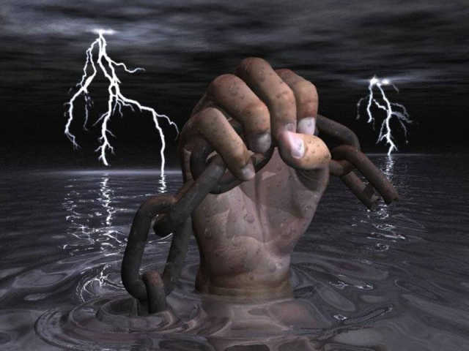
TEN THINGS GOD WON'T
ASK ON THAT DAY:

Slide 2
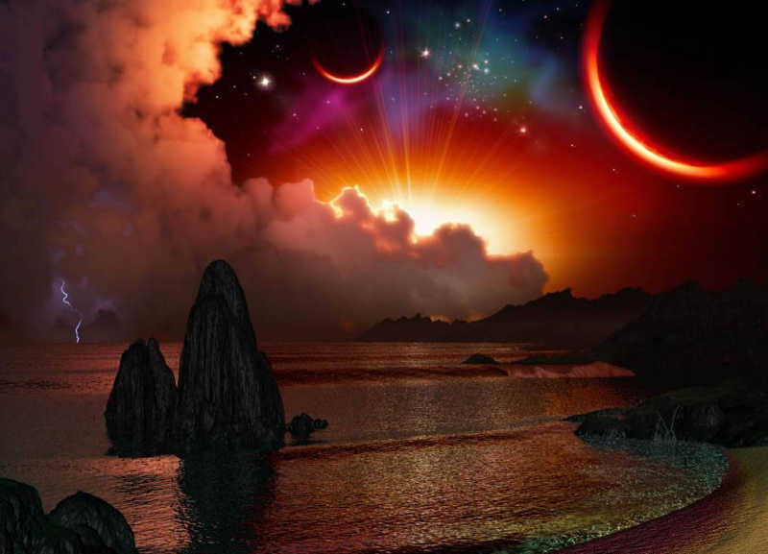
1... God won't ask what kind of car you drove. He'll ask how many people you drove who didn't have transportation.

Slide 3
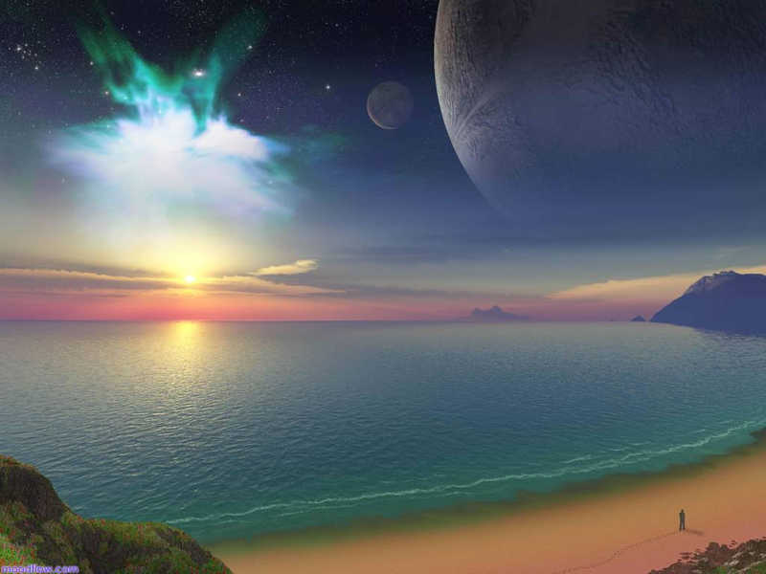
2... God won't ask the square footage of your house, He'll ask how many people you welcomed into your home.

Slide 4

3... God won't ask about the clothes you had in your closet, He'll ask how many you helped to clothe.

Slide 5
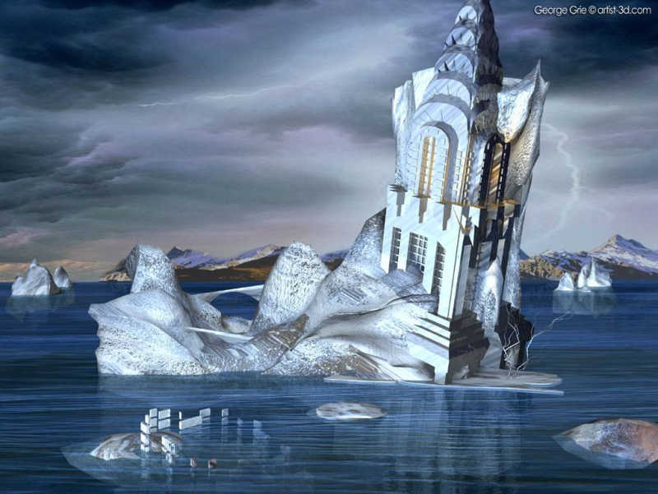
4... God won't ask what your highest salary was.
He'll ask if you compromised your character to obtain it.

Slide 6
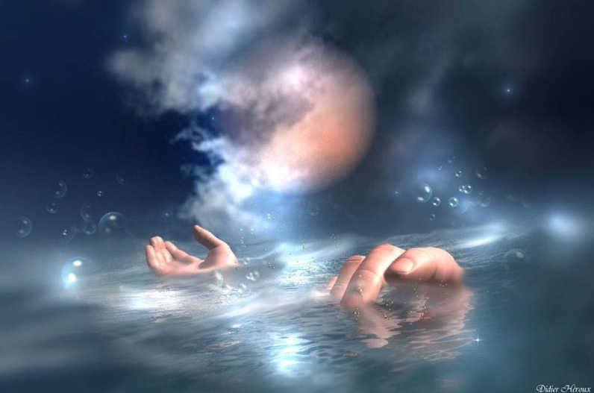
5... God won't ask what your job title was. He'll ask if you performed your job to the best of your ability.

Slide 7
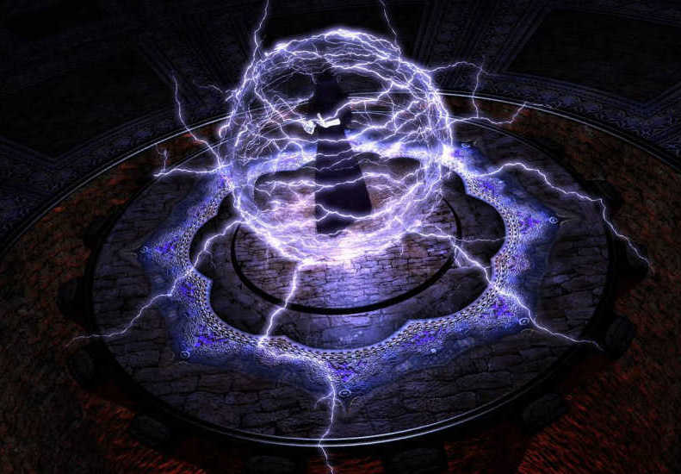
6... God won't ask how many friends you had. He'll ask how many people to whom you were a friend.

Slide 8
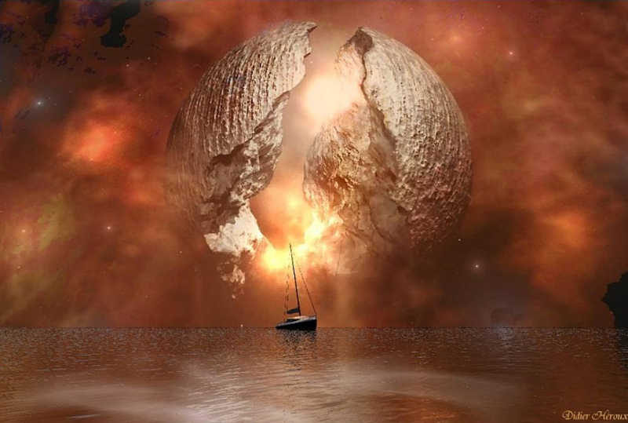
7... God won't ask in what neighborhood you lived, He'll ask how you treated your neighbors.

Slide 9

8... God won't ask about the color of your skin, He'll ask about the content of your character.

Slide 10

9... God won't ask why it took you so long to
seek Salvation. He'll lovingly take you to your
mansion in heaven,
and not to the gates of Hell.

Slide 11
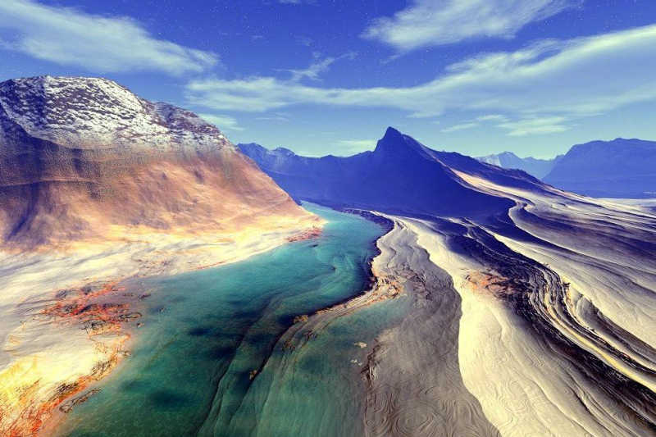
10... God won't have to ask how many people you forwarded this to, He already knows your decision.

Slide 12


I received this from someone who thinks
I am a 'keeper', so I've sent it to the people
I think of in the same way.. Now it's your turn
to send this to those people that are "keepers"
in your life. Good friends are like stars....
You don't always see them, but you know
they are always there. Keep them close!

