Slide 1
Rootkit Hunting vs.
Compromise Detection
Joanna Rutkowska
invisiblethings.org
Black Hat Federal 2006, Washington D.C., January 25th 2006.

Slide 2
What this talk is going to be about?
Showing demos of new malware which is Stealth by Design (= no classic rootkit technology used, but still fully stealthy),
Classifying existing rootkit-like malware and discussing how current anti-rootkit technology works against them,
Introducing the need for Explicit Compromise Detection (ECD),
Releasing new System Virginity Verifier (SVV 2.2) and playing some demos how it fights current malware,
Talking about how difficult is to implement ECD on a Windows box and why MS should help us…

Slide 3
Simple definitions…
Backdoors – give remote access to the compromised machine (smarter ones typically use covert channels),
Localstuff – key loggers, web password sniffers, DDoS agents, Desktop camera, eject, etc… (can be more or less fun),
Rootkits – protects backdoors and localstuff from detection.
Method of infection – exploit, worm, file infector (virus), etc... – not important from our point of view.
We will see later that rootkits are not necessary to achieve full stealth…

Slide 4
Different approaches to
Compromise Detection…
Look around in the system
  Process Explorer, netstat, etc… (this can be done automatically by smart HIDS),
  Don’t be tempted to skip this step as it’s easy to overlook very simple malware when focused on advanced kernel detection only.
Cross view based approaches
  Look for rootkit side-effects,
  Detect hidden files, registry keys, processes.
Signature based approaches
  Scan for known rootkit/backdoor/localstuff engines.
Check Integrity of Important OS elements
  Explicit Compromise Detection (ECD)

Slide 5
What do we really need?
Surviving system restart?
Process Hiding?
Win32 Services hiding?
Sockets hiding?
Kernel module/DLL hiding?
Kernel filter drivers hiding?

Slide 6
Surviving the reboot?
Should malware really care?
In many companies people do not turn their computers off at night,
And even if they do, how much damage can be done when having a backdoor for several hours and not being able to detect it?
Servers are very rarely restarted,
And we also have worms…

Slide 7
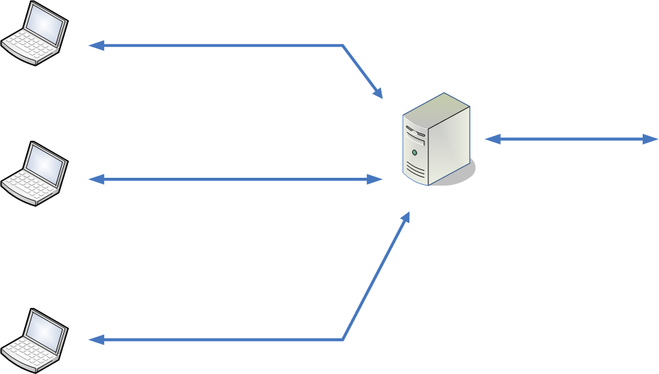
Theoretical Scary Scenario…

Slide 8
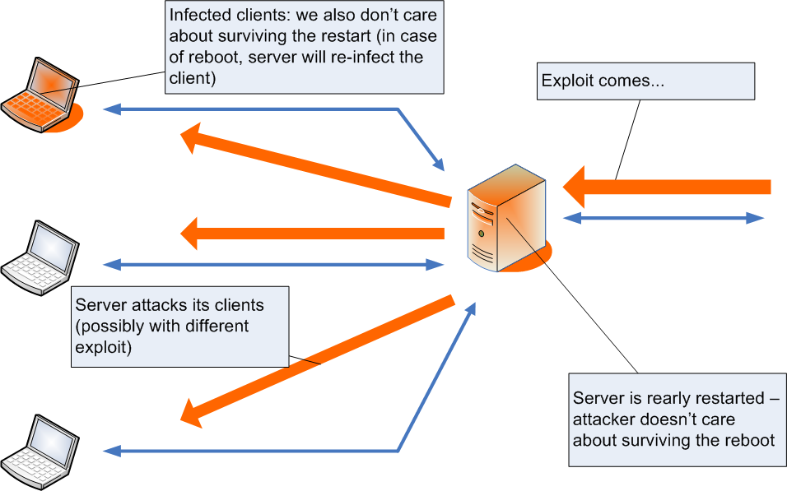
Network infected
1
4
3
2

Slide 9
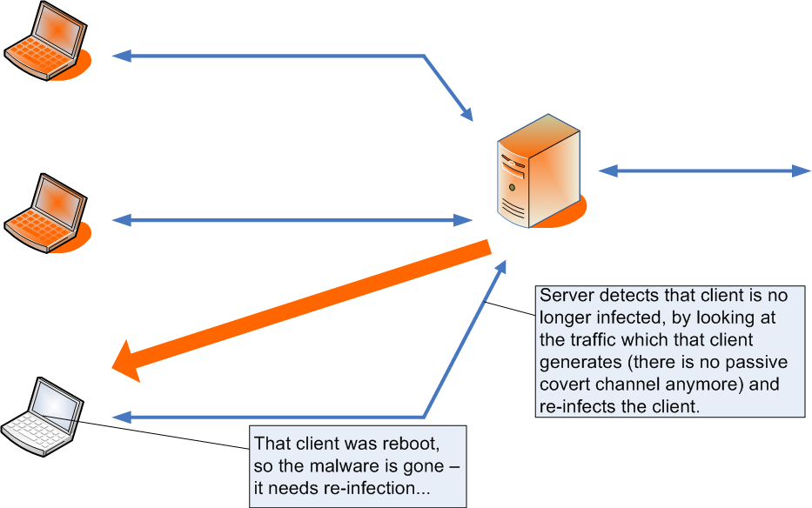
Client re-infection
2
1

Slide 10
Digression: Passive Covert Channels
Passive Covert Channels idea:
  http://invisiblethings.org/papers/passive-covert-channels-linux.pdf
NUSHU (passive covert channel POC in TCP ISNs for Linux 2.4 kernels):
  http://invisiblethings.org/tools/nushu.tar.gz
How to detect NUSHU (and how to improve it so it will not be detectable) by Steven Murdoch et al:
  http://www.cl.cam.ac.uk/users/sjm217/papers/ih05coverttcp.pdf
Another amazing paper about NUSHU detection using NN (Eugene Tumoian & Maxim Anikeev):
http://www.rootkit.com/vault/90210/neural_networks_vs_NUSHU.pdf
Maybe network based detection (not signature based!) is the future?

Slide 11
Surviving the reboot…
Still not convinced that we shouldn’t care about restart survival?
Ok, we want to place a trigger somewhere on the file system, but we don’t want to be caught by X-VIEW detection (ala RkR or Black Light)…
Of course it’s trivial to cheat those tools (in more or less generic way), but we want a “stealth by design” solution…
On average desktop computer there are thousands of files executed every day...
So, why not try using a good polymorphic file infector for one of them to start our rootkit/malware?
  Watch out for files which are digitally sign (all system binaries)!

Slide 12
File infectors
Mistfall engine, by z0mbie, is several years old, but is still considered among AV people as one of the most challenging file infectors!
Unofficial statistics: most of the current AV products is able to detect only about 98% of all mistfall infections…
…although mistfall is known for years…
How about a private, highly polymorphic, EPO file infector then?
Can AV detect infections by such unknown engine?
My bet is NO!
Consequence – elegant, stealth by design technique for reboot survival on desktop machines for your favorite malware, undetectable by all X-view diff approach by definition…

Slide 13
What about hiding other stuff?
Process Hiding?
Win32 Services hiding?
Sockets hiding?
Kernel module/DLL hiding?
Kernel filter drivers hiding?

Slide 14
Hidden Processes?
It’s convenient to be able to run (in a stealthy manner) an arbitrary process…
However, it should always be possible to find such extra hidden processes executing inside OS (as the OS should be aware of this process):
  scheduler (but look at smart PHIDE2)
  Object manager
So, do we really need hidden processes?
Maybe we can use injected threads into some other processes to do the job? (compile your favorite tools with .reloc sections)
Or even better – if we have a smart backdoor (e.g. kernel NDIS based) why not build most of the functionality into it? [see the demo later]

Slide 15
Hidden Win32 Services?
Services are very easily detectable – much easier than just ordinary processes.
But, if we agreed that we don’t need processes then it should be obvious that we don’t need services too.

Slide 16
Hidden Sockets?
That was always a very bad idea!
Hiding something which is still visible from a network point of view is a bad idea.
Use covert channels (passive if possible)
If you need to do it in a traditional way, use ‘knock scenario’ and connect back.

Slide 17
Hidden modules (kernel and DLLs)?
Very bad idea – very easy to find.
It’s even better not to hide kernel modules at all (just place them in system32\drivers so they look not suspicious)!
And if one wants real stealth – why use modules at all?
Load, allocate a block of memory, copy and relocate and unload the original module (no traces left in kernel).
Or do the same when exploiting kernel bug.
Related thing: resistance to signature based scanners
  Shadow Walker,
  Cut and Mouse (detect when somebody starts reading memory near you and relocate),
  How to do it without touching IDT?

Slide 18
Hidden kernel filters?
People use them usually to:
  hide files (but not registry)
  hide sockets
  Implement simple network backdoors
  install key loggers
We don’t need them!
No need to bother to hide them.

Slide 19
Stealth malware without rootkits
We don’t need all those rootkit technologies, but still we’re capable of writing powerful malware!
Imagine a backdoor which
  uses covert channel
  has its own TCP/IP stack implementation
  has its own implementation of all useful ‘shell’ commands (ls, mkdir, ps, kill, put, get, etc…)
  has ability to manually create short-life processes (not hidden)
  Implemented as relocate-able code – no extra module in the kernel.
No need to hide anything! (process, sockets, modules, services)
Let’s see the demo now…

Slide 20


DEMO: Pretty Stealthy Backdoor
Introducing the backdoor
Showing tcpdump trace from another machine
Showing no traces in the system log
Showing no signs of kernel module reminders (modGREPER)
Showing no hidden processes detected
Bypassing Personal Firewalls
  Norton PFW
  ZA PFW

Slide 21
Things which can be subverted
File system:
boot sectors
file infections
ASEPs (mostly registry keys)
BIOS flash, ?
persistent
CODE sections:
processes
kernel
kernel drivers
DATA sections:
processes
kernel
kernel drivers
volatile
CPU registers: Debug Registers, Some MSRs, ?

Slide 22
Things which can be subverted…
Persistent storage (file system, etc) subversion is necessary only to reboot survival (nothing more).
It’s the volatile storage which is crucial to system compromise (we can’t have a backdoor which is not in memory).
Today many detection tools are focused on file system verification (registry is also file system).

Slide 23
Interaction with OS infrastructure
The only interaction between the backdoor and OS! Just few DWORDs!
DATA
CODE
Pretty Stealth Backdoor

Slide 24
Lessons learned
Malware doesn’t need to modify code sections (we can always verify code section integrity)
The real problem is malware which modifies data sections only.
We saw a backdoor which modified only few DWORDs somewhere inside NDIS data section!

Slide 25
Malware classification proposal
Type 0: Malware which doesn’t modify OS in any undocumented way nor any other process (non-intrusive),
Type I: Malware which modifies things which should never be modified (e.g. Kernel code, BIOS which has it’s HASH stored in TPM, MSR registers, etc…),
Type II: Malware which modifies things which are designed to be modified (DATA sections).
Type 0 is not interesting for us,
Type I malware is/will always be easy to spot,
Type II is/will be very hard to find.

Slide 26
Type I Malware examples
Hacker Defender (and all commercial variations)
Sony Rootkit
Apropos
Adore (although syscall tables is not part of kernel code section, it’s still a thing which should not be modified!)
Suckit
Shadow Walker – Sherri Sparks and Jamie Butler
  Although IDT is not a code section (actually it’s inside an INIT section of ntoskrnl), it’s still something which is not designed to be modified!
  However it *may* be possible to convert it into a Type II (which would be very scary)

Slide 27
Fighting Type I malware
VICE
SDT Restore
Virginity Verifier 1.x [see the DEMO later]
Patch Guard by MS on 64 bit Windows
Today’s challenge: false positives
Lots of nasty apps which use tricks which they shouldn’t use (mostly AV products)
Tomorrow: Patch Guard should solve all those problems with false positives for Type I Malware detection…
… making Type I Malware detection a piece of cake!

Slide 28
Patch Guard
By Microsoft, to be (is) included in all x64 Windows
http://www.microsoft.com/whdc/driver/kernel/64bitPatching.mspx
Actions forbidden:
  Modifying system service tables
  Modifying the IDT
  Modifying the GDT
  Using kernel stacks that are not allocated by the kernel
  Patching any part of the kernel (detected on AMD64-based systems only) [I assume they mean code sections here]
Can PG be subverted? Almost for sure.
But this is not important!

Slide 29
Patch Guard
Important thing is: PG should force all the legal (innocent) apps not to use all those rootkit-like tricks (which dozens of commercial software use today)
PG should clear the playground, making it much easier to create tools like SVV in the future,
It won’t be necessary to implement smart heuristics to distinguish between Personal Firewall-like hooking and rootkit-like hooking.
So, even if we see a POC for bypassing PG (I’m pretty sure we will see sooner or later) in the future, it will not make PG useless…
  UPDATE: we’ve just seen such POC by skape & Skywing:
  http://www.uninformed.org/?v=3&a=3&t=pdf
It will only prove my statement that it’s good to have several detection tools (from different vendors preferably)

Slide 30
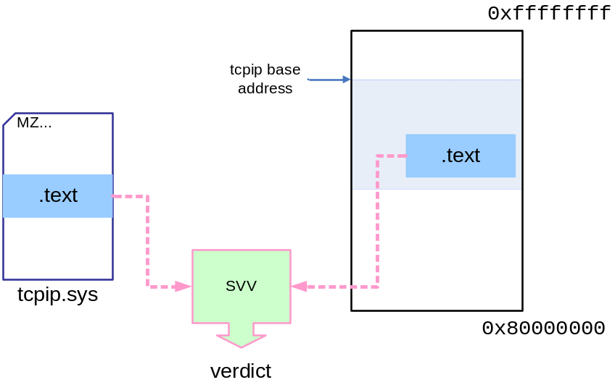
System Virginity Verifier Idea
Code sections are read-only in all modern OSes
Program should not modify their code!
Idea: check if code sections of important system DLLs and system drivers (kernel modules) are the same in memory and in the corresponding PE files on disk
  Don’t forget about relocations!
  Skip .idata
  etc…

Slide 31
Extending SVV – SVV 2.2
Check not only .text sections, because there are more things which should stay untouched…
Check all the other code sections (PAGE*, etc…)
IDT verification
MSR registers (syscall hooking on XP and 2003)
Get it from invisiblethings.org after the con :)

Slide 32
DEMO: Fighting Type I Malware
Demo showing SVV2 detecting some malware:
  Apropos Rootkit
  AFX2005
  EEYE BootRoot
Demo showing how SVV2 handles potential false positives introduced by software like Personal Firewall, etc…
Demo showing that sometimes it’s virtually impossible to distinguish between PF and a rootkit-like hooking

Slide 33
Type II Malware examples
NDIS Network backdoor in NTRootkit by Greg Hoglund (however easy to spot because adds own NDIS protocol)
Klog by Sherri Sparks – “polite” IRP hooking of keyboard driver, appears in DeviceTree (but you need to know where to look)
He4Hook (only some versions) – Raw IRP hooking on fs driver
prrf by palmers (Phrack 58!) – Linux procfs smart data manipulation to hide processes (possibility to extend to arbitrary files hiding by hooking VFS data structures)
FU by Jamie Butler
PHIDE2 by 90210 – very sophisticated process hider, still however easily detectable with X-VIEW...

Slide 34
Fighting Type II Malware
There are three issues here:
  To know where to look
  To understand what we read
  To be able to read memory
But… we all know how to read memory, don’t we?
More on this later, now let’s look at some demos…

Slide 35
DEMO: Type II Malware Detection
Demo showing spotting klog using Device Tree and KD
Demo showing he4Hook detection using KD

Slide 36
Type II Malware Detection cont.
“To know where to look” issue
On the previous demo, we somehow knew where to look…
…but there is lots of data inside the OS…
…how to make sure that we check all the potential places?

Slide 37
Memory Reading Problem (MRP)
What about those popular functions:
  __try/__except – will not protect from BugChek 0x50
  MmIsAddressValid() – will introduce a race condition (and we also won’t be able to access swapped memory)
  MmProbeAndLockPages() – may crash the system for various reasons, TLB corruption being one of them!
The truth is: We can’t read arbitrary Windows kernel memory without the risk of crashing the system!
But Why? We’re in ring0, we should be able to do everything, right?
If it’s such a problem to read kernel memory, how is it possible that all those Windows machines work?!

Slide 38
MRP cont.
The problem is not what can we physically do, but rather what we can do from the “protocol point of view”,
And kernel was not designed to allow 3rd parties to read memory areas which belong to somebody else (reading NDIS data structure by somebody who is not NDIS itself),
3rd party reading memory, which it doesn’t own, may be subject to various race conditions or cause TLB corruption,
So, before we try to read something we really need to think it over to see if we really can safely read it!
It seems that Microsoft's help is very necessary here.

Slide 39
MRP – what Microsoft can do?
It’s a hard problem – no easy solution exists.
MS should put some effort into building an infrastructure which would allow 3rd party tools for kernel memory verification/scanning.
This infrastructure should be easy to verify (e.g. check if it hasn’t been already hooked)
This “infrastructure” doesn’t have to be an API, it can also be a set of guidelines regarding how to properly synchronize with the Memory Manager and read the memory…

Slide 40
Stealth by Design vs. Type II Malware
“Stealth by Design” != “Type II”
Lots of Type II malware today is not SbD:
  All the process hiders (FU, PHIDE2)
  Files hider (he4hook)
Some Type I malware is SbD:
  Eeye bootroot NDIS backdoor
SbD is about not hiding anything – avoiding cross view detection by design.
X-VIEW detection is useless when detecting SbD malware.
Explicit Compromise Detection (ECD) is useful here.

Slide 41
Stealth by Design vs. Type II Malware
Type II is about implementing malware so that there is no easy way to detect it by performing an integrity scan (of filesystem, code sections, etc...)
Type II is about avoiding ECD.
Type II challenge: modify only those parts of the OS, where it’s hard to detect the modifications!
X-VIEW may sometimes work.
SbD Malware, which is a type II, may be extremely difficult to detect
  X-VIEW doesn’t work
  ECD is usually difficult

Slide 42
File infectors…
Advanced EPO File Infectors are SbD…
…but if infected file has a digital signature (like all Windows system files), then even the most advanced virus is a type I only!

Slide 43
Stealth by Design vs. Type II
Malware
 | Type I Malware | Type II Malware
Classic Rootkit Technology | ECD easy and effective. X-VIEW works well too. | ECD may be difficult X-VIEW easier and more effective.
Stealth By Design | X-VIEW useless. ECD easy and effective. | X-VIEW useless. ECD may be difficult. Network based detection may be easier?
ECD = Explicit Compromise Detection
X-VIEW = Cross View Based Detection

Slide 44
DEMO: Pretty Stealthy Backdoor Again
Showing that it’s a type II backdoor…
  Code verification
  SDT verification
  IDT verification
  NDIS protocols (btw, not a strict Type II requirement)
We’ve already seen it’s a Stealth by Design malware…
So where is the backdoor?
  touching the backdoor (using KD)…
  Having seen this, we still cannot come up with a detection tool, mostly because of the MRP!
  We cannot also use PFW for preventing this backdoor, as this is “the last one wins” game (not “the first one wins”!)
  We have seen only few DWORDs of the backdoor, where is the rest? Even if we knew this is not a good method for detection (polymorphism, etc).

Slide 45
Challenge
Create a list of where should we look (NDIS data structures, device IRPs, attached filters, …
What else? Is the list finite?
OMCD project
  Open Methodology for Compromise Detection
  http://isecom.org/omcd/
But do we really need *Open* Methodology? Should such a project be public?
But on the other hand…

Slide 46
Challenge
Maybe we shouldn’t worry about advancement in malware technology?
Commercial Hacker Defender shows another trend:
Implement lots of Simple and Stupid Implementation Specific Attacks (ISA) against all the tools on the market…
So, all commercial AV products are ineffective against custom malware (which one can buy for $$$),
Most of that “commercial malware” is detectable by private detectors (which one can buy for $$$$-$$$$$),
Private detectors can’t cost too little!

Slide 47
What OS vendors can do?
Make it possible to reliably read kernel memory
  We (ISVs) cannot do much when we’re blind!
  IsSystemInfected() API is *really* not a good idea!
Design system in such a way that the crucial parts are easily verifiable:
  Export symbols like
    IDT (helps to verify IDT integrity)
    KiServiceTable, (SDT integrity)
    KiFastCallEntry (MSR_SYSENTER verification)
  This will help ISVs with writing system integrity checkers
  This will *not* make creating rootkits easier, as rootkit authors already know how to find IDT and Service Table and all the other interesting stuff!
Exploiting hardware to verify kernel memory integrity may be a good idea (TPM?)

Slide 48
Losers and Winners
Mr. and Mrs. Smith always lose!
Large companies may win (using private detectors)…
Authors of ISA-based malware earn money and laugh from AV companies!
Providers of custom rootkit/compromise detection services laugh from ISA-based malware :)
AV may (at some point) become providers of those custom detectors for large companies…
Everybody waits for the next generation OS which will introduce more then two CPU privileges modes (4 years?), hopefully eliminating ISA (but not SbD type II malware…)

Slide 49
Thank you for your time!

