Slide 1


The Fillies

Slide 2
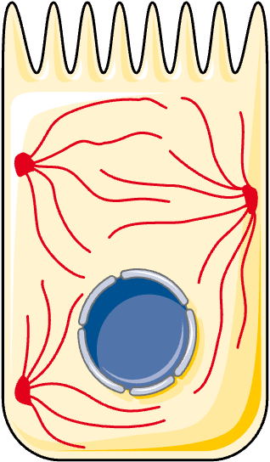
Problem
Need to track intracellular structures
Tracking protein aggregates is relevant to:
Cellular survival in stress and starvation
Neurodegenerative diseases
Cell motility
Structural integrity
cell-intermediate-filament icon by Servier https://smart.servier.com/ is licensed under CC-BY 3.0 Unported https://creativecommons.org/licenses/by/3.0/

Slide 3
Models Key Capabilities
Easy interface to upload images and extract data
Inputs entire field of view, no manual cropping required
Properly tracks individual filaments
Tested against manual annotation and synthetic data
Outputs csv data and graphs displaying filament growth
…Put screenshot of website

Slide 4
Future Directions
Compare filament growth rate in different strains, degrees of starvation and ura7 (filament forming protein) mutations
Using filament association with budding
Use z-stacks to further disentangle filament growth from filament rotation
Applying to situations with multiple filaments
Analysis of other GFP-tagged protein filament structures

