Slide 1

Intro To Android Programming
Raj Joshi
Notes:
DISCLAIMER: Android expertise + largest Android project experience

Slide 2

Quick Poll
Notes:
Java classes are compiled into a proprietary bytecode format and run on Android Runtime (ART) which performs the translation of the application's bytecode into native instructions that are later executed by the device's runtime environment.

Slide 3

Getting Up To Speed With Java
You can do it in one week (~2 hours a day):
https://www.tutorialspoint.com/java/
http://www.learnjavaonline.org/
Head First Java (book)
Learn just what is required:
Basics: classes, methods, data types, loops & conditionals, file I/O, exceptions
Parallelism: multi-threading, asynchronous function calls
Do NOT waste time on advanced OOP concepts, design patterns, etc.
Hate Java?
Try Kotlin or both Java & Kotlin
Notes:
NOT a Java programming language class or Android class. We want to pick-up just enough to get this project done!

Slide 4
Android ‘OS’ Overview
Operating System based on Linux
Code compilation workflow:
Android Runtime (ART):
javac
.class files
dx
classes.dex
aapt
.jar files
.apk file
resource files
classes.dex
dex2oat
Machine code (ELF shared object)
Notes:
The dx command stitches all of the .class and .jar files together into a single classes.dex file written in Dalvik byte-code format.
The classes.dex file and the resources from your application, such as images and layouts, are then compressed into a zip-like file called an Android Package or .apk file. This is done with the Android Asset Packaging Tool or aapt
Technically, the classes.dex will be converted into an ELF shared object. Android calls this library format OAT and the tool that converts the classes.dex file is called dex2oat.

Slide 5


Android Environment Setup
What we need?
Java compiler and libraries
Android SDK (Android Java libs, dx, aapt, etc.)
IDE and build system
Install Oracle Java 8 JDK
(download link)
Install Android Studio
(download link)

Slide 6

Android Studio
Official IDE for Android based on IntelliJ IDEA
Uses Gradle – a flexible build system
Gradle build scripts automate the process of making apk
Simplifies dependency management and thus life ☺
Bundles together all that is needed:
Java IDE
Android SDK
Android Virtual Device emulator
Notes:
The gradle build scripts take the source code, resources and everything associated with the project and turn it into an apk file
The dependencies are automatically fetched from online repos (Maven Central) during the compilation process.

Slide 7

Getting Started With Android
Head First Android Development:
http://shop.oreilly.com/product/0636920029045.do
Trial on Safari books OR buy Kindle version from Amazon (~ 50 SGD)
NUS Library: just one copy ☹
Official Getting Started Tutorial
Udacity Android Fundamentals - Google
Stanford CS 193A
http://www.vogella.com/tutorials/Android/article.html

Slide 8
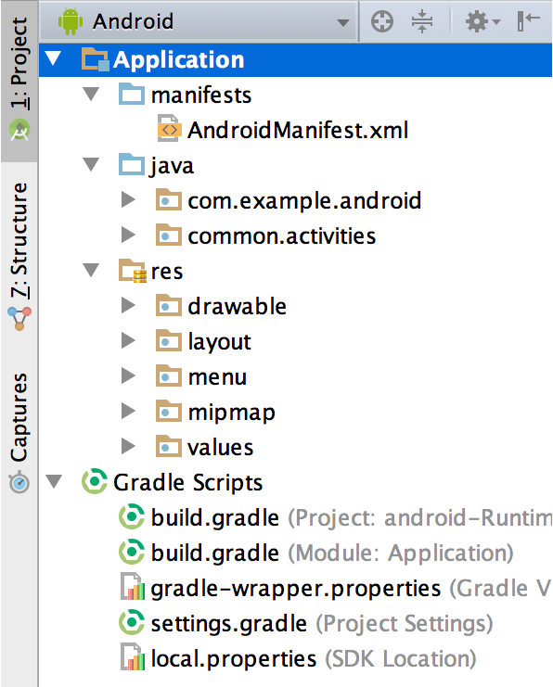
Project Structure (Logical View)
Notes:
AndroidManifest: project configurations, permissions, etc.

Slide 9
Application Fundamentals
Four Application Components
Activities
Services
Content Providers
Broadcast Receivers
More details for interested readers: https://developer.android.com/guide/components/fundamentals.html
Communication between components (except content providers): Intents
Notes:
Activity: Single screen with a user interface. An app can consists of multiple activities (inbox, compose email). Activities are independent of each other. Even outside app can call a specific activity of an app (camera app calls compose email).
Service: Just like Linux/Windows service. Performs long running tasks in the background. It has no UI.

Slide 10
Intents
Asynchronous message that binds individual components to each other at runtime.
Think of it like: messengers that request an action from other components (even from other apps)
Usage:
Pass info from one activity (or app) to another. E.g. Camera app sharing photo via email.
Pass info to a service

Slide 11
The manifest file
Carries all the metadata about your app
Important functions:
MUST declare all components of the app
Permissions that the app requires: Internet access, camera, sdcard, etc.
java.lang.SecurityException: Permission denied (missing INTERNET permission?)
Other functions:
Minimum API level required by the app

Slide 12
User Interface and Events
Activity: a single screen of UI in the app
“fundamental unit” of GUI in Android
View: visible on-screen items (XML code)
Layout: invisible container to position/size the widgets
Widgets: GUI control items like a button, drop-down menu, etc.
Event: an action that occurs when user interacts with widgets
Event Handlers (Java code)

Slide 13
Multi-threading Concerns in Android
Main thread responsible for interacting with UI components
Do NOT make a blocking I/O call from the main thread
e.g. a blocking HTTP request leads to NetworkOnMainThreadException
Use a different thread explicitly OR AsyncTask
Do not access UI components outside UI thread
Just a good practice to avoid race conditions

Slide 14
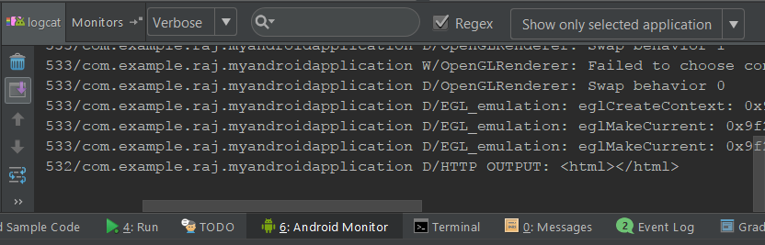
Debugging in Android
android.util.Log API
Log.v(), Log.d(), Log.i(), Log.w(), and Log.e() methods
Output: logcat tab of Android Monitor within Android Studio

Slide 15
Important API References
MediaRecorder
MediaCodec
Sometimes you need to get down and dirty!
Useful third-party libraries:
MP4Parser: for playing around MP4 container in Java
OkHttp or Retrofit: for HTTP GET and POST
Otto: event bus (publish-subscribe model)

Slide 16
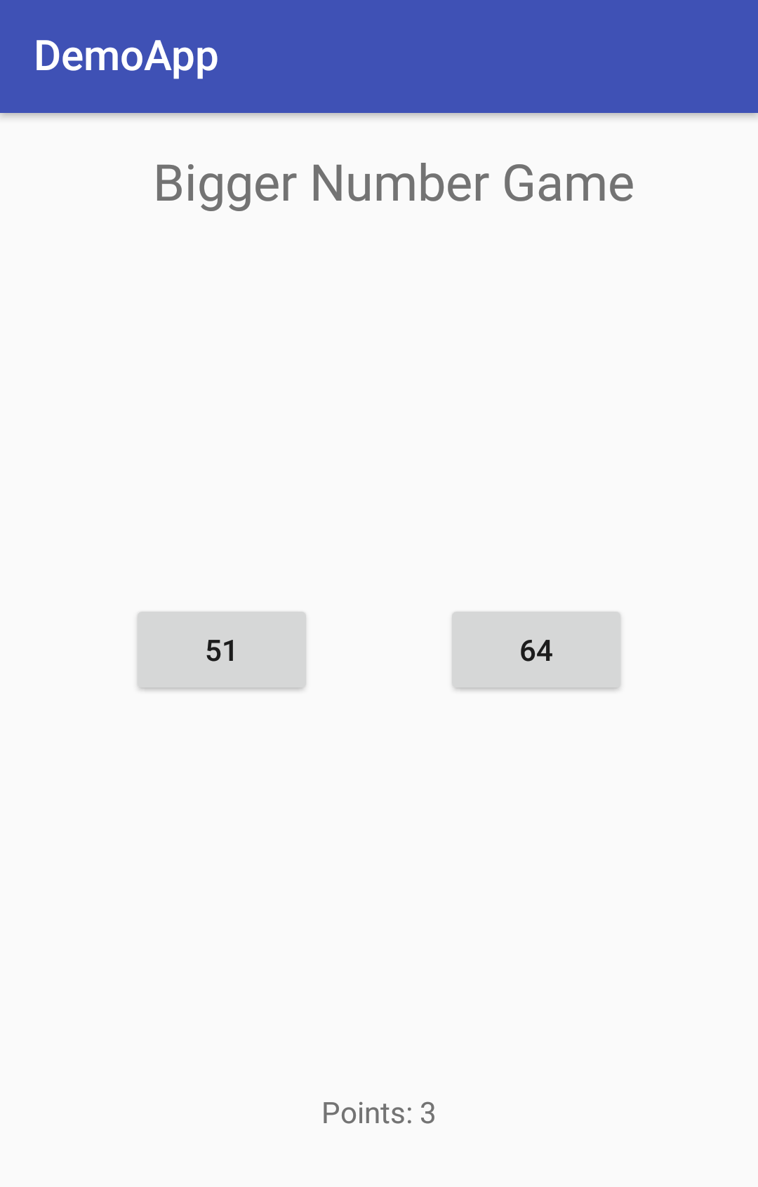
Demo: Bigger Number Game

